Slide 1
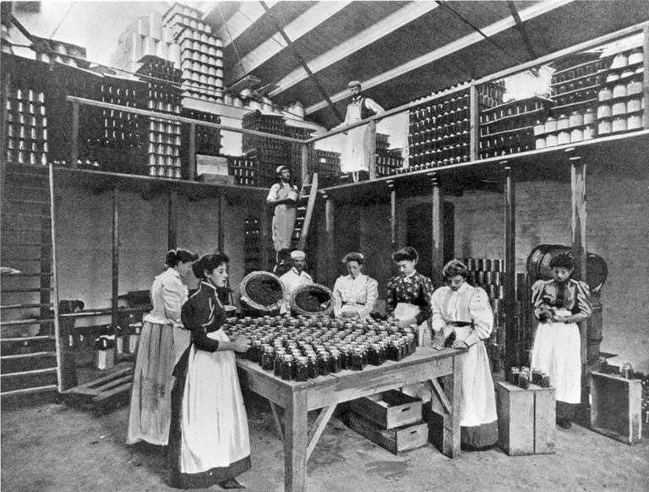
Freedom In America Part 8
Our Commercial Republic
Part 6: Commerce and the Progressive Era
https://www.docsoffreedom.org/readings/commerce-and-the-progressive-era
Side Notes:

