Slide 1
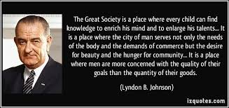
Freedom In America Part 8
Our Commercial Republic
Part 8: The Great Society and Beyond
https://www.docsoffreedom.org/readings/the-great-society-and-beyond
Side Notes:

