Slide 1
Presentations May 2020 to August 2021 - Tracing the Journey - Part 1
Tess Lambert - 21-8-21

Slide 2
The plan for today is to really review from May 2020 to today. I've prepared a document that will give a chronological order of presentations and the content of those presentations. Today we're going to work our way through it.
Of course, this review is not covering everyone's presentations, so it's not comprehensive of May 2020 to today. Of course, there’s elder Parminder’s and other people's contributions to the message. But I thought it would be beneficial to trace what I have taught over the last 15 months. I'm hoping that everyone is aware of the website the Midnight Cry. If you visit this website www.midnightcry.co.uk it will give in chronological order a list of all of the presentations that I have ever taught. You can reference the year and the date. And then if you click on it it'll take you to the presentation itself. So with this website in one hand with the document in the other I'm hoping everything then becomes easily accessible or visible.. I am happy when I see people presenting on issues of equality, but I do fear that we have a tendency to leave behind a proper view of history and also if we're properly referencing lines.

Slide 3
Our power is in the structures, and we cannot afford to move beyond them. I'm also not trying to prove any points today. This review is reference material, so I'll be showing the points of what was taught in each presentation but if you want to see that point proven you're going to have to go to the presentation.
We all know that dispensation of the Latter Rain ended on November 9th, 2019. And around that time I began to teach in more detail the history of the end of Ancient Israel. We focused on that end of Ancient Israel history into April of 2020.

Slide 4
α
Ω
Ancient
So we go to the Omega history of ancient, that’s the core theme from about November 2019 to April of 2020 as we navigate our experience as the disciples and the history of Gethsemane and the Cross and the two.
This brought an inevitable question, why did the Jewish Nation get it so wrong? We're discussing this history and they cannot recognize anything about Christ that seems familiar to them. There is nothing about Him that fulfills their expectations, this is where the study on the golden calf – the Apis Bull came from.

Slide 5
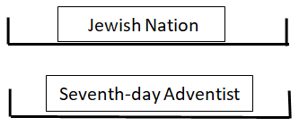
Ancient Israel
Modern Israel
11/9
2019
May
2020
1989
2001
2014
2021
Apis
Bull
We’re going to start stepping through the presentations from the 16th of May Worshiping the Apis Bull. And this study becomes our increase of knowledge in the same time frame as a counter revolution begins with the death of George Floyd. Without going into any details, I'm going to say that the formalization is about upon us. So as far as what I have taught, not ignoring what other people have taught, we are tracing our journey from the increase of knowledge to the formalization, from Concord to Exeter. Concord began for us on the 16th of May with the study of the golden calf. It developed because we had been for months looking at the end of Ancient Israel and wherever the Jewish Nation went wrong, we know parallels where Adventism went wrong. So we compared and contrasted the two and traced the issue that the Jewish Nation had with idolatry from Egypt to Rome.

Slide 6
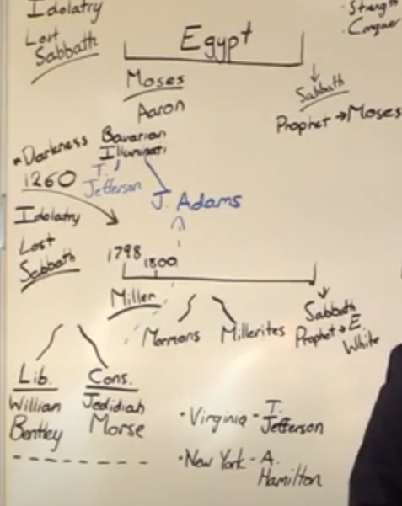
A second study, (there was two presentations on the 16th of May,) was called the Idolatry of Conservative Adventism. So we were already stepping into application. If we had to look into paganism to see where the Jewish Nation went wrong, we had to look into Protestantism to see where Adventism went wrong. In the same way that the golden calf linked the Jewish Nation to idolatry, (to paganism) we had to investigate the links between Laodicean Adventism and Protestantism. So from here also starts a very in-depth look into the history of Protestantism from 1798 and we kept reviewing that history all up until today. Just like we went back to the golden calf to their alpha history we went back now to the alpha history of the Millerites. And just like we know there were two streams in Catholicism we saw two streams within Protestantism. We saw those two streams illustrated in 1798 itself with the work of Jedediah Morse, and immediately we see the issues of conspiracy theories centered around a Protestant fight over secret societies and the Illuminati.

Slide 7
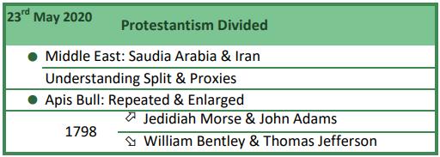
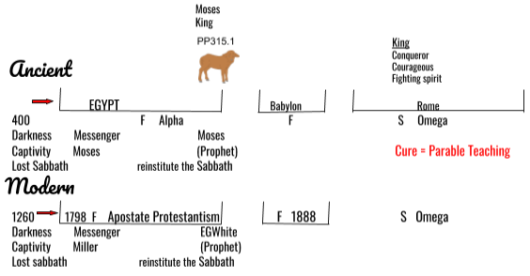
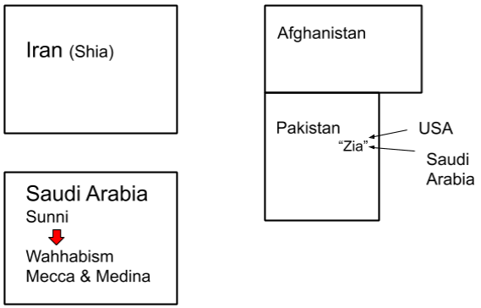
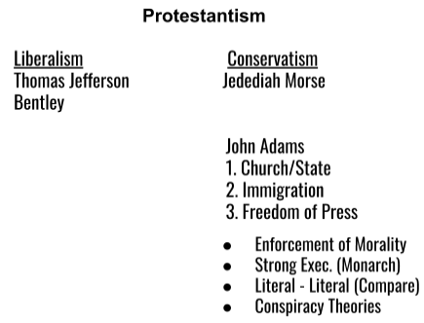
Moving on to the 23rd of May, here we seemed to take a detour, we started looking at the construction of the Middle East, the split of the Middle East between two superpowers, Saudi Arabia and Iran and their proxies.
Putting that to one side we went back to the Apis bull, we repeated and enlarged that study of the golden calf. Then we went back to 1798 Protestant history and repeated and enlarged on the split within Protestantism.
Protestantism Divided

Slide 8
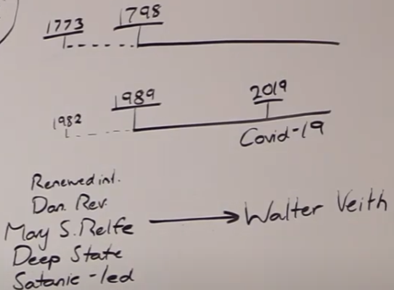
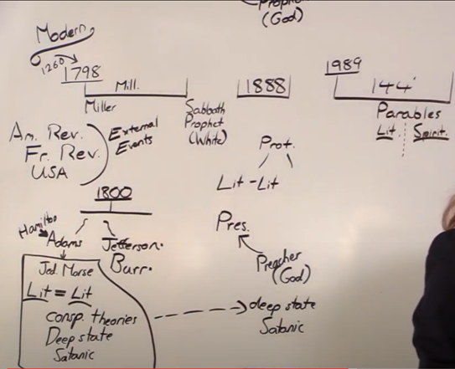
Moving on to the 30th of May, From Mary Stewart Relfe to Walter Veith. We're still building on the argument that the way that Ancient Israel held on to paganism, which you can trace from their alpha, Adventism held on to Protestantism which you can also trace from their alpha. So we are constantly then having to grow our understanding of what Protestantism even is because how can we say Adventism held on to Protestantism if we don't understand the history of Protestantism? So we had a look here of the methodology and the mindset and worldview of Walter Veith. And we start to connect that to the worldview of Protestantism from 1798 and their fight over secret societies. So automatically when we're looking at Protestantism within Adventism, we're immediately forced to look at the subject of conspiracy theories.

Slide 9
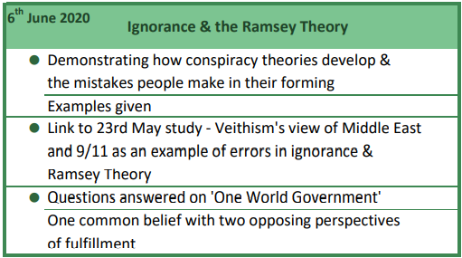
And on the 6th of June 2020 we study Ignorance & the Ramsey Theory so we can understand how conspiracy theories develop. This is where we tie in the study from the 23rd of May, the whole mindset Veithism, the methodology around the Walter Veith. And we look back at what we understand about the Middle East and then we show Walter Veith's view of the Middle East and see how his view is popular among conservative US society. His view of the Middle East is formed by Ignorance and the Ramsey Theory, the ingredients of a conspiracy theory. So this study on June 6th is really showing how conspiracy theories develop and are defended. At the end of the study, we answer a question that someone had on the one world government. And we showed how it's possible to have one core belief but depending on the methodology you take to that belief forms what you expect that to look like in real life. And those two ideas about what it looks like are polar opposites. So that's June 6th Ignorance and the Ramsey Theory.

Slide 10
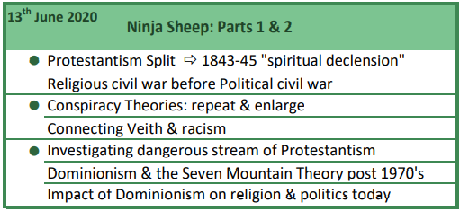
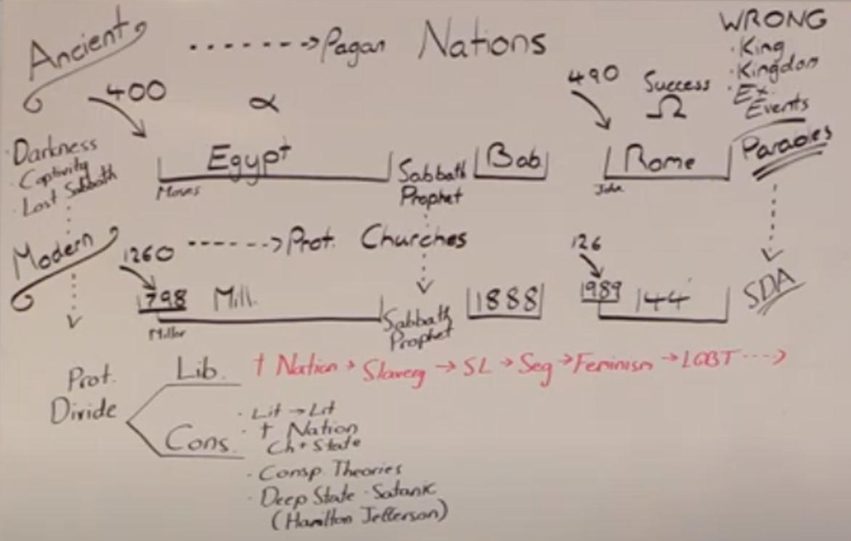
On the 13th of June we moved onto a two-part presentation, Ninja Sheep. And again, we’re constantly layering our understanding of ancient and modern Protestantism as a way to understand ancient and modern Adventism, which has all come from the original subject of the Apis bull. So, point one, we looked at the history surrounding 1844. We know that Protestantism was split in 1798 and we looked at its split in the 1844 history. But this split formed what they call a religious civil war before the political Civil War began. Then we went back and added to what we had said the week previously on conspiracy theories,
and we show that connected with Ignorance and the Ramsey Theory, also comes in racism when you use these methods. We looked at the stream of Protestantism that we described as dangerous that embraced conspiracy theories. And we looked at how they operate today, and from about the 1970s with a desire to impact not just politics but every level of society. We looked at the organized fashion in which they have had successes in this.

Slide 11
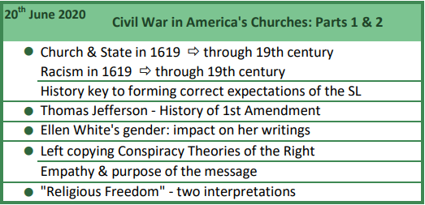
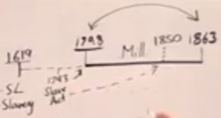
Moving on to the 20th of June: Civil War in America’s Churches. Here we give quite a bit of history, we go right back to 1619 which was part of our message in 2019. We already knew that racism existed in 1619, slavery. At the very birth of the United States it was already there; we see that church and state existed in 1619 and for a long time afterwards. So you have racism and Sunday laws from 1619 and we're going to add to that and say we also had sexism and homophobia from 1619. And the reason that we're looking into the history is because it affects what we expect to see at the Sunday law. It has a profound effect upon our expectations.

Slide 12
Then we looked at the history of the First Amendment when Thomas Jefferson split church and state. As we are covering the history of protestantism, especially a profound history of protestantism in the 19th century, we addressed the question about why did the prophet of Adventism not discuss any of this. Even in 1888 when the issues are external political events, why do we have to go to AT Jones to know what was happening because she does not tell us. So we looked at the limitations of a female prophet in the 1800s which is one point I wanted to make to say these external events are so significant. Her limit in talking about external politics does not mean they were not extremely significant. And we saw that very clearly in the presentations previous discussing the spiritual declension of 1844. We then discussed the danger of left-wing streams copying the methodology of the right, that the criticism of Donald Trump is no excuse to form this conspiracy theories about him; he's bad enough obviously. And we needed to be guarded against that danger. We began to look at two different interpretations of religious freedom but we're going to talk about that more in the future.

Slide 13
Moving on to the 27th of June, State Nationalism. We repeat and enlarge a point that we've made a couple of presentations before of how depending on your methodology you can have two different perspectives of one common belief. Then we started looking again at Protestant history, American history and we studied how the South slowly developed this Southern identity which became the Confederacy at the beginning of the Civil War. We don't go quite in that much detail in this presentation, we do in a future one. But we're particularly looking at the Protestant denominations in the south and how those denominations moved from condemning slavery to endorsing slaves.

Slide 14
Here we looked at, this was the work of a liberal wing Adventist and many within the movement were falling into the trap of looking to liberal Adventism for answers. At the same time, we are repeating an enlarging this history in our presentations. Some people were trying to look into the same history, but they were going to liberal Adventist sources. My issue with liberal Adventism is it's usually just conservatism that they've glossed over. And their methodology is just conspiracy theories made to look nicer. And this article people were sharing to go into the history to be honest it was just a fantasy, full of mistakes. So addressing this point was a warning, we're going to go into this history but be careful of your sources. Liberal Adventism does not use our methodology ever. Even if it looks deceptively close it's not our methodology so they're liable to make a lot of mistakes.

Slide 15
We then went back into history particularly 1844 to the Civil War. We saw that period of Millerite history was all about Texas and expansion, how the USA could have taken Mexico in that time period but didn't want it, then we look at the Articles of Secession put out by the confederate states in 1861 and the argument of state rights.

Slide 16
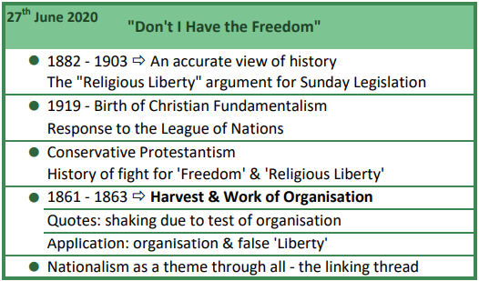
That last thought really ties into the next presentation done on the same day; Don't I have the Freedom? We discussed the importance of understanding the history correctly because it impacts our expectations of the future. In that context we looked at the whole 1888 history of Sunday legislation and how the arguments of freedom and religious liberty were used to enact this Sunday legislation. Still looking at this split within Protestantism, we looked at 1919 the end of World War I history and they attempt to form the League of Nations. This is called by some the birth of Christian fundamentalism because again one faction of that split within Protestantism was dead against the League of Nations which we can connect to 1798, their fear of secret societies. We can connect today the UN, we’re just adding more and more details on to this common thread.

Slide 17
We discussed 1861 and 1863 and the work of organization, we made application to our present harvest and showed how organization was a shaking and testing issue. We showed how those opposed to correct organization made the arguments that it conflicted with their freedom and religious liberty. And we can see that with nationalism today as that impacts the movement and ministries. I think this is the only presentation where we compare and contrast that work of organization to today. It's an important compare and contrast.

Slide 18
Then the first camp meeting of the Increase of Knowledge was Canada. So through this document the standalone presentations are in green and the camp meetings are in blue. The first two camp meetings we haven't divided it into presentations; for the first two camp meetings we just list what was taught in the whole camp meeting overall. After that point we start dividing it into presentation by presentation. So in July 2020 there’s the Canada camp meeting, we discuss how we are in the history of the wilderness. But also wanting to look at where we are over all the lines that we have located ourselves, so where we are on the lines.

Slide 19
Then we looked at Ellen White's first vision of the path. We showed this path really as a constructed reform line, tracing the challenges of the journey and the difficulty at harvest. That narrowing path is our Apis bull Protestantism gets systematically stripped from us. Then at the point of the time of trouble at the beginning of the harvest there's no path beneath their feet. Nothing holds them in this movement except for chords which we understand to be the lines, our parable teaching, which is the core of our message. And anyone who is in this movement for any other reason will fall away in this time unless we're held by those chords by the reform lines and the periods that we've been living through since November 2020 every other reason to be in this movement is stripped away. Anyone in the movement for any other reason will leave.

Slide 20
We revised these cords that hold us particularly Acts 27 and then how we form our understanding 2014 as Midway. And then through this camp meeting was the first time we identified Concord as being May of 2020 with the death of George Floyd. This is the first time we identified that not only the death of George Floyd, but the Apis Bull study was the Increase of Knowledge, May 25 the external date. Here we also began to look at what happened in 2019 but in the context of the King of the North versus the King of the South and spheres of influence and we discussed all the countries here that operate as a sphere of influence between these two superpowers. Venezuela, Libya, Yemen, etc. In presentation 7 and 8 of the camp meeting we started to discuss what good advice means.

Slide 21
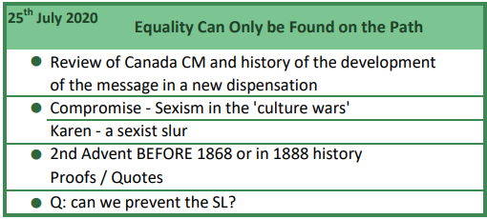
On the 25th of July we passed the camp meeting now and it's a Sabbath presentation: Equality Can Only Be Found on the Path. So the path we're referring to is the path discussed at the Canada camp meeting, Ellen White's first vision and those chords that hold us. We reviewed some of what was taught in Canada very briefly, we discussed how the messages have been developing. And then we start to look at liberalism which often is just rebranded conservatism, looking at sexism within the left. We discussed that the increasing habit of calling difficult women a “Karen,” how this is just the methodology and the behavior of the right.

Slide 22
Equality Can Only Be Found on the Path
The only hope that people have as was said all through the Canadian camp meeting is go back to the lines. Those lines will tell you where you stand. They will tell you how to behave not just in your personal life, not just in your church life, they will teach you how to view this movement as an organization. They will teach you how to view external events on both sides of the political spectrum correctly and how to respond to those events correctly. Those lines keep us in a dead center of that pathway. You let go of a line you go into one ditch or the other ditch. Either ditch is not safe. Either ditch does not practice equality.

Slide 23
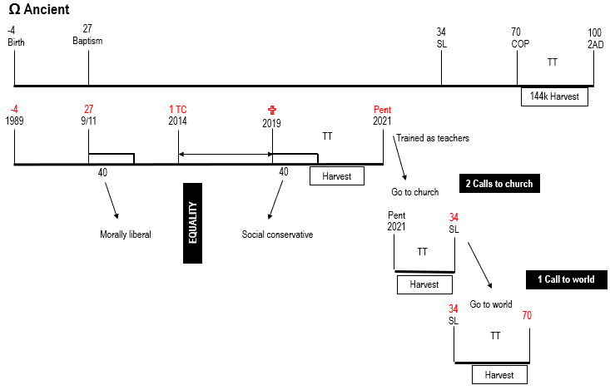
After this we’re going to answer two questions that had been asked in various corners of the movement. One question was the challenge and idea that Christ even intended to return in Millerite or 1888 history. So we answered that question some way, but we do come back to that in a later presentation and do it in more detail. The second question that was being asked around the movement was if we're good enough can we prevent the Sunday law? But this was less of a question and more of a fight to be honest because people were using that argument to say that we should be externally visible, externally fighting, externally protesting. And to add weight to that desire they had that they were also saying that the Sunday law becomes our fault if we don't fight. So I answered that conflict within the movement with a compare and contrast.

Slide 24
compare and contrast of ancient Israel and modern Israel
3 Histories of Ancient Israel
failure
failure
Success
α
Egypt
Babylon
Ω
Rome
Apis bull
Early Writings
Great Controversy
3 Histories of Modern Israel
failure
failure
Success
α
Millerite
1863
1888
1989
Ω
144,000
Christ meant to return
A NSL that would violate the right of conscience and lead to 2A
J. White sees slavery continue to the end of al earthly governments
Compare and Contrast:
α
God’s people were not ready, we did not see the cataclysmic external events - Millerites failed
Ω
144,000 movement is succeeding
Trump, dictatorship, Nationalism around the world, cataclysmic events are happening
The GC comes to a point of conflict
Internal, God’s people succeeding
External, cataclysmic events succeeding
After the Cross, the priests do not understand the nature of the Kingdom. A right understanding will give us the ability to know our work.
NSL
COP
2A
1888
DD
1868
Deferred in Mercy.--The long night of gloom is trying, but the morning is deferred in mercy, because if the Master should come, so many would be found unready. God's unwillingness to have His people perish, has been the reason of so long delay.-- Testimonies, vol. 2, p. 194. (1868) {Ev 694.2}
1856 3 Groups
“A Conference was held at Battle Creek in May, 1856. …
“But we were yet to pass through another severe trial. At the Conference a very solemn vision was given me. I saw that some of those present would be food for worms, some subjects for the seven last plagues, and some would be translated to heaven at the second coming of Christ, without seeing death. …{LS88 321.3}
1900 & 1903
The Work Might Have Been Done.--Had the purpose of God been carried out by His people in giving to the world the message of mercy, Christ would, ere this, have come to the earth, and the saints would have received their welcome into the city of God.-- Testimonies, vol. 6, p. 450. (1900) {Ev 694.3}
I know that if the people of God had preserved a living connection with Him, if they had obeyed His Word, they would today be in the heavenly Canaan. --General Conference Bulletin, March 30, 1903. {Ev 694.4}
1888 History
In the movements now in progress in the United States to secure for the institutions and usages of the church the support of the state, Protestants are following in the steps of papists. Nay, more, they are opening the door for the papacy to regain in Protestant America the supremacy which she has lost in the Old World. And that which gives greater significance to this movement is the fact that the principal object contemplated is the enforcement of Sunday observance--a custom which originated with Rome, and which she claims as the sign of her authority. It is the spirit of the papacy--the spirit of conformity to worldly customs, the veneration for human traditions above the commandments of God--that is permeating the Protestant churches and leading them on to do the same work of Sunday exaltation which the papacy has done before them. {GC 573.1}

Slide 25
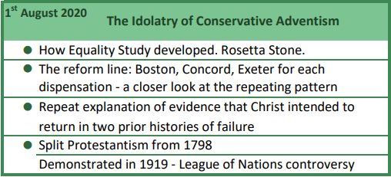
Moving into August, introduction The Idolatry of Conservative Adventism. Here we looked at the whole of the reform line, but we were looking particularly in more detail at that repeating pattern Boston Concord Exeter. People were losing sight of how the message had ever brought us to the subject of equality, so we also traced that on our reform line. And here we go back again over the evidence that we have that Christ intended to return in the two histories of failure. Then we go back and repeat and enlarge on our original topic that we keep going back to, tracing Protestantism it's journey in the United States and its split.

Slide 26
August 8th The Speaking of a Nation part 1 and 2. So when I say parts one and two this is not two presentations, it's one presentation divided into two segments, two YouTube videos, to try and make this work for the translators a little easier when here there was no live translation. So anytime you see parts one and two this is one presentation, but it's been split in to two YouTube videos. On the 8th of August we looked at the development of the message from simple to more complex. We used the external understanding of the atom as an example and the internal example of our understanding of the King of the South. Then we went to Great Controversy 440-442, continued looking at this Sunday law, trying to separate the false narrative that Adventism has developed that we take for granted.

Slide 27
But in many ways, it's indefensible. So we go to Adventism's favorite book of the Sunday law, the Great Controversy, we look what it says about the lamb like beast, it's horns and its speech. And we make the claim that those horns never break. Then we look at the three branches of government and how Ellen White says those three branches relate to the Sunday law, how she puts weight on the judicial and legislative whereas Adventism places all their attention on the executive. And we looked at 2014 and how it illustrates those two points made in the Great Controversy. We're handling Ellen White in a way that conservative Adventism doesn’t, and liberal Adventism doesn't either.

Slide 28
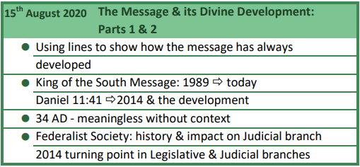
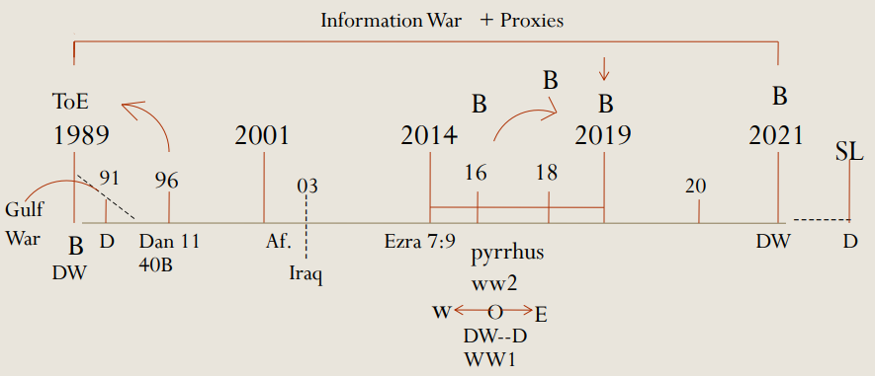
The 15th of August: The Message and its Divine Development, how it has always developed from overly simplistic to more complex. Showing how the King of the South developed which we covered before. But that’s verse 40 of Daniel 11 so we should expect the same of verse 41 which is the subject of the Sunday law. We looked at the Sunday law waymark for ancient Israel 34 ad, how the stoning of Steven is absolutely meaningless without the context of the prior history. So for the Sunday law for Adventism, will look absolutely meaningless unless they can also trace the development towards it. So this presentation is really expanding on the presentation directly before. We go back into the judicial and legislative branches; we see how the Federalist Society has hijacked the judicial branch over the last 30 to 40 years. We go into more detail about how 2014 was a turning point for both branches of government.

Slide 29
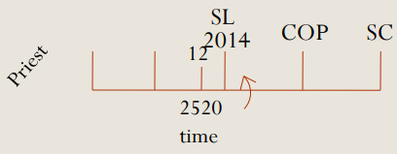
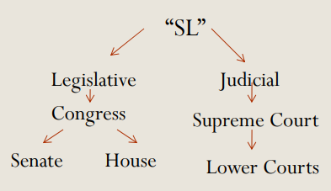

Slide 30
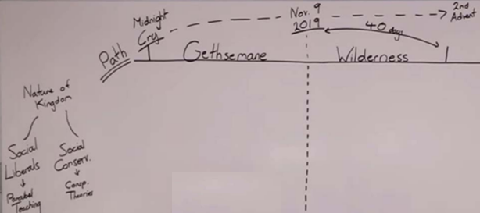
The 19th of August was not a Sabbath presentation, titled False Freedom: a Prophetic Pattern. It shows how we had two back-to-back testing time periods with parallel issues. And the shut door as a dividing line between the two time periods. We expanded on what we already taught before that conservatism and sexism can be both open and disguised. It can be overt, but it can also be practiced in a way that is more tolerable to mainstream society. We discussed the importance of relying on methodology.

Slide 31
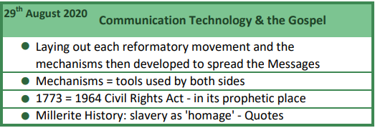
On the 29th of August: Communication Technology and the Gospel. Here we laid out all of our reformatory movements and how each time there's a reformatory movement there's also external mechanisms for spreading that message under development, how Ellen White says that Christ couldn't come until Rome had made this type of world peace and roads and shipping. We see that again with the Protestant Reformation and the printing press, Millerite history and in our history. But every time a mechanism to share information is developed it can be used by both sides. Moving on from there as a separate thought we showed how 1964 Civil Rights Act directly connects to our reform line. We locked the Civil Rights Act into its prophetic place. Then another separate thought we went, we’re going back now to our history, so we do these other detours, but we keep going back to history and protestantism. We show how slavery can be described as paying homage to the papacy.

Slide 32
-27
180
The term "Pax Romana," which literally means "Roman peace," refers to the time period from 27 B.C.E. to 180 C.E. in the Roman Empire. This 200-year period saw unprecedented peace and economic prosperity throughout the Empire, which spanned from England in the north to Morocco in the south and Iraq in the east.
End of Ancient Israel *Pax Romano/Roman Peace on land and sea
-4 Roads/Communication
(*don’t go back to Pharisees to learn)
Protestant Reformation *Printing Press
1518 Communication
(*don’t go to Papacy to learn)
Beg. Of Modern Israel *Trains/Steamboats
1798 Communication
(*don’t go to Protestants to learn)
End of Modern Israel *WWW
1989 Communication
(*don’t go to SDA pastors to learn)
There is no life outside this movement
-4
100
The Role of Printing in Medieval and Reformation Europe
https://speccoll.library.arizona.edu/online-exhibits/exhibits/show/reformation/role-of-printing
Telegraph 1844:
What has God wrought
To spread results of election
Trains: Dec. 25, 1830 first steam power passenger service
Track laid and open for operation:
Miller: 1830-1840 1800 miles of track
1st Call: 1840-1850 9000 miles of track
To world:1850-1860 more than 30,000 miles of track – network serving all states

Slide 33
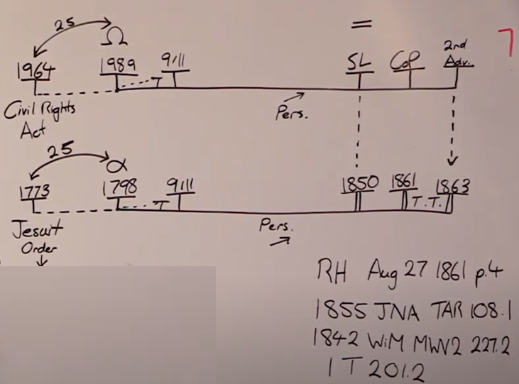

Slide 34
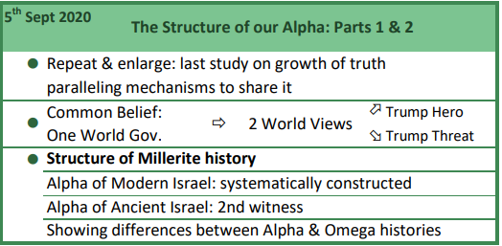
The 5th of September: The Structure of our Alpha parts 1 and 2. Again it's one presentation, the first two dot points are repeat and enlarge of what we've already done. For people still asking questions and struggling with some of those concepts or also sharing ideas and enlarging upon those concepts. So we studied what we had done the week before on how technology advances at each reformatory movement. We go again over how we can have one common belief and two different perspectives of that belief. Then back to our Alpha history as we have done from May 16th. Now we're going to construct our Alpha history, show it's differences to modern history and we used the alpha of ancient Israel as a second witness to that construction. So it had taken us some months to get here but this was our destination in wanting to have a constructed model of an alpha history. And show where it is the same but more importantly where it is different from an Omega history.

Slide 35
The Structure of our Alpha parts 1 and 2.
1 World Gov.
Trump
hero
Trump
dictator
Liberalism
Globalism
UN
Satanic deep state
QAnon
Secret Societies
Rothchilds
Bill Gates
Vaccines
Conservativism
Nationalism
USA Dictatorship
USA
UN
Rep. Party
Parables
WW1 + WW2 = WW3

Slide 36
The Structure of our Alpha parts 1 and 2.
α Modern
Egypt
A. Israel
1 Call church
Babylon
2 Calls church (P & L)
Rome
Ω A. Israel
2 Calls church
1798
911
1840
1850
COP
1861
TT
9th
11th
1798
1840
July 21,
1844
Oct. 22,
1844
1850
Harvest
Harvest
TT
1 Call to church

B C E
COP
Scattered, not bringing a message
1 Call to world
1840
July 21,
1844
Oct. 22,
1844
1850
1861
Harvest
TT
calling out of apostate Protestantism

Slide 37
The Structure of our Alpha parts 1 and 2.
Ω ANCIENT
Rome
-4
1989
27
9/11
SL
COP
2AD
144K
TT

Harvest
-4
1989
27
9/11
1 TC
2014

2019
Pent
2021
Priests
TT


Oct. 22,
1844
Harvest
Go to church
Pent
2021
34
SL
2 Calls to church
Levites
TT

Harvest
1 Call to world
Go to world
34
SL
70
COP
Nethinims
TT

Harvest
Ω MODERN

Slide 38
South
Democrats
North Whig (1833)
↓
Republicans
1st Party system 1792-1824
2nd Party system 1828-1854
3rd Party system 1854-1890’s
Moving on to Oceania, this was our second camp meeting and like the last it's not divided into the three presentations that composed it. In this camp meeting we zoom in on the external political events of Millerite history. We had already covered 1798 Jedediah Morse, 1844 the spiritual declension. But now we want to see the issues within their politics because we're about 6 weeks from the US election. So we looked at those external political events, there's another layer a bit separate to the external Protestant events. We showed the Whig party, Henry Clay the Great Compromiser who was part of the Whig party, his run in the significant 1844 election versus Polk. How that election decided the future course of the United States, they chose American expansionism which was really a religious belief and it led to the Mexican war of 1846, 1848, 1850 and the Civil War. The 1844 election was the cause, the rest of their reform line is the effect of that cause.

Slide 39
α Modern
1798
1840
1850
COP
1861
1863
Henry Clay
The Great Compromiser
John C
Calhoun
TT
1798
1840
July 21,
1844
Oct. 22,
1844
1850
South
Democrats
North Whig (1833)
TT
↓
Republicans
✓
18
33
✓
✓
✓
✓
✓
1850
1861
1st Party system 1792-1824
2nd Party system 1828-1854
3rd Party system 1854-1890’s
TT
The Constitution, a Compromise
✓
Elder Tess
September 19, 2020

Slide 40
And especially the history from 1844 to the 1850 compromise directly parallels our own dispensation ending at the Sunday law. We take all of this, and we make some applications, but we bring it to the 2020 election, and we start disagreeing and dismantling the study of the last president. The internal message of this dispensation is the Apis bull which is compromise and the Whig party which is compromise and if we want to make application that is not a Trump second term; that's a Biden presidency. So you start rattling a few feathers there and this particularly becomes an issue movement wide but in the French field with a split that was already developing and those in opposition very much holding to the study of the last president. Then looking at the US states and state rights we come back to the subject of equality, the principles of force versus choice. This brings some questions in people's minds, and I address some of them on the 3rd of October the next presentation.

Slide 41
compromises
1818 to 1821
1833
1850
There’s a number of US elections
✓1840. P. William Henry Harrison (dies)/V. John Tyler
☒1844 P. Henry Clay/V. Theodore F
✓1848 P. Zachary Taylor (dies)/V. Millard Fillmore
1860
α Modern
Henry Clay
1798
1840
1850
COP
1861
1863
TT
Elder Tess Lambert
September 5, 2020
2014
July 21,
1844
2019
Oct. 22,
1844
SL
1850
1798
1840
Failure
TT
✓
18
20
33
✓
✓
✓
✓
1850
1861
✓
⬆
2nd Adv
Henry Clay first political speech
Compromise
Tariff, Whig party formed
TT
Missouri
Compromise
Nov.9,2019
✓

Slide 42
Biden, Compromise and the MC
compromises
1818 to 1821
1833
1850
There’s a number of US elections
✓1840. P. William Henry Harrison (dies)/VP. John Tyler
☒1844 P. Henry Clay/VP. Theodore F
✓1848 P. Zachary Taylor (dies)/VP. Millard Fillmore
✓1860 P. Lincoln/VP Hannibal Hamlin
Elder Tess Lambert
September 21, 2020
α Modern
1798
1840
SL
1850
COP
1861
1863
2014
2019
TT
July 21,
1844
Oct. 22,
1844
1850
1798
1840
Failure
TT
✓
18
20
33
✓
✓
✓
✓
1850
1861
✓
⬆
2nd Adv
Henry Clay first political speech
Compromise
Tariff, Whig party formed
TT
Missouri
Compromise
Nov.9,2019
✓

Slide 43
Biden, Compromise and the MC
Elder Tess Lambert
September 21, 2020
Nov. 9
2019
IoK
2014
2016
Gethsemane
Wilderness
Republican
FFA vs. MC
Democrat compromise

Slide 44
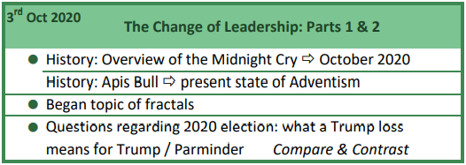
3rd of October, The Change of Leadership parts 1 and 2. We give a history, the overview of the Midnight Cry to October 2020 where we are. So we try and retrace some of our steps, so people don't lose the development of the message. Then we again bring up the Apis bull as it illustrates the present state of Adventism. We go on another tangent here but a fun one and begin discussing fractals but we're going to carry that over and cover it properly in the next presentation. Instead, I start addressing a question that had been arising in the movement which was this compare and contrast that had been taught through 2018 to 2019, between Donald Trump and Elder Parminder and any impact that the 2020 election would have on that.

Slide 45
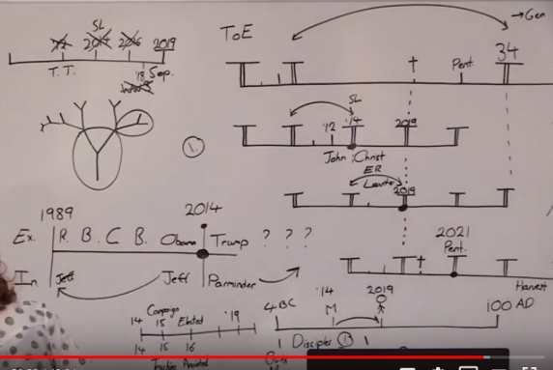
Now on the 10th of October we come back to that study of the fractals, The Nature of Fractals: part 1 and 2, we discussed the scientific history and development of the understanding of fractals, we give examples of how they occur in nature and mathematics and then we spend the rest of the presentation discussing how a correct understanding of fractals impacts how we understand the reform line.

Slide 46
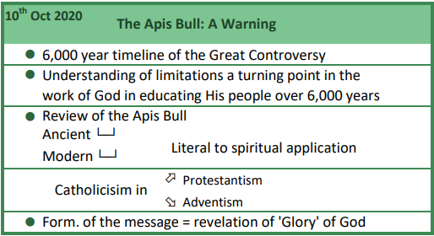
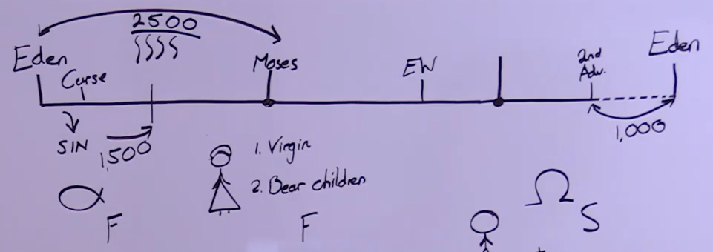
That presentation was in the morning of October 10th but on the evening for me on October 10th I presented again, and this was a presentation for the French ministry, The Apis Bull: A Warning. We were two weeks away from the French camp meeting and this served as like a prelim to that camp meeting and knowing the various shakings developing in various parts of the world including France, the topics presented were somewhat deliberate. So it's here that we introduced a timeline of the whole 6000 years of the Great Controversy, if we put the whole big picture into context, it has many implications, especially as we take inspiration back and trace it through that 6000-year timeline and how limited God is in trying to slowly educate His people. Then it's a bit of a warning to the French world but the whole movement. We reviewed the Apis bull, how that impacted ancient Israel, how then we have to see the idolatry in modern Israel, how that idolatry in modern Israel is just an extension of protestantism which is an extension of the papacy. Moving from the increase of knowledge to a discussion of the formalization, so we say that the formalization is a revelation of the glory of God, and it always comes with a shaking. People either look at that revelation of the glory of God or the character of God and they hate it, or they love it, but it always shakes.

Slide 47
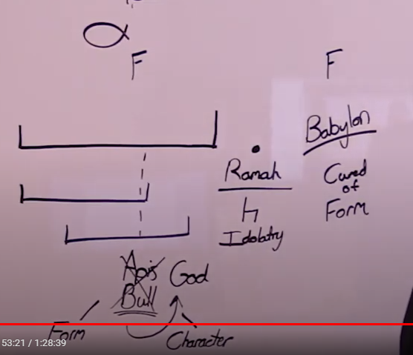
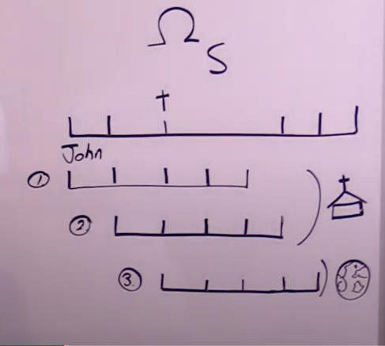

Slide 48
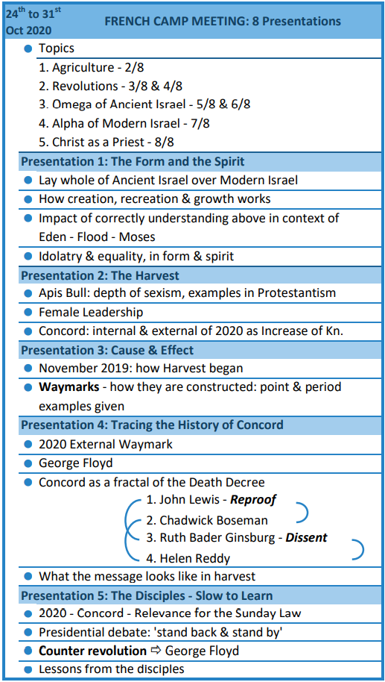
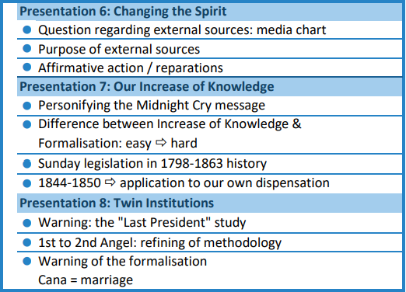
24th to 31st of October and the French camp meeting. We'll cover the French camp meeting and then we might stop and take a short break. So at the beginning of the French camp meeting, I said that I wanted to cover five topics, each topic was a line or a structure that we wanted to place ourselves in it's really five different models. In the second presentation we covered the model of agriculture, in the third and the fourth placing ourselves in the context of the revolutions. The fifth and the sixth reminding ourselves of the end of ancient Israel. The seventh was reminding ourselves of the alpha of modern Israel history, Millerite history, and the eighth touched the model of Christ as a priest.

Slide 49
First presentation, The Form in the Spirit, we want to lay the whole of ancient Israel over the whole of modern Israel, and we want to view all of that in the context of the October 10 meeting and that 6,000-year timeline. How creation, recreation and growth works and how keeping that timeline in our mind impacts how we understand inspiration. We looked at how you can keep idolatry in the form or the spirit or both; therefore, you can keep equality in the form or the spirit are both. But only the union of both is acceptable to God.

Slide 50
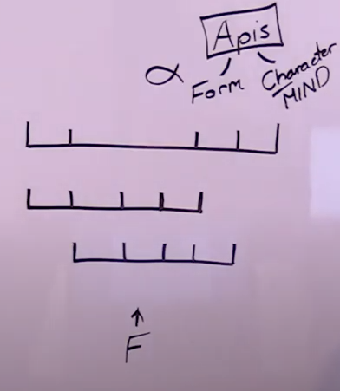
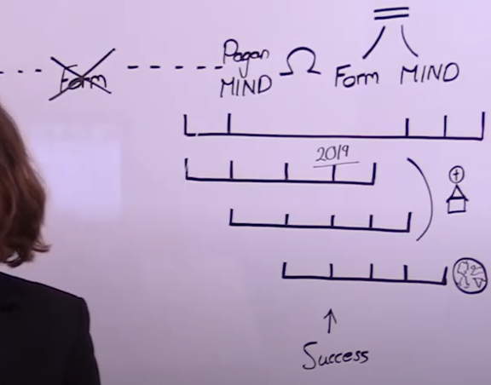

Slide 51
In presentation two, The Harvest, we go back into the Apis bull, we show the depth of sexism and how it manifests itself in protestantism and the expectation protestantism has of female leadership. Then we go into Concord in 2020 and discuss the internal and external events.

Slide 52
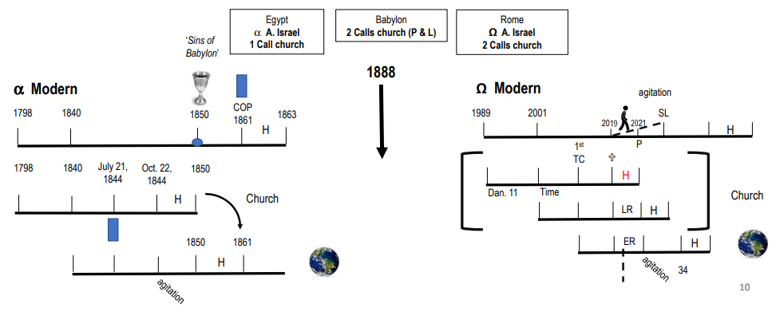

Slide 53
In presentation three, Cause and Effect, we discussed the beginning of the harvest in November of 2019, that Sabbath of November 9 being the first time this movement has been burnt out of a camp meeting and had to flee, really how a time of trouble began. Then we start looking at the structures of our reform line and the key theme of this presentation is looking at how way marks are constructed, are they just a day like September 11th or are they a period of time. And we go back into 1989 and other examples and illustrate a period of time.

Slide 54
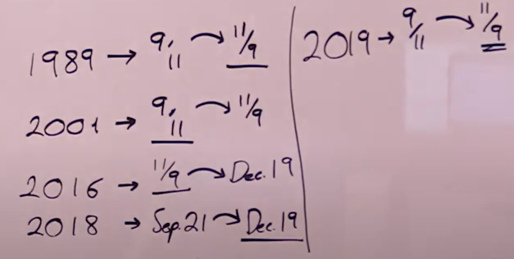
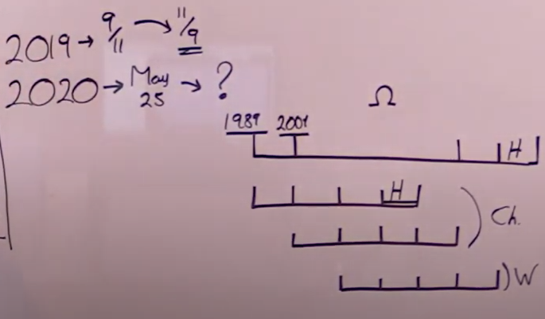

Slide 55
With that context we moved on to presentation four, Tracing the History of Concord, and 2020 the external. The death of George Floyd but then four other deaths that existed in that time frame between May and September of 2020. We have John Lewis, Chadwick Boseman Ruth Bader Ginsburg and Helen Reddy. Two are the topic of racism and two are the topic of sexism. One represents reproof and one represents dissent, two things silenced in the harvest. And then we looked at what we can expect of the message in a time period of harvest.

Slide 56
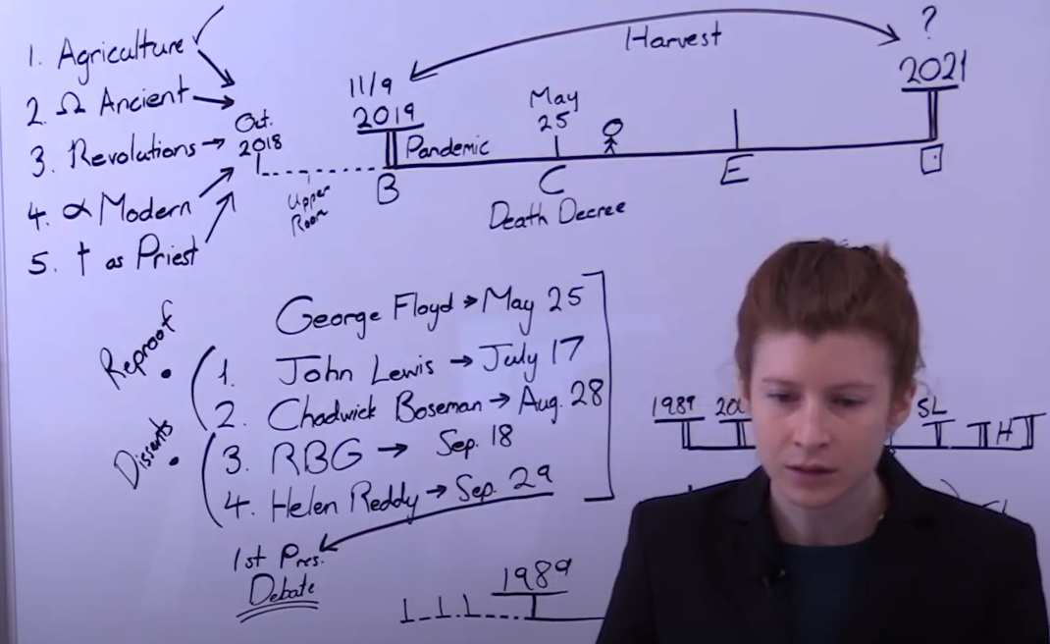
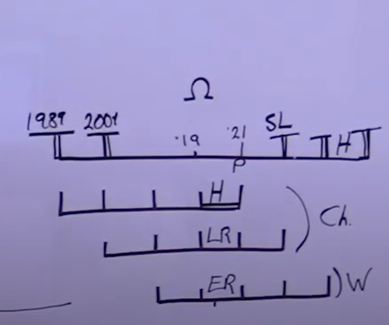

Slide 57
Presentation five, The Disciples – Slow to Learn, we discussed how the 2020 Concord waymark is relevant for the Sunday law, the presidential debate between Biden and Trump where Trump told the proud boys to stand back and stand by. This debate had recently taken place, so we discussed it. We showed the connection between race, racial issues, nationalism, sexism and patriarchy. And we took some lessons from the disciples.

Slide 58
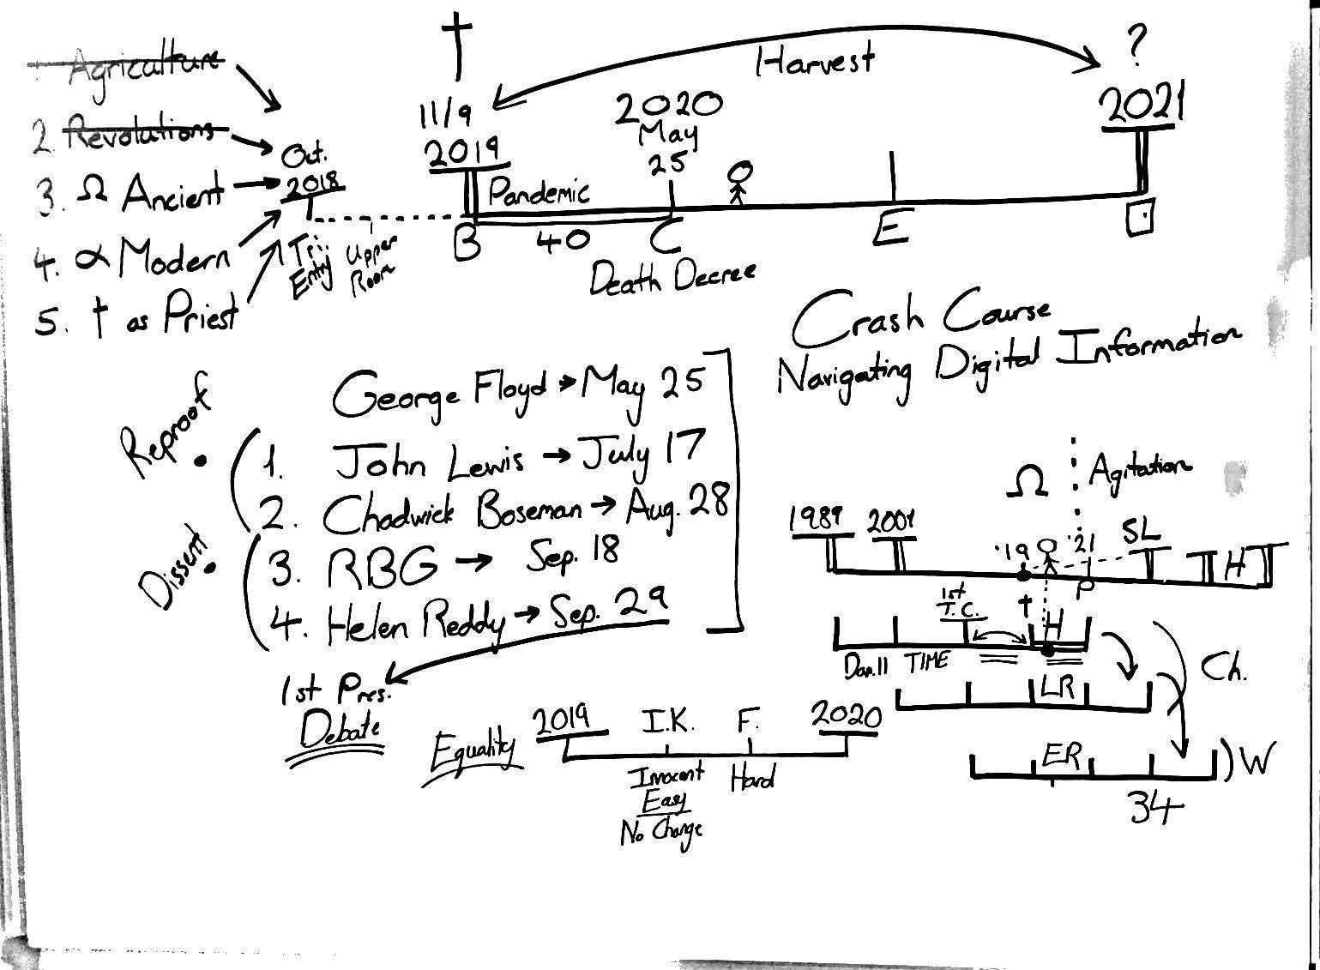

Slide 59
Presentation six, Changing the Spirit, was answering a question about external media sources , how do we know what is trustworthy and what is not trustworthy. I have, I believe it was a presentation previous, discussed the Crash Course YouTube channel, their series on navigating digital information. But now we looked at the media chart that discussed external journalistic news sources. We discussed the purpose of these sources, what they’re meant to do for us, in highlighting the errors in our world view and changing.

Slide 60
Then we moved on to a different topic discussing affirmative action and reparations, how that’s a topic externally and it must be internal. To address the issues in the movement where particularly men were unhappy if we seemed to give anything more than 50% to women.

Slide 61
Presentation seven, Our Increase of Knowledge, we showed here the difference between the increase of knowledge and formalization because at Concord, the increase of knowledge always comes in its innocency and people don’t realize until the formalization the implications of that message. We went back over Millerite history and addressed questions particularly in the French world about the subject of Sunday legislation that exists in Ellen White’s writings pre-1863. Then at the end of that presentation we’ve constructed the dispensation of 1844 to 1850.

Slide 62
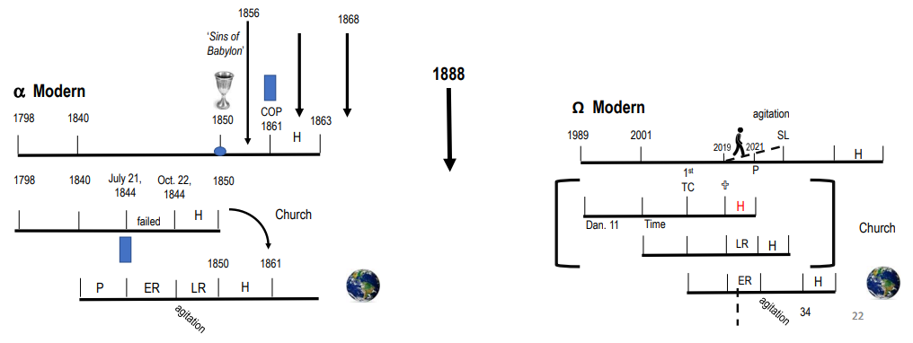

Slide 63
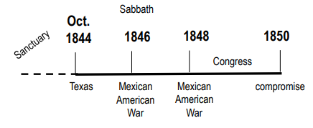

Slide 64
This is the fourth point of the five that I wanted to cover in this presentation: where were we located on the line of the alpha of modern Israel. So we located ourselves in Millerite history and made application.

Slide 65
Presentation eight, Twin Institutions. Now this was the most direct plea I could make to the shaking in the French world to exercise methodology and reason. So I spoke about the dangers in the last president’s study and that we do not hold, this was a few days before the election. I then explained the refining of methodology between the work of the first angel and the second angel in the context of that study. Then I warned people that the formalization of the message would come if they didn’t settle into what had already been taught it would take them away.

Slide 66
And I warned that the formalization is illustrated by the marriage of Cana, we’re dealing with gender equality and marriage. They needed to settle into the Apis bull increase of knowledge, the Midnight Cry and parable teaching.
So I believe we are about halfway through, maybe just over, so we’re going to take a break then we’ll come back and try and be concise.

Slide 67
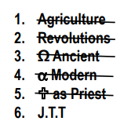
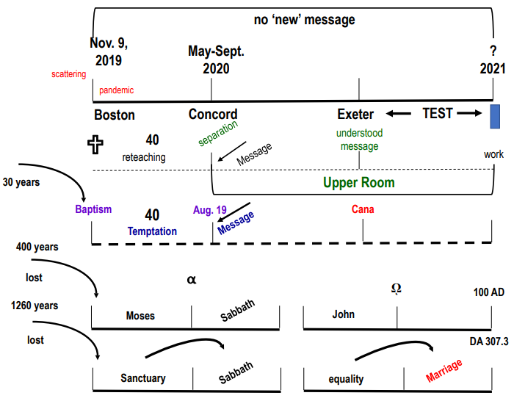

Slide 68
We’ll have a short prayer and close,
Dear Lord,
We thank you for how you have led us, the freedom that comes with a true understanding of both history and present and what you have revealed of the future. May we love each revelation of your character.
We pray in Jesus' name, Amen

Slide 69
Ω Ancient
-4
Birth
27
Baptism
34
SL
70
COP
100
2AD
TT
144k Harvest
-4
1989
27
9/11
1 TC
2014

2019
Pent
2021
TT
Trained as teachers
40
40
Harvest
Go to church
2 Calls to church
EQUALITY
Pent
2021
34
SL
Morally liberal
Social conservative
TT
Harvest
1 Call to world
34
SL
Go to world
70
TT
Harvest

