Slide 1
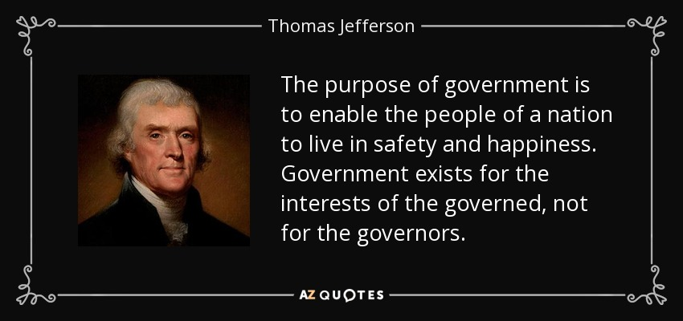
Freedom In America Part 3
The Purpose of Government
Part 1: Unit Overview
https://www.docsoffreedom.org/units/the-purpose-of-government
Side Notes:
Residual sovereignty are the powers that are not specifically assigned to the federal government and belong to the states and the people respectively.

