Slide 1
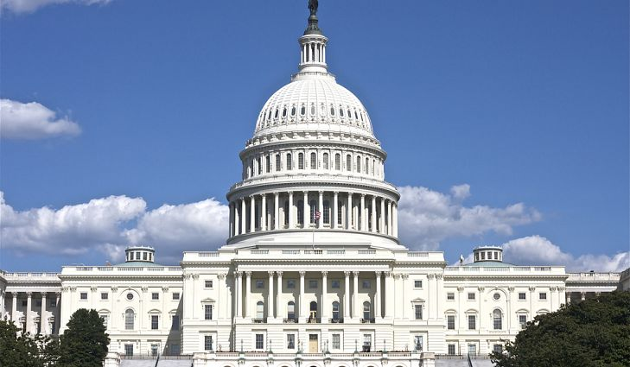
Freedom In America Part 3
The Purpose of Government
Part 2: The Role of Government
https://www.docsoffreedom.org/readings/the-role-of-government
Side Notes:
https://youtu.be/h_-wOUNhVWo
https://youtu.be/b2NnEfhQ15M
https://youtu.be/WWHHCn_7QKc
https://youtu.be/EivTHLKaa9s
https://youtu.be/82KmrV-Szhs
https://youtu.be/crcFImOwiJg

