Slide 1
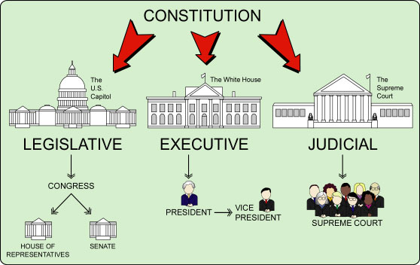
Freedom In America Part 3
The Purpose of Government
Part 3: Separations of Powers with Checks and Balances
https://www.docsoffreedom.org/readings/separation-of-powers-with-checks-and-balances
Side Notes:
Separation of powers is a doctrine of constitutional law under which the three branches of government (executive, legislative, and judicial) are kept separate. This is also known as the system of checks and balances, because each branch is given certain powers so as to check and balance the other branches.

