Slide 1
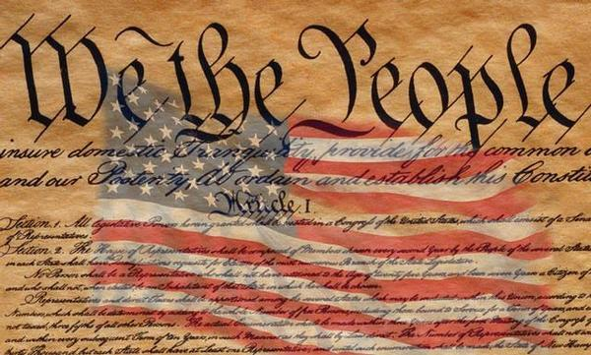
Freedom In America Part 3
The Purpose of Government
Part 4: Republican Government
https://www.docsoffreedom.org/readings/republican-government
Side Notes:
Constitutional Republic:
A Constitutional Republic is a state where the officials are elected as representatives of the people, and must govern according to existing constitutional law that limits the government's power over citizens.
From Conservapedia.
Notes:
https://youtu.be/bzsh45pD7AE
Https://youtu.be/UUvTNQ2F9dM
https://youtu.be/Q8qQyqnzD9o
https://youtu.be/W9H3gvnN468

