Slide 1
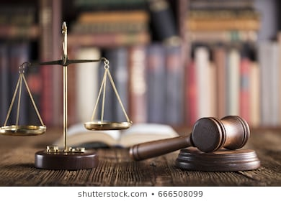
Freedom In America Part 3
The Purpose of Government
Part 5: Due Process of Law
https://www.docsoffreedom.org/readings/due-process-of-law
Side Notes:
https://youtu.be/UyHWRXAAgmQ

