Slide 1
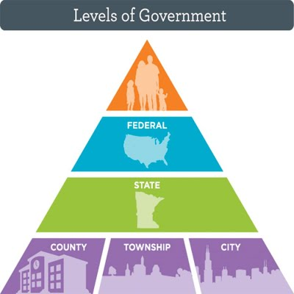
Freedom In America Part 3
The Purpose of Government
Part 6: The Structure of the National Government
https://www.docsoffreedom.org/readings/the-structure-of-the-national-government
Side Notes:

