Slide 1
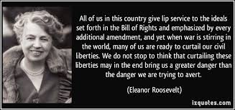
Freedom In America Part 3
The Purpose of Government
Part 7: National Government, Crisis, and Civil Liberties
https://www.docsoffreedom.org/readings/national-government-crisis-and-civil-liberties
Side Notes:
Civil liberties are guarantees and freedoms that liberal governments commit not to abridge, either by legislation or judicial interpretation, without due process.
Wikipedia Reference

