Slide 1
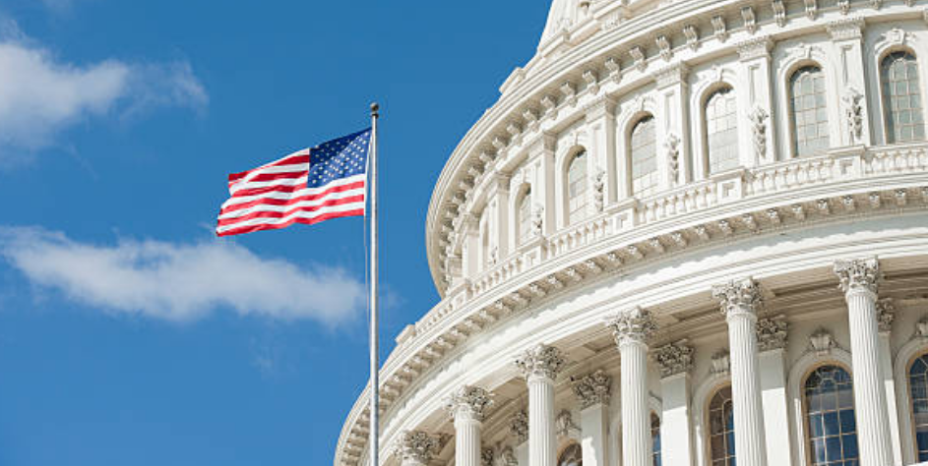
Freedom In America Part 3
Side Notes:
The Purpose of Government
Part 8: State and Local Government
https://www.docsoffreedom.org/readings/state-and-local-government
Side Notes:
Federalism, mode of political organization that unites separate states or other polities within an overarching political system in a way that allows each to maintain its own integrity. Federal systems do this by requiring that basic policies be made and implemented through negotiation in some form, so that all the members can share in making and executing decisions. The political principles that animate federal systems emphasize the primacy of bargaining and negotiated coordination among several power centres; they stress the virtues of dispersed power centres as a means for safeguarding individual and local liberties.

