Slide 1
Reform Lines
https://youtu.be/ktgyhMpIagI
Notes:
Notes created by Victoria Thomas based from Elder Tess’s presentation on the reform lines (Feb. 2020).

Slide 2
Structure of the 144K Line
We construct 1989 and 9/11.
EW gives us the SL, COP, and 2nd Adv.
144K Line
1989
9/11
SL
COP
2nd Adv

Slide 3
Agriculture, A Common Theme
144K Line
Common Theme:
Ploughing
Early Rain
Latter Rain
Harvest
1989
9/11
SL
COP
2nd Adv
The reform line of the 144K is composed of 5 major waymarks. These 5 major waymarks divide up the four stages of the agriculture process: Ploughing, early rain, latter rain, harvest.
Every step is leading us to the harvest. There is no harvest without rain. There is no point raining on a crop that has not been planted. You don’t plant unless you’ve ploughed. All are necessary steps.
Notes:
Dispensation—a gap; a space

Slide 4
A Handy Reminder
SL
9/11
COP
We could use our hand as a tool to help us remember the 5 major waymarks and 4 stages.
Latter Rain
Early Rain
2nd Adv
Harvest
Ploughing
1989
5 major waymarks cut up our line into the 4 stages of the agricultural process.

Slide 5
Fractals of the 144K Line Cont’
1989
9/11
SL
COP
2nd Adv
Swelling of the LC
4
Harvest
Take a message to the world
144K
1989
9/11
2014
2019
2021
We construct fractals from the 144K line. What we mean by this is that we have identified that God deals with His church first and then the world. Two callings for the church and one for the world. Before we go to the world, God must deal with His church.
1
Harvest
Priest
Church
2021
SL
Here you have 4 harvests : 1 harvest for the church; 2nd harvest for the church; a harvest for the world and a harvest for the 144K.
There are 4 harvests one after another.
Each group has it’s own agricultural process
2
Harvest
Levites
SL
COP
Church
3
Harvest
Nethinims
World

Slide 6
Fractals of the 144K Line Cont’
1989
9/11
SL
COP
2nd Adv
Swelling of the LC
4
Harvest
Take a message to the world
144K
1989
9/11
2014
2019
2021
1
Harvest
Priest
But if we can just conceptualize this; we have four harvests. The Priests are the first to be harvested, which make up one segment of the church. Then, we will see the harvest of the Levites. They join us. That completes the work of the church by the SL. Then follows the harvest of the Nethinims. They complete their harvest by Dan 12:1. Lastly, there is a fourth harvest, specifically for the 144K.
2021
SL
2
Harvest
Levites
SL
COP
3
Harvest
Nethinims

Slide 7
The Opening Up of Reform Lines
144K
Early Rain
Plough
Latter Rain
Harvest
1989
9/11
SL
COP
2nd Adv
Reform Lines
A reform line is not any kind of line. It is a specific type of line. It is a line that shows how God brings reformation to His church.
What was the very first study that opened up that became the foundation for increasing light that followed?
God’s people are in captivity. They’re scattered; and God needs to bring about a reformation.
Reform Lines
Reform lines opened up to God’s people in 1989.
So, in 1989, God gave this Movement reform lines. They were very specific and there are four of them. What are those lines?
What is a reform line?

Slide 8
4 Lines of Reform
Of the 4 lines of reform:
Two relate to ancient Israel:
Failure
Success
History
History
Captivity
Moses
Beginning of Ancient Israel
Captivity
Christ
End of Ancient Israel
Two relate to modern Israel:
Failure
Success
1798
1863
126
1989
2nd Adv
1260
Millerites
Beginning of Modern Israel
144K
End of Modern Israel

Slide 9
Reform Line: (2) Ancient Israel
Failure
Success
Ancient Israel:
History
History
Captivity
Moses
Beginning of Ancient Israel
Captivity
Christ
End of Ancient Israel
Egypt
God’s people come out of Egypt and enter the land of Canaan.
God’s people in captivity again
God’s people come out of Egypt. They go into the promise land. They’re meant to be this peculiar people and fail. They end up with the curse and not the blessing. God reforms His people, but this does not end in success. They don’t complete the work they are supposed to do. So you must have another line of reformation. God is again going to find His people in captivity; and again is going to attempt to reform.
In this history, it ends in success. God’s people fulfill their job function. Christ could not return in this history. Paul tells us the Papacy has to show himself. Christ was meant to come, die, and have complete victory over Satan. And the message was to be taken to the Gentiles. That was the job function of the dispensation and they succeed to do that.

Slide 10
Reform Line: (2) Modern Israel
Failure
Success
Modern Israel:
1798
1863
126
1989
2nd Adv
Captivity
Millerites
Beginning of Modern Israel
Captivity
144K
End of Modern Israel
1260
Again God’s people are held in captivity. Here, it is the 1260. And God is going to restore them. This restoration begins in 1798. Christ was supposed to come back in this history, but He didn’t. It ended in failure. They did not complete their mission. They fall into the Laodicean condition. Again God finds His people in captivity 126 years from 1863.
We come to a new line of reformation, the end of modern Israel, the final generation. Our message is to take this Movement to the world; and in our history we succeed.
Notes:
Side note: There are two glorious lands: Ancient Israel and USA.
Note: In the alpha history, they don’t complete their job function. In the omega history, they do. That is the difference between failure and success. You can see that in the blessings and the cursings.

Slide 11
Take Note
In the line of Christ (or the end of ancient Israel), they are going to complete the work. It is a history of success. So, it is going to give us a much more complete understanding of our reform line (144K).
There are some differences between the history of failure and the history of success. A few structural differences and also in the message.
The key reform line is the line of Christ (or end of ancient Israel). It is our number 1 witness. The key line that unlocks our own because it is the story of God reforming His people and then they successfully do a work. We wouldn’t find that complete story in the line of the Millerites (or the beginning of modern Israel) because it is a history of failure. They go off course.

Slide 12
End of Ancient Israel Over the Priest Line
Priest
1989
9/11
2014
2019
2021
‘91
‘96
2009
2012
2016
2018
2020
Christ Ministry begins
Ancient Israel
AD27
-4BC
Ministry of Jn. Bapt.
(Baptized)
1st TC
1. Disciples
Pentecost
BO Christ
BO Jn. Bapt.
2A
Age 12
Wilderness
Cana
40
Here forward Christ takes leadership. Disciples must stop following John. Calling of the 1st group. Those disciples are trained of John. Many are baptized by him, not all. Then they learn to follow Christ. They change their allegiance from the 1st angel, John to the 2nd angel, Christ.
Christ introduced to the Movement, but He doesn’t begin to work.
To be tempted of Satan (x3)
He goes to the marriage of Cana. His mother comes to Him and asks Him to do something for her. Christ replies, “My time has not yet come.”

Slide 13
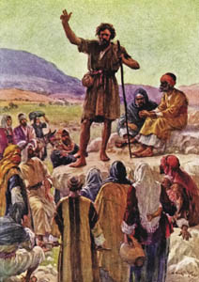
One Problem
Priest
(‘96)
(9/11)
(1989)
AD27
-4BC
Ministry of Jn. Bapt.
(’91)
(Baptized)
Age 12
2A
BO Christ
BO Jn. Bapt.
John the Baptist has one problem. He is raised up. He doesn’t get trained up by the Pharisees, but he still takes on much of their ideas. In application to our time, they take on the ideas of the leadership—the leadership of the church. They bring into the Movement those misunderstandings. For instance, John the Baptist talks about the generation of vipers, [referring] to the Pharisees and the church leaders. He condemns them. But, John the Baptist spreads the message that the Messiah has come, looking like an earthly king, which is exactly the message of the Pharisees. So He takes elements of the message of that time—the Laodicean message of the Pharisees—and blends it with his own. Thereby, his own message is half-truth—half what God has given him and the other half is the Laodicean message he has blended it with.
The message John the Baptist taught saying, “The time is come. The Messiah is here. He will restore truth, but he is going to be an earthly king, defeat the Romans, restore the Jewish nation as church and state is wrong. [It is a mixture of truth and error]. And he took this from the Laodicean church of his time. So, there are problems with John’s message.

Slide 14
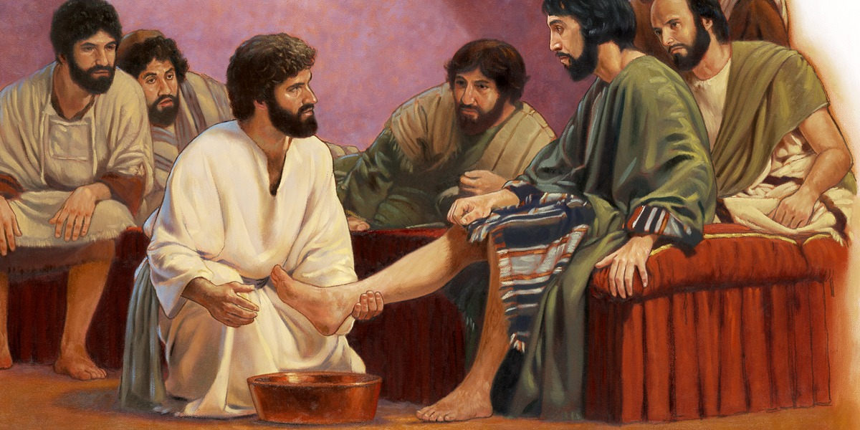
Correction is Demonstrated
Priest
(2019)
(2014)
The disciples trained under John are told, “I must decrease and He must increase.” And they learn they must follow the 2A, Christ. What does Jesus then tell them? “I’ve got nowhere to lay my head. I have no glory to give you. There is no greatest position. I am here to serve. I am going to die on a tree.” He is telling His disciples who He is and what His mission is. Most of them (you can say all of them to different degrees) are not listening.
1st TC
(2016)
(2018)
Christ Ministry begins
At the upper room, just before the cross, there is a problem. The disciples have dirty feet. There is supposed to be a servant who comes and humiliates himself; kneel and wash the feet of the guest. But no servant has come. So Jesus gives them one final lesson before the cross. They’ve held onto the kingdom of John. Christ has tried to tell them, “My kingdom is not what John led you to believe it was.” But they are not listening. And so Christ is going to demonstrate it. And Christ, who was meant to be this earthly monarch, kneels down and washes their feet. He is demonstrating to them what His kingdom is going to be like. 11 of the disciples struggle with this, but it begins to register and they start to get the message. One of them understands perfectly, but rejects the message. Judas responds, “If that is the kingdom you are giving me, then I don’t accept it. I want earthly glory. I want the kingdom that the 1st Angel promised me.” He leaves the table. He falls away before the cross.

Slide 15
Departure Happens Before the Closed Door
1st Test
Priest
(2014)
(2019)
(2021)
1st TC
(2016)
(2018)
Pentecost
(2020)
Take message back to the church.
Christ Ministry begins
1. Disciples
1. Priest
People leave before the cross.
Harvest of the 1st group
2nd Test
Levites
(2021)
(SL)
Pentecost
34AD
People leave in the SL history before the shut door. And that is Judas—all those who through their loyalty to the 1st angel, their love for the kingdom he promised, do not learn to accept the 2nd angel.
Take message to the World
2. Jews
2. Levites
Harvest of the 2nd group
So you have the first test to the first church. The first test is for the disciples. They are the ones tested at the cross. The disciples are scattered. Once the disciples get their act together, they take the message back to the church. This happens at Pentecost—the harvest of the 2nd group.

Slide 16
Two Testing Times
1st Test
Priest
(2014)
(2019)
(2021)
1st TC
(2016)
(2018)
Pentecost
(2020)
Take message back to the church.
Christ Ministry begins
1. Disciples
1. Priest
People leave before the cross.
Harvest of the 1st group
The Jewish nation had a second opportunity to hear the gospel. Those called a Pentecost were all the Jews. This was not a call for the Gentiles. These were Jews who had been scattered in foreign lands. Many of them had not had the opportunity to meet with Christ.
2nd Test
Levites
(2021)
(SL)
Pentecost
34AD
So there’s two testing times. These two harvests for the Jewish nation. First, the disciples. They join the Movement prior to the shut door. Then at the cross they are tested. They get their act together, become fit for purpose. When they have done that, they go back to the church at Pentecost. There’s a few years where the church—the Jewish nation—has an opportunity . And then in 34AD the gospel is no longer restricted to Jewish nation, and it goes to the Gentiles. 3AD lines up with SL. At SL we take the message to the world. The disciples went to the Gentiles.
Take message to the World
2. Jews
2. Levites
Harvest of the 2nd group
The gospel is no longer restricted to Adventism.

Slide 17
Gospel is No Longer Restricted
Priest
1st Test
The gospel was no longer restricted to the Jewish nation/Adventism. So in these three steps (or three harvests) you can see how the success in the history of the end of ancient Israel perfectly models our reform line (144K). They finish the work that they are designed to do in that history.
(2019)
(2021)
Pentecost
(2020)
Take message back to the church.
1. Disciples
1. Priest
Harvest of the 1st group
2nd Test
Levites
(2021)
(SL)
Pentecost
34AD
Take message to the World
2. Jews
2. Levites
Harvest of the 2nd group
The gospel is no longer restricted to Adventism.
(COP)
34AD
70AD
Nethinims
3.Gentiles
3. Nethinims
Harvest of the 3rd group

Slide 18
It was for a Reason
These reform lines, specifically these 4 key lines—the three and then our application of the three—began to open in 1989 for a specific reason. And that reason is that they undergird everything else in this Movement. It’s all built on these reform lines. Everything else just becomes another layer giving more info, but it’s built on this concept.
Failure
Success
History
History
Ancient Israel:
Moses
Beginning of Ancient Israel
Captivity
Christ
End of Ancient Israel
Failure
1798
1863
126
1989
Success
2nd Adv
Modern Israel:
Millerites
Beginning of Modern Israel
144K
End of Modern Israel

Slide 19
One is Key!
Of these three reform lines, there is one that is key— the omega history of ancient Israel. This is because that history is successful and as a history of success it tells us more about our history as it is also a history of success. When we construct that whole history, the job that they are designed to do is to take the gospel to the Gentile world. And the disciples do that.
Failure
Success
History
History
Ancient Israel:
Moses
Beginning of Ancient Israel
Captivity
Christ
End of Ancient Israel
Failure
1798
1863
126
1989
Success
2nd Adv
Modern Israel:
Millerites
Beginning of Modern Israel
144K
End of Modern Israel

Slide 20
Twice to the Church
Priest
1st Test
(2019)
(2021)
Pentecost
(2020)
Take message back to the church.
1. Disciples
1. Priest
The Jewish nation composes of two groups of Jews. The church composes of two groups of SDAs.
Harvest of the 1st group
2nd Test
Levites
(2021)
(SL)
Pentecost
34AD
Before the disciples complete the work of taking the message to the Gentiles, the Jewish nation is given an opportunity twice: 1st ) in the history of Christ—the calling of the disciples; and 2nd ) in the history of Pentecost—all those who hadn’t had sufficient opportunity.
Take message to the World
2. Jews
2. Levites
Harvest of the 2nd group
The gospel is no longer restricted to Adventism.
So twice to the church and once to the world.
This model is watertight. It cannot be moved.

Slide 21
A Transition in Leadership
Priest
Harvest
1989
9/11
2014
2019
2021
‘91
‘96
2009
2012
2016
2018
2020
1.Church
Ancient Israel
AD27
-4BC
Ministry of Jn. Bapt.
(Baptized)
1st TC
Pentecost
Upper Room
BO Christ
BO Jn. Bapt.
2A
Age 12
Wilderness
Cana
Christ Ministry begins
40
John = 1st Angel
Christ = 2nd Angel
1. Disciples
Ellen G. White tells us John led the Movement. People who did not listen to John did not listen to Christ because there is a transition in leadership.

Slide 22
A Transition in Leadership Cont'
Priest
Harvest
1989
9/11
2014
2019
1.Church
2021
‘91
‘96
2009
2012
2016
2018
2020
AD27
Ancient Israel
Ministry of Jn. Bapt.
-4BC
(Baptized)
1st TC
Pentecost
Age 12
Wilderness
Cana
Upper Room
BO Christ
BO Jn. Bapt.
2A
Christ Ministry begins
40
John = 1st Angel
Christ = 2nd Angel
1. Disciples
Has problems in his message that is taken from the Jewish nation.
Has NO mistakes in message, but has to correct the mistakes of the message of the 1st angel.
1st Angel | 2nd Angel
Mistakes in the message | Mistakes are corrected
A half wrong understanding of the nature of the kingdom. | A complete accurate understanding of the nature of the kingdom.
And this transition of leadership occurs before the 1st group face their test. It happens before 2019.

Slide 23
Those who leave 1st attack the Reform Lines
What Elder Jeff now teaches is that the change of leadership will happen at Pentecost. You cannot justify this on any reform line. Everyone who leaves this Movement; the first message they must attack is the subject of reform lines.
So when Elder Jeff separated from this Movement and he started to attack particularly Elder Parminder and Elder Tess, he would go into Inspiration and he would take a story of apostasy in the wilderness of a man and woman that brings sin into the camp and how Moses had to take action and they had to die. He makes application to Elder Parminder and Elder Tess as that man and woman who brought apostasy into the Movement and now he must stand up as the leader and have them killed. Wipe out that apostasy. He would indicate that to cleanse apostasy any tactic is acceptable. If in ancient times, those persons should be killed, then there is no restraint in what he will say or do to destroy the trust of the people in Elder Parminder or Elder Tess, Not to kill them literally, but to destroy their character and reputation.

Slide 24
A Transition in Leadership Cont'
SL
Harvest
Priest
1st Test
1989
9/11
2014
1.Church
2019
2021
‘91
‘96
2009
2012
2016
2018
2020
AD27
Pentecost
“Work”
Ancient Israel
Ministry of Jn. Bapt.
-4BC
(Baptized)
1st TC
Age 12
Wilderness
Cana
Upper Room
BO Christ
BO Jn. Bapt.
2A
Christ Ministry begins
40
John is put in prison
Judas
leaves
1. Disciples
At this waymark (2014)—the SL, there is a transition in leadership from the 1st to the 2^{nd.} And there is NO justifiable argument to apply a transition in leadership at Pentecost. The transition happens well before the test of the 1st group, which lines up perfectly with NOV. 9th 2019.
J
C

Slide 25
A Transition in Leadership Cont'
Priest
2014
2019
Mark 1:13-14 KJV
¹³ And he was there in the wilderness forty days, tempted of Satan; and was with the wild beasts; and the angels ministered unto him.
¹⁴ Now after that John was put in prison, Jesus came into Galilee, preaching the gospel of the kingdom of God,
This is marking a transition—change. As Jesus begins His work and John becomes silent.
1st TC
Ancient Israel
Christ Ministry begins
John is put in prison
1.Church
John dies
J
C
Mark 1: 14
EW 154.1
… As his work was closing, he taught his disciples to look to Jesus, and follow Him as the Great Teacher. John's life was sorrowful and self-denying. He heralded the first advent of Christ, but was not permitted to witness His miracles, and enjoy the power manifested by Him. When Jesus should establish Himself as a teacher, John knew that he himself must die… {EW 154.1}
You mark a transition from the 1st leader to the 2nd leader. There is John to Christ. At this point John is imprisoned. And, then he dies all before the shut door of the 1st group.

Slide 26
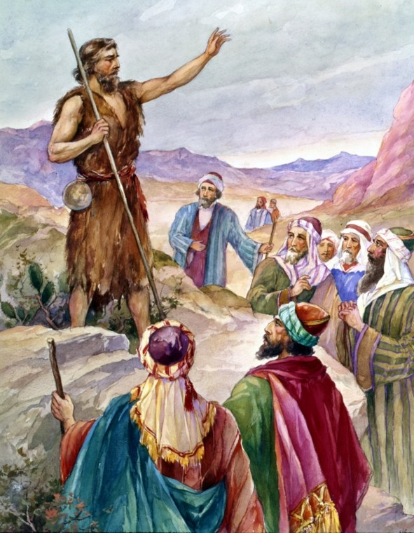
Reference to John the Baptist’s Problem
Like the Saviour's disciples, John the Baptist did not understand the nature of Christ's kingdom. He expected Jesus to take the throne of David; and as time passed, and the Saviour made no claim to kingly authority, John became perplexed and troubled. He had declared to the people that in order for the way to be prepared before the Lord, the prophecy of Isaiah must be fulfilled; the mountains and hills must be brought low, the crooked made straight, and the rough places plain. He had looked for the high places of human pride and power to be cast down. He had pointed to the Messiah as the One whose fan was in His hand, and who would thoroughly purge His floor, who would gather the wheat into His garner, and burn up the chaff with unquenchable fire. Like the prophet Elijah, in whose spirit and power he had come to Israel, he looked for the Lord to reveal Himself as a God that answereth by fire. {DA 215.2}
John’s problem was that he did not understand the nature of Christ nor His kingdom.

Slide 27
Reference to Judas’ Rejection of Christ Kingdom
The disciples knew nothing of the purpose of Judas. Jesus alone could read his secret. Yet He did not expose him. Jesus hungered for his soul. . . . His heart was crying, How can I give thee up? The constraining power of that love was felt by Judas. When the Saviour's hands were bathing those soiled feet, and wiping them with the towel, the heart of Judas thrilled through and through with the impulse then and there to confess his sin. But he would not humble himself. He hardened his heart against repentance; and the old impulses, for the moment put aside, again controlled him. Judas was now offended at Christ's act in washing the feet of His disciples. If Jesus could so humble Himself, he thought, He could not be Israel's king. All hope of worldly honor in a temporal kingdom was destroyed. Judas was satisfied that there was nothing to be gained by following Christ. . . . He was possessed by a demon, and he resolved to complete the work he had agreed to do in betraying his Lord. {CC 319.2}
Judas was offended when Christ demonstrated in the foot washing the nature of His kingdom.

Slide 28
Beginning of Modern Israel
SL
Harvest
Priest
11/9
2019
1989
9/11
2014
1.Church
2021
‘91
‘96
2009
2012
2016
2018
2020
AD27
Pentecost
“Work”
Ancient Israel
Ministry of Jn. Bapt.
-4BC
(Baptized)
1st TC
Age 12
Wilderness
Cana
BO Christ
BO Jn. Bapt.
2A
Christ Ministry begins
40
Modern Israel
4/19
1844
7/21
1844
10/22
1844
1798
*Internal
1863
William
Miller
Tarrying time
8/11
1840
*External
4/19/1844—1st Disappointment
(Miller’s prediction in 1843, Tested, Tarrying time begins.)
8/11/1844— (Litch’s Prediction 1838 Fall of Ottoman Empire or be restrained.)
This work of reformation in the beginning of modern Israel began in 1798. This is the work of WM. He represents the 1st angel. He gives a message. It’s an increase of knowledge; It is formalized; and then it’s tested (at the 9/11 waymark).

Slide 29
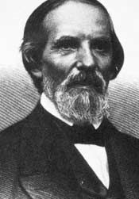
Beginning of Modern Israel Cont’
SL
Harvest
Priest
11/9
2019
1989
9/11
2014
1.Church
2021
‘91
‘96
2009
2012
J
P
2016
2018
2020
J
C
AD27
Pentecost
“Work”
Ancient Israel
Ministry of Jn. Bapt.
-4BC
(Baptized)
1st TC
Age 12
Wilderness
Cana
BO Christ
BO Jn. Bapt.
2A
Christ Ministry begins
40
Modern Israel
Tarrying time begins
M
s
1818
1833
8/1
1844
8/12
1844
1798
4/19
1844
7/21
1844
10/22
1844
1863
8/11
1840
What takes them out of the tarrying time?
There is a relative nobody who starts studying the autumn feasts. His name is Samuel Snow. And he starts to write about His studies sharing his understanding that Christ would come in the history of October. He writes them down known as the Samuel Snow’s letters before the Boston camp meeting where the midnight cry 1st begins. He writes about them in his letters.

Slide 30
Beginning of Modern Israel Cont’
SL
Harvest
Priest
9/11
2014
11/9
2019
1.Church
2021
2009
2012
J
P
2016
2018
2020
M
s
Modern Israel
4/19
1844
10/22
1844
1863
7/21
1844
8/1
1844
8/12
1844
8/11
1840
Midnight Cry Message
B
C
e
TEST
2. E. Parminder began to have controversy with this Movement, with the leadership in 2012. But, he already introduced time-setting; and it was rejected .
Boston
Concord
Exeter
1. You have Samuel Snow speaking before the midnight cry begins to swell, which we line up at 2014, which is the beginning of the swelling of the LC.
Samuel snow spoke before Boston. The leadership was already either rejecting or ignoring him.
But here, we mark Boston and it is going to swell to Concord and then finally to Exeter, which is their MC. All before their shut door of Oct 22, 1844.

Slide 31
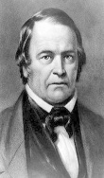
Beginning of Modern Israel Cont’
SL
Harvest
1989
9/11
2014
11/9
2019
1.Church
2021
Priest
‘91
‘96
2009
2012
J
P
2016
2018
2020
M
s
Modern Israel
4/19
1844
10/22
1844
1863
1798
7/21
1844
1818
1833
8/1
1844
8/12
1844
8/11
1840
Midnight Cry Message
B
C
e
TEST
Boston
Concord
Exeter
This is all one group of people. One group called and trained under Miller, who tarry, listen to Samuel Snow, and are there for the swelling of the MC, and face the shut door. That’s one group. You don’t find a second group in that history. So this all relates to the 1st- 10 virgins, just as the disciples.

Slide 32
Change of Leadership
Change of Leadership
So where is the change of leadership?
Is it safe for people to be following William Miller in the history of Aug to Oct.? No.
SL
Harvest
Priest
9/11
2014
11/9
2019
1.Church
2021
2009
2012
J
P
2016
2018
2020
Modern Israel
M
s
4/19
1844
10/22
1844
1863
7/21
1844
8/1
1844
8/12
1844
8/11
1840
Midnight Cry Message
B
C
e
TEST
Boston
Concord
Exeter
There is a change of leadership to Miller to Snow. Then the 2nd Angel speaks. Then the people are tested. And this is all just one group. All lining up with our shut door.
So the cross in its primary application is Nov. 9th 2019. That symbol enough explains so much of our experience. October 22nd is that 1st shut door. It also explains much of our experience. But we must acknowledge that it is a history of failure.

Slide 33
A Shut Door Experience
We also know that in 1850 they are taking their message to the world. So can Oct 22 be Dan 12:1 on their reform line? No, it can’t be.
Oct 22 Lines up with Nov 9, 2019. We have identified Oct 22 to be a shut door experience.
10/22
1844
1850
After Dan 12:1, you do not take the gospel message to the world. It’s all done by then. So, Oct 22 cannot be the final shut door for their history.
11/9
2019
We must identify that there is a fractal in their history. That you have two groups.
There is a difference between an alpha and omega history. In an alpha history, you do not have three groups, you can only identify two. That is one of the few structural differences between an alpha history and an omega history.

Slide 34
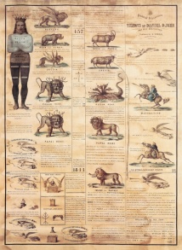
A Shut Door Experience Cont’
There is a shut door in Oct 22, but in 1850 they print the 1850 chart and take the gospel to the world.
10/22
1844
The beginning of the civil war—the judgment of God. I would suggest you start seeing the activities of the plagues.
1850
1861
J. T. T.
Gospel to the world.
11/9
2019
These reform lines—at each point in so many ways—shows us that what FFA is teaching and their chosen teachers is utter foolishness.
So this shut door is a fractal. It is the first group of people and it lines up with Oct 22.
We can see here that they are doing a work for the world with the 1850 chart.

Slide 35
Intercession Doesn’t Stop at Nov 9, 2019
For Example …
10/22
1844
FFA teaches that Nov 9, 2019 Christ stood up and stopped intercession for that first group. If you are going to apply that at Nov 9, 2019, you have to apply it to them. So lets start lining up our pioneers: James and Ellen White, Joseph Bates, Smith, etc. All of these people face their shut door.
To be consistent, we would have to teach that their probation closed here and intercession stopped. And we hope that Ellen White never did another wrong thing in her life. That In the next 70 years of her life, she never once asked God’s forgiveness because she couldn’t; because from this day forward, when you have shut door and it’s a hard close of probation, there is no intercession. So our pioneers never required God’s forgiveness after Oct 22. Can you see the problem? FFA teaches that this Nov 9, 2019 is a hard close of probation—the ceasing of all intercession.
Oct 22 is Nov 9. 2019.
11/9
2019

Slide 36
Intercession Doesn’t Stop at Nov 9, 2019 Cont’
For Example …
10/22
1844
Both Oct 22 & Nov 9, 2019 is a shut door for the 1st group. Both relate to a fractal. If you are going to say that Nov. 9. 2019 is a hard close of probation, then Oct 22, 1844 must also be a hard close of probation for the first group.
If we believe this, then all our pioneers had no intercessor from Oct 22 to the day they died. For Ellen White that would be 71 years where she never once had any sin. Not just her, but every single pioneer that went through that history.
Oct 22 is Nov 9. 2019.
11/9
2019
Their argument is not defendable on a reform line, which is why reform lines keep us safe.

Slide 37
Rejection of Prophesy
Test
11/9
2019
In Early Writings page 260, paragraph 1, Ellen White talks about the Protestants rejection of the prophesies. And, she lines up that Protestant rejection up to Oct 22 and the crucifixion of Christ. She is going to compare and contrast the rejection of Christ with particularly the 2300 days. So she’ll say the rejection of Christ—the crucifixion—is equal to rejecting the 2300 days and the time prophesies. She says, paraphrasing, “As the Jews crucified Jesus, so the protestant churches crucified the Millerite message. They claimed to love Jesus, but Jesus decided He would test them. If you don’t think you would crucify me, lets see how you respond to the 2,300 day prophecy. They are equal. ”
10/22
1844

Slide 38
Rejection of Prophesy Cont’
Many look with horror at the course of the Jews in rejecting and crucifying Christ; and as they read the history of His shameful abuse, they think they love Him, and would not have denied Him as did Peter, or crucified Him as did the Jews. But God who reads the hearts of all, has brought to the test that love for Jesus which they professed to feel. All heaven watched with the deepest interest the reception of the first angel's message. But many who professed to love Jesus, and who shed tears as they read the story of the cross, derided the good news of His coming. Instead of receiving the message with gladness, they declared it to be a delusion. They hated those who loved His appearing and shut them out of the churches. Those who rejected the first message could not be benefited by the second; neither were they benefited by the midnight cry, which was to prepare them to enter with Jesus by faith into the most holy place of the heavenly sanctuary. And by rejecting the two former messages, they have so darkened their understanding that they can see no light in the third angel's message, which shows the way into the most holy place. I saw that as the Jews crucified Jesus, so the nominal churches had crucified these messages, and therefore they have no knowledge of the way into the most holy, and they cannot be benefited by the intercession of Jesus there. Like the Jews, who offered their useless sacrifices, they offer up their useless prayers to the apartment which Jesus has left; and Satan, pleased with the deception, assumes a religious character, and leads the minds of these professed Christians to himself, working with his power, his signs and lying wonders, to fasten them in his snare. Some he deceives in one way, and some in another. He has different delusions prepared to affect different minds. Some look with horror upon one deception, while they readily receive another. Satan deceives some with Spiritualism. He also comes as an angel of light and spreads his influence over the land by means of false reformations. The churches are elated, and consider that God is working marvelously for them, when it is the work of another spirit. The excitement will die away and leave the world and the church in a worse condition than before. {EW 260.1}

Slide 39
A Word of Counsel
People today struggle with the message, particularly what Elder Tess teaches, because they suggest there is not enough of Jesus in it. To make the point, lots of people claim to love Christ; claim to trust Him; claim that they would not have crucified Him. I would suggest that for thousands of years, whether you want to look at the 1260, the persecutions, the crusades, the American South, go through 6,000 years and see how many awful actions: murder, abuse, genocide have been done in the name of God. That’s the reason there are so many Atheist today. So many people who hate God is because they see what people have done in the name of God.
It’s easy to say that we wouldn’t crucify Him. That we would love Him. But when we don’t know what He looks like, we make Him in our own image. So, for instance, the American South thinks God is this white man. They make Him this western white person. That does not agree with history. We make God into our own image when we do not accept His nature, His character.
We can say we love God all we like. He will test us to see if we know Him. He tested them with the 2300 days. And people could argue where is Christ in the 2300 day prophecy. The answer is if you knew what God looked like, you would see Him. But you don’t know what He looks like.

Slide 40
A Word of Counsel Cont’
That (2,300 day) prophesy lines up with the crucifixion and lines with the test of equality. It equals rejecting equality. And people argue where is Jesus in these prophesies; where is Jesus in the message of equality; in race and gender. I would give the same answer. If you knew what He looked like, you wouldn’t ask that question. But our problem is we claim to love Him as did one church for 1260 years, but we don’t know what He looks like; so He tests us. Do we know Him? When we see what He is like, can we still love Him? Or when He comes in a form we cannot recognize like He did for the Jews, for the Protestants, like He did for FFA; can we still love Him? Or do we say, “This is not the Christ I expected.” Can we not recognize His character? There is no point claiming to love someone when all we are loving is the reflection of ourselves that we have placed upon Him. When we make Him in our own image, that is called loving our self, not loving God because He doesn’t look like what He thought He looked like. He gives us a revelation of His character. And, that tests whether or not we love His character.

