Slide 1
REVOLUATIONS, GOOD ADVICE
TESS LAMBERT
2 – 7 - 2020

Slide 2
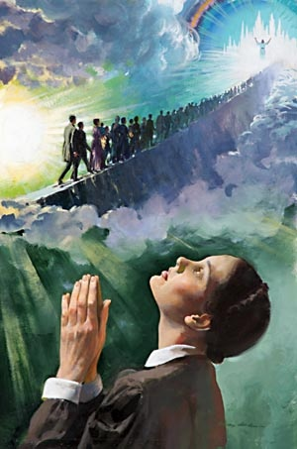
Just to remind us what we were doing over the last days we went through that dream of Ellen White which takes us through a reform line. We overlaid it with our own reform line as priests. This small group that's cut out of this larger group, this stone out of this mountain, and then tracing their journey along this narrowing path

Slide 3
The journey gets more and more difficult. At 9:11 we see cords to send; in these cords is what they must hold onto for balance and security. But still they have earth beneath their feet. They must systematically let go of all of the baggage that they tried to bring with them, all the way down to their shoes and their stockings

Slide 4
As they go barefoot their feet start to bleed. Towards the later rain Sunday Law time period that path starts to hurt. Ellen White speaks about seeing the blood of those who have gone before the blood from their feet and yet still they made it.

Slide 5
Then we come to the chasm, this chasm is marking Gethsemane, the cross, the beginning of the time of trouble, they have all of a sudden this question; what are these cords attached?

Slide 6
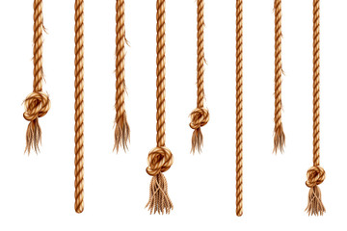
For the previous dispensation in the history of the ladder rain there is just enthusiasm, they shout we have hold from above they don't need to question what those cords are attached to.

Slide 7
But now in the time of trouble when they must let go of all of the pathway, when they must wrap their arms around those cords and trust only in those cords now comes the question. But what are the cords attached to? So we've been trying to review the cords that we were given just a few of them

Slide 8
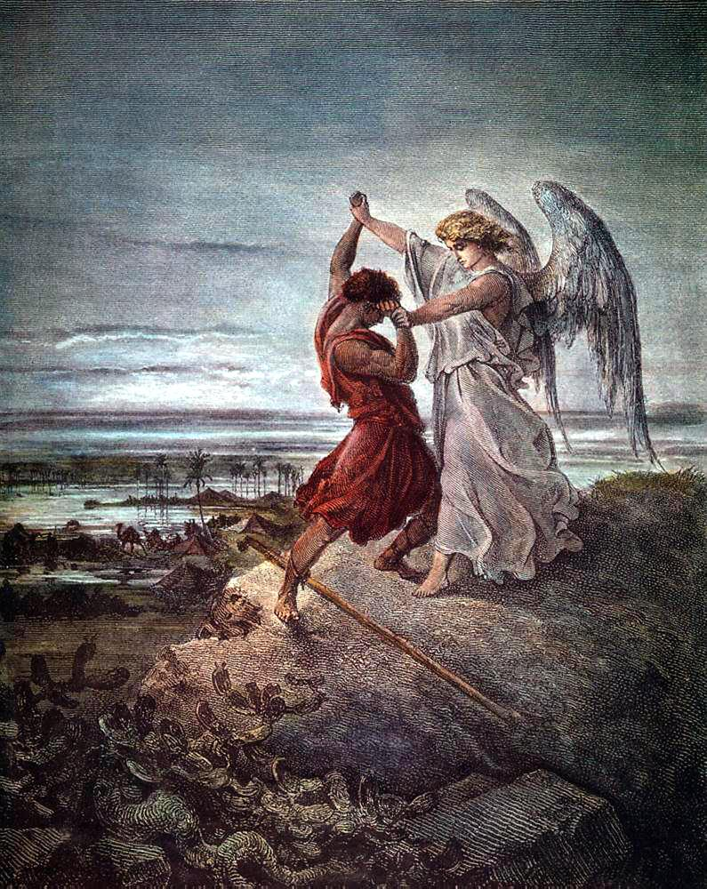
We know we are in Jacobs’ time of trouble. Elder Parmender has spoken extensively about Jacobs’s time of trouble in the previous months, why does Jacob hurt?

Slide 9
Because he is fighting the angel he, has held on to the same sin that he had before and because he's held on to that sin and his angel has come to convince him of that he sees this angel as an enemy and that had began the fight.

Slide 10
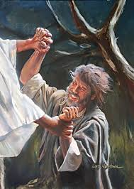
It’s the fact that he is fighting against the angel that makes this his time of trouble. He should not have been fighting against the work of the angel.

Slide 11
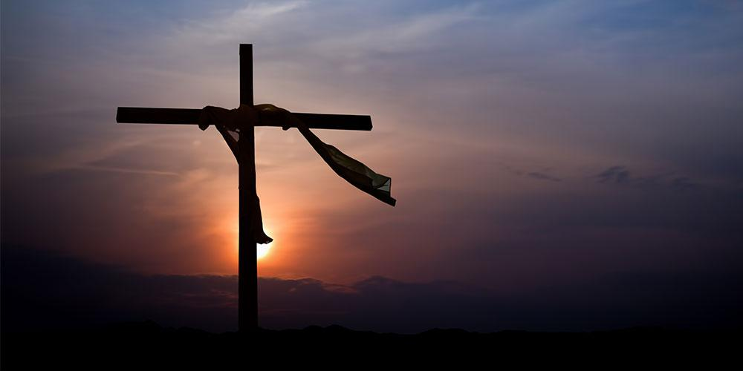
That lines up with the experience of the disciples after the cross still holding on to the sin that they were meant to have put away.

Slide 12
Then we placed the two dispensations that we are in from that history in the time in the 40 days after the cross and the 40 days after the baptism. Those 40 days tell the experience of this movement from the close of probation to that increase of knowledge, from 2019 close of probation to when we receive the increase of knowledge. We reminded ourselves of acts 20:7

Slide 13
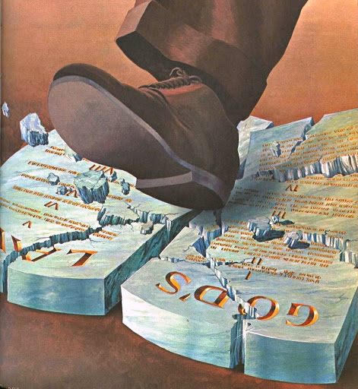
We are still in the history when the Sunday law is opening up. It is far from completed.

Slide 14
ToE
SL
COP
2A
-4
27
34
70
100
End A I
Birth
Baptism
Stoning of Stephen
Destruction of Jerusalem
Patmos
Beginning M I
1798
1840
1850
1861
1863
Then we began to look at one of the lines the chief line we take from Millerite history. We are after October 22, 1844. So I want to finish this discussion on revolutions and then I want us to look at our key reform lines, end of ancient Israel beginning of modern Israel.

Slide 15
Revolution
Counter Revolution
9/11
2014
2019
2020
2021
Beginning
Turning point
end
Beginning
So we've been discussing revolutions, we showed how we came to the study of revolutions. This study gave us this pattern a revolution from 911 to 2019 with a midpoint in 2014 where you see one side begin to have victory over the other it's a turning point. November 9 2019 marks the end of that revolution 2020 marks the beginning of the counter revolution against the dictatorship established by this revolution.

Slide 16
Revolution
Counter Revolution
9/11
2014
2019
2020
2021
Beginning
Turning point
end
Beginning
The establishment of the United States is overthrown through a revolution from 911 to 2019. In 2020 counter revolution begins against this new leadership.

Slide 17
Revolution
Counter Revolution
9/11
2014
2019
2020
2021
Beginning
Turning point
end
Beginning
The establishment of the United States is overthrown through a revolution from 911 to 2019. In 2020 counter revolution begins against this new leadership.
We discussed why 9/11 would mark the beginning of a revolution. It's this political polarization that has occurred within the United States, this divide between Democrats and Republicans but particularly centered on the beginning of the Iraq war.

Slide 18
We referenced a number of articles and a YouTube video and we discussed that and I will just read one sentence from that as revision.
The degree of bachelorization over Iraq and with the role of partisan media outlets like Fox News in driving it may have marked the dawn of a new normal.

Slide 19
So over the centuries polarization occurs but usually after there's a tense issue that they can come back to some type of agreement. There can be some semblances of normal.

Slide 20
What happened with the rise of the 24-hour cable news network’s? Beyond Fox just that system in general was a sensationalizing of news that turned it from something that was to educate us into something that was more to entertain us it made news to be sensational.

Slide 21
So it's the whole package the whole system of how news is spread now that has done that but Fox News has been something special, they have taken that sensationalism that 24-hour news cycle that is entertainment and turned it into something that is a propaganda machine for the right-wing particularly Protestant Christian white nationalistic right-wing of the United States.

Slide 22
Once that happened it was the dawn of a new normal. You cannot come back to a place of agreement with the other side. This flick can only continue to grow. This occurred from 9/11 through the Bush administration particularly enhanced by the Iraq war. A turning point occurred in 2014 where one side of this equation began to win and we mentioned three things that happened in 2014; it was the beginning of the work begun by Jeff Sessions, Steve Bannon, and Stephen Miller to purge the Republican Party from the inside.

Slide 23
Mitch McConnell started to block Obama's appointments to the judicial branch this was a taking over of that branch of the US government by right-wing conservatives, and three I wanted us to have marked this Supreme Court case Burwell versus Hobby Lobby which led according to Americans United for separation of church and state it opened a door that could lead to a dangerous Bri interpretation of the meaning of religious freedom. It was part of that opening door and it has done that.

Slide 24
Revolution
Counter Revolution
9/11
2014
2019
2020
2021
Beginning
Turning point
end
Beginning
Raphia
So leaving behind 9/11, 2014 as a turning point, 2019 end of the revolution, we discussed what November 9 was. When we look at the lines that built up that day we stepped back and considered Raphia. I have for many months now asked people to question why they call that way mark Raffia.

Slide 25
It's as if that name Raphia has its Trump's every other name you might call that way mark. It just is Raphia and I wanted us to question that because Raphia is one single aspect of a more complex way mark. I wanted us to question how we look at way marks. Why do we say 1989, 9/11 why do we go from years today when it suits us and then from days back to years when that suits us. We have been not precise in how we have handled way marks and that's part of the confusion over 2019.

Slide 26
So the last year we reinforced the point, watch the external events occurring throughout the year. They particularly started in earnest in March. March being the overthrow of the Isis Caliphate. March being Venezuela, Russian troops in Venezuela. There was this particular intensity that escalated in March that took us through the whole of 2019 in a similar way to what happened in 2014. But then there is also how we describe it as Raphia that can be misleading if we're not precise with our terms.

Slide 27
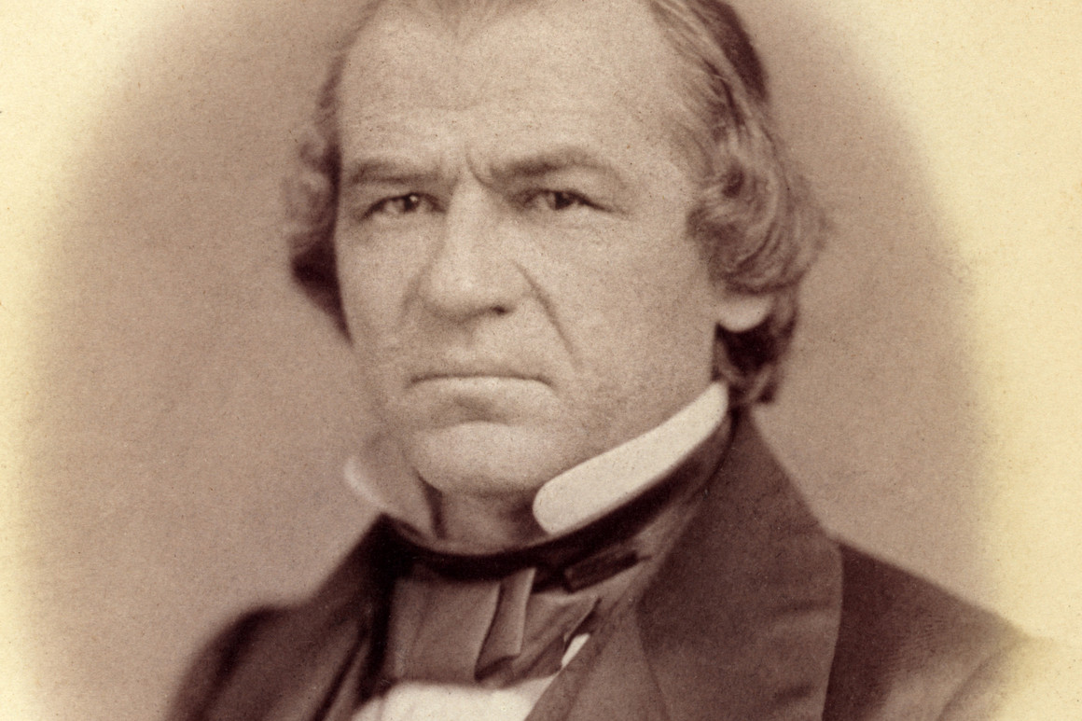
So November 9 this date did not come to by the study of time span that took us to 2019. For example impeachment, impeachment never takes us to November 9 it only takes us to the year 2019. In 1868 Andrew Johnson is impeached, it‘s a process throughout 1868. He does not get impeached on November 9.

Slide 28
WW
Front
Eastern = Russia V US
1-2
Western = US V West US V US
So when we make application of that Donald Trump was never expected to be impeached on November 9. What did take us to the day was this study on revolutions. This study on revolutions we discussed is what front in World War 3? World War l and World War ll have tw0 fronts Eastern front Russia versus the United States, Western Front United States versus the West, United States versus the United States.

Slide 29
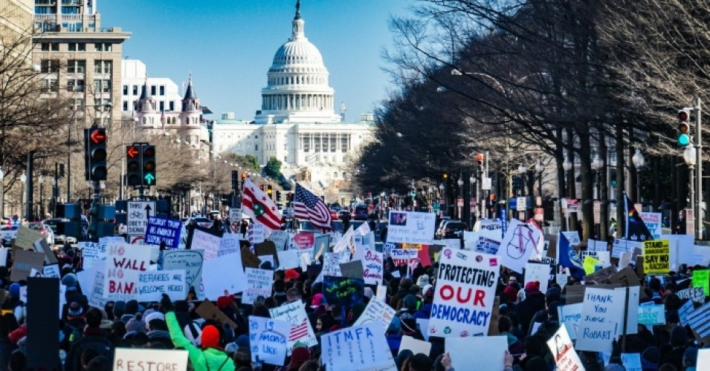
We all agreed as far as those who are willing to participate in the comments that the study of revolutions is internal, it is civil war which is United States against United States, and it’s a Western Front.

Slide 30
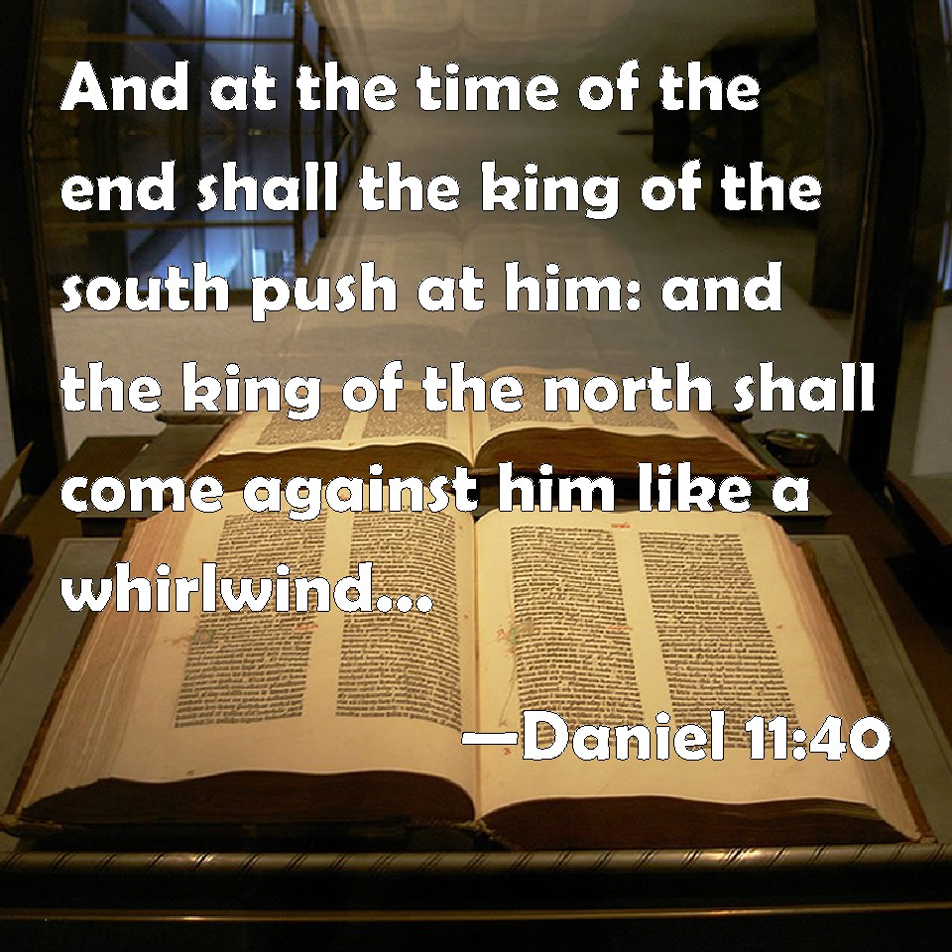
Once we had all agreed it was Western Front we went back to November 9 1989 and we reminded ourselves how that is described in Daniel 11 verse 40;

Slide 31
WW
Front
Eastern = Russia V US
1-2
Western = US V West US V US
This is a battle in 1989 between the Soviet Union the King of the South and the United States which is Eastern Front. But then we discussed why you would describe 1989 that way. The reason that the Soviet Union fell was because of internal civil unrest. It was civil war from the inside you didn't see the United States. But one of the reasons you have unrest on the inside is because of the work of the United States.

Slide 32
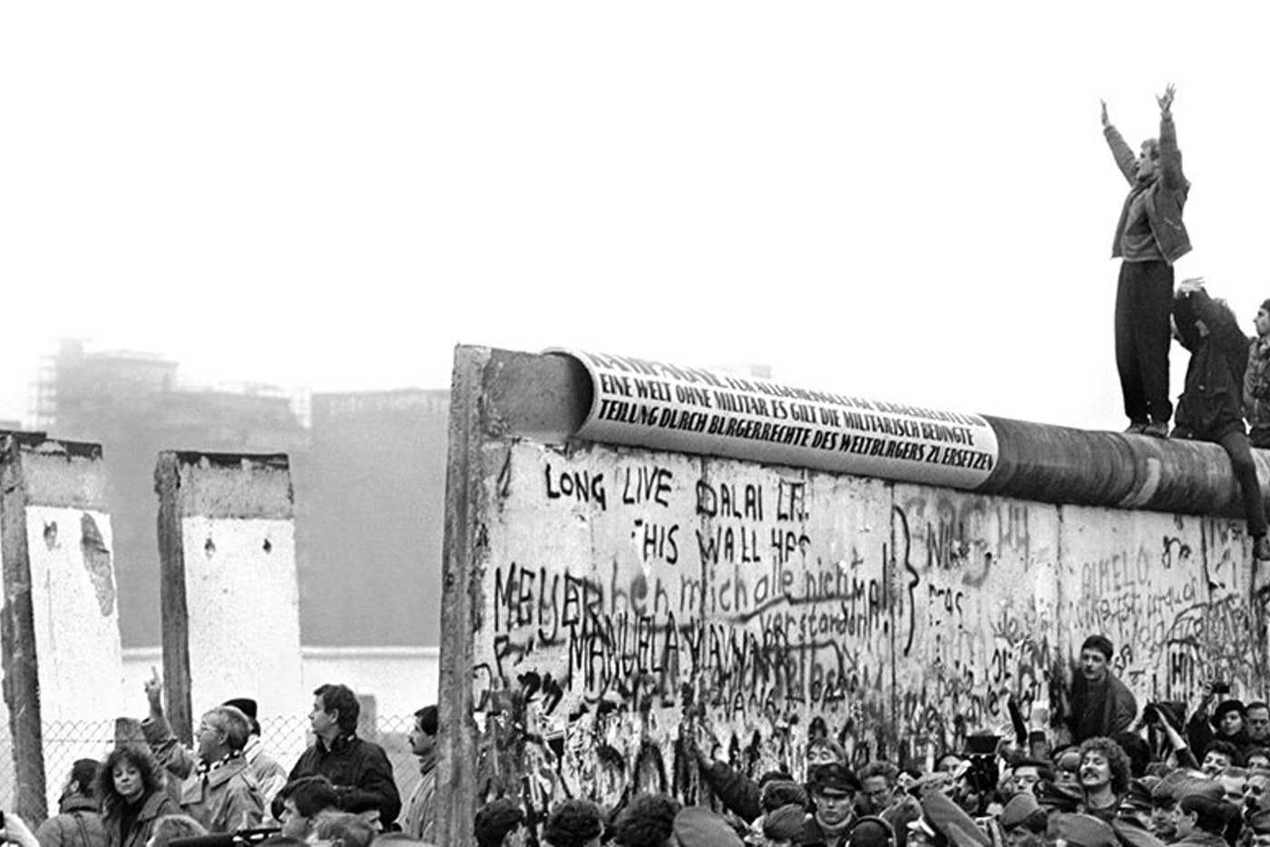
So even this unrest that led to the fall of the Berlin Wall was the result of the actions of the King of the North.

Slide 33
So this civil war this internal struggle can still be described as Eastern Front. It was really brought on by this conflict between the two superpowers.
So this civil war this internal struggle can still be described as Eastern Front. It was really brought on by this conflict between the two superpowers.

Slide 34
So when we come to November 9 is it Eastern Front or is it Western? It's both, it's Eastern because who sparked the civil unrest? Russia its Western because all you're going to see is internal issues inside America relating to America. There is a strong connection between what happened in 1989 and what Vladimir Putin did in South America.

Slide 35
You'll remember we discussed Libya. Libya before 2011 it was a sphere of influence of Russia. Gaddafi was a Russian puppet if I can put it so black and white. When the CIA had him overthrown and killed Vladimir Putin lost his sphere of influence that happens in 2011.

Slide 36
You'll remember we discussed Libya. Libya before 2011 it was a sphere of influence of Russia. Gaddafi was a Russian puppet if I can put it so black and white. When the CIA had him overthrown and killed Vladimir Putin lost his sphere of influence that happens in 2011.
In 2011 he watches Arab Spring rise. Arab Spring is hitting many of the countries that are also in his sphere of influence. It started hitting Syria for example, and then you have what is also called the snow revolutions. In 2011 Vladimir Putin announces he's making a return as president and tens of thousands of Russian people take to the streets in protest.

Slide 37
So you have all of these events in 2011 that make Vladimir Putin very angry against the United States, and what does he decide to do? He is going to do to the United States the exact same thing he believes the United States did to the Soviet Union and is doing to him. The United States conducts regime change from the inside. The United States sends in the CIA and overthrows rulers from the inside. He believes the United States was behind the protests in his own country. He believes that they were behind what happened in Ukraine through those years.

Slide 38
So his response from 2011 to 2014 is to set up Russia. Over a few years he sets up the Internet Research Agency and begins building up recruiting people to start doing to America what he believed America did to him at the end of the Cold War. He physically watched the fall of the Soviet Union. So he's going to do to America what America did to him, interfere from the inside. Looking at 1989 he blamed the United States.

Slide 39
He knew that that civil unrest was a result of the Cold War and he's taken those tactics and that is what he has done against the United States in the last eight or nine years. So these two dates that is what’s happening in America. What happens inside the Soviet Union in 1989 also has a direct link. But the Battle of Raphia itself was not something internal that happened in in the Seleucus Empire or the Ptolemaic Empire it wasn't civil unrest in those countries, it was a fight over coele Syria that middle strategic piece of land that they were fighting over.

Slide 40
So when we talk about Raphia and we're waiting for November 9th or Raffia that's where we would start to get into trouble. Raffia was a fight over spheres of influence. It's not limited to one territory like it was when the world was small.

Slide 41
So when we talk about Raphia and we're waiting for November 9th or Raffia that's where we would start to get into trouble. Raffia was a fight over spheres of influence. It's not limited to one territory like it was when the world was small.
Ptolemy and Seleucus were never going to fight over Venezuela but I don't know how it exists. Now this battle is worldwide and we discussed yesterday this Raphia this fight over spheres of influence. You have Libya, Yemen, Syria, Venezuela and there are others like Ukraine those are some of the key ones that we discussed and when we looked at just why they are so strategically important.

Slide 42
Revolution
Counter Revolution
9/11
2014
2019
2020
2021
Beginning
Turning point
end
Beginning
Panium
So some people have asked about this date the end of the counter-revolution. So I'm going to take us back to the Western Front, if this is part of that story it's discussing this Western Front .When does the Western Front end? In World War II. The Western Front ends at the same point that the Eastern Front does, and when does the Eastern front end? It ends in 2021 at Panium.

Slide 43
Revolution
Counter Revolution
9/11
2014
2019
2020
2021
Beginning
Turning point
end
Beginning
Panium
It is an ending but remember this is a deadly wound. The conflict continues all the way to the Sunday law, but the deadly wound is struck there. So there will not be so suddenly an end of polarization and end of all of these issues, but it is the deadly wound that pathway is set in concrete.

Slide 44
So then well do this fast 2020 where we are now the counter-revolution. This is why I wanted to us to study these revolutions is to bring us back to 2020. So I'm not sure how we view 1991, I'm not sure if we believe that increase of knowledge in 1991 happened on the exact same day that the Soviet Union crumbled. I would suggest that it did not. I'm not sure how much people are aware of the external events of 2009 that way mark of Concord. Whether or not they believed those events happened on the exact same day as Parmender was presenting the 2520 Series in Arkansas. I would suggest that they did not.

Slide 45
Nov 8-9
2014
2016
2018
2019
B
C
E
Oct 22
One that I can speak about more clearly is 2016. 2016 is Concord and you can mark it by a day it's the victory of Donald Trump in that election in the Sunday Law history. When was Concord just a reminder Boston, concord, Exeter, October 22. This way mark of Concord the external event. What's the external event in 2016? It's November 8 and 9, 2016 that election.

Slide 46
Nov 8-9
2014
2016
2018
2019
B
C
E
Oct 22
So did Acts 20:7 open up on November 8 and November 9? No, there isn't a day-to-day correlation between a sudden opening up of that message and the external event but it happened in that time period, it happened in the later months of 2016.

Slide 47
So what I want to mark is that internal increase of knowledge when it becomes visible either to an individual or to the movement. The movement doesn't know until two years later just to remind us. But it actually doesn't become visible to anyone on the same day, what happens is something that occurs within that time frame in the history of Concord externally you have an increase of knowledge. So when it comes to 2020 and we have our increase of knowledge this is a time period internally, but it's also a day externally.

Slide 48
Revolution
Counter Revolution
9/11
2014
2019
2020
2021
Beginning
Turning point
end
Beginning
Panium
American Revolution
Civil war
Lexington
Concord
What I want to briefly discuss is the day. It's easy to see that November 8 and 9, 2016 marked Concord. What were we expecting to see in 2020? One more revolution that we haven't particularly discussed and that is the American Revolution, and what is 2020 in American Revolution? It's the Battle of Concord and Lexington.

Slide 49
Revolution
Counter Revolution
9/11
2014
2019
2020
2021
Beginning
Turning point
end
Beginning
Panium
American Revolution
Civil war
Lexington
Concord
So we know that this way mark is Concord and we marked the beginning of the American Revolution here. What had been occurring was a growing dissatisfaction in the United States back to their British dictators if you could say it that way.

Slide 50
Revolution
Counter Revolution
9/11
2014
2019
2020
2021
Beginning
Turning point
end
Beginning
Panium
American Revolution
Civil war
Lexington
Concord
So just to take us back a step there are two revolutions in American history, they don't take us over the whole of this period. This is the American Civil War this is the American Revolution, combine the two and you have our line of revolutions.

Slide 51
Revolution
Counter Revolution
9/11
2014
2019
2020
2021
Beginning
Turning point
end
Beginning
Panium
American Revolution
Civil war
Lexington
Concord
2020 marks the Battle of Lexington and Concord and the beginning of the American Revolution. There had been discontent growing before but what happens at the Battle of Concord and Lexington? There is a shot fired it's called the shot that was heard around the world, there had been other shots fired this wasn't just one shot that came suddenly there were other shots that had been fired previously.

Slide 52
5/25/20
George Floyd
There was these other issues, other closures but something happened in this battle that was particularly severe that particularly shocks the people to where they were now ready to unite and Concord and fight against the British. I want to suggest that we have already seen that external way mark in our own history, it's May 25, what happened May 25 that was heard worldwide that United a group of people already dissatisfied, who had already heard other shots fired who are now ready to fight against the dictatorship?

Slide 53
So death of George Floyd those words I can't breathe they went worldwide, it was the shot heard around the world. The impeachment of Donald Trump did not even unify the Democrats let alone go worldwide. A few people in other cities held up protests signs saying impeach the president. Even the Democrats themselves were split about whether or not to impeach him.

Slide 54
5/25/20
George Floyd
They voted to impeach him once it came to that but this was not the unifying force that this way mark described to us in 2018. What was described to us in 2018 was that something would happen that would unify a group of people into a movement to fight against Donald Trump. After all the things that has been said and done over the last three and a half years of his presidency this was the event that unified worldwide against him.

Slide 55
Concord
5/25/20
George Floyd
I want to suggest that Concord externally, Concord meaning to unite is May 25. If that's external what should we begin to expect in turn? We're reaching the end of that 40 day period, we're reaching the end of the wilderness experience and that comes with implications. So I want to go back to that wilderness experience and make sure we all fully understand what that is on a reform line, what that is in application.

Slide 56
So before going into a subject and a discussion of that wilderness time period of the two forty day histories. I want to speak about another subject that I've been facing questions, a lot of questions about in the last month particularly from around the time the school in Uganda. So Elder Parminder taught some things in that school; in everything I say I agree fully with what he taught.

Slide 57
Please don't think there is error between Parminder and myself. I'm describing another way how I view that subject of what he taught and what he taught is good advice. I have questions frequently about this from people and it's phrased in such a way as I want to do this thing am I not allowed to do it or is that just good advice and I can if I want to.

Slide 58
So that becomes the way many questions are phrased at this point in time since those studies were done and like the subject of liberalism, conservativism, freedom, and religious liberty those arguments get not maliciously, but in whatever way they get twisted.

Slide 59
So I want to discuss good advice, this is the way good advice works. I want people to take themselves out of their own shoes, now you're not a member of this movement now you're a US Navy Seal. So you're a US Navy Seal you have a commander up above you, you have a lieutenant tasked with organizing. You're about to go on a mission, you're told before this mission begins how many of you are going to make it through.

Slide 60
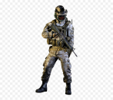
You're a US Navy Seal you're going on a mission how many are going to survive about one in six. I have 30 on the board, so about one in six of you will survive this mission.

Slide 61
You're sitting with your comrades the men that you've trained with this whole time, you look around the room you know that one in six of you are going to make it but five in your row of seating are going to die on that battlefield. The lieutenant says the commander gave you some good advice. Do you think you would take the good advice? Do you think you would stop to question it?

Slide 62
When you go into battle would you say that's his opinion I don't need his experience, I do not need his good advice. This is the way people are using good advice in the movement. The commander is God, he sees all he knows all we can't get wiser. The commander is God he tells the lieutenant I've given good advice to these people, I know its good advice because I'm God. Tell them to follow this good advice when they're going into this battle. You know five out of six of those people of your comrades are going to die. Are you going to take the good advice? Yes, the only reason you would not take the good advice is if you believe it is in fact bad advice.

Slide 63
So I want to deal with that first directly. It's a straw man argument to say its good advice but I don't need to take it. Because what people are doing is not just saying its good advice for others but it’s not good advice for me. What they're doing is saying it's not good advice for me it isn't to you either or for you also whats she doing following good advice.

Slide 64
If they genuinely believed it was good advice and they knew that there was a five out of six chance the person sitting next to them was going to die on that battlefield they would turn to them and said I might not follow it but I sure hope that you do. The only reason you wouldn't support your comrades in following that good advice is if you believed in your heart it was not good advice.

Slide 65
So we need to stop using good advice as an excuse. Just be open about it. Say this is not good advice this is bad advice. So if we genuinely believed this is good advice and we realized that who gave us this good advice was not mortal but God. When we realized and we looked at Millerite history at every history at the stone cut out of the mountain at the portion of the crowd that begin the pathway at the people that drop off every time that pathway gets harder we would not handle good advice lightly.

Slide 66
We would see the need to take it ourselves and even if we decided that we didn't want to follow God's good advice, if we believed it was good advice we would not turn to our comrade on the likelihood that they're not going to survive the great controversy final conflict and encourage them to do their own thing their own way and go against the good advice.

Slide 67
Good advice = life or death
So when someone asks me must I obey or is that just good advice and I can do what I want. My response to that is its good advice but its life and death. We need to treat good advice as life and death. If you're on a battlefield where there's a 5 out of 6 chance you're going to die. Then you know that every good advice from your commander who trained you is life and death.

Slide 68
I hope one feels that that parable is overdramatizing what this movement is in danger of. I am being more than generous to suggest that one out of five people who start this journey make it I'm being more than generous to suggest that this is just a mortal death. Beyond that what is the Navy Seals fighting for? For their own freedom, for their own protection. If they don't make it the enemy wins. If the enemy takes one of them down and blunts that attack who suffers? The people that they're designed to protect.

Slide 69
The priests come with a job description go to the church and to the world our failures impact them. When we fail people are lost because of us not only does our example how we behave, how we treat good advice impacts our own chance of salvation, it impacts those around us that we influence, our colleagues and it has a flow-on effect to the people that we could have saved but won't because we left this movement over good advice.

Slide 70
The lieutenant what's his position he's just stuck in the middle can he stand in front of them and say the commander told me to give you this good advice but I think you should do what you want. No he has to say the commander told me to.

Slide 71
Gods good advice = life and death
This commander is God, the lieutenant is the organization the leaders of this movement. There is a vast degree of difference between God and between the leaders of this movement but we are still stuck in the middle, we're still trapped saying the commander said if you don't want to do it that's your choice but it's life and death.

Slide 72
Gods good advice = life and death
We can say that when people will at least admit that it is good advice but people are not going that far. Sister Rockwell said not one in twenty as I said and when I say one in five I am being very generous. We don't realize the danger of the battle we are in and the lives that are lost because of us. So good advice is life and death.

Slide 73
But at the very least what we are asked to sign up to when we join this movement is at the very least that advice is good and what people are doing when they use the argument of good advice is to suggest that it is not actually good advice at all that it came from the commander as bad advice.

Slide 74
Dipensationalism
Freedom
Natural - Spiritual
Liberalism
So what are people's arguments against the vows of reform because that the argument cannot be good advice. The arguments usually used to undermine those vows are the following; Dispensationalism that becomes an easy word to throw out it becomes a major topic of this movement because of what occurred last year when it came to equality, racial equality, and gender equality, nationalism, and sexism. The concept of freedom the concept of literal to spiritual and this is what it means to be a liberal.

Slide 75
Adornment
Diet Entertainment Sabbath
Vows <
So I want to deal with some of these vows and I want to deal with them as they should be from the very beginning with appropriate methodology. So what are these vows? We have vows that relate to adornment and jewelry the vows that relates to diet, vows that relate to entertainment. We also have a vow that relates to the Sabbath going to put that in as well.

Slide 76
1a
ToE
1989
E. Jeff
I want us to start looking at a couple of these subjects with appropriate methodology. But before doing that I want to remind us how this movement began. 1989 the arrival of the first angel in human form for us, Elder Jeff pippenger. How conservative is he? He's very conservative both socially and morally conservative

Slide 77
So why would God choose a conservative? If the point that we are brought to is a point of freedom and liberalism why does God always choose for conservative? Why Elder Jeff? I’m going to remind us of the line that we drew for equality. He has to deal gently with his church, no that was not gentle for a liberal it's gentle for a conservative with as many of liberal people who would have found Elder Jeff incredibly harsh. Why not deal gently with the Liberals and hard with the Conservatives at the beginning? Because we wouldn't have joined a liberal movement.

Slide 78
Liberals could have joined a liberal movement from the beginning .You could have had someone like Ida Meyers; by the way Ida Meyers is not the latter rain for the Levites I just want to put that out there I won't go into proving it but he is bad news. We could have had a liberal at the very beginning and it could have formed a liberal movement because he's dealing with a conservative Church he's dealing with the church that is split.

Slide 79
I want to tell you why he had to choose a conservative. How do conservative study the Bible and Ellen White? Conservatives believe in a spirit of prophecy that's why he had to choose a conservative because even though they might miss read the words, they believe in the words that they read. What does a liberal do to the spirit of prophecy?

Slide 80
So when you have the subject of trousers when a conservative reads that what do they do? Literal to literal no proper methodology they read the words they believe them, they apply them. Can God work with that? Yes he can show them how they're reading those words incorrectly; he can show them that they need to read about dress reform and trousers in a correct fashion following systematic rules and methodology.

Slide 81
When a liberal reads Ellen White and she says we cannot wear trousers what does a liberal do to that? Why do liberals wear trousers? It's not because they understand methodology they do not it's because they simply do not care. Can God work with someone who just doesn't care? No! God cannot work with those who are willing to ignore inspiration and instructions. He can't work with those who are willing to ignore good advice and call it bad advice.

Slide 82
He's trapped working with the conservatives because even though they can read incorrectly they still read and they still believe that those words are the inspired Word of God. A liberal who does not read at all, a liberal who does not believe the inspired Word of God a liberal who believes that they can do what is right in their own eyes God could not work with them and he cannot work with them now.

Slide 83
Eden
Curse
Eden
Removing
The line of equality; It takes us from Eden where there is perfect equality. There is a curse and what comes in suffering? What does the God have to take us back to? Eden, Equality it's the removing of this curse.

Slide 84
Eden
Curse
Eden
Diet
Removing
Vegan
I wanted to move from that subject of equality and turn this into the diet. Now I want to discuss veganism. This is one of the vows it's one of the moral reforms make it into a line and what happened? This was taught in Uganda and its been taught since.

Slide 85
Eden
Curse
Eden
Diet
Removing
Vegan
So many of you may be familiar with it. How did our diet begin? vegan And then what happened Ellen White says that meat eating was a curse and what came in was an incredible amount of suffering. What has to happen now? That curse has to be removed before the new earth or after? Before.

Slide 86
Eden
Curse
Eden
Diet
Removing
Vegan
Vegan
So you have this removal of suffering now, it's not about nationality it's not about sexism, now it's about the animal life we were designed to rule and protect and care for. Now that suffering must be removed because Gods people cannot participate in it and in the final generation. What are they expected to be? Vegan.

Slide 87
Eden
Curse
Eden
Diet
Removing
Vegan
Vegan
So when a conservative is vegan why are they vegan? Because they read the words, they read them literally. Ellen White says don't they say we won't, when a liberal is not vegan why are they not vegan? They have all the words is it because they're applying some type of methodology we don't know about? It's because they don't fundamentally care what God has said that's the issue with liberalism.

Slide 88
Eden
Curse
Eden
Diet
Removing
Vegan
Vegan
It's the fact that they will do what is right in their own eyes. So conservatives however often they may miss read not always somehow that the reason that their not Vegan is because they fundamentally do not care. Did it somehow go from literal veganism to spiritual veganism?

Slide 89
Eden
Curse
Eden
Diet
Removing
Vegan
Vegan
EW
Let me remind you Ellen White is here you had only about 150 years you've had thousands of years between the garden and Ellen White and did the diet somehow go from literal to spiritual in those four thousand five thousand years and then between Ellen White and us it went from literal of spiritual. Equality between men and women was it true here literal introduction of patriarchal leadership that somehow turn into spiritual patriarchal leadership here?

Slide 90
Eden
Curse
Eden
Diet
Removing
Vegan
Vegan
EW
No it's sexism, sexism patriarchy, patriarchy, veganism, veganism. How that diet looks like on a plate we may have different foods depends on what country you're from, depends what has been grown through that time period.

Slide 91
Eden
Curse
Eden
Diet
Removing
Vegan
Vegan
EW
The way the patriarchy might look is different from country to country it may look slightly different to what it did back then but the system the message has not gone from literal to spiritual. It has been an eternal principle.

Slide 92
Eden
Curse
Eden
Diet
Removing
Vegan
Vegan
EW
So that is just one reform vow that you can put on a line and see where studies and liberals come to different understandings and why. God can work with a conservative that he can teach how to read properly. God could never work with a liberal who simply doesn't care what the words say.

