Slide 1
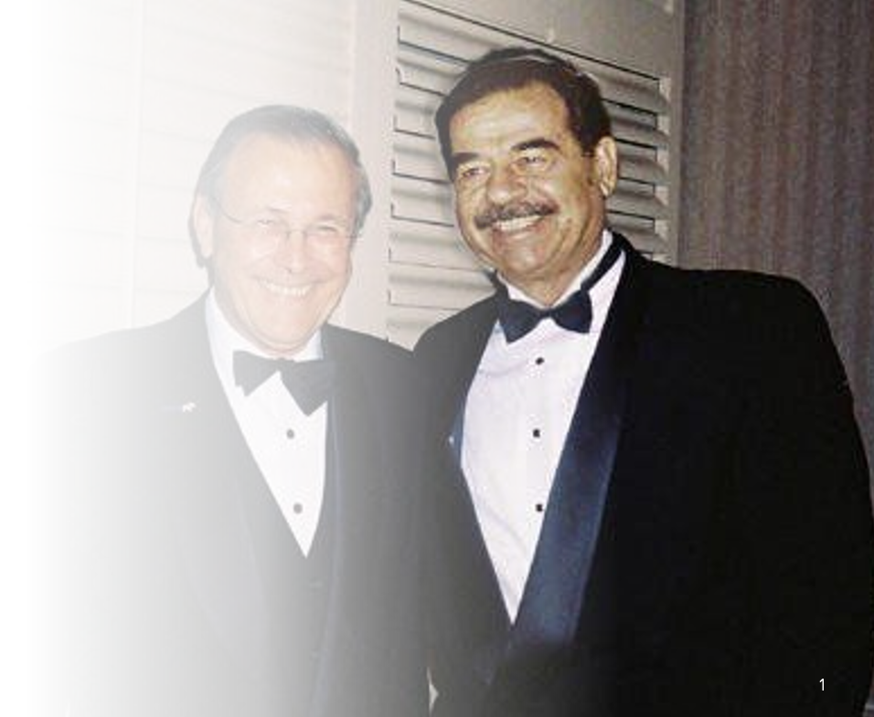
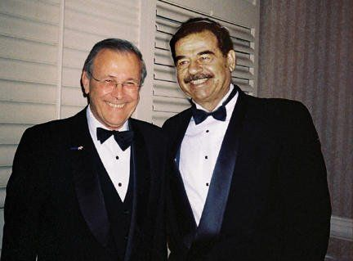
Saddam Hussein and the USA
Saddam Key in Early CIA Plot
By Richard Sale
United Press International April 10, 2003

Slide 2
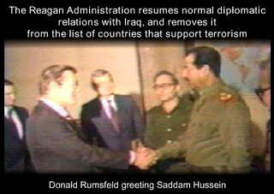
Saddam Hussein and the USA
U.S. forces in Baghdad might now be searching high and low for Iraqi dictator Saddam Hussein, but in the past Saddam was seen by U.S. intelligence services as a bulwark of anti-communism and they used him as their instrument for more than 40 years, according to former U.S. intelligence diplomats and intelligence officials.
Picture: Donald Rumsfeld, then special US envoy, shaking hands with Saddam Hussein during a visit to Iraq in December, 1983.
United Press International has interviewed almost a dozen former U.S. diplomats, British scholars and former U.S. intelligence officials to piece together the following account. The CIA declined to comment on the report.

Slide 3
US intelligence helped Saddam's Ba`ath Party seize power for the first time in 1963. Evidence suggests that Saddam was on the CIA payroll as early as 1959, when he participated in a failed assassination attempt against Iraqi strongman Abd al-Karim Qassem. In the 1980s, the US and Britain backed Saddam in the war against Iran, giving Iraq arms, money, satellite intelligence, and even chemical & bio-weapon precursors. As many as 90 US military advisors supported Iraqi forces and helped pick targets for Iraqi air and missile attacks.
Baʽathism calls for unification of the Arab world into a single state. Its motto, "Unity, Liberty, Socialism", refers to Arab unity, and freedom from non-Arab control and interference.
Ba'athist Iraq, formally the Iraqi Republic, covers the history of Iraq between 1968 and 2003, during the period of the Arab Socialist Ba'ath Party's rule. This period began with high economic growth and soaring prosperity, but ended with Iraq facing social, political, and economic stagnation. The average annual income decreased both because of external factors and the internal policies of the government.
Iraqi President Abdul Rahman Arif, and Iraqi Prime Minister Tahir Yahya, were ousted during the 17 July coup d'état led by Ahmed Hassan al-Bakr of the Ba'ath Party, which had previously held power in 1963 and was led primarily by al-Bakr, its leader, and Saddam Hussein.^{[2]} Saddam through his post as de facto chief of the party's intelligence services, became the country's de facto leader by the mid-1970s, and became de jure leader in 1979 when he succeeded al-Bakr in office as President. During al-Bakr's de jure rule, the country's economy grew, and Iraq's standing within the Arab world increased. However, several internal factors were threatening the country's stability, among them the country's conflict with Iran and factions within Iraq's own Shia Muslim community. An external problem was a border dispute with Iran.

Slide 4
Saddam Hussein and the USA
Saddam became the President of Iraq, Chairman of the Revolutionary Command Council, Prime Minister and General Secretary of the Regional Command of the Ba'ath Party in 1979, during a wave of anti-government protests in Iraq led by Shias. The Ba'ath Party, which was officially secular in nature, harshly repressed the protests. Another policy change was Iraq's foreign policy towards Iran, a Shia country. Deteriorating relations eventually led to the Iran–Iraq War, which started in 1980 when Iraq launched a full-scale invasion of Iran. Following the 1979 Iranian Revolution, the Iraqis believed the Iranians to be militarily weak, and thus an easy target for their military. This notion proved to be incorrect, and the war lasted for eight years. The economy of Iraq deteriorated during the war, and the country became dependent on foreign loans to fund its war effort. The war ended in a stalemate when a ceasefire was reached in 1988, which resulted in a status quo ante bellum.
When the war ended, Iraq found itself in the midst of an economic depression, owed millions of dollars to foreign countries, and was unable to repay its creditors. Kuwait, which had deliberately increased oil output following the war, reducing international oil prices, further weakened the Iraqi economy. In response to this, Saddam threatened Kuwait that, unless it reduced its oil output, Iraq would invade. Negotiations broke down, and on 2 August 1990, Iraq launched an invasion of Kuwait. The resulting international response led to the Persian Gulf War, which Iraq lost. The United Nations (UN) initiated economic sanctions in the war's aftermath to weaken the Ba'athist Iraqi regime. The country's economic conditions worsened during the 1990s, and at the turn of the 21st century, Iraq's economy started to grow again as several states ignored the UN's sanctions. In the aftermath of the September 11 attacks of 2001, the United States proclaimed a War on Terror and labelled Iraq as part of an "Axis of Evil". In 2003, a US-led coalition forces invaded Iraq, and the Ba'athist Iraqi regime was deposed less than a month later.

Slide 5
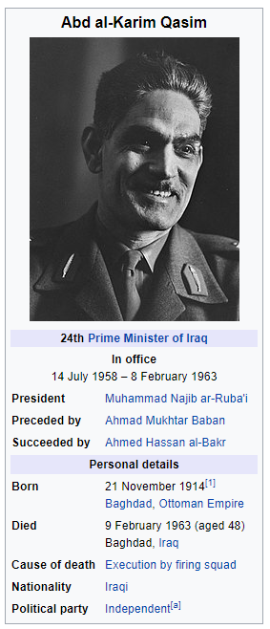
Saddam Hussein and the USA
While many have thought that Saddam first became involved with U.S. intelligence agencies at the start of the September 1980 Iran-Iraq war, his first contacts with U.S. officials date back to 1959, when he was part of a CIA-authorized six-man squad tasked with assassinating then Iraqi Prime Minister Gen. Abd al-Karim Qasim.
In July 1958, Qasim had overthrown the Iraqi monarchy in what one former U.S. diplomat, who asked not to be identified, described as "a horrible orgy of bloodshed."
According to current and former U.S. officials, who spoke on condition of anonymity, Iraq was then regarded as a key buffer and strategic asset in the Cold War with the Soviet Union. For example, in the mid-1950s, Iraq was quick to join the anti-Soviet Baghdad Pact which was to defend the region and whose members included Turkey, Britain, Iran and Pakistan.

Slide 6
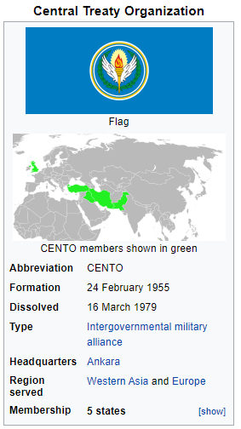
Saddam Hussein and the USA
anti-Soviet Baghdad Pact
https://en.wikipedia.org/wiki/Baghdad_Pact
The Central Treaty Organization (CENTO), originally known as the Baghdad Pact or the Middle East Treaty Organization (METO), was a military alliance of the Cold War. It was formed in 1955 by Iran, Iraq, Pakistan, Turkey and the United Kingdom and dissolved in 1979.
US pressure and promises of military and economic aid were key in the negotiations leading to the agreement, but the United States could not initially participate. John Foster Dulles, who was involved in the negotiations as U.S. Secretary of State under President Dwight D. Eisenhower, claimed that was due to "the pro-Israel lobby and the difficulty of obtaining Congressional Approval."^{[1]} Others said that the reason was "for purely technical reasons of budgeting procedures."^{[2]}
In 1958, the US joined the military committee of the alliance. It is generally viewed as one of the least successful of the Cold War alliances.^{[3]}
The organization's headquarters were in Baghdad, Iraq, in 1955 to 1958 and in Ankara, Turkey, in 1958 to 1979. Cyprus was also an important location for CENTO because of its location in the Middle East and the British Sovereign Base Areas on the island.^{[4]}

Slide 7
Saddam Hussein and the USA
anti-Soviet Baghdad Pact
https://en.wikipedia.org/wiki/Baghdad_Pact
Modeled after the North Atlantic Treaty Organization (NATO), CENTO committed the nations to mutual cooperation and protection, as well as non-intervention in each other's affairs. Its goal was to contain the Soviet Union (USSR) by having a line of strong states along the USSR's southwestern frontier. Similarly, it was known as the 'Northern Tier' to prevent Soviet expansion into the Middle East.^{[5]} Unlike NATO, CENTO did not have a unified military command structure, nor were many U.S. or UK military bases established in member countries, although the U.S. had communications and electronic intelligence facilities in Iran, and operated U-2 intelligence flights over the USSR from bases in Pakistan. The United Kingdom had access to facilities in Pakistan and Iraq at various times while the treaty was in effect.
On July 14, 1958, the Iraqi monarchy was overthrown in a military coup. The new government was led by General Abdul Karim Qasim who withdrew Iraq from the Baghdad Pact, opened diplomatic relations with Soviet Union and adopted a non-aligned stance. The organization dropped the name 'Baghdad Pact' in favor of 'CENTO' at that time.
The Middle East and South Asia became extremely volatile areas during the 1960s with the ongoing Arab–Israeli Conflict and the Indo-Pakistani Wars. CENTO was unwilling to get deeply involved in either dispute. In 1965 and 1971, Pakistan tried unsuccessfully to get assistance in its wars with India through CENTO, but this was rejected under the idea that CENTO was aimed at containing the USSR, not India.

Slide 8
Saddam Hussein and the USA
anti-Soviet Baghdad Pact
https://en.wikipedia.org/wiki/Baghdad_Pact
CENTO did little to prevent the expansion of Soviet influence to non-member states in the area. Whatever containment value the pact might have had was lost when the Soviets 'leap-frogged' the member states, establishing close military and political relationships with governments in Egypt, Syria, Iraq, the People's Democratic Republic of Yemen, Somalia, and Libya. By 1970, the USSR had deployed over 20,000 troops to Egypt, and had established naval bases in Syria, Somalia, and P.D.R. Yemen.
The Iranian revolution spelled the end of the organization in 1979, but in reality, it essentially had been finished since 1974, when Turkey invaded Cyprus. This led the United Kingdom to withdraw forces that had been earmarked to the alliance,^{[citation needed]} and the United States Congress halted Turkish military aid despite two Presidential vetoes.^{[5]} With the fall of the Iranian monarchy, whatever remaining rationale for the organization was lost. Future U.S. and British defense agreements with regional countries—such as Pakistan, Egypt, and the Persian Gulf states—were conducted bilaterally.
https://2001-2009.state.gov/r/pa/ho/time/lw/98683.htm

Slide 9
Qasim soon withdrew Iraq from the pro-Western Baghdad Pact and established friendly relations with the Soviet Union. Iraq also abolished its treaty of mutual security and bilateral relations with the UK. Iraq also withdrew from the agreement with the United States that was signed by the monarchy during 1954 and 1955 regarding military, arms, and equipment. On 30 May 1959, the last of the British soldiers and military officers departed the al-Habbāniyya base in Iraq.
https://en.wikipedia.org/wiki/Abd_al-Karim_Qasim#:~:text=Abd%20al%2DKarim%20Qasim%20Muhammad,during%20the%2014%20July%20Revolution.
Little attention was paid to Qasim's bloody and conspiratorial regime until his sudden decision to withdraw from the pact in 1959, an act that "freaked everybody out" according to a former senior U.S. State Department official.
Washington watched in marked dismay as Qasim began to buy arms from the Soviet Union and put his own domestic communists into ministry positions of "real power," according to this official. The domestic instability of the country prompted CIA Director Allan Dulles to say publicly that Iraq was "the most dangerous spot in the world."
In the mid-1980s, Miles Copeland, a veteran CIA operative, told UPI the CIA had enjoyed "close ties" with [the] . . . ruling Baath Party, just as it had close connections with the intelligence service of Egyptian leader Gamel Abd Nassar. In a recent public statement, Roger Morris, a former National Security Council staffer in the 1970s, confirmed this claim, saying that the CIA had chosen the authoritarian and anti-communist Baath Party "as its instrument."

Slide 10
Saddam Hussein and the USA
According to another former senior State Department official, Saddam, while only in his early 20s, became a part of a U.S. plot to get rid of Qasim. According to this source, Saddam was installed in an apartment in Baghdad on al-Rashid Street directly opposite Qasim's office in Iraq's Ministry of Defense, to observe Qasim's movements.
Adel Darwish, Middle East expert and author of "Unholy Babylon," said the move was done "with full knowledge of the CIA," and that Saddam's CIA handler was an Iraqi dentist working for CIA and Egyptian intelligence. U.S. officials separately confirmed Darwish's account.
Darwish said that Saddam's paymaster was Capt. Abdel Maquid Farid, the assistant military attaché at the Egyptian Embassy who paid for the apartment from his own personal account. Three former senior U.S. officials have confirmed that this is accurate.

Slide 11
Saddam Hussein and the USA
The assassination was set for Oct. 7, 1959, but it was completely botched. Accounts differ. One former CIA official said that the 22-year-old Saddam lost his nerve and began firing too soon, killing Qasim's driver and only wounding Qasim in the shoulder and arm. Darwish told UPI that one of the assassins had bullets that did not fit his gun and that another had a hand grenade that got stuck in the lining of his coat.
"It bordered on farce," a former senior U.S. intelligence official said. But Qasim, hiding on the floor of his car, escaped death, and Saddam, whose calf had been grazed by a fellow would-be assassin, escaped to Tikrit, thanks to CIA and Egyptian intelligence agents, several U.S. government officials said.
Saddam then crossed into Syria and was transferred by Egyptian intelligence agents to Beirut, according to Darwish and former senior CIA officials. While Saddam was in Beirut, the CIA paid for Saddam's apartment and put him through a brief training course, former CIA officials said. The agency then helped him get to Cairo, they said.
One former U.S. government official, who knew Saddam at the time, said that even then Saddam "was known as having no class. He was a thug -- a cutthroat."

Slide 12
Saddam Hussein and the USA
In Cairo, Saddam was installed in an apartment in the upper class neighborhood of Dukki and spent his time playing dominos in the Indiana Café, watched over by CIA and Egyptian intelligence operatives, according to Darwish and former U.S. intelligence officials.
One former senior U.S. government official said: "In Cairo, I often went to Groppie Café at Emad Eldine Pasha Street, which was very posh, very upper class. Saddam would not have fit in there. The Indiana was your basic dive."
But during this time Saddam was making frequent visits to the American Embassy where CIA specialists such as Miles Copeland and CIA station chief Jim Eichelberger were in residence and knew Saddam, former U.S. intelligence officials said.
Saddam's U.S. handlers even pushed Saddam to get his Egyptian handlers to raise his monthly allowance, a gesture not appreciated by Egyptian officials since they knew of Saddam's American connection, according to Darwish. His assertion was confirmed by former U.S. diplomat in Egypt at the time.

Slide 13
Saddam Hussein and the USA
In February 1963 Qasim was killed in a Baath Party coup. Morris claimed recently that the CIA was behind the coup, which was sanctioned by President John F. Kennedy, but a former very senior CIA official strongly denied this.
"We were absolutely stunned. We had guys running around asking what the hell had happened," this official said.
But the agency quickly moved into action. Noting that the Baath Party was hunting down Iraq's communist, the CIA provided the submachine gun-toting Iraqi National Guardsmen with lists of suspected communists who were then jailed, interrogated, and summarily gunned down, according to former U.S. intelligence officials with intimate knowledge of the executions.
Many suspected communists were killed outright, these sources said. Darwish told UPI that the mass killings, presided over by Saddam, took place at Qasr al-Nehayat, literally, the Palace of the End.
A former senior U.S. State Department official told UPI: "We were frankly glad to be rid of them. You ask that they get a fair trial? You have to get kidding. This was serious business."

Slide 14
Saddam Hussein and the USA
A former senior CIA official said: "It was a bit like the mysterious killings of Iran's communists just after Ayatollah Khomeini came to power in 1979. All 4,000 of his communists suddenly got killed."
British scholar Con Coughlin, author of "Saddam: King of Terror," quotes Jim Critchfield, then a senior Middle East agency official, as saying the killing of Qasim and the communists was regarded "as a great victory." A former long-time covert U.S. intelligence operative and friend of Critchfield said: "Jim was an old Middle East hand. He wasn't sorry to see the communists go at all. Hey, we were playing for keeps."
Saddam, in the meantime, became head of al-Jihaz a-Khas, the secret intelligence apparatus of the Baath Party.

Slide 15
Saddam Hussein and the USA
The CIA/Defense Intelligence Agency relation with Saddam intensified after the start of the Iran-Iraq war in September of 1980. During the war, the CIA regularly sent a team to Saddam to deliver battlefield intelligence obtained from Saudi AWACS surveillance aircraft to aid the effectiveness of Iraq's armed forces, according to a former DIA official, part of a U.S. interagency intelligence group.
This former official said that he personally had signed off on a document that shared U.S. satellite intelligence with both Iraq and Iran in an attempt to produce a military stalemate. "When I signed it, I thought I was losing my mind," the former official told UPI.
A former CIA official said that Saddam had assigned a top team of three senior officers from the Estikhbarat, Iraq's military intelligence, to meet with the Americans.
According to Darwish, the CIA and DIA provided military assistance to Saddam's ferocious February 1988 assault on Iranian positions in the al-Fao peninsula by blinding Iranian radars for three days.
The Saddam-U.S. intelligence alliance of convenience came to an end at 2 a.m. Aug. 2, 1990, when 100,000 Iraqi troops, backed by 300 tanks, invaded its neighbor, Kuwait. America's one-time ally had become its bitterest enemy.

Slide 16
1959
1963
1979
Saddam Hussein invades Iran

