Slide 1
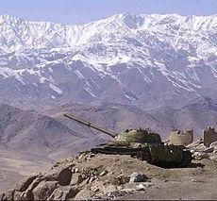
Soviet Afghan War
1979-1989
This Photo by Unknown Author is licensed under CC BY-SA

Slide 2
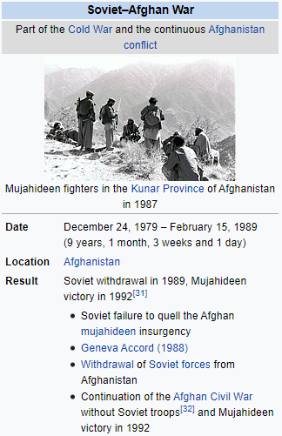
The Soviet–Afghan War was a conflict wherein insurgent groups (known collectively as the mujahideen) as well as smaller Maoist groups, fought a nine-year guerrilla war against the Soviet Army and the Democratic Republic of Afghanistan government throughout the 1980s, mostly in the Afghan countryside. The mujahideen were variously backed primarily by the United States, Pakistan, Iran, Saudi Arabia, China, and the United Kingdom; the conflict was a Cold War-era proxy war. Between 562,000^{[48]} and 2,000,000 civilians were killed and millions of Afghans fled the country as refugees,^{[49][50][52][53]} mostly to Pakistan and Iran.
The foundations of the conflict were laid by the Saur Revolution, a 1978 coup wherein Afghanistan's communist party took power, initiating a series of radical modernization and land reforms throughout the country. These reforms were deeply unpopular among the more traditional rural population and established power structures.^{[54]} The repressive nature of the "Democratic Republic",^{[55]} which vigorously suppressed opposition and executed thousands of political prisoners, led to the rise of anti-government armed groups; by April 1979, large parts of the country were in open rebellion.^{[56]} The communist party itself experienced deep internal rivalries between the Khalqists and Parchamites; in September 1979, President Nur Mohammad Taraki was assassinated under orders of the second-in-command, Hafizullah Amin, which soured relations with the Soviet Union. Eventually the Soviet government, under leader Leonid Brezhnev, decided to deploy the 40th Army on December 24, 1979.^{[57]} Arriving in the capital Kabul, they staged a coup (Operation Storm-333),^{[58]} killing president Amin and installing Soviet loyalist Babrak Karmal from the rival faction Parcham.^{[56]} The deployment had been variously called an "invasion" (by Western media and the rebels) or a legitimate supporting intervention (by the Soviet Union and the Afghan government)^{[59][60]} on the basis of the Brezhnev Doctrine.

Slide 3
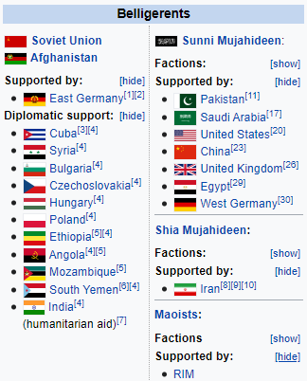
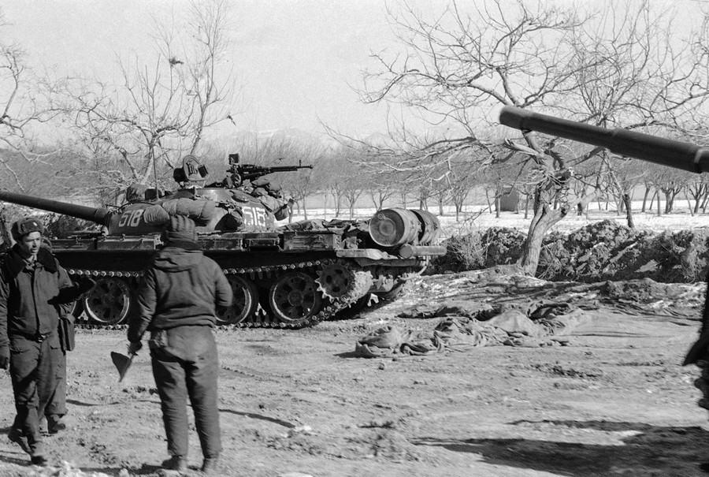
Soviet Afghan War
Dec. 24
1979
Feb.
1989
Feb.
1979
US Afghn. Ambassador
Kidnapped & killed
Soviet 40th Army arrives in Kabul, kills Amin, installs loyalist

Slide 4
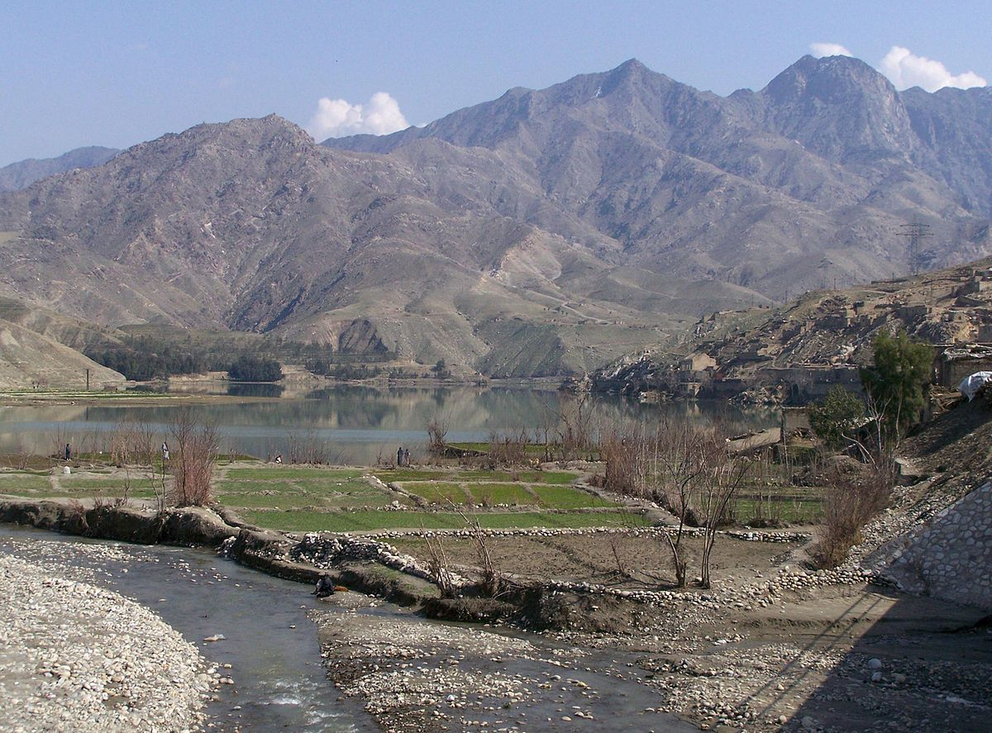
Dec. 24
1979
Jan. 1980
Feb.
1989
Soviet 40th Army arrives in Kabul, kills Amin, installs loyalist
OIC demand withdrawal of Soviet troops
In January 1980, foreign ministers from 34 nations of the Organisation of Islamic Cooperation adopted a resolution demanding "the immediate, urgent and unconditional withdrawal of Soviet troops" from Afghanistan.^{[61]} The UN General Assembly passed a resolution protesting the Soviet intervention by a vote of 104 (for) to 18 (against), with 18 abstentions and 12 members of the 152-nation Assembly absent or not participating in the vote;^{[61][62]} only Soviet allies Angola, East Germany and Vietnam, along with India, supported the intervention.^{[63]} Afghan insurgents began to receive massive amounts of support through aid, finance and military training in neighbouring Pakistan with significant help from the United States and United Kingdom.^{[64]} They were also heavily financed by China and the Gulf Cooperation Council countries.^{[65][18][66][67]} Soviet troops occupied the cities and main arteries of communication, while the mujahideen waged guerrilla war in small groups operating in the almost 80 percent of the country that was outside government and Soviet control, almost exclusively^{[68]} being the rugged, mountainous terrain of the countryside.^{[69][70]} The Soviets used their air power to deal harshly with both rebels and civilians, levelling villages to deny safe haven to the mujahideen, destroying vital irrigation ditches, and laying millions of land mines.^{[71][72][73][74]}
This Photo by Unknown Author is licensed under CC BY-SA

Slide 5
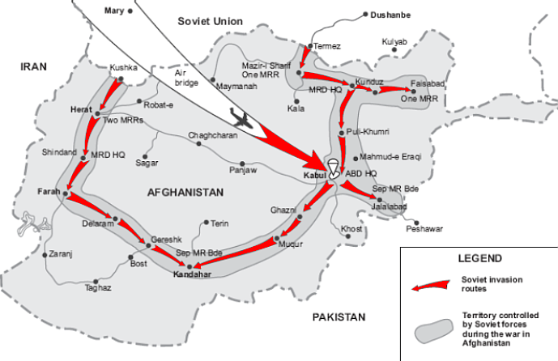
Dec. 24
1979
Jan. 1980
Feb.
1989
Soviet 40th Army arrives in Kabul, kills Amin, installs loyalist
OIC demand withdrawal of Soviet troops
The international community imposed numerous sanctions and embargoes against the Soviet Union, and the U.S. led a boycott of the 1980 Summer Olympics held in Moscow. The boycott and sanctions exacerbated Cold War tensions and enraged the Soviet government, which later led a revenge boycott of the 1984 Olympics held in Los Angeles.^{[75]} The Soviets initially planned to secure towns and roads, stabilize the government under new leader Karmal, and withdraw within six months or a year. But they were met with fierce resistance from the guerillas^{[76]} and had difficulties on the harsh cold Afghan terrain,^{[77]} resulting in them being stuck in a bloody war that lasted nine years.^{[78]} By the mid-1980s, the Soviet contingent was increased to 108,800 and fighting increased, but the military and diplomatic cost of the war to the USSR was high.^{[15]} By mid-1987 the Soviet Union, now under reformist leader Mikhail Gorbachev, announced it would start withdrawing its forces after meetings with the Afghan government.^{[9][10]} The final troop withdrawal started on May 15, 1988, and ended on February 15, 1989, leaving the government forces alone in the battle against the insurgents, which continued until 1992, when the former Soviet-backed government collapsed. Due to its length, it has sometimes been referred to as the "Soviet Union's Vietnam War" or the "Bear Trap" by the Western media.^{[79][80][81]} The Soviets' failure in the war^{[82]} is thought to be a contributing factor to the fall of the Soviet Union.^{[83]}

Slide 6
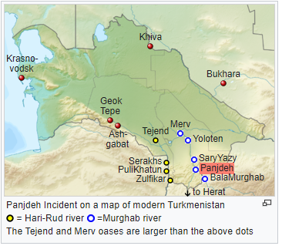
In 1885, Russian forces seized the disputed oasis at Panjdeh south of the Oxus River from Afghan forces, which became known as the Panjdeh Incident. The border was agreed by the joint Anglo-Russian Afghan Boundary Commission of 1885–87. The Russian interest in the region continued on through the Soviet era, with billions in economic and military aid sent to Afghanistan between 1955 and 1978.^{[85]}
In 1947, Prime Minister of Afghanistan, Mohammed Daoud Khan, had rejected the Durrand Line, which was accepted as international border by successive Afghan governments for over a half a century.^{[86]} The British Raj also came to an end and the British Crown colony of India was partitioned into the new nations of India and Pakistan, the latter which inherited the Durrand Line as its frontier with Afghanistan. Daoud Khan's irredentist foreign policy to reunite the Pashtun homeland caused much tension with Pakistan, a nation that allied itself with the United States. Daoud Khan's policy was fueled by his desire to unite his divided country. Daoud Khan started emulating policies of Emir Abdur Rahman Khan and for that he needed a popular cause (a Pashtun homeland) to unite the Afghan people divided along the tribal lines and a modern, well equipped Afghan army which would be used to surpass anyone who would oppose the Afghan government.^{[87]} Daoud Khan's policy to annex Pashtun areas of Pakistan had also angered Non-Pashtun population of Afghanistan.^{[88]} Similarly, Pashtun population in Pakistan were also not interested in having their areas being annexed by Afghanistan.^{[89]} In 1951, the United States's State Department urged Afghanistan to drop its claim against Pakistan and accept the Durrand Line.^{[90]}
The Panjdeh incident of 1885 was a diplomatic crisis between the British Empire and the Russian Empire caused by the Russian expansion south-eastwards towards the Emirate of Afghanistan and the British Raj (India). After nearly completing the Russian conquest of Central Asia (Russian Turkestan) the Russians captured an Afghan border fort. Seeing a threat to India, Britain came close to threatening war but both sides backed down and the matter was settled by diplomacy. The effect was to stop further Russian expansion in Asia, except for the Pamir Mountains and to define the north-western border of Afghanistan.

Slide 7
Dec. 24
1979
Jan. 1980
Feb.
1989
Apr. 27
1978
Feb.
1979
Treaty of Friendship
SU & Afghn
US Afghn. Ambassador
Kidnapped & killed
Soviet 40th Army arrives in Kabul, kills Amin, installs loyalist
OIC demand withdrawal of Soviet troops
In 1954, the United States began selling arms to Pakistan while refusing an Afghan request to buy arms out of the fear that the Afghans would use any weapons they had purchased against America's ally Pakistan.^{[90]} As a consequence, Afghanistan, though officially neutral in the Cold War, drew closer to India and the Soviet Union, which unlike the United States, was willing to sell Afghanistan weapons.^{[90]} In 1962, China defeated India in a border war, and as a result, China formed an alliance with Pakistan against their common enemy, India. The Sino-Pakistani alliance pushed Afghanistan even closer to India and the Soviet Union.
After the Saur Revolution in 1978, the Democratic Republic of Afghanistan was formed on April 27, 1978. The government was one with a pro-poor, pro-farmer socialist agenda. It had close relations with the Soviet Union. On December 5, 1978, a treaty of friendship was signed between the Soviet Union and Afghanistan.^{[91]}
In February 1979, the United States Ambassador to Afghanistan, Adolph Dubs, was kidnapped by Setami Milli militants and was later killed during an assault carried out by the Afghan police, assisted by Soviet advisers. Dubs' death led to a major deterioration in Afghanistan–United States relations.^{[92]}

Slide 8
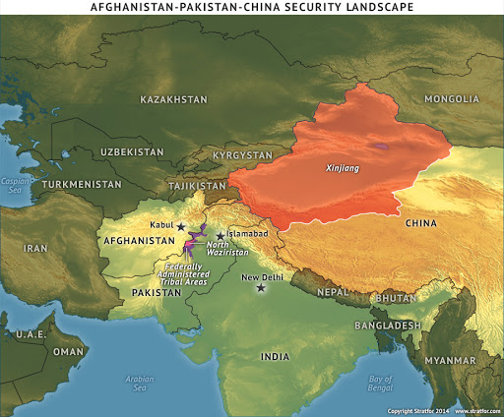

Slide 9
Dec. 24
1979
Jan. 1980
Feb.
1989
Apr. 27
1978
Feb.
1979
Treaty of Friendship
SU & Afghn
US Afghn. Ambassador
Kidnapped & killed/Iran. Revolution Shah ousted
Soviet 40th Army arrives in Kabul, kills Amin, installs loyalist
OIC demand withdrawal of Soviet troops
In Southwestern Asia, drastic changes were taking place concurrent with the upheavals in Afghanistan. In February 1979, the Iranian Revolution ousted the American-backed Shah from Iran, losing the United States as one of its most powerful allies.^{[93]} The United States then deployed twenty ships in the Persian Gulf and the Arabian Sea including two aircraft carriers, and there were constant threats of war between the U.S. and Iran.^{[94]} March 1979 marked the signing of the U.S.-backed peace agreement between Israel and Egypt. The Soviet leadership saw the agreement as giving a major advantage to the United States. A Soviet newspaper stated that Egypt and Israel were now "gendarmes of the Pentagon". The Soviets viewed the treaty not only as a peace agreement between their erstwhile allies in Egypt and the US-supported Israelis but also as a military pact.^{[95]} In addition, the US sold more than 5,000 missiles to Saudi Arabia. Also, the Soviet Union's previously strong relations with Iraq had recently soured. In June 1978, Iraq began entering into friendlier relations with the Western world and buying French and Italian-made weapons, though the vast majority still came from the Soviet Union, its Warsaw Pact allies, and China.

Slide 10
Dec. 24
1979
Jan. 1980
Feb.
1989
Apr. 27
1978
Feb.
1979
Treaty of Friendship
SU & Afghn
US Afghn. Ambassador
Kidnapped & killed/Iran. Revolution Shah ousted
Soviet 40th Army arrives in Kabul, kills Amin, installs loyalist
OIC demand withdrawal of Soviet troops
Saur Revolution
King Mohammed Zahir Shah ascended to the throne and reigned from 1933 to 1973. Zahir's cousin, Mohammad Daoud Khan, served as Prime Minister from 1954 to 1963. The Marxist People's Democratic Party of Afghanistan (PDPA)'s strength grew considerably in these years. In 1967, the PDPA split into two rival factions, the Khalq (Masses) faction headed by Nur Muhammad Taraki and Hafizullah Amin and the Parcham (Flag) faction led by Babrak Karmal.^{[96]} The leaders of the Khalq faction tended to be Pashtuns from a poorer background while the leaders of the Parcham faction were usually Farsi-speakers from the Tajik and Hazara ethnic groups who came from well-off backgrounds.^{[97]} Symbolic of the different backgrounds of the two factions were the fact that Taraki's father was a poor Pashtun herdsman while Karmal's father was a Tajik general in the Royal Afghan Army.^{[97]} More importantly, the radical Khalq faction believed in rapidly transforming Afghanistan by violence if necessary from a feudal nation into a Communist nation while the moderate Parcham faction favored a more gradualist and gentler approach, arguing that Afghanistan was simply not ready for Communism and would not be for some time.^{[98]} The Parcham faction favored building up the PDPA as a mass party in support of the Daoud Khan government while the Khalq faction were organized in the Leninist style as a small, tightly organized elite group, allowing the latter to enjoy ascendancy over the former.^{[99]}

Slide 11
Dec. 24
1979
Jan. 1980
Feb.
1989
Apr. 27
1978
Feb.
1979
Treaty of Friendship
SU & Afghn
US Afghn. Ambassador
Kidnapped & killed/Iran. Revolution Shah ousted
Soviet 40th Army arrives in Kabul, kills Amin, installs loyalist
OIC demand withdrawal of Soviet troops
Saur Revolution
Former Prime Minister Daoud seized power in a military coup on July 17, 1973 after allegations of corruption and poor economic conditions against the king's government. Daoud put an end to the monarchy, and his time in power was marked by unpopularity as the abolition of the monarchy was not widely approved of in a conservative society. Daoud Khan billed himself as a reformer, but few of his reforms were ever implemented and his rule grew more repressive as the 1970s went on.^{[100]} In 1975, both Pakistan and Saudi Arabia began to support Islamic fundamentalist groups committed to overthrowing the Daoud Khan regime and establishing an Islamist theocracy in its place.^{[101]}
Intense opposition from factions of the PDPA was sparked by the repression imposed on them by Daoud's regime and the death of a leading PDPA member, Mir Akbar Khyber.^{[102]} The mysterious circumstances of Khyber's death sparked massive anti-Daoud demonstrations in Kabul, which resulted in the arrest of several prominent PDPA leaders.^{[103]}
On April 27, 1978, the Afghan army, which had been sympathetic to the PDPA cause, overthrew and executed Daoud along with members of his family.^{[104]} The Finnish scholar Raimo Väyrynen wrote about the so-called "Saur Revolution": "There is a multitude of speculations on the real nature of this coup. The reality appears to be that it was inspired first of all by domestic economic and political concerns and that the Soviet Union did not play any role in the Saur Revolution".^{[101]} Nur Muhammad Taraki, Secretary General of the PDPA, became President of the Revolutionary Council and Prime Minister of the newly established Democratic Republic of Afghanistan.

Slide 12
Sept
1979
Dec. 24
1979
Jan. 1980
Feb.
1989
Apr. 27
1978
Feb.
1979
Treaty of Friendship
SU & Afghn
US Afghn. Ambassador
Kidnapped & killed/Iran. Revolution Shah ousted
Taraki killed, Amin takes over
Soviet 40th Army arrives in Kabul, kills Amin, installs loyalist
OIC demand withdrawal of Soviet troops
Factions inside the PDPA
After the revolution, Taraki assumed the Presidency, Prime Ministership and General Secretaryship of the PDPA. The government was divided along factional lines, with President Taraki and Deputy Prime Minister Hafizullah Amin of the Khalq faction pitted against Parcham leaders such as Babrak Karmal and Mohammad Najibullah.
Though the new regime promptly allied itself to the Soviet Union, many Soviet diplomats believed that the Khalqi plans to transform Afghanistan would provoke a rebellion in a deeply conservative and Muslim nation.^{[97]} Immediately after coming to power, the Khalqis began to persecute the Parchamis, not the least because the Soviet Union favored the Parchami faction whose "go slow" plans were felt to be better suited for Afghanistan, thereby leading the Khaqis to eliminate their rivals so the Soviets would have no other choice but to back them.^{[105]} Within the PDPA, conflicts resulted in exiles, purges and executions of Parcham members.^{[106]} The PDPA executed between 10,000 and 27,000 people, mostly at Pul-e-Charkhi prison prior to the Soviet intervention.^{[107][108][109]}
During its first 18 months of rule, the PDPA applied a Soviet-style program of modernizing reforms, many of which were viewed by conservatives as opposing Islam.^{[110]} Decrees setting forth changes in marriage customs and land reform were not received well by a population deeply immersed in tradition and Islam, particularly by the powerful landowners who were harmed economically by the abolition of usury (although usury is prohibited in Islam) and the cancellation of farmers' debts. The new government also enhanced women's rights, sought a rapid eradication of illiteracy and promoted Afghanistan's ethnic minorities, although these programs appear to have had an effect only in the urban areas.^{[111]} By mid-1978, a rebellion started, with rebels attacking the local military garrison in the Nuristan region of eastern Afghanistan and soon civil war spread throughout the country. In September 1979, Deputy Prime Minister Hafizullah Amin seized power, arresting and killing President Taraki. Over two months of instability overwhelmed Amin's regime as he moved against his opponents in the PDPA and the growing rebellion.

Slide 13
Sept
1979
Dec. 24
1979
Jan. 1980
Feb.
1989
Apr. 27
1978
Feb.
1979
Treaty of Friendship
SU & Afghn
US Afghn. Ambassador
Kidnapped & killed/Iran. Revolution Shah ousted
Taraki killed, Amin takes over
Soviet 40th Army arrives in Kabul, kills Amin, installs loyalist
OIC demand withdrawal of Soviet troops
Soviet–Afghan relations
The Soviet Union (USSR) had been a major power broker and influential mentor in Afghan politics. Its involvement ranging from civil-military infrastructure to Afghan society.^{[112]} Since 1947, Afghanistan had been under the influence of the Soviet government and received large amounts of aid, economic assistance, military equipment training and military hardware from the Soviet Union. Economic assistance and aid had been provided to Afghanistan as early as 1919, shortly after the Russian Revolution and when the regime was facing the Russian Civil War. Provisions were given in the form of small arms, ammunition, a few aircraft, and (according to debated Soviet sources) a million gold rubles to support the resistance during the Third Anglo-Afghan War in 1919. In 1942, the USSR again moved to strengthen the Afghan Armed Forces by providing small arms and aircraft, and establishing training centers in Tashkent (Uzbek Soviet Socialist Republic). Soviet-Afghan military cooperation began on a regular basis in 1956, and further agreements were made in the 1970s, which saw the USSR send advisers and specialists.
In 1978, after witnessing India's nuclear test, Smiling Buddha, President Daud Khan initiated a military buildup to counter Pakistan's armed forces and Iranian military influence in Afghan politics. A final pre-war treaty, signed in December 1978, allowed the PDPA (The Marxist People's Democratic Party of Afghanistan (PDPA)) to call upon the Soviet Union for military support.^{[113]}

Slide 14
March
1979
Sept
1979
Dec. 24
1979
Jan. 1980
Feb.
1989
Apr. 27
1978
Feb.
1979
Treaty of Friendship
SU & Afghn
US Afghn. Ambassador
Kidnapped & killed/Iran. Revolution Shah ousted
Taraki meets with Brezhnev
Negotiates some Soviet support
Taraki killed, Amin takes over
Soviet 40th Army arrives in Kabul, kills Amin, installs loyalist
OIC demand withdrawal of Soviet troops
We believe it would be a fatal mistake to commit ground troops. [...] If our troops went in, the situation in your country would not improve. On the contrary, it would get worse. Our troops would have to struggle not only with an external aggressor, but with a significant part of your own people. And the people would never forgive such things. – Alexei Kosygin, the Chairman of the USSR Council of Ministers, in response to Taraki's request for Soviet presence in Afghanistan^{[114]}
Soviet–Afghan relations
Following the Herat uprising, President Taraki contacted Alexei Kosygin, chairman of the USSR Council of Ministers, and asked for "practical and technical assistance with men and armament". Kosygin was unfavorable to the proposal on the basis of the negative political repercussions such an action would have for his country, and he rejected all further attempts by Taraki to solicit Soviet military aid in Afghanistan.^{[115]} Following Kosygin's rejection, Taraki requested aid from Leonid Brezhnev, the general secretary of the Communist Party of the Soviet Union and Soviet head of state, who warned Taraki that full Soviet intervention "would only play into the hands of our enemies – both yours and ours". Brezhnev also advised Taraki to ease up on the drastic social reforms and to seek broader support for his regime.^{[116]}
In 1979, Taraki attended a conference of the Non-Aligned Movement in Havana, Cuba. On his way back, he stopped in Moscow on March 20 and met with Brezhnev, Soviet Foreign Minister Andrei Gromyko and other Soviet officials. It was rumoured that Karmal was present at the meeting in an attempt to reconcile Taraki's Khalq faction and the Parcham against Amin and his followers. At the meeting, Taraki was successful in negotiating some Soviet support, including the redeployment of two Soviet armed divisions at the Soviet-Afghan border, the sending of 500 military and civilian advisers and specialists and the immediate delivery of Soviet armed equipment sold at 25 percent below the original price; however, the Soviets were not pleased about the developments in Afghanistan and Brezhnev impressed upon Taraki the need for party unity. Despite reaching this agreement with Taraki, the Soviets continued to be reluctant to intervene further in Afghanistan and repeatedly refused Soviet military intervention within Afghan borders during Taraki's rule as well as later during Amin's short rule.^{[117]}

Slide 15
March
1979
May
1979
Sept
1979
Dec. 24
1979
Jan. 1980
Feb.
1989
Apr. 27
1978
Feb.
1979
Treaty of Friendship
SU & Afghn
US Afghn. Ambassador
Kidnapped & killed/Iran. Revolution Shah ousted
Taraki meets with Brezhnev
Negotiates some Soviet support
US to support non-lethal aid to mujahideen
Taraki killed, Amin takes over
Soviet 40th Army arrives in Kabul, kills Amin, installs loyalist
OIC demand withdrawal of Soviet troops
Pakistan–U.S. relations
In the mid-1970s, Pakistani intelligence officials began privately lobbying the U.S. and its allies to send materiel assistance to the Islamist insurgents. Pakistani President Muhammad Zia-ul-Haq's ties with the U.S. had been strained during Jimmy Carter's presidency due to Pakistan's nuclear program and the execution of Zulfikar Ali Bhutto in April 1979, but Carter told National Security Adviser Zbigniew Brzezinski and Secretary of State Cyrus Vance as early as January 1979 that it was vital to "repair our relationships with Pakistan" in light of the unrest in Iran.^{[132]} According to former Central Intelligence Agency (CIA) official Robert Gates, "the Carter administration turned to CIA ... to counter Soviet and Cuban aggression in the Third World, particularly beginning in mid-1979.“
In March 1979, "CIA sent several covert action options relating to Afghanistan to the SCC [Special Coordination Committee]" of the United States National Security Council. At a March 30 meeting, U.S. Department of Defense representative Walter B. Slocombe "asked if there was value in keeping the Afghan insurgency going, 'sucking the Soviets into a Vietnamese quagmire?'"^{[133]} When asked to clarify this remark, Slocombe explained: "Well, the whole idea was that if the Soviets decided to strike at this tar baby [Afghanistan] we had every interest in making sure that they got stuck."^{[134]} Yet an April 5 memo from National Intelligence Officer Arnold Horelick warned: "Covert action would raise the costs to the Soviets and inflame Moslem opinion against them in many countries. The risk was that a substantial U.S. covert aid program could raise the stakes and induce the Soviets to intervene more directly and vigorously than otherwise intended."^{[133]}
In May 1979, U.S. officials secretly began meeting with rebel leaders through Pakistani government contacts.^{[135]} After additional meetings Carter signed a "presidential 'finding'" that "authorized the CIA to spend just over $500,000" on "non-lethal" aid to the mujahideen, which "seemed at the time a small beginning."^{[132][133][136]}

Slide 16
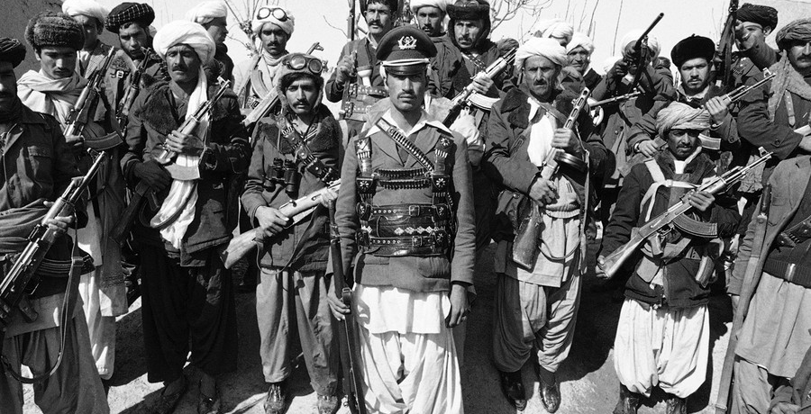

Slide 17
March
1979
Sept
1979
Dec. 24
1979
Jan. 1980
Feb.
1989
Apr. 27
1978
Feb.
1979
Treaty of Friendship
SU & Afghn
US Afghn. Ambassador
Kidnapped & killed/Iran. Revolution Shah ousted
Taraki meets with Brezhnev
Negotiates some Soviet support
Taraki killed, Amin takes over
Soviet 40th Army arrives in Kabul, kills Amin, installs loyalist Karmal
OIC demand withdrawal of Soviet troops
Soviet operations 1979–1985
The Amin government, having secured a treaty in December 1978 that allowed them to call on Soviet forces, repeatedly requested the introduction of troops in Afghanistan in the spring and summer of 1979. They requested Soviet troops to provide security and to assist in the fight against the mujaheddin rebels. After the killing of Soviet technicians in Herat by rioting mobs, the Soviet government sold several Mi-24 helicopters to the Afghan military, and increased the number of military advisers in the country to 3,000.^{[137]} On April 14, 1979, the Afghan government requested that the USSR send 15 to 20 helicopters with their crews to Afghanistan, and on June 16, the Soviet government responded and sent a detachment of tanks, BMPs, and crews to guard the government in Kabul and to secure the Bagram and Shindand airfields. In response to this request, an airborne battalion, commanded by Lieutenant Colonel A. Lomakin, arrived at the Bagram Air Base on July 7. They arrived without their combat gear, disguised as technical specialists. They were the personal bodyguards for President Taraki. The paratroopers were directly subordinate to the senior Soviet military advisor and did not interfere in Afghan politics. Several leading politicians at the time such as Alexei Kosygin and Andrei Gromyko were against intervention.
After a month, the Afghan requests were no longer for individual crews and subunits, but for regiments and larger units. In July, the Afghan government requested that two motorized rifle divisions be sent to Afghanistan. The following day, they requested an airborne division in addition to the earlier requests. They repeated these requests and variants to these requests over the following months right up to December 1979. However, the Soviet government was in no hurry to grant them.

Slide 18
March
1979
Sept
1979
Dec. 24
1979
Jan. 1980
Feb.
1989
Apr. 27
1978
Feb.
1979
Treaty of Friendship
SU & Afghn
US Afghn. Ambassador
Kidnapped & killed/Iran. Revolution Shah ousted
Taraki meets with Brezhnev
Negotiates some Soviet support
Taraki killed, Amin takes over
Soviet 40th Army arrives in Kabul, kills Amin, installs loyalist Karmal
OIC demand withdrawal of Soviet troops
Soviet operations 1979–1985
Based on information from the KGB, Soviet leaders felt that Prime Minister Hafizullah Amin's actions had destabilized the situation in Afghanistan. Following his initial coup against and killing of President Taraki, the KGB station in Kabul warned Moscow that Amin's leadership would lead to "harsh repressions, and as a result, the activation and consolidation of the opposition."^{[139]}
The Soviets established a special commission on Afghanistan, comprising KGB chairman Yuri Andropov, Boris Ponomarev from the Central Committee and Dmitriy Ustinov, the Minister of Defence. In late April 1978, the committee reported that Amin was purging his opponents, including Soviet loyalists, that his loyalty to Moscow was in question and that he was seeking diplomatic links with Pakistan and possibly the People's Republic of China (which at the time had poor relations with the Soviet Union). Of specific concern were Amin's secret meetings with the U.S. chargé d'affaires, J. Bruce Amstutz, which, while never amounting to any agreement between Amin and the United States, sowed suspicion in the Kremlin.^{[140]}
Information obtained by the KGB from its agents in Kabul provided the last arguments to eliminate Amin. Supposedly, two of Amin's guards killed the former president Nur Muhammad Taraki with a pillow, and Amin, himself, was suspected to be a CIA agent. The latter, however, is still disputed with Amin repeatedly demonstrating friendliness toward the various delegates of the Soviet Union who would arrive in Afghanistan. Soviet General Vasily Zaplatin, a political advisor of Premier Brezhnev at the time, claimed that four of President Taraki's ministers were responsible for the destabilization. However, Zaplatin failed to emphasize this in discussions and was not heard.^{[141]}

Slide 19
March
1979
Sept
1979
Dec. 24
1979
Jan. 1980
Feb.
1989
Apr. 27
1978
Feb.
1979
Treaty of Friendship
SU & Afghn
US Afghn. Ambassador
Kidnapped & killed/Iran. Revolution Shah ousted
Taraki meets with Brezhnev
Negotiates some Soviet support
Taraki killed, Amin takes over
Soviet 40th Army arrives in Kabul, kills Amin, installs loyalist Karmal
OIC demand withdrawal of Soviet troops
Soviet operations 1979–1985
During meetings between President Taraki and Soviet leaders in March 1979, the Soviets promised political support and to send military equipment and technical specialists, but upon repeated requests by Taraki for direct Soviet intervention, the leadership adamantly opposed him; reasons included that they would be met with "bitter resentment" from the Afghan people, that intervening in another country's civil war would hand a propaganda victory to their opponents, and Afghanistan's overall inconsequential weight in international affairs, in essence realizing they had little to gain by taking over a country with a poor economy, unstable government, and population hostile to outsiders. However, as the situation continued to deteriorate from May–December 1979, Moscow changed its mind on dispatching Soviet troops. The reasons for this complete turnabout are not entirely clear, and several speculative arguments include: the grave internal situation and inability for the Afghan government; the effects of the Iranian Revolution that brought an Islamic theocracy into power, leading to fears that religious fanaticism would spread through Afghanistan and into Soviet Muslim Central Asian republics; Taraki's murder and replacement by Amin, who the Soviets feared could become aligned with the Americans and provide them with a new strategic position after the loss of Iran; and the deteriorating ties with the United States after NATO's two-track missile deployment decision and the failure of Congress to ratify the SALT II treaty, creating the impression that détente was "already effectively dead."^{[142]} The British journalist Patrick Brogan wrote in 1989: "The simplest explanation is probably the best. They got sucked into Afghanistan much as the United States got sucked into Vietnam, without clearly thinking through the consequences, and wildly underestimating the hostility they would arouse".^{[143]} By the fall of 1979, the Amin regime was collapsing with morale in the Afghan Army having fallen to rock-bottom levels while the mujahideen ("Those engaged in jihad") had taken control of much of the countryside.^{[144]} The general consensus amongst Afghan experts at the time was that it was not a question of if mujahideen would take Kabul, but only when the mujahideen would take Kabul.^{[144]}

Slide 20
March
1979
Sept
1979
Dec. 24
1979
Jan. 1980
Feb.
1989
Apr. 27
1978
Feb.
1979
Treaty of Friendship
SU & Afghn
US Afghn. Ambassador
Kidnapped & killed/Iran. Revolution Shah ousted
Taraki meets with Brezhnev
Negotiates some Soviet support
Taraki killed, Amin takes over
Soviet 40th Army arrives in Kabul, kills Amin, installs loyalist Karmal
OIC demand withdrawal of Soviet troops
Soviet operations 1979–1985
In Moscow, Leonid Brezhnev was indecisive and waffled as he usually did when faced with a difficult decision.^{[145]} The three decision-makers in Moscow who pressed the hardest for an invasion in the fall of 1979 were the troika consisting of Foreign Minister Andrei Gromyko; the Chairman of KGB, Yuri Andropov and the Defense Minister Marshal Dmitry Ustinov.^{[145]} The principle reasons for the invasion was the belief in Moscow that Amin was a leader both incompetent and fanatical who had lost control of the situation together with the belief that it was the United States via Pakistan who was sponsoring the Islamist insurgency in Afghanistan.^{[145]} Androprov, Gromyko and Ustinov all argued that if a radical Islamist regime came to power in Kabul, it would attempt to sponsor radical Islam in Soviet Central Asia, thereby requiring a preemptive strike.^{[145]} What was envisioned in the fall of 1979 was a short intervention under which Moscow would replace radical Khalqi Communist Amin with the moderate Parchami Communist Babrak Karmal to stabilize the situation.^{[145]} The concerns raised by the Chief of the Red Army General Staff, Marshal Nikolai Ogarkov who warned about the possibility of a protracted guerrilla war were dismissed by the troika who insisted that any occupation of Afghanistan would be short and relatively painless.^{[145]} Most notably, through the diplomats of the Narkomindel at the Embassy in Kabul and the KGB officers stationed in Afghanistan were well informed about the developments in that nation, but such information rarely filtered through to the decision-makers who viewed Afghanistan more in the context of the Cold War rather than understanding Afghanistan as a subject in its own right.^{[146]} The viewpoint that it was the United States that was fomenting the Islamic insurgency in Afghanistan with the aim of destabilizing Soviet Central Asia tended to downplay the effects of an unpopular Communist government pursuing policies that the majority of Afghans violently disliked as a generator of the insurgency and strengthened those who argued some sort of Soviet response was required to what was seen as an outrageous American provocation.^{[146]} It was assumed in Moscow that because Pakistan (an ally of both the United States and China) was supporting the mujahideen that therefore it was ultimately the United States and China who were behind the rebellion in Afghanistan.

Slide 21
March
1979
Sept
1979
Dec. 24
1979
Jan. 1980
Feb.
1989
Apr. 27
1978
Feb.
1979
Treaty of Friendship
SU & Afghn
US Afghn. Ambassador
Kidnapped & killed/Iran. Revolution Shah ousted
Taraki meets with Brezhnev
Negotiates some Soviet support
Taraki killed, Amin takes over
Soviet 40th Army arrives in Kabul, kills Amin, installs loyalist Karmal
OIC demand withdrawal of Soviet troops
Soviet intervention and coup
On October 31, 1979, Soviet informants under orders from the inner circle of advisors under Soviet General Secretary Leonid Brezhnev relayed information to the Afghan Armed Forces for them to undergo maintenance cycles for their tanks and other crucial equipment. Meanwhile, telecommunications links to areas outside of Kabul were severed, isolating the capital. With a deteriorating security situation, large numbers of Soviet Airborne Forces joined stationed ground troops and began to land in Kabul on December 25. Simultaneously, Amin moved the offices of the president to the Tajbeg Palace, believing this location to be more secure from possible threats. According to Colonel General Tukharinov and Merimsky, Amin was fully informed of the military movements, having requested Soviet military assistance to northern Afghanistan on December 17.^{[147][148]} His brother and General Dmitry Chiangov met with the commander of the 40th Army before Soviet troops entered the country, to work out initial routes and locations for Soviet troops.^{[147]}
On December 27, 1979, 700 Soviet troops dressed in Afghan uniforms, including KGB and GRU special forces officers from the Alpha Group and Zenith Group, occupied major governmental, military and media buildings in Kabul, including their primary target, the Tajbeg Presidential Palace. The operation began at 19:00, when the KGB-led Soviet Zenith Group destroyed Kabul's communications hub, paralyzing Afghan military command. At 19:15, the assault on Tajbeg Palace began; as planned, president Hafizullah Amin was killed. Simultaneously, other objectives were occupied (e.g., the Ministry of Interior at 19:15). The operation was fully complete by the morning of December 28, 1979.

Slide 22
March
1979
Sept
1979
Dec. 24
1979
Jan. 1980
Feb.
1989
Apr. 27
1978
Feb.
1979
Treaty of Friendship
SU & Afghn
US Afghn. Ambassador
Kidnapped & killed/Iran. Revolution Shah ousted
Taraki meets with Brezhnev
Negotiates some Soviet support
Taraki killed, Amin takes over
Soviet 40th Army arrives in Kabul, kills Amin, installs loyalist Karmal
OIC demand withdrawal of Soviet troops
Soviet intervention and coup
The Soviet military command at Termez, Uzbek SSR, announced on Radio Kabul that Afghanistan had been liberated from Amin's rule. According to the Soviet Politburo, they were complying with the 1978 Treaty of Friendship, Cooperation and Good Neighborliness, and Amin had been "executed by a tribunal for his crimes" by the Afghan Revolutionary Central Committee. That committee then elected as head of government former Deputy Prime Minister Babrak Karmal, who had been demoted to the relatively insignificant post of ambassador to Czechoslovakia following the Khalq takeover, and announced that it had requested Soviet military assistance.^{[149]}
Soviet ground forces, under the command of Marshal Sergei Sokolov, entered Afghanistan from the north on December 27. In the morning, the 103rd Guards 'Vitebsk' Airborne Division landed at the airport at Bagram and the deployment of Soviet troops in Afghanistan was underway. The force that entered Afghanistan, in addition to the 103rd Guards Airborne Division, was under command of the 40th Army and consisted of the 108th and 5th Guards Motor Rifle Divisions, the 860th Separate Motor Rifle Regiment, the 56th Separate Airborne Assault Brigade, and the 36th Mixed Air Corps. Later on the 201st and 68th Motor Rifle Divisions also entered the country, along with other smaller units.^{[150]} In all, the initial Soviet force was around 1,800 tanks, 80,000 soldiers and 2,000 AFVs. In the second week alone, Soviet aircraft had made a total of 4,000 flights into Kabul.^{[151]} With the arrival of the two later divisions, the total Soviet force rose to over 100,000 personnel.

Slide 23
March
1979
Sept
1979
Dec. 24
1979
Jan. 1980
Feb.
1989
Apr. 27
1978
Feb.
1979
Treaty of Friendship
SU & Afghn
US Afghn. Ambassador
Kidnapped & killed/Iran. Revolution Shah ousted
Taraki meets with Brezhnev
Negotiates some Soviet support
Taraki killed, Amin takes over
Soviet 40th Army arrives in Kabul, kills Amin, installs loyalist Karmal
OIC demand withdrawal of Soviet troops
International positions on Soviet intervention
Foreign ministers from 34 Islamic nations adopted a resolution which condemned the Soviet intervention and demanded "the immediate, urgent and unconditional withdrawal of Soviet troops" from the Muslim nation of Afghanistan.^{[61]} The UN General Assembly passed a resolution protesting the Soviet intervention in Afghanistan by a vote of 104–18.^{[62]} According to political scientist Gilles Kepel, the Soviet intervention or "invasion" was "viewed with horror" in the West, considered to be a "fresh twist" on the geo-political "Great Game" of the 19th Century in which Britain feared that Russia sought access to the Indian Ocean and posed "a threat to Western security", explicitly violating "the world balance of power agreed upon at Yalta" in 1945.^{[56]}
Weapons supplies were made available through numerous countries. The United States purchased all of Israel's captured Soviet weapons clandestinely, and then funnelled the weapons to the Mujahideen, while Egypt upgraded its army's weapons and sent the older weapons to the militants. Turkey sold their World War II stockpiles to the warlords, and the British and Swiss provided Blowpipe missiles and Oerlikon anti-aircraft guns respectively, after they were found to be poor models for their own forces.^{[152]} China provided the most relevant weapons, likely due to their own experience with guerrilla warfare, and kept meticulous record of all the shipments.^{[152]}

Slide 24
March
1979
Sept
1979
Dec. 24
1979
Jan. 1980
Feb.
1989
Apr. 27
1978
Feb.
1979
Treaty of Friendship
SU & Afghn
US Afghn. Ambassador
Kidnapped & killed/Iran. Revolution Shah ousted
Taraki meets with Brezhnev
Negotiates some Soviet support
Taraki killed, Amin takes over
Soviet 40th Army arrives in Kabul, kills Amin, installs loyalist Karmal
OIC demand withdrawal of Soviet troops
December 1979 – February 1980: Occupation
The first phase of the war began with the Soviet intervention in Afghanistan and first battles with various opposition groups.^{[61]} Soviet troops entered Afghanistan along two ground routes and one air corridor, quickly taking control of the major urban centers, military bases and strategic installations. However, the presence of Soviet troops did not have the desired effect of pacifying the country. On the contrary, it exacerbated nationalistic sentiment, causing the rebellion to spread further.^{[153]} Babrak Karmal, Afghanistan's new president, charged the Soviets with causing an increase in the unrest, and demanded that the 40th Army step in and quell the rebellion, as his own army had proved untrustworthy.^{[154]} Thus, Soviet troops found themselves drawn into fighting against urban uprisings, tribal armies (called lashkar), and sometimes against mutinying Afghan Army units. These forces mostly fought in the open, and Soviet airpower and artillery made short work of them.^{[155]}

Slide 25
March
1979
Sept
1979
Dec. 24
1979
Jan. 1980
Feb.
1989
Apr. 27
1978
Feb.
1979
Treaty of Friendship
SU & Afghn
US Afghn. Ambassador
Kidnapped & killed/Iran. Revolution Shah ousted
Taraki meets with Brezhnev
Negotiates some Soviet support
Taraki killed, Amin takes over
Soviet 40th Army arrives in Kabul, kills Amin, installs loyalist Karmal
OIC demand withdrawal of Soviet troops
March 1980 – April 1985: Soviet offensives
The Soviets did not initially foresee taking on such an active role in fighting the rebels and attempted to play down their role there as giving light assistance to the Afghan army. However, the arrival of the Soviets had the opposite effect as it incensed instead of pacified the people, causing the mujahideen to gain in strength and numbers.^{[160]} Originally the Soviets thought that their forces would strengthen the backbone of the Afghan army and provide assistance by securing major cities, lines of communication and transportation.^{[161]} The Afghan army forces had a high desertion rate and were loath to fight, especially since the Soviet forces pushed them into infantry roles while they manned the armored vehicles and artillery. The main reason that the Afghan soldiers were so ineffective, though, was their lack of morale, as many of them were not truly loyal to the communist government but simply collecting a paycheck.
Once it became apparent that the Soviets would have to get their hands dirty, they followed three main strategies aimed at quelling the uprising.^{[162]} Intimidation was the first strategy, in which the Soviets would use airborne attacks and armored ground attacks to destroy villages, livestock and crops in trouble areas. The Soviets would bomb villages that were near sites of guerrilla attacks on Soviet convoys or known to support resistance groups. Local peoples were forced to either flee their homes or die as daily Soviet attacks made it impossible to live in these areas. By forcing the people of Afghanistan to flee their homes, the Soviets hoped to deprive the guerrillas of resources and safe havens. The second strategy consisted of subversion, which entailed sending spies to join resistance groups and report information as well as bribing local tribes or guerrilla leaders into ceasing operations. Finally, the Soviets used military forays into contested territories in an effort to root out the guerrillas and limit their options. Classic search and destroy operations were implemented using Mil Mi-24 helicopter gunships that would provide cover for ground forces in armored vehicles. Once the villages were occupied by Soviet forces, inhabitants who remained were frequently interrogated and tortured for information or killed.^{[163]}

Slide 26
March
1979
Sept
1979
Dec. 24
1979
Jan. 1980
Feb.
1989
Apr. 27
1978
Feb.
1979
Treaty of Friendship
SU & Afghn
US Afghn. Ambassador
Kidnapped & killed/Iran. Revolution Shah ousted
Taraki meets with Brezhnev
Negotiates some Soviet support
Taraki killed, Amin takes over
Soviet 40th Army arrives in Kabul, kills Amin, installs loyalist Karmal
OIC demand withdrawal of Soviet troops
1980s Insurrection
In the mid-1980s, the Afghan resistance movement, assisted by the United States, Pakistan, Saudi Arabia, the United Kingdom, Egypt,^{[15]} the People's Republic of China and others, contributed to Moscow's high military costs and strained international relations. The U.S. viewed the conflict in Afghanistan as an integral Cold War struggle, and the CIA provided assistance to anti-Soviet forces through the Pakistani intelligence services, in a program called Operation Cyclone.^{[168]}
Pakistan's North-West Frontier Province became a base for the Afghan resistance fighters and the Deobandi ulama of that province played a significant role in the Afghan 'jihad', with Madrasa Haqqaniyya becoming a prominent organizational and networking base for the anti-Soviet Afghan fighters.^{[169]} As well as money, Muslim countries provided thousands of volunteer fighters known as "Afghan Arabs", who wished to wage jihad against the atheist communists. Notable among them was a young Saudi named Osama bin Laden, whose Arab group eventually evolved into al-Qaeda.^{[170][171][172]} Despite their numbers,^{[173][174][175][176]} the contribution has been called a "curious sideshow to the real fighting,"^{[177]} with only an estimated 2000 of them fighting "at any one time", compared with about a 250,000 Afghan fighters and 125,000 Soviet troops.^{[178]} Their efforts were also sometimes counterproductive as in the March 1989 battle for Jalalabad. Instead of being the beginning of the collapse of the Afghan Communist government forces after their abandonment by the Soviets, the Afghan communists rallied to break the siege of Jalalabad and to win the first major government victory in years, provoked by the sight of a truck filled with dismembered bodies of Communists chopped to pieces after surrendering by radical non-Afghan salafists eager to show the enemy the fate awaiting the infidels.^{[179]} "This success reversed the government's demoralization from the withdrawal of Soviet forces, renewed its determination to fight on, and allowed it to survive three more years." ^{[180]}

Slide 27
March
1979
Sept
1979
Dec. 24
1979
Jan. 1980
Feb.
1989
Apr. 27
1978
Feb.
1979
1983
1984-85
1988
Treaty of Friendship
SU & Afghn
US Afghn. Ambassador
Kidnapped & killed/Iran. Revolution Shah ousted
Taraki meets with Brezhnev
Negotiates some Soviet support
Taraki killed, Amin takes over
Soviet 40th Army arrives in Kabul, kills Amin, installs loyalist Karmal
Pakistan works with SU to provide exit from Afghanistan
OIC demand withdrawal of Soviet troops
Framework of Geneva Accords developed
Geneva Accords signed between Pakistan and Afghanistan
Diplomatic efforts and Geneva Accords (1983–1988)
As early as 1983, Pakistan's Foreign ministry began working with the Soviet Union to provide them an exit from Afghanistan, initiatives led by Foreign Minister Yaqub Ali Khan and Khurshid Kasuri. Despite an active support for insurgent groups, Pakistanis remained sympathetic to the challenges faced by the Russians in restoring the peace, eventually exploring the idea towards the possibility of setting-up the interim system of government under former monarch Zahir Shah but this was not authorized by President Zia-ul-Haq due to his stance on issue of Durand line.^{:247–248[195]} In 1984–85, Foreign Minister Yaqub Ali Khan paid state visits to China, Saudi Arabia, Soviet Union, France, United States and the United Kingdom in order to develop framework for the Geneva Accords which was signed in 1988 between Pakistan and Afghanistan.^{:335[196]}

Slide 28
March
1979
Sept
1979
Dec. 24
1979
Jan. 1980
Feb.
1989
Apr. 27
1978
Feb.
1979
1983
1984-85
1988
Treaty of Friendship
SU & Afghn
US Afghn. Ambassador
Kidnapped & killed/Iran. Revolution Shah ousted
Taraki meets with Brezhnev
Negotiates some Soviet support
Taraki killed, Amin takes over
Soviet 40th Army arrives in Kabul, kills Amin, installs loyalist Karmal
Pakistan works with SU to provide exit from Afghanistan
OIC demand withdrawal of Soviet troops
Framework of Geneva Accords developed
Geneva Accords signed between Pakistan and Afghanistan
Geneva Accords 1988
The Geneva Accords, known formally as the agreements on the settlement of the situation relating to Afghanistan, were signed on 14 April 1988 at the Geneva headquarters of the United Nations,^{[1]} between Afghanistan and Pakistan, with the United States and the Soviet Union serving as guarantors.
The accords consisted of several instruments: a bilateral agreement between the Islamic Republic of Pakistan and the Democratic Republic of Afghanistan on the principles of mutual relations, in particular on non-interference and non-intervention; a declaration on international guarantees, signed by the Soviet Union and the United States; a bilateral agreement between Pakistan and Afghanistan on the voluntary return of Afghan refugees; and an agreement on the interrelationships for the settlement of the situation relating to Afghanistan, signed by Pakistan and Afghanistan and witnessed by the Soviet Union and the United States.
The agreements also contained provisions for the timetable of the withdrawal of Soviet troops from Afghanistan. It officially began on 15 May 1988 and ended by 15 February 1989, thus putting an end to a nine-year-long Soviet occupation and Soviet–Afghan War.
The United States reneged on an agreement it had made, with White House clearance,l albeit aloofness, in December 1985 to stop the supply of arms to the mujahideen through Pakistan once the Soviet withdrawal was complete. Mikhail Gorbachev felt betrayed, but the Soviet Union was determined to withdraw and so the accords were supplanted with a contradictory "understanding" that the arms supply would continue.^{[2]}
The Afghan resistance, or mujahideen, were neither party to the negotiations nor to the Geneva accords and so refused to accept the terms of the agreement. As a result, the civil war continued after the completion of the Soviet withdrawal. The Soviet-backed regime of Mohammad Najibullah failed to win popular support, territory, or international recognition but was able to remain in power until 1992, when it collapsed and was overrun by the mujahideen.

Slide 29
March
1979
Sept
1979
Dec. 24
1979
Jan. 1980
Feb.
1989
Apr. 27
1978
Feb.
1979
1983
1984-85
1988
Treaty of Friendship
SU & Afghn
US Afghn. Ambassador
Kidnapped & killed/Iran. Revolution Shah ousted
Taraki meets with Brezhnev
Negotiates some Soviet support
Taraki killed, Amin takes over
Soviet 40th Army arrives in Kabul, kills Amin, installs loyalist Karmal
Pakistan works with SU to provide exit from Afghanistan
OIC demand withdrawal of Soviet troops
Framework of Geneva Accords developed
Geneva Accords signed between Pakistan and Afghanistan
April 1985 – January 1987: Exit strategy
The first step of the Soviet Union's exit strategy was to transfer the burden of fighting the mujahideen to the Afghan armed forces, with the aim of preparing them to operate without Soviet help. During this phase, the Soviet contingent was restricted to supporting the DRA forces by providing artillery, air support and technical assistance, though some large-scale operations were still carried out by Soviet troops.
Under Soviet guidance, the DRA armed forces were built up to an official strength of 302,000 in 1986. To minimize the risk of a coup d'état, they were divided into different branches, each modeled on its Soviet counterpart. The ministry of defense forces numbered 132,000, the ministry of interior 70,000 and the ministry of state security (KHAD) 80,000. However, these were theoretical figures: in reality each service was plagued with desertions, the army alone suffering 32,000 per year.

Slide 30
March
1979
Sept
1979
Dec. 24
1979
Jan. 1980
Feb.
1989
Apr. 27
1978
Feb.
1979
1983
1984-85
1988
Treaty of Friendship
SU & Afghn
US Afghn. Ambassador
Kidnapped & killed/Iran. Revolution Shah ousted
Taraki meets with Brezhnev
Negotiates some Soviet support
Taraki killed, Amin takes over
Soviet 40th Army arrives in Kabul, kills Amin, installs loyalist Karmal
Pakistan works with SU to provide exit from Afghanistan
OIC demand withdrawal of Soviet troops
Framework of Geneva Accords developed
Geneva Accords signed between Pakistan and Afghanistan
April 1985 – January 1987: Exit strategy
The decision to engage primarily Afghan forces was taken by the Soviets, but was resented by the PDPA, who viewed the departure of their protectors without enthusiasm. In May 1987 a DRA force attacked well-entrenched mujahideen positions in the Arghandab District, but the mujahideen held their ground, and the attackers suffered heavy casualties.^{[197]} In the spring of 1986, an offensive into Paktia Province briefly occupied the mujahideen base at Zhawar only at the cost of heavy losses.^{[198]} Meanwhile, the mujahideen benefited from expanded foreign military support from the United States, Saudi Arabia, Pakistan and other Muslim nations. The US tended to favor the Afghan resistance forces led by Ahmed Shah Massoud, and US support for Massoud's forces increased considerably during the Reagan administration in what US military and intelligence forces called "Operation Cyclone". Primary advocates for supporting Massoud included two Heritage Foundation foreign policy analysts, Michael Johns and James A. Phillips, both of whom championed Massoud as the Afghan resistance leader most worthy of US support under the Reagan Doctrine.^{[199][200][201]}

Slide 31
March
1979
Sept
1979
Dec. 24
1979
Jan. 1980
Feb.
1989
Apr. 27
1978
Feb.
1979
1983
1984-85
1988
Treaty of Friendship
SU & Afghn
US Afghn. Ambassador
Kidnapped & killed/Iran. Revolution Shah ousted
Taraki meets with Brezhnev
Negotiates some Soviet support
Taraki killed, Amin takes over
Soviet 40th Army arrives in Kabul, kills Amin, installs loyalist Karmal
Pakistan works with SU to provide exit from Afghanistan
OIC demand withdrawal of Soviet troops
Framework of Geneva Accords developed
Geneva Accords signed between Pakistan and Afghanistan
Last Soviet troops depart on schedule from Afghanistan
Foreign Involvement Pro-Mujaheddin
The Afghan mujahideen were backed primarily by the United States, Saudi Arabia, Pakistan and the United Kingdom making it a Cold War proxy war. Out of the countries that supported the Mujahideen, the U.S. and Saudi Arabia offered the greatest financial support.^{[13][14][16][18][222][223]} However, private donors and religious charities throughout the Muslim world—particularly in the Persian Gulf—raised considerably more funds for the Afghan rebels than any foreign government; Jason Burke recounts that "as little as 25 per cent of the money for the Afghan jihad was actually supplied directly by states."^{[224]} Saudi Arabia was heavily involved in the war effort and matched the United States' contributions dollar-for-dollar in public funds. Saudi Arabia also gathered an enormous amount of money for the Afghan mujahideen in private donations that amounted to about $20 million per month at their peak.^{[225]}
Other countries that supported the mujaheddin were Egypt and China. Iran on the other hand only supported the Shia Mujaheddin namely the Persian speaking Shiite Hazaras in a limited way. One of these groups was the Tehran Eight a political union of Afghan Shi'a.^{[226]} They were supplied predominately by the Islamic Revolutionary Guard Corps but Iran's support for the Hazaras nevertheless frustrated efforts for a united mujahedeen front.^{[227]}

Slide 32
10
Beneventum
-275
2021
Fourth Diodochi war
Ukraine
2014
Ipsus
2016
Heraclea
2018
Asculum
2019
-272
SL
1979
1989
Pyrrhus
WW2
-273
Pact
KN & KS
W. front
Tarentum falls
Pyrrhus dies
E front
Iraq
Syria
Ukraine
Venezuela
Pyrrhus loses ‘spheres of influence’
a
KN
1789
1798
1799
resurrect
war
Deadly wound
Death
b
KS
1945
1989
1991
resurrect
war
Ω
Deadly wound
Death
Panium
war
SL
death
Deadly wound
KS
KN

Slide 33
Third Diodochi war
‘to the
borders’
Peace of the Dynasts
Battle of
Gabiene
Peithon
Killed
Antigonus
Vs
3 allies
Battle of Gaza
Seleucus
Master of Asia
ultimatum
Seleucus
War
Antig KN
Eumenes KS
Antig
ê
Eumenes
Pheiton
Seleucus
Antigonus
dictator
3 allies
ê
Antigonus
Spheres of
influence
Dem defeated against adv. gen
Seleucus
Nabateans
Treaty of Brest-Ltovsk
Armistice Day
Nov. 11, 1918
Treaty of Versailles
1919
WW1
Bosnian Crisis 1908
Archduke Franz Ferdinand
July 28, 1914
Nov. 8, 1917
Mar 3, 1918
Black Hand
ultimatum
Spanish flu
Serbia
Bosnia
AH Russia
Terrorist
attack
Serbia from
AH “give up sovereignty’
AH invades Serbia
E front
Loss to Russia
WW3
E front
WW1
E front
WW2
2021
‘to the
borders’
Panium
10
2019
Battle of Raphia
SL
1989
9/11
2001
2003
Nov. 8, 2016
1979
9/11
1990
ultimatum
E
→
W
Al-Qaeda
COVID-19
War
USA
USSR
USSR
Mujahedeen
Papacy
Taliban
Iraq “give up sovereignty’
Iraq
War
E front
Loss
to USA
Afghanistan
Time of trouble
Iraq
Kuwait
USA USSR
War
Peace

Slide 34
Napoleon
Egypt Expedition
10 year Proxy War
Syria
10 years
1798
1814
1818
1831
1841
1850
COP
1861
2 Ad
1863
Egyptian KS
Turkey KN
1799
1840
French Revolution
Ottoman
Wahabbi
1833
1839
KN Deadly wound
Islam restrained
KN Death
KN – capitalism
KS - communism
KN – democratization
KS - Islamization
KN ✓
KS ☒
10 year Proxy War
Syria
KN ✓
KS ☒
1979
10 years
1989
2001
2011
2021
SL
COP
2 Ad
Iranian Revolution
Iran/Iraq War
Soviet Afghan War
KS ✓
KN ☒
Russia KS
US KN
1991
Al-Qaeda
2003
2020
Iraq War
War
USA
USSR
Taliban
Gaddafi killed
Arab Spring
2014
Caliphate
declared
2019
Caliphate
Defeated
Islam restrained
KS Deadly wound
KS Deadly wound
KS Death
KS Death
Afghanistan
Mujahedeen
Gulf War
1990-1991
The international community imposed numerous sanctions and embargoes against the Soviet Union, and the U.S. led a boycott of the 1980 Summer Olympics held in Moscow. The boycott and sanctions exacerbated Cold War tensions and enraged the Soviet government, which later led a revenge boycott of the 1984 Olympics held in Los Angeles.^{[75]} The Soviets initially planned to secure towns and roads, stabilize the government under new leader Karmal, and withdraw within six months or a year. But they were met with fierce resistance from the guerillas^{[76]} and had difficulties on the harsh cold Afghan terrain,^{[77]} resulting in them being stuck in a bloody war that lasted nine years.^{[78]} By the mid-1980s, the Soviet contingent was increased to 108,800 and fighting increased, but the military and diplomatic cost of the war to the USSR was high.^{[15]} By mid-1987 the Soviet Union, now under reformist leader Mikhail Gorbachev, announced it would start withdrawing its forces after meetings with the Afghan government.^{[9][10]} The final troop withdrawal started on May 15, 1988, and ended on February 15, 1989, leaving the government forces alone in the battle against the insurgents, which continued until 1992, when the former Soviet-backed government collapsed. Due to its length, it has sometimes been referred to as the "Soviet Union's Vietnam War" or the "Bear Trap" by the Western media.^{[79][80][81]} The Soviets' failure in the war^{[82]} is thought to be a contributing factor to the fall of the Soviet Union.^{[83]}

Slide 36
