Slide 1
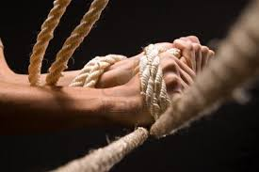
Theme | Structure |  | FAILURE | FAILURE | SUCCESS
Adventism | 1) Modern Israel | ➔ | Millerite 1798-1844; 46 years | 1888 | 144,000
Papacy | 2) Counterfeit | ➔ | 1899-1945 46 years Pope Pius XII | 1989 John Paul II | 2001 Benedict and Francis
Protestantism | 3) “In God We Trust” | ➔ | 1863-1900 Christian Amendment Movement | 1950s Judeo-Christian Nationalism | 1979-SL New Christian Right
“Hold the Rope” Camp Meeting
Germany December 2020 – January 2021
The Group Threat- Tess Lambert 01.01.2021
FIN1844

Slide 2
The Group Threat Hold The Rope
Charles
Finney
Charles
Hodge
North
South
Oberlin
Princeton
2nd Advent
1st GA
1798
1863
1900
40s
50s
1979
ToE
Jews
Catholics
Mormons
SDAs
Free thinkers

Slide 3
The Group Threat Hold The Rope
We want to make a few points before we get into the document. This document doesn't give the history prior to 1863 in much detail. We're halfway through this camp meeting and we have barely started the first history. We are going to have to move really quickly, there won't be time for much revision or perhaps as detailed explanation as could be given. I hope that people come back to these presentations, go back to the sources that have been shared to make sure these rushed points are not missed.
There are some things I'm just stating more as fact. I didn't give a great deal of proof when I talked about the North and South. But the evidence is solid, it is there. Both translation and time restraints prevent from going into that in great depth. I hope that these presentations are revisited, and the documents read multiple times in full. The first reading you won't pick up the points.
Charles
Finney
Charles
Hodge
North
South
Oberlin
Princeton

Slide 4
The Group Threat Hold The Rope
People say, "I watched your presentations" which translated means they listened at 1.5 speed on the way to work. They did not watch; they did not study and regardless of the messages they send me they did not understand. There are select portions of the world that need audio, that need is rare and limited. Outside of that no one should be listening to my presentations, they should be watching. The power of our message is not in the sound of my voice. The power of our message is in structures. An audible voice can only transmit those structures so well. They must be seen, watched, drawn, God gave a visual message in the history of the big bang of media.
If He meant for us to be listening to the radio, He could have had this message go around the world 50 years ago. He waited until it could be seen. And for the 144,000 to be picking up this message through lazy listening at 1.5 speed on the way to work, it's ignoring what God has tried to do in the history of information. So don't just come back to presentations, come back to structures. Don't listen to me, watch. Draw them, only then will the methodology and the message be understood.

Slide 5
The Group Threat Hold The Rope
I took time when we had little time because it's an important point. And it's important for these presentations because of how quickly we're going to move through material, and I guarantee you, you speed them up and you will not understand, you will miss out.

Slide 6
The Group Threat Hold The Rope
The few points we made before going into our document, we know that Christ was to return before 1863. We know the United States would have needed a ‘Church State’ relationship. We know that if God's people were a success, then the Sunday law in that history, 1850 compromise movement, needed to be a success. Another way to put that: ‘Adventism history of success,’ ‘the South history of success.’ And well before 1840 the South had already unified on a ‘Church State’ model. They had an impenetrable southern identity. In the middle late 1700’s traveling ministers went into the South to evangelize and they taught the South that slavery was wrong. Then they settled down and became more comfortable in the South, they started to make friends and be proud of being southern. They knew the North was looking down upon them for slavery. Those ministers started to feel defensive, and they started to argue slavery isn’t ideal, but you northerners are judgmental and bossy. Stop telling us what to do, focus on your own problems. The North got stronger against slavery and it was this form of southern nationalism that turned these ministers from opposing slavery to gradually defending it.

Slide 7
The Group Threat Hold The Rope
Until, by the Civil War they were saying it's biblical. Partly because of their own regional nationalism and pride, the South became united around a certain identity. This was also successful because of their limited economy, religion there was practically entirely unified, the churches controlled the schools and the colleges, they had little immigration from the North, very little immigration from overseas and just small rural communities, all of this fostered a strong identity that became impenetrable.

Slide 8
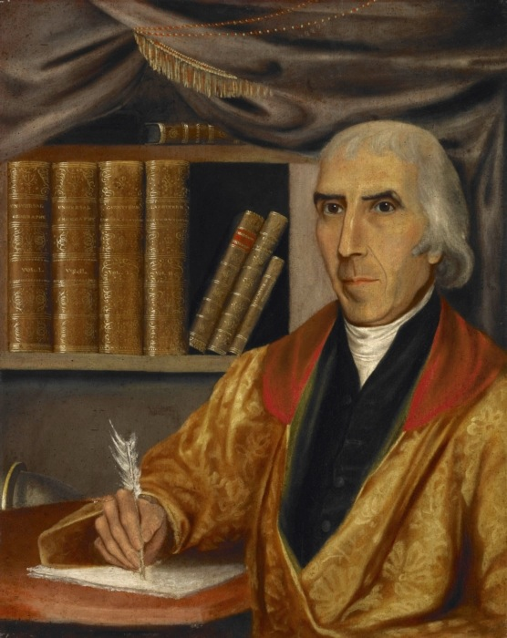
The Group Threat Hold The Rope
Already, they had a ‘Church and State’ relationship. If the South had been successful in that history, that would have been forced on the United States. By the time we get into the history of 1863 the South has failed, the fights in the North and the South even after it loses the Civil War with the additional wound of pride, they insulate themselves even more. That really only starts to get broken down around the time of Billy Graham.
The second point we made, Protestantism tends to be split, it’s really traceable all the way back to the First Great Awakening. This is what we were studying in the Oceania series. So much of what we're studying is just built on what we've already said when we were tracing the history of 1798 and Jedidiah Morse.
Jedidiah Morse was a geographer whose textbooks became a staple for students in the United States. He was the father of the telegraphy pioneer and painter Samuel Morse, and his textbooks earned him the sobriquet of "father of American geography."

Slide 9
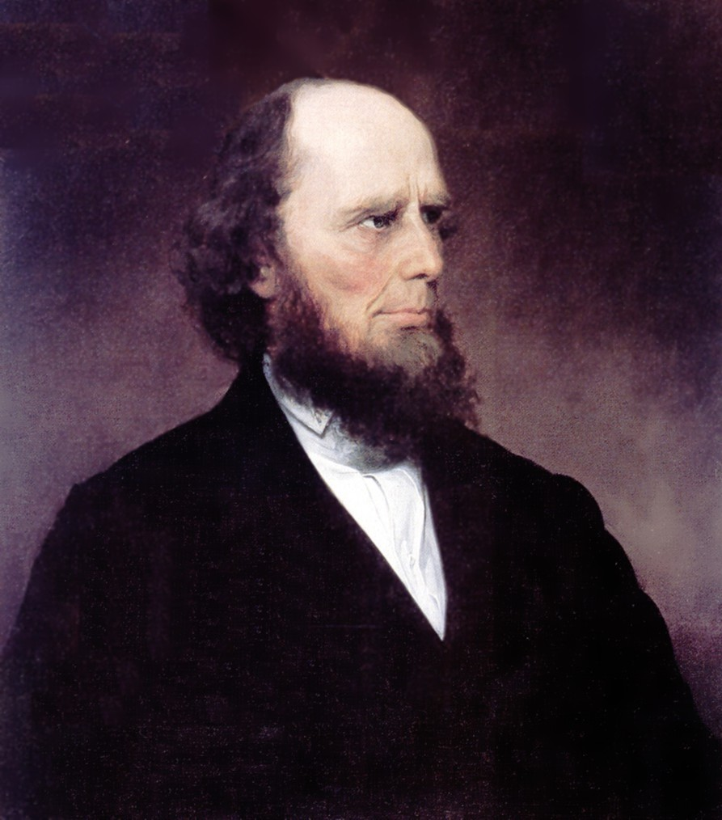
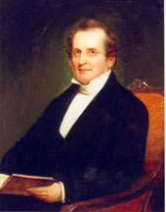
The Group Threat Hold The Rope
We discussed how these two streams of Protestantism can be symbolized by two key United States colleges: Oberlin and Princeton. Oberlin with Charles Finney and Princeton with Charles Hodge. They will come up through our study. That's all our review.
Charles
Finney
Charles
Hodge
Oberlin
Princeton

Slide 10
The Group Threat Hold The Rope
If you go to the document to the table of contents, this document is broken down into three parts and each part is addressing one of the three movements, one, two, three. These three parts of the document are bookended by an introduction and a conclusion. So there is an introduction, three movements, and a conclusion. We are in part one the first movement. This part one is further broken down into A, B, C and D and A, B, C are the repeating pattern. A is a threat, B is the nationalistic mobilization, C is the Constitutional demands. I hope we can see that A, B, C is the three steps. D is just explaining what happened in A, B and C, actually after A, B, C.
2nd Advent
1st GA
1798
1863
1900
40s
50s
1979
ToE
Jews
Catholics
Mormons
SDAs
Free thinkers

Slide 11
The Group Threat Hold The Rope
We are up to part A and in part A it’s the first of those three repeating steps. The author here is explaining the group threat theory. This is something we should all be very familiar with; we've been discussing this when it comes to things like racism and sexism for a long time now. So, I'll skip that except to remind us of who the threat is; Catholics, Jews, Mormons, Adventist, free thinkers. Five threats
2nd Advent
1st GA
1798
1863
1900
40s
50s
1979
ToE
Jews
Catholics
Mormons
SDAs
Free thinkers

Slide 12
The Group Threat Hold The Rope
Now part A is further broken down, it's possibly the most complicated movement because it's so far away from us. We’re just going to paraphrase a few parts of this section. "The US Constitution contains no expression of religious devotion." We're on page 267 which is Page 11 in the PDF. I'm going to reference the last quote on that page, he's just defending the argument he's made that key Protestants objected to the Constitution. He quotes Luther Martin, page 268 or page 12 in the PDF, “Anti-Federalists argued that under the Constitution Jews, Muslims, pagans etc, may be elected to federal offices and therefore the Constitution would serve as an invitation for Jews and pagans of every kind to come among us.”
2nd Advent
1st GA
1798
1863
1900
40s
50s
1979
ToE
Jews
Catholics
Mormons
SDAs
Free thinkers

Slide 13
The Group Threat Hold The Rope
The next paragraph, "long after ratification many evangelicals continue to oppose the Constitution because of its absence of expression of religious devotion." Five lines down beginning with Reverend Chauncey Lee, "Reverend Chauncey Lee intoned in an 1813 sermon the Constitution has not the impress of religion upon it, not the smallest recognition of the government or the being of God. I leave it with a single reflection, whether if God be not in the camp, we have not reason to tremble for the ark." He quotes Reverend Ezra Stiles Ely, and then in 1844, former President John Quincy Adams, remember how we discussed Adams in the 1798 history. So, he's made his point, they opposed the Constitution.
2nd Advent
1st GA
1798
1863
1900
40s
50s
1979
ToE
Jews
Catholics
Mormons
SDAs
Free thinkers

Slide 14
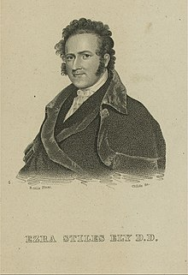
The Group Threat Hold The Rope
Ezra Stiles Ely serves as an example of how early nineteenth century American Christian ministers viewed the problem of urban poverty.
Ely, through his work in the New York Almshouse (1811, 1813), was credited as being "one of the first in America to face openly the problem of prostitution and to deal sympathetically with its victims." ^{[4]} His sympathy for the poor he served, however, was reflected in lines such as: asking if it would be lawful "to confine in work-houses some of the clamorous and diseased persons, who are a nuisance to the city?"^{[5]} He also called for the banning of the procreation of the poor by separating families in the Almshouse: "No sort of connexion [sic] should exist between men, women, and children. This would prevent the multiplication of many paupers." ^{[6]} Ely’s anti-procreation solution did not abate in time. Two years later he wrote how poor children were "born and educated in the Almshouse for the devil" and that "the evil will extend, and the miserable will procreate children of misery" unless the genders were separated.".^{[7]}
Ely's ideology regarding the poor was rooted in the concept of Divine Benevolence.^{[8]} This belief entailed that the problem of poverty was a fact of nature. Poverty, in this view, has always been a problem and always will be.^{[9]} The poverty-stricken were believed to be in their state, not due to external forces such as economics, war, or famine, but because they have made poor life choices, or are too insufficient as humans to be prosperous. This is an important concept to consider as events such as the War of 1812, trade embargoes, and numerous market fluctuations during the era had severe, and negative consequences, on the problem of poverty. Divine Benevolence held that Christians that were better off serving the poor with compassion and direction towards more godly living and away from the dangers of vice. Direct assistance, in the form of food, clothing, or fuel for fire, was viewed as an enabling agent, and was therefore discouraged. Although Ely described his written work about the poor as: “My journal is of necessity the record of wretchedness,”^{[10]} he nevertheless maintained a positive outlook regarding his ministerial role. He described himself as a "guide-post… besides a public road, multitudes pass him; he points them to a path that leads to a better country, and they are soon out of sight."^{[11]}

Slide 15
The Group Threat Hold The Rope
The next page, 269, that's page 13 in the PDF, starting at the top, "the reformed Presbytery Church, a sect of radical Scotch-Irish Presbyterians commonly referred to as Covenanters was among the groups that continued to reject the Constitution as a blasphemous document." We're going to leave that subject there because we're coming back to the Covenanters.
The next paragraph, "although there were long-standing expressions of opposition to the godless Constitution it took the Civil War to give rise to a movement to put God in the Constitution." And this is because both North and South understood this war in religious terms as did Ellen White.
2nd Advent
1st GA
1798
1863
1900
40s
50s
1979
ToE
Jews
Catholics
Mormons
SDAs
Free thinkers

Slide 16
The Group Threat Hold The Rope
About 2/3 through that paragraph starting with in the North, "in the north the war was described as punishment for the national sin of slavery. Ministers in the South argue that the absence of an expression of religious devotion in the US Constitution had been a national sin and the adoption of the new Confederate Constitution in March of 1861 gave them the opportunity to fix it."
2nd Advent
1st GA
1798
1863
1900
40s
50s
1979
ToE
Jews
Catholics
Mormons
SDAs
Free thinkers

Slide 17
The Group Threat Hold The Rope
The last sentence of that paragraph, "the South could say that it had God on its side because it's Constitution said so unlike the North's." The South was just demonstrating that it had long surrendered to this mindset.
Next paragraph, "in 1863 a movement began in the north to put God in the US Constitution as well. In February of that year members of 11 Protestant denominations met in Xenia, Ohio to discuss the spiritual implications of the war. The group was dominated by Covenanters and consistent with their beliefs."
2nd Advent
1st GA
1798
1863
1900
40s
50s
1979
ToE
Jews
Catholics
Mormons
SDAs
Free thinkers

Slide 18
The Group Threat Hold The Rope
So, whatever comes out of that group of 11 denominations it's the Covenanters that came together and called that meeting that introduced their beliefs and drove their agenda. What came out of those meetings was consistent with Covenanter beliefs. They say slavery is bad, but the crowning original sin of the nation is the omission of God from the Constitution. And so driven by the Covenanters the National Reform Association (NRA) was founded.
2nd Advent
1st GA
1798
1863
1900
40s
50s
1979
ToE
Jews
Catholics
Mormons
SDAs
Free thinkers

Slide 19
The Group Threat Hold The Rope
We'll skip the details of what they were proposing and go to page 271 or page 15 in the PDF file. I want to pick up just two phrases, most of the way at down the end of the first section, "in doing so or pursuing their agenda supporters of the Christian Amendment wanted to make it perfectly clear who 'we the people' are, we the people are the Christian people." And remember Adventists are not Christians, we're a cult, wear it with pride. Mormons aren't Christians, Catholics aren't Christians, and those liberal Protestants embracing 'free thought' are not Christians. None of them fit the prototype.
2nd Advent
1st GA
1798
1863
1900
40s
50s
1979
ToE
Jews
Catholics
Mormons
SDAs
Free thinkers

Slide 20
The Group Threat Hold The Rope
Continuing directly on from where we were before, "the proposed amendment quickly received several key endorsements" it lists them, "as well as “The Independent,” the nations leading religious journal, and the faculty of the Princeton Theological Seminary, the nation's leading seminary." You all know the point I'm making there, it's Princeton, the center of old school fundamentalism.
They approach Abraham Lincoln, and he says just take your time don't hurry.
2nd Advent
1st GA
1798
1863
1900
40s
50s
1979
ToE
Jews
Catholics
Mormons
SDAs
Free thinkers

Slide 21
The Group Threat Hold The Rope
Towards the end of the Civil War when the union is winning, this movement starts to lose ground. That publication, “The Independent,” the nation's leading religious journal, says that the members of the National Reform Association are all fanatics. So mainstream Protestantism says this is just fanaticism and some of those key people start to withdraw support.
2nd Advent
1st GA
1798
1863
1900
40s
50s
1979
ToE
Jews
Catholics
Mormons
SDAs
Free thinkers

Slide 22
The Group Threat Hold The Rope
They start off successful and then they started to lose some ground. In 1867 they go through a major restructuring. That same year they start publishing the “Christian Statesman.” If you've read AT Jones, it's him against the “Christian Statesman” in most of his writing career. They say the movement which emerged in the late 1860s, it had transformed and that it was less sectarian and more political (paraphrase).
2nd Advent
1st GA
1798
1863
1900
40s
50s
1979
ToE
Jews
Catholics
Mormons
SDAs
Free thinkers

Slide 23
The Group Threat Hold The Rope
So the NRA starts out really successfully, loses ground, restructures, starts their publication, becomes more political and then the late 1860s it's back up on the upward trend.
The last of the three quotes from that source, "the religious amendment of the Constitution is not in itself the end we seek", wrote the “Christian Statesman.” So that final goal was not to amend the Constitution.
2nd Advent
1st GA
1798
1863
1900
40s
50s
1979
ToE
Jews
Catholics
Mormons
SDAs
Free thinkers

Slide 24
The Group Threat Hold The Rope
NRA. --- Amend Constitution
They needed to amend the Constitution in their words “as a means to an end.” "this is but a means to an end and that end is the arousing and combining of the Christian people in America in a compact, enthusiastic, determined movement to carry out the religious idea of government in all its practical applications".
2nd Advent
1st GA
1798
1863
1900
40s
50s
1979
ToE
Jews
Catholics
Mormons
SDAs
Free thinkers

Slide 25
The Group Threat Hold The Rope
So once they amend the Constitution, they can set in stone the Protestant Christian identity, then the government, all three branches are forced to operate off that Constitution and carry out that religious ideal.
What’s a practical application, what's the fine print?
NRA. --- Amend Constitution
2nd Advent
1st GA
1798
1863
1900
40s
50s
1979
ToE
Jews
Catholics
Mormons
SDAs
Free thinkers

Slide 26
The Group Threat Hold The Rope
‘religious oaths of office’
They've established the religion in the Constitution, what's the fine print of that?
‘Laws against blasphemy’
And remember they were interpreting blasphemy has anything that spoke against their Protestant beliefs. Their fight over abortion is a little more recent I don't think they were fighting over that then.
NRA. --- Amend Constitution
-- Religious oaths of office
-- Laws against blasphemy
2nd Advent
1st GA
1798
1863
1900
40s
50s
1979
ToE
Jews
Catholics
Mormons
SDAs
Free thinkers

Slide 27
The Group Threat Hold The Rope
‘Sunday Law’
So these are all the fine print. Can you see how they are tailored to attack the threat? If you institute a Sunday law you take care of the free thinkers, the Adventists, and the Jews. If you institute blasphemy laws, you take care of all of them. You wouldn't be able to do a sermon on the daughters of Babylon, not the way they interpreted blasphemy.
NRA. --- Amend Constitution
-- Religious oaths of office
-- Laws against blasphemy
-- Sunday Law
2nd Advent
1st GA
1798
1863
1900
40s
50s
1979
ToE
Jews
Catholics
Mormons
SDAs
Free thinkers

Slide 28
The Group Threat Hold The Rope
Religious oaths of office: there was no way a Catholic was going to be president. I'm assuming that my conceptions growing up, my training in Adventist churches, at least broadly speaking are similar to yours. So I hope some of that is getting broken down. When Ellen White says in parabolic language that there will be this hand across the gulf, Protestantism and Catholicism, the Vatican agreed. In 1893 they responded to the Protestants with mockery.
NRA. --- Amend Constitution
-- Religious oaths of office
-- Laws against blasphemy
-- Sunday Law
2nd Advent
1st GA
1798
1863
1900
40s
50s
1979
ToE
Jews
Catholics
Mormons
SDAs
Free thinkers

Slide 29
The Group Threat Hold The Rope
They said you Protestants think you have your foot on our necks, but look what you're doing (SL), you're paying us homage, we own you. This is not friendship. In 1888 history you didn't have friends between Catholics and Protestants. 1893 the Catholic Church responds to what the Protestant church is doing. You find what the Catholic Church put out in our pioneer writings. So all of these Adventists today, building their faith on 1888 history, waiting for some liberal World Council of Churches to unite with Francis and all be nice friends. God is trying to tell us we don't understand 1888, they were never going to be friends.
NRA. --- Amend Constitution
-- Religious oaths of office
-- Laws against blasphemy
-- Sunday Law
2nd Advent
1st GA
1798
1863
1900
40s
50s
1979
ToE
Jews
Catholics
Mormons
SDAs
Free thinkers

Slide 30
The Group Threat Hold The Rope
Slavery paid homage to the papacy, the concept of owning the bodies and souls of men and women. Their Sunday laws paid homage to the papacy. At the same time, they thought they were in a fight against the papacy. So why are we so concerned that we see a fight between Protestantism and the papacy today? They were fighting in our favorite history, so why shouldn't Francis and the religious right fight today?
NRA. --- Amend Constitution
-- Religious oaths of office
-- Laws against blasphemy
-- Sunday Law
2nd Advent
1st GA
1798
1863
1900
40s
50s
1979
ToE
Jews
Catholics
Mormons
SDAs
Free thinkers

Slide 31
The Group Threat Hold The Rope
And the Catholic Church says despite what you think, that you might think you're winning, you Protestants are paying us homage because you keep following our 1260 example. You're just copying what we did. ‘Imitation is the greatest form of flattery.’ So, the Catholic Church was saying we're flattered that you're imitating us, even though the Protestants think they're taking down Catholicism in America.
NRA. --- Amend Constitution
-- Religious oaths of office
-- Laws against blasphemy
-- Sunday Law
2nd Advent
1st GA
1798
1863
1900
40s
50s
1979
ToE
Jews
Catholics
Mormons
SDAs
Free thinkers

Slide 32
The Group Threat Hold The Rope
And there is no evidence, not an inspiration, not in history that there was some type of hidden deep state working behind the scenes between the 1888 papacy and Protestantism. How much of our thinking has been bent buy a scattering time neck deep in Protestant idolatry?
This is how powerful 1888 history is if it's properly understood.
.
NRA. --- Amend Constitution
-- Religious oaths of office
-- Laws against blasphemy
-- Sunday Law
2nd Advent
1st GA
1798
1863
1900
40s
50s
1979
ToE
Jews
Catholics
Mormons
SDAs
Free thinkers

Slide 33
The Group Threat Hold The Rope
We'll revise: the Covenanters call a meeting, they're afraid that the United States has committed this crowning sin; the Constitution is sin. 11 different Protestant denominations show up. They're seen as fanatics or radicals by some mainstream Protestantism, but they start a publication, they restructure, they become active politically, and it sets up a fight that's going to go on for decades.
Fix that sin in the Constitution
NRA. --- Amend Constitution
-- Religious oaths of office
-- Laws against blasphemy
-- Sunday Law
2nd Advent
1st GA
1798
1863
1900
40s
50s
1979
ToE
Jews
Catholics
Mormons
SDAs
Free thinkers

Slide 34
The Group Threat Hold The Rope
Take on the group threat from these five identities
Jews
Catholics
Mormon's
Adventists
Free thinkers
through the fine print of this Constitutional Amendment.
NRA. --- Amend Constitution
-- Religious oaths of office
-- Laws against blasphemy
-- Sunday Law
2nd Advent
1st GA
1798
1863
1900
40s
50s
1979
ToE
Jews
Catholics
Mormons
SDAs
Free thinkers

Slide 35
The Group Threat Hold The Rope
Just a question, which branch of government makes decisions based on the interpretation of the Constitution? The Supreme Court, the Judicial Branch. So, when they want the Constitution amended, the Supreme Court would be forced to read it their way. In our history they only want it interpreted their way, so all they need to do is make sure they have a supreme court that's interpreting it their way to get the fine print done.
interpret
NRA. --- Amend Constitution
-- Religious oaths of office
-- Laws against blasphemy
-- Sunday Law
2nd Advent
1st GA
1798
1863
1900
40s
50s
1979
ToE
Jews
Catholics
Mormons
SDAs
Free thinkers

Slide 36
The Group Threat Hold The Rope
interpret
NRA. --- Amend Constitution
-- Religious oaths of office
-- Laws against blasphemy
-- Sunday Law
RR, Evangelicals. --- Interpret Constitution
Religious oaths of office
Laws against blasphemy
Sunday law
But it's not the NRA, it's the religious right the evangelicals. It's not to amend the Constitution but rather to interpret it and the fine print will be different too, because the threat has changed. You need different laws to keep your foot on the neck of different groups of people.
2nd Advent
1st GA
1798
1863
1900
40s
50s
1979
ToE
Jews
Catholics
Mormons
SDAs
Free thinkers

Slide 37
The Group Threat Hold The Rope
But in our history when all they need is the interpretation set in stone, all they need to do is to spread that interpretation and then get judges on that Court who will use their interpretation. Can you see how we are already set up, how Adventism is blind? Because if this was an amendment Adventism would have woken up by now. But because they don't understand structures, they're looking for an amendment that's never going to come, and the Sunday law waymark is already set up, they’ve already succeeded. If this history needed an amendment, it would either already be amended or it would be about to be amended. And then all that is instituted at the Sunday law is the fine print. I hope we can see that. Adventism is going through this history blind, but the message is so solid.
interpret
NRA. --- Amend Constitution
-- Religious oaths of office
-- Laws against blasphemy
-- Sunday Law
RR, Evangelicals. --- Interpret Constitution
Religious oaths of office
Laws against blasphemy
Sunday law
2nd Advent
1st GA
1798
1863
1900
40s
50s
1979
ToE
Jews
Catholics
Mormons
SDAs
Free thinkers

Slide 38
The Group Threat Hold The Rope
interpret
NRA. --- Amend Constitution
-- Religious oaths of office
-- Laws against blasphemy
-- Sunday Law
RR, Evangelicals. --- Interpret Constitution
Religious oaths of office
Laws against blasphemy
Sunday law
We’ll skip page 272 and go to page 273 and in the PDF it's page 17. I'm going to paraphrase because we have so little time, the fights that they were having was because they already had some of the fine print at least in state laws and these new groups we're already fighting against those laws. There was a danger that Protestantism was going to lose the fight and that was largely because of immigration. Catholics were finding their voice; they were becoming politically organized, and the demographics of the nation were changing.
2nd Advent
1st GA
1798
1863
1900
40s
50s
1979
ToE
Jews
Catholics
Mormons
SDAs
Free thinkers

Slide 39
The Group Threat Hold The Rope
interpret
NRA. --- Amend Constitution
-- Religious oaths of office
-- Laws against blasphemy
-- Sunday Law
RR, Evangelicals. --- Interpret Constitution
Religious oaths of office
Laws against blasphemy
Sunday law
But just like today what is threatening their identity is immigration. And in the last sentence of that page, "many Protestants understood the demands for religious liberty made by Catholics and other minorities to amount to a demand to subjugate the Protestant majority."
2nd Advent
1st GA
1798
1863
1900
40s
50s
1979
ToE
Jews
Catholics
Mormons
SDAs
Free thinkers

Slide 40
The Group Threat Hold The Rope
interpret
NRA. --- Amend Constitution
-- Religious oaths of office
-- Laws against blasphemy
-- Sunday Law
RR, Evangelicals. --- Interpret Constitution
Religious oaths of office
Laws against blasphemy
Sunday law
Next page, generic Protestantism was taught in the public schools (paraphrasing). These groups start to fight against that based on the principles of equality and the separation of church and state. And just like the South and the Civil War the Protestants say that they are the ones that need protecting, they are the ones being subjugated. There is a war on Christianity. Quoting one fellow, at the bottom of page 274, "they are waging relentless war upon every vestige of national religion yet left us."
2nd Advent
1st GA
1798
1863
1900
40s
50s
1979
ToE
Jews
Catholics
Mormons
SDAs
Free thinkers

Slide 41
The Group Threat Hold The Rope
interpret
NRA. --- Amend Constitution
-- Religious oaths of office
-- Laws against blasphemy
-- Sunday Law
RR, Evangelicals. --- Interpret Constitution
Religious oaths of office
Laws against blasphemy
Sunday law
Have you ever heard about the war on Christmas? Protestants are convinced today that there's a war against Christmas, it's a ridiculous argument. But all of this is just a reflection of exactly what's happening today.
2nd Advent
1st GA
1798
1863
1900
40s
50s
1979
ToE
Jews
Catholics
Mormons
SDAs
Free thinkers

Slide 42
The Group Threat Hold The Rope
interpret
NRA. --- Amend Constitution
-- Religious oaths of office
-- Laws against blasphemy
-- Sunday Law
RR, Evangelicals. --- Interpret Constitution
Religious oaths of office
Laws against blasphemy
Sunday law
Now to page 275 which in the document is page 19; who are the people plotting against Protestantism? Atheists, infidels, communists, Catholics, deists, Jews, Seventh-Day Baptists, none of these are considered Christians. But regardless of what group you put them in one fact was clear, those attacking Christianity were all foreigners. The majority of the threat came from immigrants who were not prototypically American.
2nd Advent
1st GA
1798
1863
1900
40s
50s
1979
ToE
Jews
Catholics
Mormons
SDAs
Free thinkers

Slide 43
The Group Threat Hold The Rope
interpret
NRA. --- Amend Constitution
-- Religious oaths of office
-- Laws against blasphemy
-- Sunday Law
RR, Evangelicals. --- Interpret Constitution
Religious oaths of office
Laws against blasphemy
Sunday law
This is all a lead up into part B when he's going to discuss this link between this Protestant group threat theory and how it links into nationalism. They're going to have to defend not just their religion but America itself.
This is the part where I intend to stop with this document and discuss who they were: the Covenanters, they were just early immigrants from Scotland.
2nd Advent
1st GA
1798
1863
1900
40s
50s
1979
ToE
Jews
Catholics
Mormons
SDAs
Free thinkers

Slide 44
The Group Threat Hold The Rope
interpret
We're going to close at this conclusion of part A; this has all been an explanation of the group threat and we want to go and look at who this branch of Protestantism is. What is the Protestantism that's fighting? Because part of Protestantism just thinks this is all fanaticism. In our next study we'll discuss the Covenanters.
I think it has settled into my mind more than it ever has before and I hope it has then into yours as well; how the first work has already been done and people don't know it.
NRA. --- Amend Constitution
-- Religious oaths of office
-- Laws against blasphemy
-- Sunday Law
RR, Evangelicals. --- Interpret Constitution
Religious oaths of office
Laws against blasphemy
Sunday law
2nd Advent
1st GA
1798
1863
1900
40s
50s
1979
ToE
Jews
Catholics
Mormons
SDAs
Free thinkers

Slide 45
The Group Threat Hold The Rope
interpret
NRA. --- Amend Constitution
-- Religious oaths of office
-- Laws against blasphemy
-- Sunday Law
RR, Evangelicals. --- Interpret Constitution
Religious oaths of office
Laws against blasphemy
Sunday law
It's just the fine print that's coming now
Religious oaths of office
Laws against blasphemy
Sunday law
2nd Advent
1st GA
1798
1863
1900
40s
50s
1979
ToE
Jews
Catholics
Mormons
SDAs
Free thinkers

Slide 46
The Group Threat Hold The Rope
interpret
Because as the NRA said interpreting the Constitution isn't the final goal, it's a means to an end. The Sunday law is our final goal, and we are close. And it's in understanding this history we’ll be able to recognize what it looks like. Not a friendship between Jerry Falwell Jr. and Francis, it's not going to happen because as we said earlier, the greatest way to pay homage is to imitate. And what they have always been intended to imitate is the 1260. Whether that's in buying and selling men and women, body and soul, or through enforcing Sunday, or through something else.
NRA. --- Amend Constitution
-- Religious oaths of office
-- Laws against blasphemy
-- Sunday Law
RR, Evangelicals. --- Interpret Constitution
Religious oaths of office
Laws against blasphemy
Sunday law
2nd Advent
1st GA
1798
1863
1900
40s
50s
1979
ToE
Jews
Catholics
Mormons
SDAs
Free thinkers

Slide 47
The Group Threat Hold The Rope
interpret
NRA. --- Amend Constitution
-- Religious oaths of office
-- Laws against blasphemy
-- Sunday Law
RR, Evangelicals. --- Interpret Constitution
Religious oaths of office
Laws against blasphemy
Sunday law
Does Ellen White say the Sunday law develops in darkness? Interpret that in 1888 and define to me what that darkness was in 1888 and then read everything AT Jones ever wrote about the Sunday law and how it was visibly progressing and then we will relook at the quote.
2nd Advent
1st GA
1798
1863
1900
40s
50s
1979
ToE
Jews
Catholics
Mormons
SDAs
Free thinkers

Slide 48
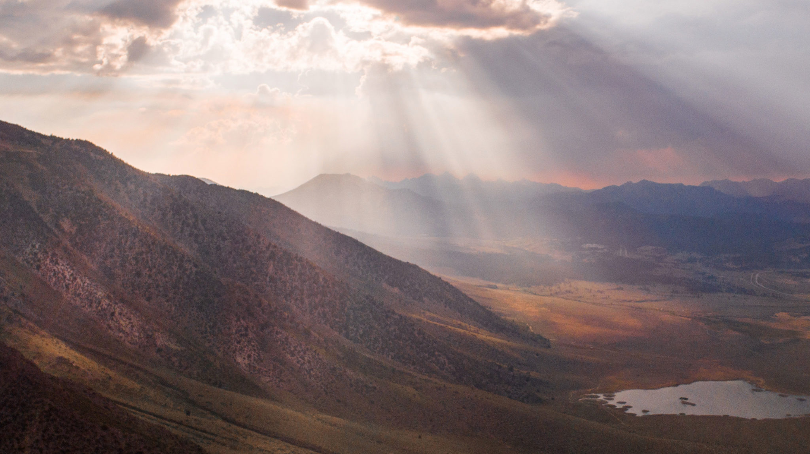
If you kneel with me in prayer,
Dear Lord, we see that we are close. We see how far we've come and how blind Adventism is. The subject of these studies is not directly equality, but we look at a movement in the time of trouble. And in human eyes it just looks like failure all around us, boards all around us, practicing sexism, we see that we do not need the Illuminati to have a boy's club in this movement. We've created all our own clubs; it's so easy to despair that this movement can be ready to do a work. But regardless of who's still in it when it does you said that it will do it. I pray Lord that you not make that success we know that it will, but may people see the serious need to look at themselves, to come up to the standard that they do not have freedom, boards do not have freedom. You have not given us freedom anymore than you gave the United States the freedom to practice slavery. You dictated their behavior and you're telling us what ours must be. We do not want souls lost but I pray that everyone, board members and those watching we'll see that lack of choice with reasonable eyes, come up to that standard to pass the test that they're frankly just not lost. We come before you on your Sabbath, we look solemnly at the condition we are in, and pray Lord that you will give us the messages, the power to identify that conservative nationalism sexism and repent and change because it's already almost too late. And for some they've already set their hearts. Grant us courage to stick to your truth and hold to those chords all the way through our time of trouble.
I pray in Jesus' name, Amen.

