Slide 1
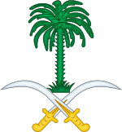
The House of Saud

Slide 2
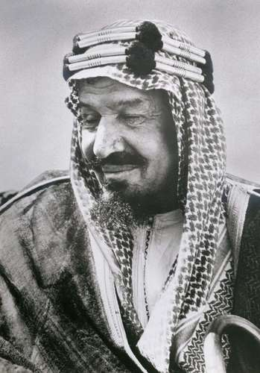
Overview
Saud dynasty, Arabic Āl Saʿūd (“House of Saʿūd”), rulers of Saudi Arabia. In the 18th century Muhammad ibn Saud (died 1765), chief of an Arabian village that had never fallen under control of the Ottoman Empire, rose to power together with the Wahhābī religious movement. He and his son ʿAbd al-ʿAzīz I (reigned 1765–1803) conquered much of Arabia; Saud I (reigned 1803–14) conquered the holy cities of Mecca and Medina in the early years of his rule. The Ottoman sultan induced the viceroy of Egypt to crush the Saudis and Wahhābīs, which was accomplished by 1818. A second Saudi state was formed in 1824 by Muhammad ibn Saud’s grandson Turkī (reigned 1823–34), who made Riyadh his capital. When Turkī’s son Fayṣal (reigned 1834–38; 1843–65) died, succession disputes led to civil war. Power did not return to Saudi hands until 1902, when Ibn Saud recaptured Riyadh. He established the kingdom of Saudi Arabia by royal decree in 1932. A number of his sons later ruled the country: Saud II (reigned 1953–64), Faisal (reigned 1964–75), Khalid (reigned 1975–82), Fahd (reigned 1982–2005), Abdullah (reigned 2005–15), and Salman (reigned 2015– ).
Ibn Saud

Slide 3
Parent family | Al-Muqrin of the Diriyah house of Al-Muraydi of Banu Hanifa
Country | Saudi Arabia
Founded | 1720
Founder | Saud I (died 1725)
Current head | Salman bin Abdulaziz
Titles | King of Saudi Arabia Custodian of the Two Holy Mosques Crown Prince of Saudi Arabia King of Arabia King of Nejd and Hejaz Sultan of Nejd King of Hejaz Imam of Nejd Imam of Diriyah Amir of Diriyah Amir of Nejd and Hasa
Traditions | Sunni
Religion | Islam
Emblem of Saudi Arabia,
adopted in 1950

Slide 4
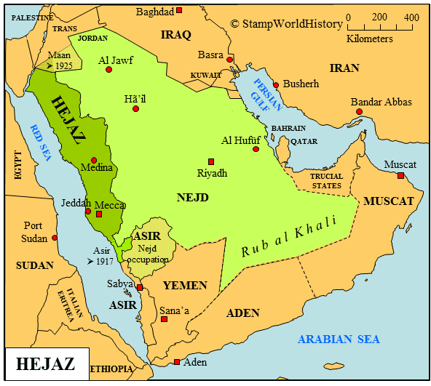
Custodian of the Two Holy Mosques
(abbreviation CTHM; Arabic: خَادِمُ ٱلْحَرَمَيْنِ ٱلشَّرِيفَيْنِ‎, Khādim al-Ḥaramayn aš-Šarīfayn), Servant of the Two Noble Sanctuaries or Protector of the Two Holy Cities, is a royal style that has been used by many Muslim rulers, including the Ayyubids, the Mamluk Sultans of Egypt, the Ottoman Sultans, and in the modern age, Saudi Arabian kings. The title was sometimes regarded to denote the de facto Caliph of Islam,^{[1]} but it mainly refers to the ruler taking the responsibility of guarding and maintaining the two holiest mosques in Islam: Al-Haram Mosque (Arabic: اَلْمَسْجِدُ ٱلْحَرَامُ‎, romanized: Al-Masjid al-Ḥarām, "The Sacred Mosque") in Mecca and the Prophet's Mosque (Arabic: اَلْمَسْجِدُ ٱلنَّبَوِيُّ‎, romanized: Al-Masjid an-Nabawī) in Medina,^{[1][2]} both of which are in the Hejazi region^{[3]} of the Arabian Peninsula.

Slide 5
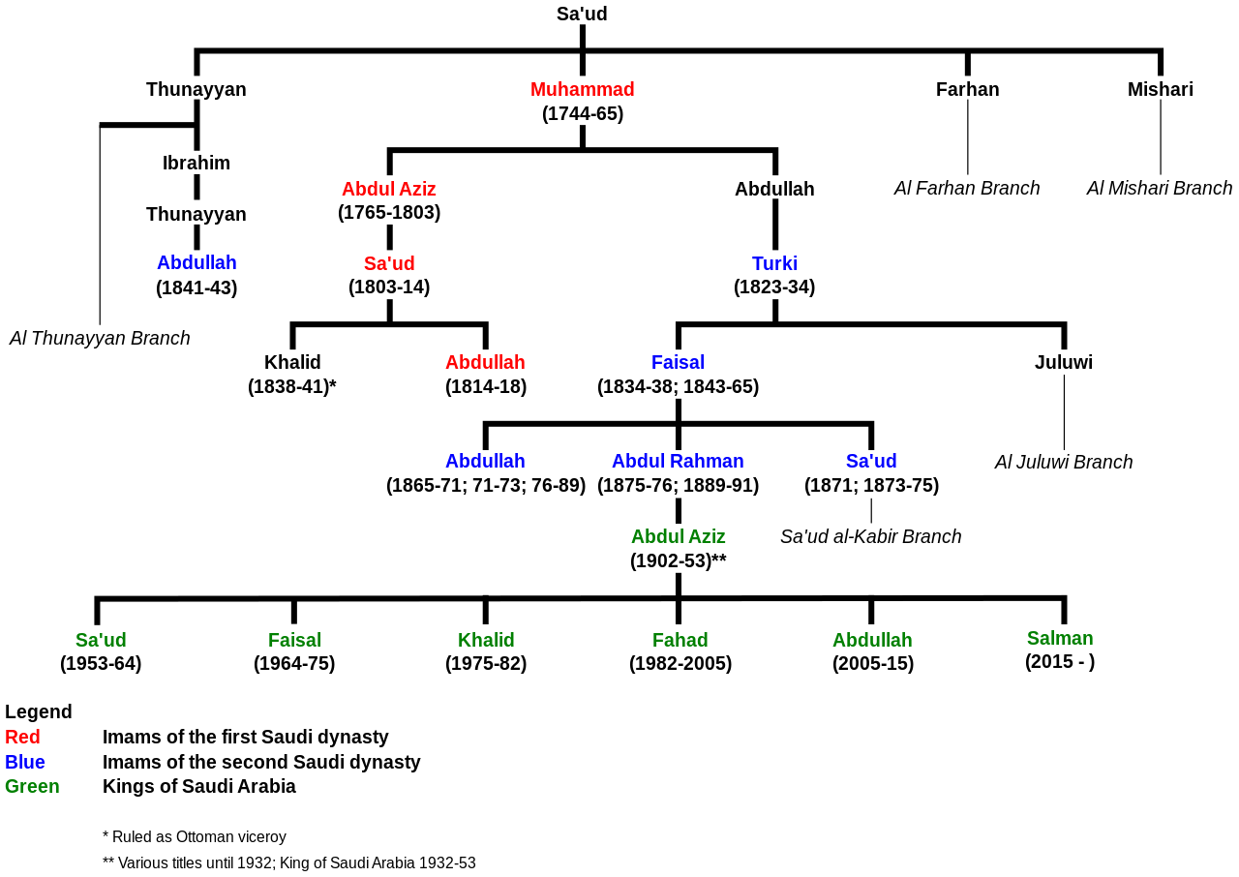

Slide 6
The House of Saud (Arabic: آل سعود‎, romanized: ʾĀl Suʿūd IPA: [ʔaːl sʊʕuːd]) is the ruling royal family of Saudi Arabia. It is composed of the descendants of Muhammad bin Saud, founder of the Emirate of Diriyah, known as the First Saudi state (1744–1818), and his brothers, though the ruling faction of the family is primarily led by the descendants of Ibn Saud, the modern founder of Saudi Arabia.^{[1]} The most influential position of the royal family is the King of Saudi Arabia. The family in total is estimated to comprise some 15,000 members, however the majority of power, influence and wealth is possessed by a group of about 2,000 of them.^{[2][3]}
The House of Saud has had three phases: the Emirate of Diriyah, the First Saudi State (1744–1818), marked by the expansion of Wahhabism; the Emirate of Nejd, the Second Saudi State (1824–1891), marked with continuous infighting; and the Third Saudi State (1902–present), which evolved into Saudi Arabia in 1932 and now wields considerable influence in the Middle East. The family has had conflicts with the Ottoman Empire, the Sharif of Mecca, the Al Rashid family of Ha'il and their vassal houses in Najd, numerous Islamist groups both inside and outside Saudi Arabia and Shia minority in Saudi Arabia.
The succession to the Saudi Arabian throne was designed to pass from one son of the first king, Ibn Saud, to another. King Salman, who reigns currently, first replaced the next crown prince, his brother Muqrin, with his nephew Muhammad bin Nayef. In 2017, Muhammad bin Nayef was replaced by Mohammad bin Salman, King Salman's son, as the crown prince after an approval by the Allegiance Council with 31 out of 34 votes.^{[4][5][6][7][8][9]} The monarchy was hereditary by agnatic seniority until 2006, when a royal decree provided that future Saudi kings are to be elected by a committee of Saudi princes.^{[10]} The king-appointed cabinet includes more members of the royal family.

Slide 7
Saud I
Sheikh Saud I ibn Muhammad ibn Muqrin (Arabic: سعود الأول بن محمد آل مقرن‎, 1640 1725)^{[1]} was the eponymous ancestor of the House of Saud, otherwise known as the Al-Saud.
He was from the family of Al Muqrin, a family that traces its origin to the Arabian tribe of 'Amir ibn Saasaa.^{[2]} He was the leader of the oasis of Dariya from 1720 to 1725.^{[3]}
The Al-Saud originated as a leading family in a town called Diriyah, close to the modern city of Riyadh, near the center of Najd. Sometime in the early 16th century, ancestors of Saud bin Muhammad took over some date groves, one of the few forms of agriculture the area could support, and settled there. Over time, the groves grew into a small town, and the clan came to be recognized as its leaders.^{[4]}
Two decades after his death, Saud's son Muhammad ibn Saud (died 1765) made his historic pact with Muhammad ibn Abd al-Wahhab (died 1792), leading to their conquest of Arabia and the First Saudi State. Sheikh Muhammad's patronymic "ibn Saud" eventually gave the clan its name of "Al-Saud".
He also had sons called Thunayyan, Mishari, and Farhan.^{[5]}

Slide 8
Muhammad ibn Abd al-Wahhab (/wəˈhɑːb/; Arabic: محمد بن عبد الوهاب‎; 1703 – 22 June 1792) was a religious leader,^{[2]} Islamic scholar and theologian^{[1][3][15]} from Najd in central Arabia, founder of the Islamic doctrine and movement known as Wahhabism.^{[1][3][8][16][17][18][19][20]} Born to a family of jurists,^{[3]} Ibn 'Abd al-Wahhab's early education consisted of learning a fairly standard curriculum of orthodox jurisprudence according to the Hanbali school of law, which was the school of law most prevalent in his area of birth.^{[3]} Despite his initial rudimentary training in classical Sunni Muslim tradition, Ibn 'Abd al-Wahhab gradually became opposed to many of the most popular Sunni practices such as the visitation to and the veneration of the tombs of saints,^{[3][8]} which he felt amounted to heretical religious innovation or even idolatry.^{[3][8][21]} Despite his teachings being rejected and opposed by many of the most notable Sunni Muslim scholars of the period,^{[1][3][21]} including his own father and brother,^{[1][3][21]} Ibn 'Abd al-Wahhab charted a religio-political pact with Muhammad bin Saud to help him to establish the Emirate of Diriyah, the first Saudi state,^{[22]} and began a dynastic alliance and power-sharing arrangement between their families which continues to the present day in the Kingdom of Saudi Arabia.^{[2][23]} The Al ash-Sheikh, Saudi Arabia's leading religious family, are the descendants of Ibn ʿAbd al-Wahhab,^{[2]} and have historically led the ulama in the Saudi state,^{[24]} dominating the state's clerical institutions.^{[25]}

Slide 9
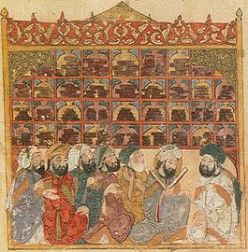
In Islam, the ulama (/ˈuːləˌmɑː/; Arabic: علماء‎ ʿUlamāʾ, singular عالِم ʿĀlim, "scholar", literally "the learned ones",^{[1]} also spelled ulema; feminine: alimah [singular] and uluma [plural])^{[2]} are the guardians, transmitters and interpreters of religious knowledge in Islam, including Islamic doctrine and law.^{[2]}
By longstanding tradition, ulama are educated in religious institutions (madrasas). The Quran and sunnah (authentic hadith) are the scriptural sources of traditional Islamic law.^{[3]}

Slide 10
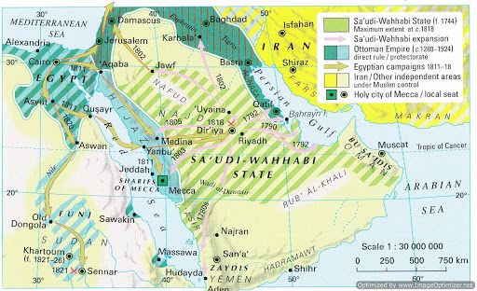
Origins and early history[edit]
The earliest recorded ancestor of the Al Saud was Mani' ibn Rabiah Al-Muraydi who settled in Diriyah in 1446–1447 with his clan, the Mrudah.^{[16]} Although the Mrudah are believed to be descended from the Rabi'ah tribal confederation, the 'Anizza branches of the Rabi'ah.^{[16]} Mani was invited by a relative named Ibn Dir. Ibn Dir was the ruler of a set of villages and estates that make up modern-day Riyadh.^{[17][18][19]} Mani's clan had been on a sojourn in east Arabia, near al-Qatif, from an unknown point in time. Ibn Dir handed Mani two estates called al-Mulaybeed and Ghusayba. Mani and his family settled and renamed the region "al-Diriyah", after their benefactor Ibn Dir.^{[20][21]}
The Mrudah became rulers of al-Diriyah, which prospered along the banks of Wadi Hanifa and became an important Najdi settlement. As the clan grew larger, power struggles ensued, with one branch leaving for nearby Dhruma, while another branch (the "Al Watban") left for the town of az-Zubayr in southern Iraq. The Al Muqrin became the ruling family among the Mrudah in Diriyah.
The name of the clan comes from Sheikh Saud ibn Muhammad ibn Muqrin who died in 1725.^{[22]}

Slide 11
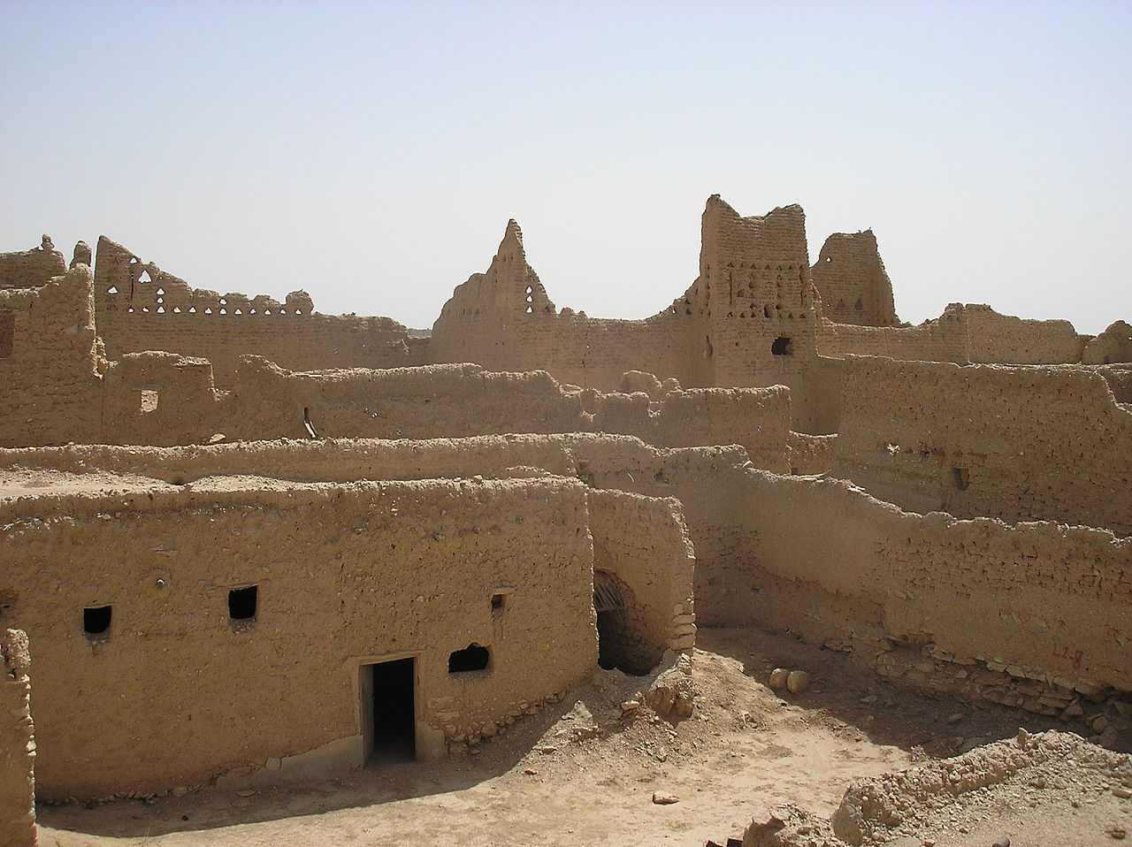
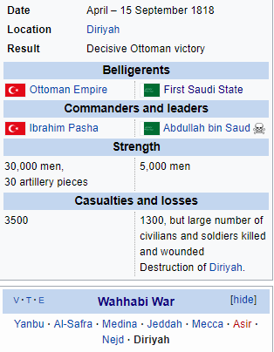
The Emirate of Diriyah was the first Saudi state.^{[1]} It was established in the year 1744 (1157 AH) when Muhammad ibn Abd al-Wahhab and Prince Muhammad bin Saud formed an alliance to found a socio-religious reform movement to unify the many states of the Arabian Peninsula and free it from Ottoman rule.^{[2][3]} In 1744, both Muhammed bin Abd Al Wahhab and Muhammad bin Saud took an oath to achieve their goal.^{[4]} Marriage between Muhammad bin Saud's son, Abdul-Aziz bin Muhammad, and the daughter of Muhammad ibn Abd al-Wahhab helped to seal the pact between their families which has lasted through the centuries to the present day.
By Xristoph, CC BY-SA 3.0, https://commons.wikimedia.org/w/index.php?curid=6443249
The Destruction of Diriyah took place in late 1818 at the end of the Wahhabi War of 1811–18 during the Nejd Expedition. When the forces of Ibrahim Pasha had reached Diriyah, Abdullah I tried to defend his capital with an outnumbered army. After a siege of several months Abdullah surrendered to the Ottomans on September 9 with the promise of the safety of the civilian population of Diriyah which was breached by Ibrahim Pasha and the town was destroyed . Abdullah was imprisoned and with his treasurer and secretary was taken to Cairo where he met Mohammed Ali. Later Abdullah was sent to Istanbul, where, in spite of Ibrahim's promise of safety and of Mohammad Ali's intercession in his favor, he was put to death after a show trial. At the end of the year 1819 Ibrahim returned to Cairo, having subdued all opposition in the Arabian Peninsula, ending the First Saudi state.

Slide 12
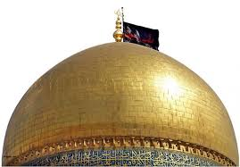
First Saudi state[edit]
Main article: Emirate of Diriyah
The First Saudi State was founded in 1744. This period was marked by conquest of neighboring areas and by religious zeal. At its height, the First Saudi State included most of the territory of modern-day Saudi Arabia, and raids by Al Saud's allies and followers reached into Yemen, Oman, Syria, and Iraq. Islamic Scholars, particularly Muhammad ibn Abdul Wahhab and his descendants, are believed to have played a significant role in Saudi rule during this period. The Saudis and their allies referred to themselves during this period as the Muwahhidun or Ahl al-Tawhid ("the monotheists"). Later they were referred to as the Wahhabis, a group of particularly strict, puritanical Sunni sect, named for its founder.
Leadership of the Al Saud during the time of their first state passed from father to son without incident. The first imam, Muhammad ibn Saud, was succeeded by his eldest son Abdulaziz in 1765. In 1802, Abdulaziz led ten thousand Wahhabi soldiers into an attack on the Shi'ite holy city of Karbala, in what is now southern Iraq and where Hussein ibn Ali, the grandson of the prophet Muhammad is buried.^{[23]} Led by Abdulaziz, the Wahhabi soldiers killed more than two thousand people,
including women and children.^{[23]} The soldiers plundered the city, demolishing the massive
golden dome above Hussein's tomb and loaded hundreds of camels with weapons, jewelry,
coins and other valuable goods.^{[23]}
The attack on Karbala convinced the Ottomans and the Egyptians that the Saudis were a threat to regional peace.^{[24]} Abdulaziz was killed in 1803 by an assassin, believed by some to have been a Shi'ite seeking revenge over the sacking of Karbala the year before. Abdul-Aziz was in turn succeeded by his son, Saud, under whose rule the Saudi state reached its greatest extent. By the time Saud died in 1814, his son and successor Abdullah ibn Saud had to contend with an Ottoman-Egyptian invasion in the Ottoman–Wahhabi War seeking to retake lost Ottoman Empire territory. The mainly Egyptian force succeeded in defeating Abdullah's forces, taking over the Saudi capital of Diriyyah in 1818. Abdullah was taken prisoner and was soon beheaded by the Ottomans in Constantinople, putting an end to the First Saudi State. The Egyptians sent many members of the Al Saud clan and other members of the local nobility as prisoners to Egypt and Constantinople, and razed the Saudi capital Diriyyah.

Slide 13
Second Saudi state[edit]
Main article: Emirate of Nejd
A few years after the fall of Diriyah in 1818, the Saudis were able to re-establish their authority in Najd, establishing the Emirate of Nejd, commonly known as the Second Saudi State, with its capital in Riyadh.
Compared to the First Saudi State, the second Saudi period was marked by less territorial expansion (it never reconquered the Hijaz or 'Asir, for example) and less religious zeal, although the Saudi leaders continued to go by the title of imam and still employed Salafi religious scholars. The second state was also marked by severe internal conflicts within the Saudi family, eventually leading to the dynasty's downfall. In all but one instance, succession occurred by assassination or civil war, the exception being the passage of authority from Faisal ibn Turki to his son Abdullah ibn Faisal ibn Turki.
The Emirate of Nejd was the second Saudi state, existing between 1824 and 1891^{[2]} in Nejd, the regions of Riyadh and Ha'il of what is now Saudi Arabia. Saudi rule was restored to central and eastern Arabia after the Emirate of Diriyah, the First Saudi State, having previously been brought down by the Ottoman Empire's Egypt Eyalet in the Ottoman–Wahhabi War (1811–1818).
The second Saudi period was marked by less territorial expansion and less religious zeal, although the Saudi leaders continued to be called Imam and still employed Wahhabist religious scholars. Turki bin Abdullah bin Muhammad's reconquest of Riyadh from Egyptian forces in 1824 is generally regarded as the beginning of the Second Saudi State. Severe internal conflicts within the House of Saud eventually led to the dynasty's downfall at the Battle of Mulayda in 1891, between the forces loyal to the last Saudi imam, Abdul Rahman ibn Faisal ibn Turki, and the Rashidi dynasty of Ha'il.

Slide 14
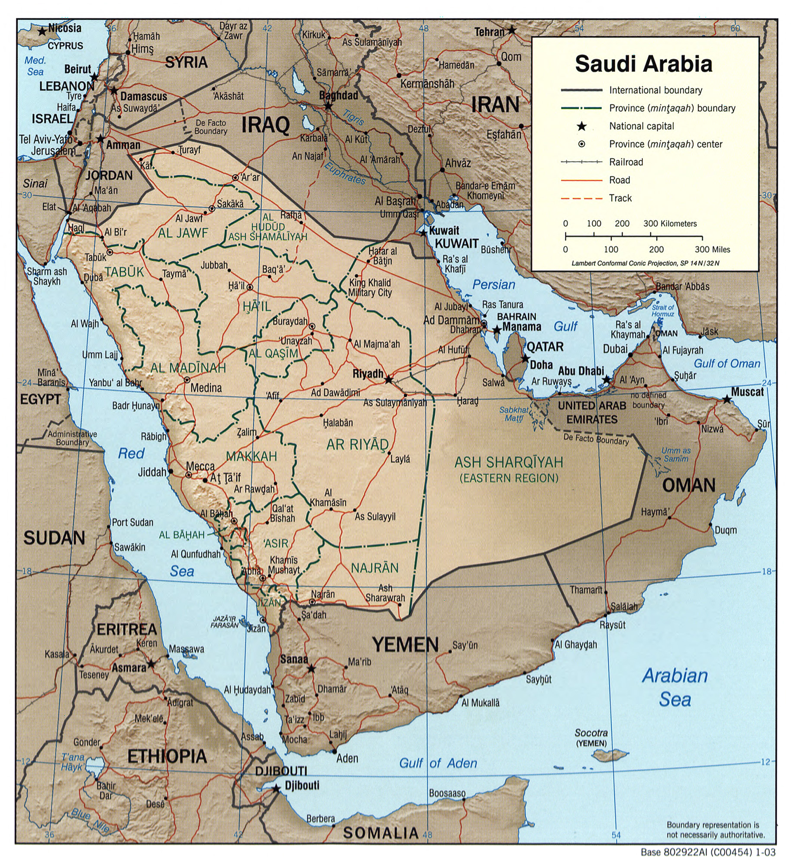

Slide 15
Saudi Arabia
After his defeat at Mulayda, Abdul-Rahman ibn Faisal went with his family into exile in the deserts of eastern Arabia among the Al Murra bedouin. Soon afterward, however, he found refuge in Kuwait as a guest of the Kuwaiti emir, Mubarak Al Sabah. In 1902, Abdul-Rahman's son, Abdul Aziz, took on the task of restoring Saudi rule in Riyadh. Supported by a few dozen followers and accompanied by some of his brothers and relatives, Abdul Aziz was able to capture Riyadh's Masmak fort and kill the governor appointed there by Ibn Rashid. Abdul Aziz, reported to have been barely 20 at the time, was immediately proclaimed ruler in Riyadh. As the new leader of the House of Saud, Abdul Aziz became commonly known from that time onward as "Ibn Saud" in Western sources, though he is still called "Abdul Aziz" in the Arab world.
Ibn Saud spent the next three decades trying to re-establish his family's rule over central Arabia, starting with his native Najd. His chief rivals were the Al Rashid clan in Ha'il, the Sharifs of Mecca in the Hijaz, and the Ottoman Turks in al-Hasa. Ibn Saud also had to contend, however, with the descendants of his late uncle Saud ibn Faisal (later known as the "Saud al-Kabir" branch of the family), who posed as the rightful heirs to the throne. Though for a time acknowledging the sovereignty of the Ottoman Sultans and even taking the title of pasha, Ibn Saud allied himself to the British, in opposition to the Ottoman-backed Al Rashid. From 1915 to 1927, Ibn Saud's dominions were a protectorate of the British Empire, pursuant to the 1915 Treaty of Darin.

Slide 16
Saudi Arabia
Ibn Saud won final victory over the Rashidis in 1921, making him the ruler of most of central Arabia. He consolidated his dominions as the Sultanate of Nejd. He then turned his attention to the Hijaz, finally conquering it in 1926, just months before the British protectorate ended. For the next five and a half years, he administered the two parts of his dual realm, the Kingdom of Hejaz and Nejd, as separate units.
By 1932, Ibn Saud had disposed of all his main rivals and consolidated his rule over much of the Arabian Peninsula. He united his dominions into the Kingdom of Saudi Arabia that year. Ibn Saud's father, Abdul Rahman retained the honorary title of "imam." In 1937 near Dammam, American surveyors discovered what later proved to be Saudi Arabia's vast oil reserves. Before the discovery of oil, many family members were destitute.^{[25]}

Slide 17
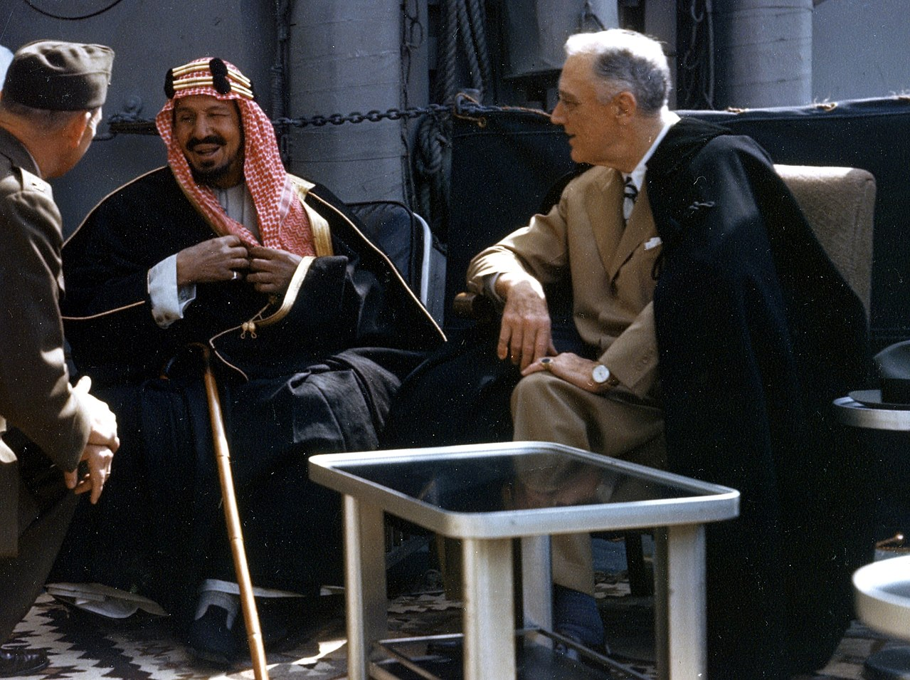
Saudi Arabia
Ibn Saud sired dozens of children by his many wives. He had at most four wives at a time, divorcing many times. He made sure to marry into many of the noble clans and tribes within his territory, including the chiefs of the Bani Khalid, Ajman, and Shammar tribes, as well as the Al ash-Sheikh (descendants of Muhammad ibn Abd al-Wahhab). He also arranged for his sons and relatives to enter into similar marriages. He appointed his eldest surviving son, Saud as heir apparent, to be succeeded by the next eldest son, Faisal. The Saudi family became known as the "royal family," and each member, male and female, was accorded the title amir ("prince") or amira ("princess"), respectively.
Ibn Saud died in 1953, after having cemented an alliance with the United States in 1945.
He is still celebrated officially as the "Founder," and only his direct descendants may take on
the title of "his or her Royal Highness." The date of his recapture of Riyadh in 1902 was chosen
to mark Saudi Arabia's centennial in 1999 (according to the Islamic lunar calendar).
Upon Ibn Saud's death, his son Saud assumed the throne without incident, but his lavish
spending led to a power struggle with his brother, Crown Prince Faisal. In 1964, the royal family forced Saud to abdicate in favor of Faisal, aided by an edict from the country's grand mufti. During this period, some of Ibn Saud's younger sons, led by Talal ibn Abdul Aziz, defected to Egypt, calling themselves the "Free Princes" and calling for liberalization and reform, but were later induced to return by Faisal. They were fully pardoned but were also barred from any future positions in government.

Slide 18
Saudi Arabia
Faisal was assassinated in 1975 by a nephew, Faisal ibn Musaid, who was promptly executed. Another brother, Khalid, assumed the throne. The next prince in line had actually been Prince Muhammad, but he had relinquished his claim to the throne in favor of Khalid, his only full brother.
Khalid died of a heart attack in 1982, and was succeeded by Fahd, the eldest of the powerful "Sudairi Seven", so-called because they were all sons of Ibn Saud by his wife Hassa Al Sudairi. Fahd did away with the previous royal title of "his Majesty" and replaced it with the honorific "Custodian of the Two Holy Mosques", in reference to the two Islamic holy sites in Mecca and Medina, in 1986.
A stroke in 1995 left Fahd largely incapacitated. His half-brother, Crown Prince Abdullah [who was descended on the maternal side from the rival Rashidi] , gradually took over most of the king's responsibilities until Fahd's death in August 2005. Abdullah was proclaimed king on the day of Fahd's death and promptly appointed his younger brother, Sultan bin Abdulaziz, the minister of defense and Fahd's "Second Deputy Prime Minister," as the new heir apparent. On 27 March 2009, Abdullah appointed Prince Nayef Interior Minister as his "second deputy prime minister" and Crown Prince on 27 October.^{[26]} Sultan died in October 2011 while Nayef died in Geneva, Switzerland on 15 June 2012. On 23 January 2015, Abdullah died after a prolonged illness, and his half-brother, Crown Prince Salman bin Abdulaziz Al Saud, was declared the new King.
Many princes and government officials have been arrested in the 2017 in alleged anti corruption campaign by the King and Crown prince. United States President Donald Trump has expressed support for the arrests.^{[27]}

Slide 19
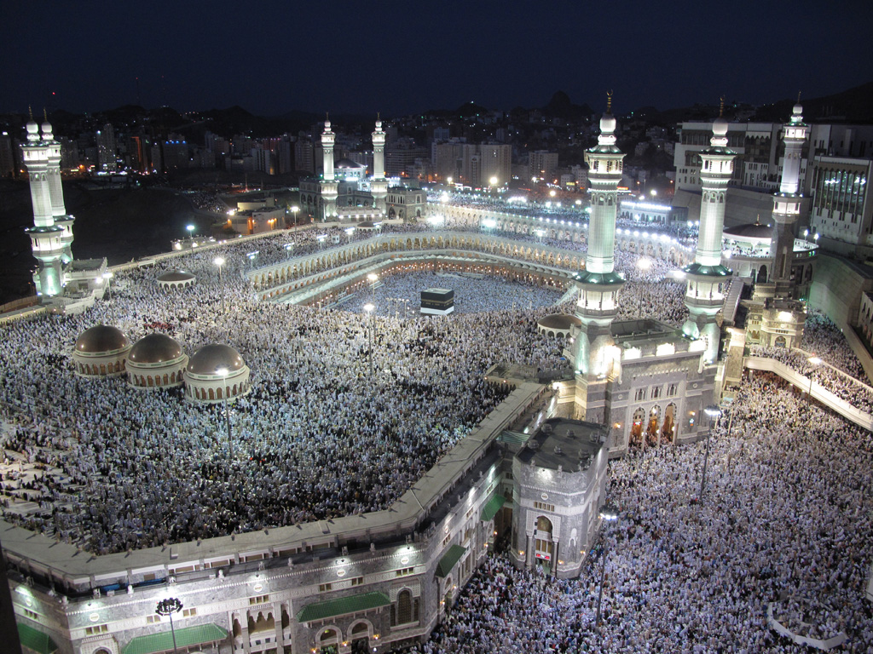
Opposition
Resume 8/8
Due to its authoritarian and quasi-theocratic rule, the House of Saud has attracted much criticism during its rule of Saudi Arabia. There have been numerous incidents, including the Wahhabi Ikhwan militia uprising during the reign of Ibn Saud. Osama Bin Laden, a critic of the US, was a critic of Saudi Arabia and was denaturalized in the mid 1990s.^{[33]}
On 20 November 1979, the Grand Mosque seizure saw the al-Masjid al-Haram in Mecca violently seized by a group of 500 heavily armed and provisioned Saudi dissidents led by Juhayman al-Otaybi and Abdullah al-Qahtani,^{[34]} consisting mostly of members of the former Ikhwan militia of Otaibah^{[35]} but also of other peninsular Arabs and a few Egyptians enrolled in Islamic studies at the Islamic University of Madinah. The Saudi royal family turned to the Ulema who duly issued a fatwa permitting the storming of the holy sanctuary by Saudi forces, aided by French and Pakistani special ops units.^{[36]} According to Lawrence Wright, the GIGN commandos did convert to Islam.^{[37]} Most of those responsible, including Al-Otaybi himself, were beheaded publicly in four cities of Saudi Arabia.^{[38]}
In January 2016, Saudi Arabia executed the prominent Shiite cleric Sheikh Nimr, who had called for pro-democracy demonstrations, along with forty-seven other Saudi Shia citizens sentenced by the Specialized Criminal Court on terrorism charges.^{[39]}
The Otaibah (Arabic: عتيبة‎, also spelled Otaiba, Utaybah) is a tribe originating in Saudi Arabia. Many members of the Saudi royal family descend maternally from the tribe^{[full citation needed]}, which is distributed throughout Saudi Arabia and the Middle East. The Otaibah are descended from the Bedouin. They trace back to the Mudar family and belong to the Qays ʿAylān confederacy through its previous name, Hawazin.^{[1][2]}

Slide 20
Opposition
Since May 2017 in response to protests against the government,^{[disputed – discuss]} the predominantly Shia town of Al-Awamiyah has been put under full siege by the Saudi military. Residents are not allowed to enter or leave, and military indiscriminately shells the neighborhoods with airstrikes, mortar^{[40]} and artillery^{[41]} fire along with snipers^{[42]} shooting residents.^{[43][44][45][46]} Dozens of Shia civilians were killed, including a three year old and^{[47]} a two-year-old child.^{[48][49]} The Saudi government claims it is fighting terrorists in al-Awamiyah.
Crown Prince Mohammed bin Salman kept his own mother away from his father for more than two years, out of the fear that she would stop the king from giving the power to him. Princess Fahda bint Falah Al Hathleen, third wife of King Salman, was said to be in America for medical treatment. However, according to American intelligence this was refuted stating that she was not in the country.^{[50]}
Some Royals have been criticised for various Human Rights violations, including the death of
Jamal Khashoggi, treatment of workers ^{[51]} and the Yemen war.
The Reuters reported on 23 June, 2020, Saudi Crown Prince Mohammed bin Salman of
allegedly threatening and intimidating a former intelligence officer, Saad al-Jabri along with
his family of adult children, of returning to Saudi Arabia from exile in Canada. Saad was a long-time
aide to the former crown prince, Prince Mohammed bin Nayef, who Prince Salman ousted in 2017. The official allegedly has access to documents containing information sensitive and pivotal for the crown prince’s leadership.^{[52]}

Slide 21
Timeline
Saudi Arabia
1744
1902
1924-25
1932
1933
1945
1947
Muhammad ibn Abd al-Wahhab, arrives in the central Arabian state of Najd preaching a return to "pure" Islam. He seeks protection from the local emir, Muhammad ibn Saud, head of the Al Saud tribal family, and they cut a deal. The Al Saud will endorse al-Wahhab's austere form of Islam and in return, the Al Saud will get political legitimacy and regular tithes from al-Wahhab's followers. The religious-political alliance that al-Wahhab and Saud forge endures to this day in Saudi Arabia.
22 year old Abd al-Aziz ibn Saud captures Riyadh, the ancient capital of the Saudi kingdom, but to conquer all of the Arabian Peninsula, he seeks the help of nomadic Bedouins, the Ikhwan, or Muslim brothers. Renowned warriors, the Ikhwan are also fervent Wahhabi Islamic puritans who want to spread their form of Islam throughout the Middle East.
With the Ikhwan by his side, he captures Mecca in 1924 and Medina in 1925, becoming the ruler of the Two Holy Cities of Islam. But the Ikhwan want to spread Wahhabism beyond Arabia and when Abd al-Aziz tries to restrain them, they rebel. To survive, Abd al-Aziz realizes he has to destroy the Ikhwan. But how can he, a defender of Islam, justify going to war against his Muslim warriors?
Abd al-Aziz seeks the approval of the ulama, the religious authorities, regarded as the moral guardians of the realm. With the ulama's endorsement, he crushes the Ikhwan.
Abd al-Aziz ibn Saud declares himself king and gives his name to the country: Saudi Arabia. To keep his new kingdom united, he marries a daughter from every tribe as well as from the influential clerical families -- more than twenty wives, although never more than four at one time, in accordance with the Quran.
These unions produce 45 legitimate sons and an unknown number of daughters (daughters are not counted). Abd al-Aziz then begins consolidating power away from the brothers and cousins who helped him conquer the peninsula in favor of his own sons. Every Saudi king since has been a son of Abd al-Aziz ibn Saud.
Saudi Arabia and the U.S. establish diplomatic relations, and in 1933 the first foreign oil prospectors arrive in the kingdom. The Americans pay $170,000 in gold for land concessions that turn out to contain the biggest oil fields on earth. Ignoring criticism that inviting foreigners into the kingdom is un-Islamic, and citing precedent in the Quran, King Abd al-Aziz invites U.S oil companies to develop Saudi oil resources. The oil companies and the Saudi government set up a joint enterprise that later becomes the Arabian American Oil Company (Aramco). Its shareholders include America's four largest oil corporations.
By 1945, the U.S. urgently needs oil facilities to help supply forces fighting in the Second World War. Meanwhile, security is at the forefront of King Abd al-Aziz's concerns. President Franklin Roosevelt invites the king to meet him aboard the U.S.S. Quincy, docked in the Suez Canal. The two leaders cement a secret oil-for-security pact: The king guarantees to give the U.S. secure access to Saudi oil and in exchange the U.S. will provide military assistance and training to Saudi Arabia and build the Dhahran military base.
Also discussed at the meeting is the issue of creating a Jewish homeland in Palestine. King Abd al-Aziz acknowledges the plight of the Jews, but argues taking part of Palestine is unfair to the Palestinians. In a letter to the king that Roosevelt sends after their meeting, the president writes: "I will take no action which might prove hostile to the Arab people." But Roosevelt dies shortly after sending this letter and Vice President Harry Truman becomes president.
Prince Faisal, the King's second son, arrives in New York for the UN vote on the partition of Palestine into Jewish and Arab states. The Saudis are dead set against it. Prince Faisal is promised by Gen. George Marshall, one of President Truman's top aides, that the U.S. will vote against the proposal. When Truman decides to support Palestine's partition, Prince Faisal takes this as a personal affront.
In 1948, King Abd al-Aziz sends Saudi forces to join an unsuccessful effort to destroy the nascent Jewish state. Saudi Arabia has since never officially recognized Israel, and is technically still at war with it.

Slide 22
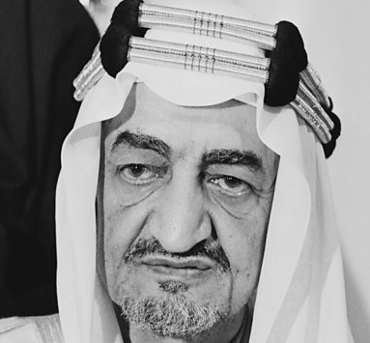
Timeline
Saudi Arabia
1953
1957
1958-59
1964
1964-75
Before his death in 1953, King Abd al-Aziz designates his eldest son, Prince Saud, the next king and appoints his second son, Prince Faisal, minister of foreign affairs. But Prince Saud will prove an ineffective ruler. His reign will be marked by inattention to governance and misuse of money.
The Middle East balance of power shifts after Gamal Abdel Nasser's overthrow of Egypt's king in 1952. Nasser proclaims himself a pan-Arabist -- a secular, socialist -- and allies himself with the Soviet Union against the West. Nasser also wants Saudi oil under his control, saying it belongs to all Arab people.
The U.S. moves to shore up support for Saud. President Eisenhower invites him for a state visit in Feb. 1957. Eisenhower wants to renew the lease on the Dhahran airbase, a useful strategic asset in the Cold War. Saud wants the money that the U.S. will pay to extend the lease. And he privately promises to suspend all aid to Egypt. To this day, the agreement that Faisal and Eisenhower sign constitutes the basis of U.S.-Saudi military cooperation.
But Saud soon spends the revenues from the Dhahran lease on luxury trips to Europe and falls out of favor with his own family.
In the late 50s, one of King Abd al-Aziz's younger sons, Prince Talal, begins a movement for political reform in the kingdom. In 1958, he drafts a new Saudi constitution to establish a national consultative council, a first step toward establishing a constitutional monarchy. But his proposal is rejected by King Saud and in 1961 he is forced from his position as transportation minister.
From exile in Egypt and Lebanon, Prince Talal announces the establishment of a royal opposition group comprised of some of his full brothers and other well-educated Saudis. It is nicknamed the "Free Princes." They continue to lobby for political reform, but without success.
By the early 60s, King Saud is losing support everywhere and has brought the country to the brink of economic collapse. The senior Al Saud brothers realize something has to be done and arrive at a consensus to replace Saud with a more capable leader. They go to the ulama, the religious authorities, and get a fatwa sanctioning Saud's abdication in favor of his half-brother Faisal. King Saud and his entourage quietly leave the country, and the ailing monarch spends his last years exiled in Athens, Greece, where he dies in 1969.
King Faisal begins a program of bringing the kingdom up to date, stressing economic development and educational improvements. During his reign oil revenues increase by more than 1,600 percent, enabling Faisal to build a communications and transportation infrastructure and set up a generous system of welfare benefits for all citizens. Even today, Saudi citizens do not pay taxes.
But almost every aspect of modernization brings the king into conflict with the religious establishment. For the ulama, innovation threatens Islam. To appease the conservatives, King Faisal allows Saudia Arabia to become a sanctuary for extremist Muslims from Egypt and Syria where the governments are cracking down on fundamentalist scholars and professionals. Faisal invites them to teach Saudi Arabia's youth. His decision will have far-reaching consequences; many of today's Saudi radicals studied under Egyptian and Syrian fundamentalists.
Partly due to his standing as a pious Muslim, Faisal is able to introduce cautious social reforms such as female education. In 1965, he approves the first television broadcast inside the kingdom -- a recitation of the Quran. Nonetheless, religious conservatives stage a large protest. When a nephew of the king is killed at the protest in clashes with the police, the king does nothing to punish the policemen. This decision will later have disastrous consequences.
King Faisal

Slide 23
Timeline
Saudi Arabia
https://www.pbs.org/wgbh/pages/frontline/shows/saud/cron/
1967
1973
1975
1975-79
1979
In the spring of 1967 war is brewing. President Nasser of Egypt moves troops to Israel's border and orders the UN out. Uniting against Israel, Faisal reconciles with Nasser. Fearing an attack is imminent, Israel launches a massive pre-emptive war. In just six days the bulk of Arab armies are destroyed and Arab leaders are humiliated. At Aramco's compounds, hundreds of Saudis riot against the United States. The Arab league pressures King Faisal to use Saudi oil as a weapon against the West.
In Oct. 1973, another Arab-Israeli war breaks out. Despite growing tensions, the Arab attack on Israel comes as a surprise. In the first day, Egyptian and Syrian armies gain considerable ground.
In the midst of the war, the U.S. airlifts supplies to Israel. The Arab League pressures Faisal for an oil boycott and Faisal acts, ordering Aramco to stop pumping. With Saudi oil kept off the market, world oil prices quadruple. President Nixon sends Secretary of State Henry Kissinger on an urgent mission to meet with Faisal. The Pentagon begins considering military options. Kissinger says oil is a national security priority, and if necessary, the U.S. will intervene militarily.
With the oil embargo having a major impact on the war in Vietnam, a secret solution is devised: King Faisal agrees to arrange for Saudi oil to be covertly supplied to the U.S. Navy. The oil embargo officially ends in 1974.
On the morning of March 25, King Faisal's past catches up with him. At a meeting with Kuwait's petroleum minister, one of the king's nephews, Faisal ibn Musaid, slips into the room. His brother had been killed by police at the 1965 protest against the introduction of television. Ibn Musaid shoots and kills the king. The assassination comes as a violent shock, especially because the killer is a member of the royal family.
As his father had decreed, King Faisal is succeeded by his half-brother Prince Khalid, who becomes the fourth king of Saudi Arabia.
During the reign of King Khalid, hundreds of billions in oil revenue pours into Saudi Arabia. The tiny population, estimated at four million and with only half a million literate males, finds it hard to absorb such wealth. The government begins a frenzied pace of buying and building. Foreign contractors flood in. Among those accumulating massive riches during these years are the bin Ladens, principal builders for the Al Saud royal family.
The boom also leads to widespread official corruption. Deals are riddled with influence peddling, bribes and oversize commissions. The Saudi royals, with their huge allowances, become notorious big spenders in Europe's casinos. Saudi leaders lose the credibility and respect of the country's religious conservatives.
One of Saudi Arabia's most shocking events occurs the morning of November 20, 1979. Several hundred Saudi fundamentalists take over al-Haram, the Great Mosque at Mecca and the holiest site in Islam. The leader of the insurgents is Juhayman al-Utaybi, a direct descendant of the Ikhwan, the Wahhabi warriors who helped the Al Saud family take power in the early 1920s.
The radicals call for a return to pure Islam, and a reversal of modernization. Juhayman also accuses the royal family of corruption and says they have lost their legitimacy because of their dealings with the West.
The royal family again turns to the ulama, the religious leaders of Saudi Arabia, and the clerics issue a fatwa based on verses from the Quran that allows the government to use all necessary force to retake the Great Mosque. The standoff lasts for several weeks before the Saudi military can remove the insurgents. More than 200 troops and dissidents are killed in the attacks and, to set an example, over sixty of the zealots are publicly beheaded in their hometowns.

Slide 24
Timeline
Saudi Arabia
1979
Late 70s – early 80s
1982
1990-91
1991
Shaken by the seizure of the Great Mosque by radical fundamentalists, the royal family moves to increase its religious standing and starts implementing a more Islamist agenda. They begin pumping millions into religious education under the ulama. Saudi charities raise even more. New theological schools and universities are built to produce large numbers of clerics who teach Wahhabism as the only true form of Islam and preach jihad against infidels is the obligation of every true believer.
This same year, the Wahhabis find a rallying cause like no other: The Soviet Union, the godless Communist power, invades the Muslim nation of Afghanistan. Saudi Arabia and the U.S. make a secret deal to contribute equal amounts to finance the Afghan war against the Soviets.
Thousands of young Saudis are sent to fight alongside the mujahideen in Afghanistan For the next decade, some 45,000 young Saudi volunteers will trek to Afghanistan where they acquire military skills and come to believe that dedicated Islamic fighters can defeat a superpower. One of their leaders is Osama bin Laden.
In the wake of Ayatollah Khomeini's bitterly anti-American Shi'a fundamentalist revolution in Iran and the Soviet Union's invasion of Afghanistan, the U.S. and Saudi Arabia strengthen their security relationship. Rising oil revenues allow the Saudis to increase military expenditures at all levels.
King Kahlid dies after a short illness and is succeeded by his half-brother Crown Prince Fahd. The new king will face economic constraints as oil prices decline in the late 80s.
Just as Fahd takes power, war breaks out between his two powerful neighbors, Iran and Iraq. Fahd befriends Saddam Hussein, a fellow Sunni, and gives him money and weapons to battle the Shi'a in Iran. But two years after the war ends, Saddam will invade neighboring Kuwait, with his eye on Saudi oil.
On August 2, 1990, Iraq invades Kuwait, and moves its troops toward the border of Saudi Arabia. Osama bin Laden visits members of the royal family and offers his Afghan-trained mujahideen to help fight Iraq, but they don't take his offer seriously.
King Fahd turns to his U.S. allies for help. But can he, the Defender of the Two Mosques of Mecca and Medina, invite hundreds of thousands of non-Muslim "infidel" troops into the kingdom? Once again, the royal family turns to the ulama for a ruling or fatwa. With their approval, over half a million U.S. troops arrive in Saudi Arabia and neighboring countries.
With U.S. women soldiers in many parts of the kingdom because of the Gulf War, Saudi women decide to challenge restrictions on their rights, including the right to drive. In November, forty-seven Saudi women meet at the parking lot of a Safeway and drive their cars through the streets of Riyadh. The women are arrested by the religious police, but released the same night under orders of Prince Salman, the governor of Riyadh.
The ulama calls their driving a depravity and issues the names and numbers of all 47 women, urging clerics to punish the women as they see fit. The Al Saud royal family publicly reasserts the ban on women drivers.

Slide 25
Timeline
Saudi Arabia
1992
1994
1995
1995-96
1996
1996
1996
A group of 107 Wahhabi religious figures sends a 46-page "Memorandum of Advice" to King Fahd criticizing the government for corruption and human rights abuses and for allowing U.S. troops on Saudi soil. The document calls on the government to more strictly follow shari'a, or Islamic law, and end relations with Western governments. King Fahd dismisses seven of the 17 members of the ulama for refusing to denounce the memorandum.
Amid calls for democratic reform, King Fahd introduces the "Basic Law of Government," essentially the country's first written constitution. The first of the laws specifies that Saudi Arabia is a sovereign Arab Islamic state with a monarchy headed by the House of Saud. The Al Saud's control of government remains tight, but the new laws make some concessions to reformers. For example, a Consultative Council of 60 members appointed by the king is created to interpret laws and make recommendations on matters of state. The laws also establish the first municipal governments in the country.
Following the government's arrest of two Wahhabi clerics for anti-government preaching, several thousand protestors stage demonstrations in the town of Buraida. The clerics accuse the monarchy of corruption and betraying Islam by allowing U.S. troops on the Arabian Peninsula. The government admits to arresting over a hundred protestors; opposition groups claim thousands were seized.
The incident ends up forcing the government to cede more control to the Wahhabi clerics, but only if the clerics promise to support the government. The two Wahhabi clerics are quietly released from prison in 1999.
Four years after the Gulf War, U.S. troops are still in the kingdom. Osama bin Laden seizes on the issue and his followers go on the offensive. On the morning of November 13, 1995 a massive bomb shakes the U.S.-operated Saudi National Guard training center in Riyadh. Five American military contractors and one U.S. soldier are killed. Those arrested say they are inspired by bin Laden.
Following a series of strokes in 1995 and 1996, King Fahd is no longer able to run the government and Crown Prince Abdullah, Fahd's half brother, becomes the kingdom's de facto ruler.
On the morning of June 25,1996 a large truck bomb explodes at the U.S. military residence in Dhahran called Khobar Towers, killing 19 U.S. servicemen. U.S. law enforcement efforts to investigate the bombing are met with resistance by Saudi officials. Five years later, a federal grand jury will indict 13 Saudis and one Lebanese man for the attack.
In his 1996 declaration of war against the Americans occupying the lands of the Two Holy Places, Osama bin Laden calls on Muslims everywhere to fight the Jews and crusaders. He also accuses the Saudi royal family of pocketing the national wealth.
Arab satellite television begins broadcasting throughout the region, beyond the control of the Saudi monarchy. For the first time, Saudi citizens see for themselves reports of their country's shortcomings: the lack of civil rights, political freedoms, royal corruption. Disturbing images of the Arab-Israeli conflict become part of Saudis' daily viewing.
Throughout the 90s, U.S. efforts to forge a lasting peace in the Israeli-Palestinian conflict are unsuccessful. When the Saudis sense that the new U.S. president, George W. Bush, might abandon the peace process, they decide to take a more active role.

Slide 26
Timeline
Saudi Arabia
August 2001
Sept. 11, 2001
April 2003
May 2003
2004
Nov. 2004
2003-05
Frustrated by what he sees as a continuing pro-Israeli bias by the Bush administration and its predecessors, Crown Prince Abdullah sends an angry letter to President Bush on August 29, stating that if the U.S. does not behave in a more equitable manner toward the Palestinians, the Saudis will have to reconsider their long-standing alliance with the U.S. But before any measurable action can be taken on his complaint, the terrorist attacks of Sept. 11 occur.
At the official level, the Saudi government is appalled by the terrorist attacks in the U.S. and publishes a statement calling them "regrettable" and "inhuman." Although it is known almost immediately that 15 of the 19 hijackers in the Al Qaeda plot are Saudi citizens, months pass before the Saudi government will admit it.
America's subsequent war on terror in Afghanistan against Al Qaeda deeply divides Saudis. But Saudi leaders quietly allow the U.S. military to use Saudi air bases for command and control operations.
Saudi militants captured in Afghanistan will make up the biggest segment of the population shipped to the prison camps in Guantanamo Bay, Cuba.
Just days after Baghdad falls to U.S. forces in Iraq, U.S. Secretary of Defense Donald Rumsfeld arrives in Riyadh to announce that U.S. troops will pull out of Saudi air bases. For more than ten years, the American presence in the Land of the Two Holy Mosques has been a rallying cry for Al Qaeda.
The fact that U.S. troops are withdrawing from the kingdom makes no difference to Al Qaeda. On May 12, 2003 Al Qaeda militants attack three compounds in Riyadh that house hundreds of foreign workers. Thirty-five people are killed, including nine Americans. Over one hundred are wounded. Shocked, Saudi society and the royal family begin to look inward and to question how their own citizens could have been behind the attacks.
In early 2004, a group of prominent Saudi citizens, including attorney Bassim Alim, petition the government for constitutional reforms.
Prince Nayef, the minister of the interior, meets with them and insists that the petitions stop. Shortly after, many of the petitioners are arrested.
At Friday prayers on November 5, 2004, twenty-six prominent Saudi clerics, including Sheikh Nasser al-Omar, sign a fatwa saying that Iraqis should rise up and oppose the Americans in Iraq. Many interpret the fatwa as encouraging all Muslims to go fight the Americans.
In Dec. 2004, a young Saudi medical student travels to Mosul, Iraq and detonates a bomb that kills 22 U.S. soldiers. To date, an unknown number of Saudis have traveled to Iraq to join the insurgency.
From May 2003 to December 2004, some 100 people are killed in attacks by Al Qaeda in Saudi Arabia. Westerners are a prime target. In the summer of 2004, a BBC cameraman is gunned down while filming in a Riyadh street. Two days later, a U.S. defense contractor is shot to death in his garage. A week later, another U.S. defense worker is killed outside his home in Riyadh, and U.S. engineer Paul Johnson is abducted by terrorists and is seen being beheaded in a video that is put on the Internet.
In December 2004 an assault on the U.S. consulate in Jeddah leaves five foreign staff dead. Two weeks later, the Saudi Ministry of the Interior is car bombed. As of February 2005, thousands of Americans have pulled out of the kingdom and British Airways has suspended flights to the country.
On Aug. 1, 2005, King Fahd dies at the age of 82, and his half-brother Abdullah is officially named monarch. Today, King Abdullah and the Saudi royal family face the most severe challenge in its one hundred-year history and straining its oil-for-security alliance with the U.S. Ultimately, the Saudis believe an oil dependent America cannot afford Saudi Arabia's demise. The House of Saud believes it will survive.

Slide 27
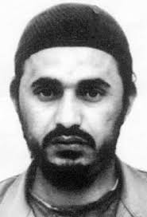
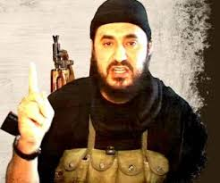
ISIS
https://www.history.com/topics/21st-century/isis
2003
2004
2006
2010
2013
US invades Iraq
al Qaeda in Iraq formed by
al-Zarqawi to remove Western occupation
US kills
al-Zarqawi
Al-Masri renames to ISI
Islamic State of Iraq
al Masri dies
Abu Bakr
al-Baghdadi takes over
ISIS
Islamic State of Iraq and Syria
The Making of ISIS
The roots of ISIS trace back to 2004, when the organization known as “al Qaeda in Iraq” formed. Abu Musab al-Zarqawi, who was originally part of Osama bin Laden’s al Qaeda Network, founded this militant group.
The U.S. invasion of Iraq began in 2003, and the aim of al Qaeda in Iraq was to remove Western occupation and replace it with a Sunni Islamist regime.
When Zarqawi was killed during a U.S. airstrike in 2006, Egyptian Abu Ayyub al-Masri became the new leader and renamed the group “ISI,” which stood for “Islamic State of Iraq.” In 2010, Masri died in a US-Iraqi operation, and Abu Bakr al-Baghdadi took power.
When the civil war in Syria started, ISI fought against Syrian forces and gained ground throughout the region. In 2013, the group officially renamed themselves “ISIS,” which stands for “Islamic State of Iraq and Syria,” because they had expanded into Syria.

Slide 28
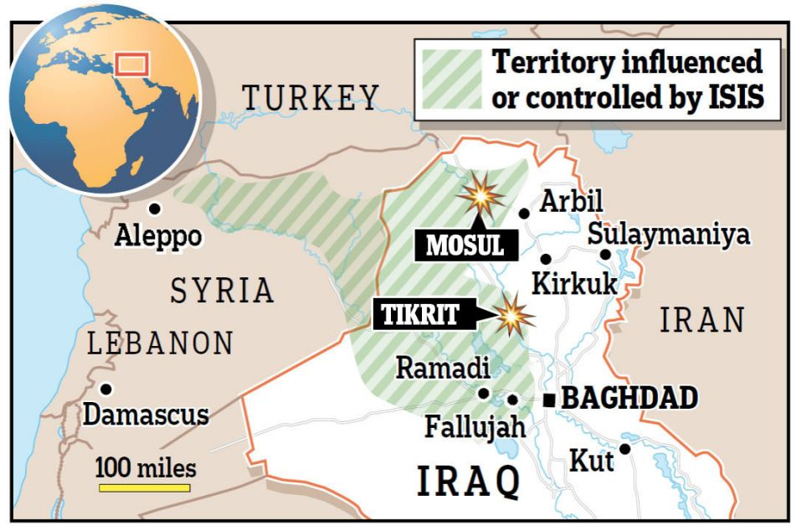
https://www.history.com/topics/21st-century/isis
ISIS
2003
2004
2006
2010
2013
2014
US invades Iraq
al Qaeda in Iraq formed by
al-Zarqawi to remove Western occupation
US kills
al-Zarqawi
Al-Masri renames to ISI
Islamic State of Iraq
al Masri dies
Abu Bakr
al-Baghdadi takes over
ISIS
Islamic State of Iraq and Syria
ISIS
Takes Falluja, Mosul, Tikrit
Declares caliphate
International media coverage: Yazidis
Al Qaeda breaks with ISIS
ISIS and Sharia Law
ISIS rule spread quickly throughout Iraq and Syria. The group focused on creating an Islamic state and implementing sharia law—a strict religious code based on traditional Islamic rules and practices.
In 2014, ISIS took control of Falluja, Mosul and Tikrit in Iraq, and declared itself a caliphate, which is a political and religious territory ruled by a leader known as a caliph.
ISIS fighters attacked a northern town in Iraq that was home to the Yazidis, a minority religious group, in August 2014. They killed hundreds of people, sold women into slavery, forced religious conversions and caused tens of thousands of Yazidis to flee from their homes.
The attack sparked international media coverage and brought attention to the brutal tactics employed by ISIS. Also in 2014, al Qaeda broke ties with ISIS, formally rejecting the group and disavowing their activities.

Slide 29
https://www.politico.com/news/2019/10/27/baghdadi-islamic-rise-fall-058970
ISIS
2003
2004
2006
2010
2013
2014
2019
US invades Iraq
al Qaeda in Iraq formed by
al-Zarqawi to remove Western occupation
US kills
al-Zarqawi
Al-Masri renames to ISI
Islamic State of Iraq
al Masri dies
Abu Bakr
al-Baghdadi takes over
ISIS
Islamic State of Iraq and Syria
ISIS
Takes Falluja, Mosul, Tikrit
Declares caliphate
International media coverage: Yazidis
Al Qaeda breaks with ISIS
Caliphate ends
The Islamic State group erupted from the chaos of Syria and Iraq’s conflicts and swiftly did what no Islamic militant group had done before, conquering a giant stretch of territory and declaring itself a “caliphate.”
Its territorial rule, which at its height in 2014 stretched across nearly a third of both Syria and Iraq, ended in March (2019) with a last stand by several hundred of its militants at a tiny Syrian village on the banks of the Euphrates near the border with Iraq.

Slide 30
ISIS
https://www.straitstimes.com/world/middle-east/timeline-the-rise-and-fall-of-isis
Sept.2014
2003
2004
2006
2010
2011
2013
2014
2019
US invades Iraq
al Qaeda in Iraq formed by
al-Zarqawi to remove Western occupation
US kills
al-Zarqawi
Al-Masri renames to ISI
Islamic State of Iraq
al Masri dies
Abu Bakr
al-Baghdadi takes over
ISIL
Islamic State of Iraq and the Levant
Sets up in Syria
ISIS
Islamic State of Iraq and Syria
ISIS
Takes Falluja, Mosul, Tikrit
Declares caliphate
International media coverage: Yazidis
Al Qaeda breaks with ISIS
US coalition
Airstrikes begin
Caliphate ends
2004-11 - In the chaos following the 2003 US-led invasion of Iraq, an Al-Qaeda offshoot sets up there, changing its name in 2006 to Islamic State in Iraq.
2011 - After Syria's crisis begins, the group's leader Abu Bakr al-Baghdadi sends operatives there to set up a Syrian subsidiary. Baghdadi follows in 2013, breaking with Al-Qaeda and renaming his group "The Islamic State in Iraq and the Levant".
2014 - Its sudden success starts with the seizure of Fallujah in Iraq and Raqqa in Syria at the turn of the year. The extremists take Mosul and Tikrit in June and overrun the border with Syria. At Mosul's great Mosque, Baghdadi renames the group Islamic State (IS) and declares a caliphate.
So begins a reign of terror. In Iraq, ISIS slaughters thousands of Yazidis in Sinjar and forces more than 7,000 women and girls into sexual slavery. In Syria, it massacres hundreds of members of the Sheitaat tribe. ISIS beheads Western hostages in grotesquely choreographed films.
In September, the United States builds a coalition against ISIS and starts air strikes to stop its momentum, helping the Syrian Kurdish YPG militia turn the militants back from Kobani on the border with Turkey.

Slide 31
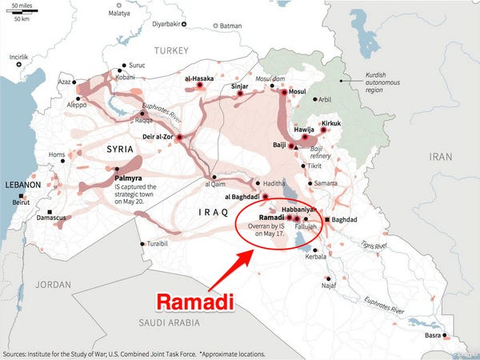
https://www.straitstimes.com/world/middle-east/timeline-the-rise-and-fall-of-isis
ISIS
Sept.2014
2003
2004
2006
2010
2011
2013
2014
2015
2019
US invades Iraq
al Qaeda in Iraq formed by
al-Zarqawi to remove Western occupation
US kills
al-Zarqawi
Al-Masri renames to ISI
Islamic State of Iraq
al Masri dies
Abu Bakr
al-Baghdadi takes over
ISIL
Islamic State of Iraq and the Levant
Sets up in Syria
ISIS
Islamic State of Iraq and Syria
ISIS
Takes Falluja, Mosul, Tikrit
Declares caliphate
International media coverage: Yazidis
Al Qaeda breaks with ISIS
US coalition
Airstrikes begin
Paris attack
Charlie Hebdo Newspaper
Caliphate ends
2015 - Militants in Paris attack a satirical newspaper and a kosher supermarket, the bloody start to a wave of attacks that ISIS claims around the world. Militants in Libya behead Christians and pledge allegiance to ISIS, followed by groups in other countries, but they stay operationally independent.
In May, ISIS takes Ramadi in Iraq and the ancient desert town of Palmyra in Syria, but by the end of the year it is on the back foot in both countries.
Terrorists Strike Charlie Hebdo Newspaper in Paris, Leaving 12 Dead
The attack comes as thousands of Europeans have joined jihadist groups in Iraq and Syria, further fueling concerns about Islamic radicalism and terrorism being imported. Those worries have been especially acute in France, where fears have grown that militants are bent on retaliation for the government’s support for the United States-led air campaign against jihadists with the Islamic State group in Syria and Iraq.
https://www.nytimes.com/2015/01/08/world/europe/charlie-hebdo-paris-shooting.html

Slide 32
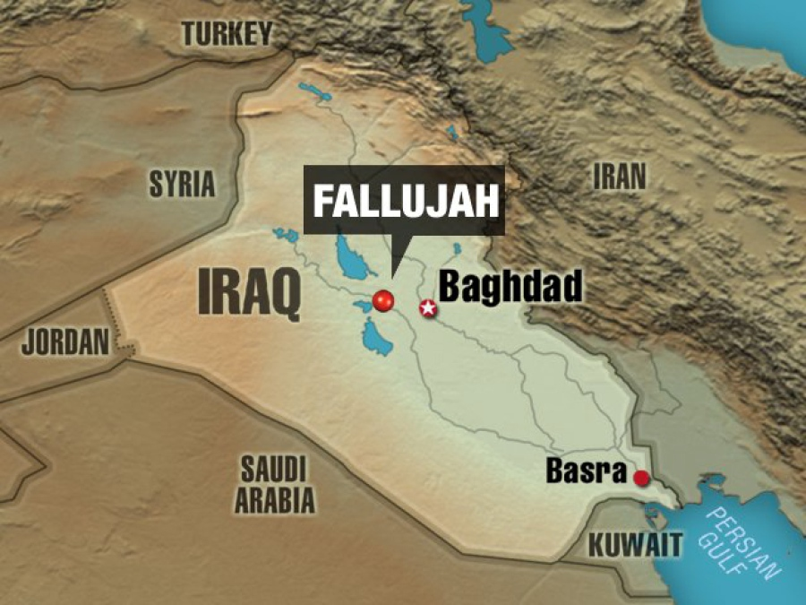
https://www.straitstimes.com/world/middle-east/timeline-the-rise-and-fall-of-isis
ISIS
Sept.2014
2003
2004
2006
2010
2011
2013
2014
2015
2016
2019
US invades Iraq
al Qaeda in Iraq formed by
al-Zarqawi to remove Western occupation
US kills
al-Zarqawi
Al-Masri renames to ISI
Islamic State of Iraq
al Masri dies
Abu Bakr
al-Baghdadi takes over
ISIL
Islamic State of Iraq and the Levant
Sets up in Syria
ISIS
Islamic State of Iraq and Syria
ISIS
Takes Falluja, Mosul, Tikrit
Declares caliphate
International media coverage: Yazidis
Al Qaeda breaks with ISIS
US coalition
Airstrikes begin
Paris attack
Charlie Hebdo Newspaper
Iraq takes back Falluja
Turkey strikes ISIS and YPG
Caliphate ends
2016 - Iraq takes back Fallujah in June, the first town ISIS had captured during its initial blaze of success. In August, the US-backed Syrian Democratic Forces (SDF), spearheaded by the Kurdish YPG, takes Manbij in Syria.
Alarmed by the Kurdish advances near its own frontier, Turkey launches an offensive into Syria against both ISIS and the YPG. Enmity between Turkey and the YPG will continue to complicate operations against ISIS.
The YPG is a mainly-Kurdish militia in Syria and the primary component of the Syrian Democratic Forces (SDF).^{[4][5]} The YPG mostly consists of ethnic Kurds, but also includes Arabs and foreign volunteers; it is closely allied to the Syriac Military Council, a militia of Assyrians. The YPG was formed in 2011. It expanded rapidly in the Syrian Civil War and came to predominance over other armed Kurdish groups. A sister group, the Women's Protection Units (YPJ), fights alongside them. The YPG is active in Northern and Eastern Syria.

Slide 33
https://www.straitstimes.com/world/middle-east/timeline-the-rise-and-fall-of-isis
ISIS
Sept.2014
2003
2004
2006
2010
2011
2013
2014
2015
2016
2017
2018
2019
US invades Iraq
al Qaeda in Iraq formed by
al-Zarqawi to remove Western occupation
US kills
al-Zarqawi
Al-Masri renames to ISI
Islamic State of Iraq
al Masri dies
Abu Bakr
al-Baghdadi takes over
ISIL
Islamic State of Iraq and the Levant
Sets up in Syria
ISIS
Islamic State of Iraq and Syria
ISIS
Takes Falluja, Mosul, Tikrit
Declares caliphate
International media coverage: Yazidis
Al Qaeda breaks with ISIS
US coalition
Airstrikes begin
Paris attack
Charlie Hebdo Newspaper
Iraq takes back Falluja
Turkey strikes ISIS and YPG
ISIS loses Mosul
Baghdad declares end of caliphate
Syrian gov. retakes territories
US vows to remove troops
ISIS fighters defeated at Baghous
SDF declares Caliphate “eliminated”
2017 - ISIS suffers a year of catastrophic defeats. In June it loses Mosul to Iraqi forces after months of fighting and Baghdad declares the end of the caliphate. In September the Syrian army races eastwards backed by Russia and Iran to relieve Deir al-Zor and re-extend state control at the Euphrates River. In October, the SDF drives ISIS from Raqqa.
2018 - The Syrian government retakes ISIS enclaves in Yarmouk, south of Damascus, and on the frontier with the Israeli-occupied Golan Heights. The SDF advances further down the Euphrates and Iraqi forces take the rest of the border region. The US vows to withdraw troops.
2019 - ISIS fighters are defeated at their last enclave on the Euphrates at the village of Baghouz, the SDF says. The SDF declares the "caliphate" eliminated.

Slide 34
https://www.npr.org/2019/03/22/701266887/analysis-the-end-of-the-caliphate-doesn-t-mean-the-end-of-isis
ISIS
Sept.2014
2003
2004
2006
2010
2011
2013
2014
2015
2016
2017
2018
2019
US invades Iraq
al Qaeda in Iraq formed by
al-Zarqawi to remove Western occupation
US kills
al-Zarqawi
Al-Masri renames to ISI
Islamic State of Iraq
al Masri dies
Abu Bakr
al-Baghdadi takes over
ISIL
Islamic State of Iraq and the Levant
Sets up in Syria
ISIS
Islamic State of Iraq and Syria
ISIS
Takes Falluja, Mosul, Tikrit
Declares caliphate
International media coverage: Yazidis
Al Qaeda breaks with ISIS
US coalition
Airstrikes begin
Paris attack
Charlie Hebdo Newspaper
Iraq takes back Falluja
Turkey strikes ISIS and YPG
ISIS loses Mosul
Baghdad declares end of caliphate
Syrian gov. retakes territories
US vows to remove troops
ISIS fighters defeated at Baghous
SDF declares Caliphate “eliminated”
2019
Analysis: The End Of The 'Caliphate' Doesn't Mean The End Of ISIS
Here are five things to know after the declaration of the defeat of the ISIS "caliphate."

Slide 35
https://www.npr.org/2019/03/22/701266887/analysis-the-end-of-the-caliphate-doesn-t-mean-the-end-of-isis
ISIS
Sept.2014
2003
2004
2006
2010
2011
2013
2014
2015
2016
2017
2018
2019
US invades Iraq
al Qaeda in Iraq formed by
al-Zarqawi to remove Western occupation
US kills
al-Zarqawi
Al-Masri renames to ISI
Islamic State of Iraq
al Masri dies
Abu Bakr
al-Baghdadi takes over
ISIL
Islamic State of Iraq and the Levant
Sets up in Syria
ISIS
Islamic State of Iraq and Syria
ISIS
Takes Falluja, Mosul, Tikrit
Declares caliphate
International media coverage: Yazidis
Al Qaeda breaks with ISIS
US coalition
Airstrikes begin
Paris attack
Charlie Hebdo Newspaper
Iraq takes back Falluja
Turkey strikes ISIS and YPG
ISIS loses Mosul
Baghdad declares end of caliphate
Syrian gov. retakes territories
US vows to remove troops
ISIS fighters defeated at Baghous
SDF declares Caliphate “eliminated”
2019
ISIS is not defeated
U.S.-backed forces have retaken nearly all the small pockets in Syria that were still under ISIS control. But many ISIS fighters are believed to have blended in with the local population, according to U.S. officials. Russ Travers, the deputy director of the National Counterterrorism Center, estimates there are about 14,000 ISIS fighters still in Syria and Iraq. They remain armed and have carried out recent attacks such as the January suicide bombing in the northern Syrian town of Manbij that killed at least 16 people, including four Americans. What's more, ISIS' ideology remains potent and continues to inspire attacks in Europe and Afghanistan. It's unlikely there is a command structure directing terrorist attacks around the globe, but local groups identify as ISIS.

Slide 36
https://www.npr.org/2019/03/22/701266887/analysis-the-end-of-the-caliphate-doesn-t-mean-the-end-of-isis
ISIS
Sept.2014
2003
2004
2006
2010
2011
2013
2014
2015
2016
2017
2018
2019
US invades Iraq
al Qaeda in Iraq formed by
al-Zarqawi to remove Western occupation
US kills
al-Zarqawi
Al-Masri renames to ISI
Islamic State of Iraq
al Masri dies
Abu Bakr
al-Baghdadi takes over
ISIL
Islamic State of Iraq and the Levant
Sets up in Syria
ISIS
Islamic State of Iraq and Syria
ISIS
Takes Falluja, Mosul, Tikrit
Declares caliphate
International media coverage: Yazidis
Al Qaeda breaks with ISIS
US coalition
Airstrikes begin
Paris attack
Charlie Hebdo Newspaper
Iraq takes back Falluja
Turkey strikes ISIS and YPG
ISIS loses Mosul
Baghdad declares end of caliphate
Syrian gov. retakes territories
US vows to remove troops
ISIS fighters defeated at Baghous
SDF declares Caliphate “eliminated”
2019
Thousands of ISIS members and relatives are in limbo
There are thousands of wives and children of ISIS fighters or people loosely connected to the militants whose fate is undetermined and, in many cases, are being mistreated. A recent Human Rights Watch report says in just one corner of the war — northern Iraq — Kurdish authorities are holding 1,500 children under 18 years old in detention and torturing many. Also unknown is the fate of thousands of Western men and women, mostly from Europe but also from North America. About 1,800 women and children from Europe and elsewhere are languishing in detention camps in northeastern Syria. Their countries are hesitant to take them back home because the authorities don't know what to do with them — whether they can prosecute them or prevent them from being domestic security threats once they return. Advocates of those detained say their home countries have a responsibility to take them back and either prosecute them or release them. They also say that letting them languish endlessly in camps just breeds more radicalism.

Slide 37
https://www.npr.org/2019/03/22/701266887/analysis-the-end-of-the-caliphate-doesn-t-mean-the-end-of-isis
ISIS
Sept.2014
2003
2004
2006
2010
2011
2013
2014
2015
2016
2017
2018
2019
US invades Iraq
al Qaeda in Iraq formed by
al-Zarqawi to remove Western occupation
US kills
al-Zarqawi
Al-Masri renames to ISI
Islamic State of Iraq
al Masri dies
Abu Bakr
al-Baghdadi takes over
ISIL
Islamic State of Iraq and the Levant
Sets up in Syria
ISIS
Islamic State of Iraq and Syria
ISIS
Takes Falluja, Mosul, Tikrit
Declares caliphate
International media coverage: Yazidis
Al Qaeda breaks with ISIS
US coalition
Airstrikes begin
Paris attack
Charlie Hebdo Newspaper
Iraq takes back Falluja
Turkey strikes ISIS and YPG
ISIS loses Mosul
Baghdad declares end of caliphate
Syrian gov. retakes territories
US vows to remove troops
ISIS fighters defeated at Baghous
SDF declares Caliphate “eliminated”
2019
U.S. troops will stay in Syria
President Trump declared in December that all U.S. troops in Syria — some 2,000 — would be withdrawn following the defeat of the territorial caliphate. The decision led to an outpouring of criticism. Defense Secretary Jim Mattis resigned; opposition in Congress was bipartisan; France and Britain, which also have troops in Syria, said they would leave with the U.S. The administration now says about 200 service members will remain in northeast Syria near the border with Turkey and another 200 or so near the Iraq border at a garrison called al-Tanf. France and Britain now say their troops will remain as well. U.S. officials say the troops' purpose is observation and counterterrorism, but their presence also serves to protect Kurdish allies who led the ground war against ISIS. Turkey has threatened to attack those forces, which it considers to be anti-Turkey terrorists.

Slide 38
ISIS
https://www.npr.org/2019/03/22/701266887/analysis-the-end-of-the-caliphate-doesn-t-mean-the-end-of-isis
Sept.2014
2003
2004
2006
2010
2011
2013
2014
2015
2016
2017
2018
2019
US invades Iraq
al Qaeda in Iraq formed by
al-Zarqawi to remove Western occupation
US kills
al-Zarqawi
Al-Masri renames to ISI
Islamic State of Iraq
al Masri dies
Abu Bakr
al-Baghdadi takes over
ISIL
Islamic State of Iraq and the Levant
Sets up in Syria
ISIS
Islamic State of Iraq and Syria
ISIS
Takes Falluja, Mosul, Tikrit
Declares caliphate
International media coverage: Yazidis
Al Qaeda breaks with ISIS
US coalition
Airstrikes begin
Paris attack
Charlie Hebdo Newspaper
Iraq takes back Falluja
Turkey strikes ISIS and YPG
ISIS loses Mosul
Baghdad declares end of caliphate
Syrian gov. retakes territories
US vows to remove troops
ISIS fighters defeated at Baghous
SDF declares Caliphate “eliminated”
2019
Syria and Iraq are still unstable
The conditions in Iraq and Syria are still conducive to conflict and extremism. The war against ISIS ended the group's brutal rule but also came at a high cost that will continue to cause suffering. Intensive U.S. airstrikes numbering in the thousands in Mosul, Iraq and Raqqa, Syria, and other cities killed thousands of civilians — though the totals are uncounted. Large areas of cities remain destroyed, with people homeless and living in refugee camps. Major reconstruction is needed and, in the case of Syria especially, there is no plan to undertake it. Many blame the U.S. and allied local fighters for the destruction as much as ISIS. In Iraq, Sunni Muslims say they're abused by Shiite militias that paint them as accomplices of the Sunni extremists in ISIS. Meanwhile, victims of ISIS want revenge. These are the kinds of conditions ISIS exploited when it rose to prominence and started taking over cities in Syria and Iraq a few years ago. In Syria, the U.S. cut money for programs to help stabilize the city of Raqqa and asked other countries, including Saudi Arabia, to pay the bill.

Slide 39
https://www.npr.org/2019/03/22/701266887/analysis-the-end-of-the-caliphate-doesn-t-mean-the-end-of-isis
ISIS
Sept.2014
2003
2004
2006
2010
2011
2013
2014
2015
2016
2017
2018
2019
US invades Iraq
al Qaeda in Iraq formed by
al-Zarqawi to remove Western occupation
US kills
al-Zarqawi
Al-Masri renames to ISI
Islamic State of Iraq
al Masri dies
Abu Bakr
al-Baghdadi takes over
ISIL
Islamic State of Iraq and the Levant
Sets up in Syria
ISIS
Islamic State of Iraq and Syria
ISIS
Takes Falluja, Mosul, Tikrit
Declares caliphate
International media coverage: Yazidis
Al Qaeda breaks with ISIS
US coalition
Airstrikes begin
Paris attack
Charlie Hebdo Newspaper
Iraq takes back Falluja
Turkey strikes ISIS and YPG
ISIS loses Mosul
Baghdad declares end of caliphate
Syrian gov. retakes territories
US vows to remove troops
ISIS fighters defeated at Baghous
SDF declares Caliphate “eliminated”
2019
Abu Bakr al-Baghdadi is alive — or not
The fate of the self-described caliph, Abu Bakr al-Baghdadi, remains unknown. He has been reported "killed" perhaps a half-dozen times. In 2017, a Russian lawmaker said a Russian airstrike "close to 100 percent" killed him. U.S. military officials in Syria believe he is still alive, hiding out in the desert near the Syria-Iraq border, based on communications intercepts and interviews with ISIS detainees. Last August, ISIS released an audio recording purporting to be Baghdadi, but he has not been heard from since.

Slide 40
ISIS
https://abcnews.go.com/Politics/pentagon-report-al-baghdadi-death-impact-isis-leadership/story?id=68755044
Sept.2014
2003
2004
2006
2010
2011
2013
2014
2015
2016
2017
2018
2019
US invades Iraq
al Qaeda in Iraq formed by
al-Zarqawi to remove Western occupation
US kills
al-Zarqawi
Al-Masri renames to ISI
Islamic State of Iraq
al Masri dies
Abu Bakr
al-Baghdadi takes over
ISIL
Islamic State of Iraq and the Levant
Sets up in Syria
ISIS
Islamic State of Iraq and Syria
ISIS
Takes Falluja, Mosul, Tikrit
Declares caliphate
International media coverage: Yazidis
Al Qaeda breaks with ISIS
US coalition
Airstrikes begin
Paris attack
Charlie Hebdo Newspaper
Iraq takes back Falluja
Turkey strikes ISIS and YPG
ISIS loses Mosul
Baghdad declares end of caliphate
Syrian gov. retakes territories
US vows to remove troops
ISIS fighters defeated at Baghous
SDF declares Caliphate “eliminated”
2019
"USCENTCOM and the DIA both assessed that the October death of al-Baghdadi did not result in any immediate degradation to ISIS’s capabilities," the Pentagon's report -- released every three months -- said on Tuesday. "USCENTCOM told the DoD OIG that following the death of ISIS leader Abu Bakr al-Baghdadi, the group’s capabilities in Syria remained the same.“
The IG added, "USCENTCOM said that ISIS remained cohesive, with an intact command and control structure, urban clandestine networks, and an insurgent presence in much of rural Syria."

Slide 41
https://abcnews.go.com/Politics/pentagon-report-al-baghdadi-death-impact-isis-leadership/story?id=68755044
ISIS
Sept.2014
2003
2004
2006
2010
2011
2013
2014
2015
2016
2017
2018
2019
US invades Iraq
al Qaeda in Iraq formed by
al-Zarqawi to remove Western occupation
US kills
al-Zarqawi
Al-Masri renames to ISI
Islamic State of Iraq
al Masri dies
Abu Bakr
al-Baghdadi takes over
ISIL
Islamic State of Iraq and the Levant
Sets up in Syria
ISIS
Islamic State of Iraq and Syria
ISIS
Takes Falluja, Mosul, Tikrit
Declares caliphate
International media coverage: Yazidis
Al Qaeda breaks with ISIS
US coalition
Airstrikes begin
Paris attack
Charlie Hebdo Newspaper
Iraq takes back Falluja
Turkey strikes ISIS and YPG
ISIS loses Mosul
Baghdad declares end of caliphate
Syrian gov. retakes territories
US vows to remove troops
ISIS fighters defeated at Baghous
SDF declares Caliphate “eliminated”
2019
But the Central Command also reported that the terror group "did not significantly advance its insurgency" and has struggled to attack U.S. or coalition forces.
The military command said that ISIS has had more success with low-level attacks against local government and Kurdish forces in both Iraq and Syria.
Following Turkey's invasion into northern Syria, President Donald Trump initially ordered a full withdrawal of the 1,000 U.S. troops in Syria helping Kurdish forces in the fight against ISIS.
The withdrawal changed in scope after Trump said hundreds of U.S. forces would remain in Syria to prevent ISIS from regaining access to key oil fields in Kurdish held areas from which the terror group might gain revenue for its operations.

Slide 42
https://apnews.com/9b76ca4f828542f38300dd171be62497
ISIS
Sept.2014
2003
2004
2006
2010
2011
2013
2014
2015
2016
2017
2018
2019
US invades Iraq
al Qaeda in Iraq formed by
al-Zarqawi to remove Western occupation
US kills
al-Zarqawi
Al-Masri renames to ISI
Islamic State of Iraq
al Masri dies
Abu Bakr
al-Baghdadi takes over
ISIL
Islamic State of Iraq and the Levant
Sets up in Syria
ISIS
Islamic State of Iraq and Syria
ISIS
Takes Falluja, Mosul, Tikrit
Declares caliphate
International media coverage: Yazidis
Al Qaeda breaks with ISIS
US coalition
Airstrikes begin
Paris attack
Charlie Hebdo Newspaper
Iraq takes back Falluja
Turkey strikes ISIS and YPG
ISIS loses Mosul
Baghdad declares end of caliphate
Syrian gov. retakes territories
US vows to remove troops
ISIS fighters defeated at Baghous
SDF declares Caliphate “eliminated”
2019
BEIRUT (AP) — A media arm of the Islamic State group is reporting that militants from Egypt’s Sinai and Bangladesh have pledged allegiance to the new leader, who succeeded Abu Bakr al-Baghdadi, in the first sign of support from the organization’s global affiliates.
Nasher news, which carries the group’s news releases, posted pictures Saturday of a handful of militants purportedly from Bangladesh with their faces covered standing under the group’s black flag. Their index fingers were raised to pledge allegiance to new leader Abu Ibrahim al-Hashemi Al-Qurayshi. Other pictures showed militants purportedly from Egypt’s Sinai with their rifles and index fingers raised. The agency reports they too were pledging allegiance to the new leader.
Al-Baghdadi was killed last week in a U.S. raid in Syria. Al-Qurayshi was named his successor Thursday.

Slide 43
ISIS
https://www.voanews.com/middle-east/us-officials-uncover-true-identity-new-islamic-state-leader
Sept.2014
2003
2004
2006
2010
2011
2013
2014
2015
2016
2017
2018
2019
US invades Iraq
al Qaeda in Iraq formed by
al-Zarqawi to remove Western occupation
US kills
al-Zarqawi
Al-Masri renames to ISI
Islamic State of Iraq
al Masri dies
Abu Bakr
al-Baghdadi takes over
ISIL
Islamic State of Iraq and the Levant
Sets up in Syria
ISIS
Islamic State of Iraq and Syria
ISIS
Takes Falluja, Mosul, Tikrit
Declares caliphate
International media coverage: Yazidis
Al Qaeda breaks with ISIS
US coalition
Airstrikes begin
Paris attack
Charlie Hebdo Newspaper
Iraq takes back Falluja
Turkey strikes ISIS and YPG
ISIS loses Mosul
Baghdad declares end of caliphate
Syrian gov. retakes territories
US vows to remove troops
ISIS fighters defeated at Baghous
SDF declares Caliphate “eliminated”
2020
WASHINGTON - U.S. defense officials believe they have unmasked the Islamic State terror group’s current leader, until now known by his nom de guerre, Abu Ibrahim al-Hashimi al-Qurashi.
IS announced the selection of Qurashi as its new caliph this past October, just days after the death of former leader Abu Bakr al-Baghdadi in a U.S. raid, but his true identity has been a question.

Slide 44
https://youtu.be/vxN8oEnIQ2w

