Slide 1
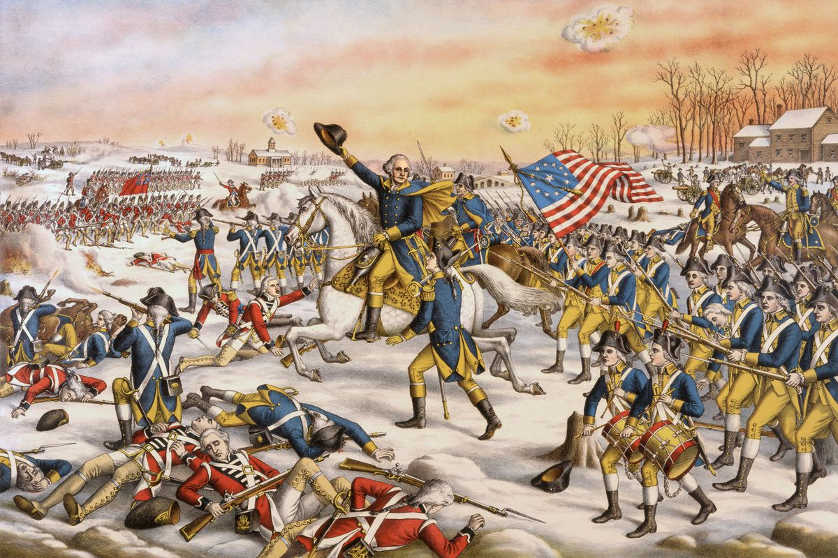
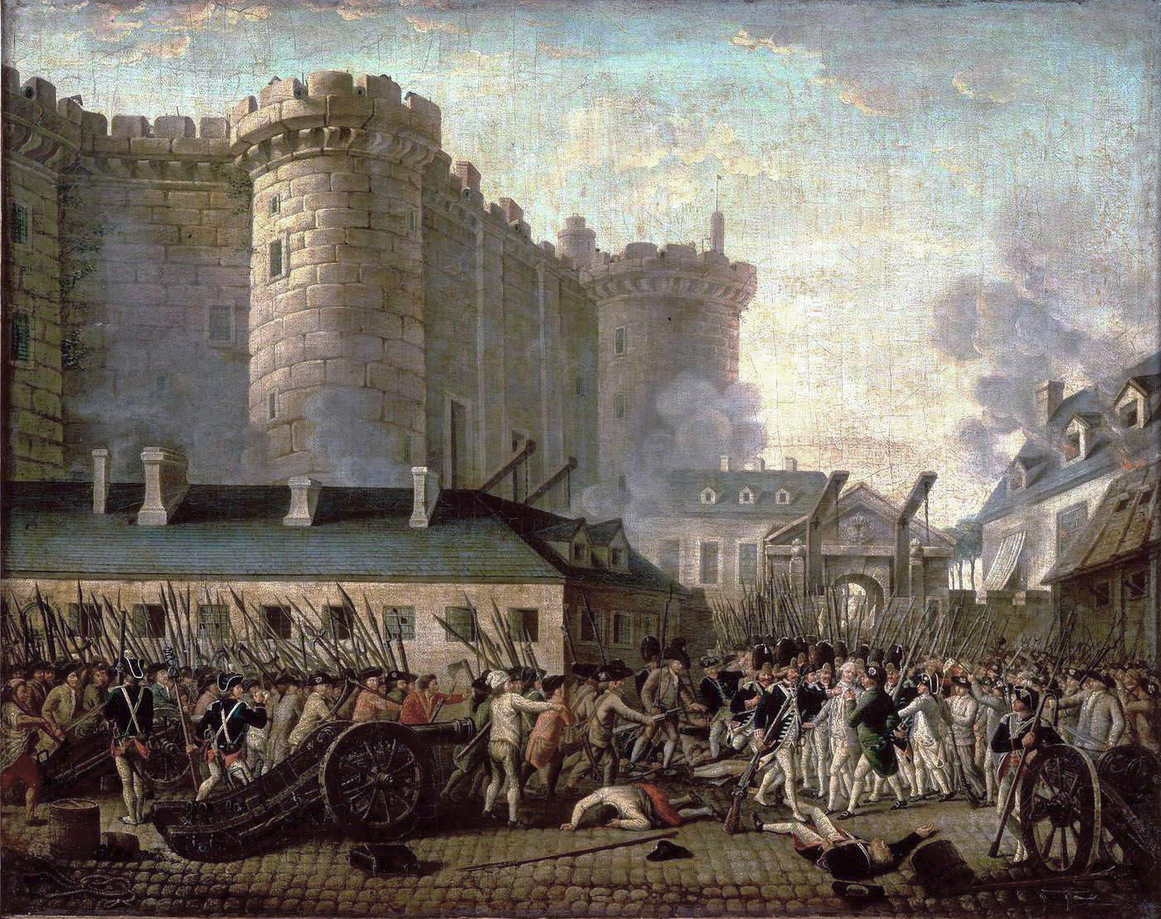
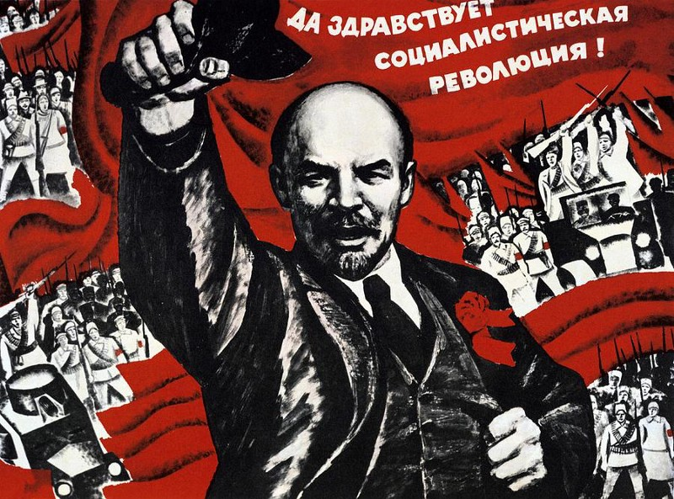
The Lines of Revolutions by Tess Lambert
5
WSF
Weekend Prophecy School
(11-07-2020)

Slide 2
J. T. T.
2nd Ad.
CoP
2nd Adv.
1989
9/11
SL
COP
144,000
No earthly support
40
2014
2019
Christ as Melchizedek
Priest
Baptism
1st T. C.
April 19
July 21
Oct. 22
1844
wilderness
tarry
40
Cry
Midnight
Midway
Disciples
1st group

Pentecost
220
two revolutionary periods
Who holds the cord?
Heaven
151
CHASM
1794
1863
2014
1789
1799
1861
1865
9-11
2019
Who holds the cord?
MN
MC
Acts 27
Midway
literal
Midway
literal
Midway
symbolic
Oct. 22
1844
Form
?
There is a question, is 1888 a Midway also? Yes, all of those dates that take us to 2014 are ‘Midway’ in their own history. The reason I didn't speak about 1888 is it doesn't have the theme of a revolution in 1888 in the same way that the others do. So, I wanted us to focus on revolutions. That's why I just chose these two dates, two witnesses, American Civil War, and the French Revolution. But 1888 is also a ‘Midway.’
Acts 27

Slide 3
J. T. T.
2nd Ad.
CoP
2nd Adv.
1989
9/11
SL
COP
144,000
No earthly support
40
2014
2019
Christ as Melchizedek
Priest
Baptism
1st T. C.
April 19
July 21
Oct. 22
1844
wilderness
tarry
40
Cry
Midnight
Midway
Disciples
1st group

Pentecost
220
two revolutionary periods
Who holds the cord?
Heaven
151
CHASM
1794
1863
2014
1789
1799
1861
1865
9-11
2019
Who holds the cord?
MN
MC
Acts 27
Midway
literal
Midway
literal
Midway
symbolic
Oct. 22
1844
Form
?
A question came after that, I won’t answer this question now, but just want to speak about one thought that I feel is expressed in this question. Just as a thought to add to, "do you think that issues of micro aggressions and race related biases has been addressed within the context of the movement, speaking from the perspective of a person of color, we deal with micro aggressions on a daily basis at work and in common society. Are the movements of white population being educated on the problems with micro aggressions in comments and assumptions that are often made about people of color? You have spoken about the external identification of racism and perhaps even sexism."
Acts 27

Slide 4
J. T. T.
2nd Ad.
CoP
2nd Adv.
1989
9/11
SL
COP
144,000
No earthly support
40
2014
2019
Christ as Melchizedek
Priest
Baptism
1st T. C.
April 19
July 21
Oct. 22
1844
wilderness
tarry
40
Cry
Midnight
Midway
Disciples
1st group

Pentecost
220
two revolutionary periods
Who holds the cord?
Heaven
151
CHASM
1794
1863
2014
1789
1799
1861
1865
9-11
2019
Who holds the cord?
MN
MC
Acts 27
Midway
literal
Midway
literal
Midway
symbolic
Oct. 22
1844
Form
?
I'm not sure why they say, “perhaps even sexism.” Sexism, it's not “perhaps even.” So, I find that it's a person who's anonymous so I'm not embarrassing anyone, I find that phrasing problematic. I've spoken about the external identification of racism and sexism that definitely worldwide exists in a fashion that kills thousands, tens of thousands of women every year, let alone the way that they are abused and held back, outside of just murder.
I just want to address one point of that. We'll erase the board now that we've seen these two revolutionary periods taking us to 2014, if we can hold that in our minds.
Acts 27

Slide 5
When we discussed racism and sexism and equality, what we did was went back, we could go more complex, we could discuss about the movements that brought us to the time of the end and exist today from the Civil Rights movement, Second Wave Feminism, Stonewall. But originally the opening up of the Sunday law subject came from understanding a triple application.
1850
1888
SL
1850 plus 1888 brings us to the Sunday law and we must combine both of them to understand the sin of the United States at the end of the world. And then because of the strong right leading bent that existed in the movement up until last year, we had to be quite emphatic and firm with the words that we used. But there has been a major, I'm going to say twisting of that message that has caused some misdirection. I tried to say this gently many times before, but I think with this question, not to answer the question directly, but I need to make that point and I want us to have it in our minds as we go back into these studies. We are doing a literal to a symbolic application.

Slide 6
1850 there is a sin in the United States that relates to slavery. It's slavery where the black population is put into slavery and made slaves by the white population. It's a black and white issue and it exists in the United States. When the United States is judged for that in the history of the Civil War, on a line that is the history of the plagues. So, 1961 to 1963 is the plague's falling because of the sin. Is anywhere else in the world experiencing those plagues? No, the time of trouble, the falling of the plagues, the sin is encapsulated inside America. Can we see that? It's just encased inside America and this issue of slavery.
1850
1888
SL
slavery
Sunday law
amend Constitution
church
and
state
When we come to 1888 what is the issue? In 1888 the issue is as I said before, it's the Sunday law but they also wanted an amendment to the Constitution. So, are we going to experience a Sunday law today? No, there is no Sunday law going to come into effect. (Video inaudible).

Slide 7
… So 1850 closed and 1888 starts to open up and it becomes an issue of church and state. What happens in our own dispensation? It's worldwide. 1850 closed, 1888 opens up, 144,000 it is worldwide. But there is no literal Sunday law in the 1888 history. The theme that we take from that is the coming together of church and state. There is no slavery in the SL issue, what is the theme? What was the issue in 1850, the core issue? Why didn't they want Mexicans? It's because they considered them interbred.
1850
1888
SL
slavery
Sunday law
amend Constitution
church & state
nationalism
Those coming from South America, there were indigenous populations; there were European populations they didn't want. There was a mixing of the people happening in Mexico. But when the United States annexed Texas, they said we don't even want Mexico, you keep Mexico, we don't want to dilute our race. The issue is nationalism.

Slide 8
The point that I want to make is the application of 1850 today is worldwide. It is not condensed in the United States and it is much much broader than an issue between black and white. It is an issue of nationalism and anyone can be nationalists. I've said before I went to the United States, I taught the message of equality and what did FFA say? Who are you, you European socialist to come and tell us how to behave? I went to Uganda and what did they tell me? Who are you, you white colonialist Westerner to come to our country and tell us how to behave?
1850
1888
SL
slavery
Sunday law
amend Constitution
church & state
nationalism
What's the equal issue in the United States and in Uganda? In America and in Africa? Nationalism, it does not become condensed into the issue of color. Color is a part of that, but it is so much broader than we realize. It cannot be limited to just color.

Slide 9
1850
1888
SL
slavery
Sunday law
amend Constitution
church & state
nationalism
If we speak only of color, we risk failing the test ourselves. People are often shouting for equality when it comes to color and actually do that from the platform of nationalism. If we don't see the test as clearly as we must, there's the danger that we fail it. Someone says internally we addressed sexism but I'm not currently seeing the racism issue being tackled as enthusiastically. The reason that much is being said about sexism is because people in the movement as far as I can see, online are not practicing equality when it comes to sexism to nearly the same degree that they are practicing equality when it comes to color. We understand why do these issues come in three steps? I've taught this multiple times.

Slide 10
1850
1888
SL
slavery
Sunday law
amend Constitution
church & state
nationalism
homophobia
Racism, sexism, homophobia, why are we targeting sexism? Because people feel they understand racism, while they don't, when people feel they understand racism there's a sense they've passed the test because they can say black lives matter. Martin Luther King was a sexist. One test comes after the other; it's harder than the other. And sexism is still being openly overtly practiced in this movement even by people who say black lives matter.
sexism
racism

Slide 11
homophobia
sexism
1850
1888
SL
racism
slavery
Sunday law
amend Constitution
church & state
nationalism
I wanted to make the point at 1850 it's enclosed in the United States, it's an issue between black and white. We must see it today as universal and not condensed into just the subject of color. It is but unless we can see our own nationalism, whatever color we are, if we are black and we are in Africa we face the same risk of failing that test then if we're white and in America. And that was very evidenced with how some people took the subject of sexism. Because the minute a white woman from the West tells you to stop paying dowry, all of the sudden it's my culture it's my country and I'm proud of where I come from. We do not have a dual citizenship. This issue of racism is not condensed to the United States. And it's not condensed to the subject of color. Everyone is facing the same test of nationalism, no matter the color of the skin or the country that they come from. It's an issue for everyone.

Slide 12
homophobia
sexism
1850
1888
SL
racism
slavery
Sunday law
amend Constitution
church & state
nationalism
So that has been in some ways misdirected. Yes, it is part of that, the issues in America right now are part of that issue. But we have to look globally. The message of equality was for us to turn to those around us and see how we are hurting them. It was for us to look inside and see our own sins, our own nationalism, our own sexism, our own homophobia and to deal with ourselves. It wasn't for us to fight for our own rights, it was to see how we are hurting the rights of other people and sexism is so deeply embedded in this movement, people cannot even see it when it's overtly practiced. I don't want to get sidetracked.

Slide 13
homophobia
sexism
1850
1888
SL
racism
slavery
Sunday law
amend Constitution
church & state
nationalism
So, how would Christ have come in 1863 if the conflict was local and not worldwide? We face the same issue today, what does worldwide mean? We have no people in the movement that I'm aware of, (inaudible) people will go to Heaven who are not properly trained and properly prepared. That's why we have a heavy burden. That's why we have to live so true to the lines and what God teaches because it is our duty to teach them. If Christ had come back in 1863, there would have been many sins still practiced. Racism would not have been understood as being the depth of sin that it was, even as much as we understand it today.

Slide 14
homophobia
sexism
1850
1888
SL
racism
slavery
Sunday law
amend Constitution
church & state
nationalism
They would have had to experience in Heaven the growth and understanding that we have had to come to a hundred and fifty years later. They would have had to come to the same position that we have on equality for women. There wouldn't have been barely a single person in Heaven who truly understood equality in the home, all of that would have had to take place in Heaven. Which brings the question, how much do we still have to learn? Do we think we're going to heaven perfect? Or do we continue to be challenged? I think we have a lot to learn in 1,000 years, perhaps more than we can realize. We'll look forward to that journey if we see it's for our benefit.

Slide 15
Back to the revolutions, I don't want to go through all of these revolutions, there's charts done where they're easy to see, nicely drawn, some very talented people have been helpful to us there and laid out those waymarks for us. I just want to remind us of the application. When we discuss the revolutions, what are we discussing? I'd like to suggest is what was said before, we're discussing the transformation of the United States from a republic to a dictatorship. We're discussing the changing of kingdoms. When you look at Russia, you can see that it had transitioned from a dictatorship, communist dictatorship, it had transformed into at least the beginning steps of a fragile democracy, and then Vladimir Putin has pulled it back into being a dictatorship. He did that through a process, he became president in 1999, he was elected in 2000, re-elected in 2004, stood down in 2008 because he couldn't run again, came back in 2012, changed the time span of a term to six years instead of four. In 2018 he is elected again to 2024, he’s already set himself up to run a third term by changing the Russian Constitution. So, there are all of these points along the way where you can mark Russia transforming from a fledgling democracy to a dictatorship. But it's happening progressively in subtle steps, that if someone in an information age wants to deny, they can.

Slide 16
The exact same thing is happening within the United States, the transformation of a democracy into a dictatorship. And what these lines of the revolutions enable us to do is to see how that process occurs; it takes us through some specific steps along that journey. When the United States passes a 'Sunday law', that waymark, it must already be set up in such a position that it can do that. The United States has strong institutions; it's got three branches of government holding each other in check. For the United States to do such an action at the 'Sunday law' it must be enabled to do that. If it's to break that Republican horn, there must have been a process by which those branches of government are structured in such a way that enables it to do that. There must be a restructuring of the Executive Branch, of the Judicial Branch, of the Legislative Branch, just as Vladimir Putin through 2004, 2008, 2018, he has restructured Russia to be able to set himself up in the position of power that he has, uniting 'Church and State' in the process. What we're seeing is that exact same thing occurring in the United States and it's just as subtle. All of that must happen before the United States can even consider placing a 'Sunday law'.

Slide 17
Nov. 9,
2019
9/11
2014
MW
dictatorship
The best way to change a government, whether it's from a democratic government to a dictatorial government or to change a dictatorial government to a democratic government, the usual way that occurs is through revolution or civil war. It's very hard to change the institutions of a country without that degree of activism and effort.
What the lines of revolutions enable us to do is to see that transformation happen in two parts, much like other revolutions in history. It takes us from the beginning of a revolution to its end. This is just what we have drawn above, 9/11 to 2019, 2014 as a midway point in that history. That's the history of a revolution as it's given to us in the American Civil War and in the French Revolution. But then as we overlaid the German, the Russian, and the second application of the French Revolution, we identified that that was just one part of that history. That's the history by which the United States transforms from a democracy to a dictatorship, 2019, November 9th 2019, the endpoint of that revolutionary period.

Slide 18
revolution
counter revolution
Nov. 9,
2019
2020
9/11
2014
MW
dictatorship
German
Oct. 30,1918
Nov. 9, 1919
Jan. 1919
May 1919
Russian
Mar. 8, 1917
Nov. 9, 1917
1918
1922
French
1989
11/9
1794
1795
1799
Then we marked a period of quiet until 2020, and the beginning of a counter revolution. If we were to mark the other histories that we have connected with this (9/11-2019), this is the French Revolution, and the American Civil War. What takes us from this history (9/11) is the German Revolution October 30, 1918 to November 9, 1919 (2019). The counter revolution begins January 1919 (2020), and ends in May 1919.
Then we took the Russian Revolution March 8, 1917, and ended November 9, 1917. And then 1918 was the counter revolution, and ended in 1922.
Then we took the French Revolution, its whole expansive history. We took it from 1789, by their own revolutionary calendar to the ninth day of the 11th month of 1794. Then counter Revolution in 1795, then ending in 1799.

Slide 19
revolution
counter revolution
Nov. 9,
2019
2020
9/11
2014
MW
dictatorship
German
Oct. 30,1918
Nov. 9, 1919
Jan. 1919
May 1919
Russian
Mar. 8, 1917
Nov. 9, 1917
1918
1922
French
1989
11/9
1794
1795
1799
We used those histories to understand our own Revolution 9/11 to 2019, that overthrows the establishment as many people would call it. Then the following year there's a counter Revolution that begins against this new establishment. I have discussed particularly in Australia in November and December of 2019 mostly early December, then, in late December and early January in Kenya, there were presentations at a camp meeting done there where we spoke about what happened between 9/11 and 2019. As we place where we are on the line, I just want us to see we are in this time period. It's covering these revolutions in a way that isn't really just one fixed dispensation. It’s showing how the United States is transforming, one way of showing this transformation of the United States.

Slide 20
revolution
counter revolution
Nov. 9,
2019
2020
9/11
2014
MW
dictatorship
German
Oct. 30,1918
Nov. 9, 1919
Jan. 1919
May 1919
Russian
Mar. 8, 1917
Nov. 9, 1917
1918
1922
French
1989
11/9
1794
1795
1799
What does a dictatorship in the United States look like? What would we expect it to look like? If we think about Vladimir Putin, his people voted him into office, and he has a very high popularity rating compared to most world leaders. It has slipped a little, but it is still high, he wins his elections easily. Yes, there is voter fraud, but the fraud is there to enhance the degree by which he wins. Yes, he kills his political opponents, yes, he silences them, but many Russians still believe in him as their democratically elected leader that they chose and want that gives some glory back to Russia.

Slide 21
revolution
counter revolution
Nov. 9,
2019
2020
9/11
2014
MW
dictatorship
German
Oct. 30,1918
Nov. 9, 1919
Jan. 1919
May 1919
Russian
Mar. 8, 1917
Nov. 9, 1917
1918
1922
French
1989
11/9
1794
1795
1799
So we have to consider in a history of information what dictatorship looks like. Back in 1888 when the Constitution had been physically changed, yes there would have been an amendment to the Constitution. If that had happened early enough, they may have scrapped the whole thing. By the 1880s it would have been amended. Is it going to be amended today? No, all that they do is say if you think the Constitution protects minority rights, you're reading it wrong. It’ll be about how you read. These subjects become more difficult to identify. A dictatorship is more difficult to identify today because they keep a degree of deniability. Russia still has its institutions, its parliament, its elections, its constitutions, all of that intact. Vladimir Putin has just been able to manipulate that system.

Slide 22
revolution
counter revolution
Nov. 9,
2019
2020
9/11
2014
MW
dictatorship
German
Oct. 30,1918
Nov. 9, 1919
Jan. 1919
May 1919
Russian
Mar. 8, 1917
Nov. 9, 1917
1918
1922
French
1989
11/9
1794
1795
1799
These lines marked the beginning of the process in the United States towards this system as beginning in 2001; I want us to think about why it would do that, what happens in 2001?
I'm going to read a little from articles, this actually is a YouTube clip that I've watched him, and I've transcribed what he's saying. I'm quoting Gideon Rose. Gideon Rose was the editor of "Foreign Affairs," he was a member of the Council on Foreign Relations, he served as associate director for Near East and South Asian affairs, on the staff of the National Security Council from 1994 to 1995 under the Clinton administration. So he's worked particularly for Democrats.

Slide 23
revolution
counter revolution
Nov. 9,
2019
2020
9/11
2014
MW
dictatorship
German
Oct. 30,1918
Nov. 9, 1919
Jan. 1919
May 1919
Russian
Mar. 8, 1917
Nov. 9, 1917
1918
1922
French
1989
11/9
1794
1795
1799
Quoting him, "911 has changed US foreign policy dramatically in two ways. The first and more obvious way was in bringing the issue of terrorism in general and radical Islamist terrorism in particular to the forefront of US foreign policy agenda. During the 1990s specialists in terrorist events had noted events like the first World Trade Center bombing, the Oklahoma City bombing they had started to worry about the rise of terrorism." So they already in the 1990s started noting the rise of terrorism and were concerned about it. "Some in the Middle East were worried about the rise of Islamic radicalism. What 9/11 did was to combine those trends and make everybody realize that it was the single most important challenge to American foreign policy, the combination of Islamist radicalism and large-scale massive terrorism with mass casualty impact.

Slide 24
revolution
counter revolution
Nov. 9,
2019
2020
9/11
2014
MW
dictatorship
German
Oct. 30,1918
Nov. 9, 1919
Jan. 1919
May 1919
Russian
Mar. 8, 1917
Nov. 9, 1917
1918
1922
French
1989
11/9
1794
1795
1799
Basically, made everybody from top to bottom realize that this was what we had to focus on and this really could hurt us in only the way that a few specialists had thought of before." So that's the first way that 9/11 changed US foreign policy, that's not the one I want to focus on. I want us to focus on the second change. Quoting Gideon Rose, “The second thing it did which was perhaps less obvious was that he unleashed US power on the world. This sounds a bit weird because the US was obviously powerful before him. But during the 1990s unlike what many people expected the unipolar moment as Charles Krauthammer put it in 1991, I believe in foreign affairs, turned out to not be a short temporary period of American dominance but rather an ongoing and growing one. With the Soviet Union gone, the United States was at top of the heap. But in the decade of the 1990s it actually lacked the rest of the world even more so, so it was even stronger in relative power in terms 2000 than it had been a 1990.”

Slide 25
revolution
counter revolution
Nov. 9,
2019
2020
9/11
2014
MW
dictatorship
German
Oct. 30,1918
Nov. 9, 1919
Jan. 1919
May 1919
Russian
Mar. 8, 1917
Nov. 9, 1917
1918
1922
French
1989
11/9
1794
1795
1799
So what he's saying is that in the world the global order went from bipolar, United States Soviet Union to unipolar at the beginning of the 1990s and then through the 1990s America continued to become more and more and more powerful. “And yet because of domestic political constraints the United States basically didn't use this power in major dramatic ways.” So America has condensed power, but it hasn't used power because it has these constraints, these domestic political constraints on its system. “The Clinton administration wasn't focused obsessively in projecting American power and wanted to keep it in public limits and so the American public didn't authorize a lot of things.” So the Clinton administration is controlled by the desires of the American public. The Clinton administration does not want to project American power outside what the public in America, outside the limits of what the public in America place upon it.

Slide 26
revolution
counter revolution
Nov. 9,
2019
2020
9/11
2014
MW
dictatorship
German
Oct. 30,1918
Nov. 9, 1919
Jan. 1919
May 1919
Russian
Mar. 8, 1917
Nov. 9, 1917
1918
1922
French
1989
11/9
1794
1795
1799
“And the American public didn't wish American power be used unilaterally internationally. What 9/11 did was basically have Congress and the American public give the executive branch a blank check to get the people who did this and make sure it didn't happen again. That was essentially the keys to the bank account that essentially unleashed all the American power that had been building up and turned it into power projection capabilities. We resulted not just in the Afghanistan campaign but in the Iraq campaign, in the global war on terror, and massive deployment of American resources in power projection and an activist world role which were not have been conceivable without the immediate trigger of a threat,” that threat being 9/11, terrorism.

Slide 27
revolution
counter revolution
Nov. 9,
2019
2020
9/11
2014
MW
dictatorship
German
Oct. 30,1918
Nov. 9, 1919
Jan. 1919
May 1919
Russian
Mar. 8, 1917
Nov. 9, 1917
1918
1922
French
1989
11/9
1794
1795
1799
“The interesting thing is that in both these trends we overshot the mark, we went too far and in retrospect we can see now that we didn't just get seized with the idea of radical Islamist terrorism, we got obsessed with it. We not only unleashed American power, we squandered American power through its misapplication and misuse. So the irony is that after a decade of dealing with 911 and its aftermath, the United States is now coming back to its pre 9/11 condition with a more chastened, less hubristic attitude, a declining power based domestic situation. We're trying to establish ourselves not just as a global liberal hegemon at large, but also to renew it. It has been a sober decade that in the long run will be considered a detour from the path we were on before and that we're getting back to.”

Slide 28
revolution
counter revolution
Nov. 9,
2019
2020
9/11
2014
MW
dictatorship
German
Oct. 30,1918
Nov. 9, 1919
Jan. 1919
May 1919
Russian
Mar. 8, 1917
Nov. 9, 1917
1918
1922
French
1989
11/9
1794
1795
1799
He said all this in 2011 under the Obama administration. So what Gideon Rose is saying, the United States defeated the Soviet Union, the global order turned into this unipolar system, the United States built up immense power in the 1990s that was not used under the Clinton administration because of domestic constraints. What happened in 2001 was essentially the keys to the bank vault. It enables the executive branch not just to absorb more power; it had that power, but now to project that power internationally with the approval of Congress and with the approval of much of the American public. What he's saying is that they can see that they overstep the mark by far. Just one example of that without going into the history of the countries they destroyed, the thousands of lives that they ended, innocent lives, was just in the fact that they did that against international law.

Slide 29
revolution
counter revolution
Nov. 9,
2019
2020
9/11
2014
MW
dictatorship
German
Oct. 30,1918
Nov. 9, 1919
Jan. 1919
May 1919
Russian
Mar. 8, 1917
Nov. 9, 1917
1918
1922
French
1989
11/9
1794
1795
1799
That in itself is a prime example in 2003. What he is saying naively, is that it was unleashed in 2001, George Bush used that power internationally, but now it's the Obama administration, now we have a more chastened, less hubristic attitude under Obama, we're bringing back that over extension, we're reigning ourselves in. Essentially, we're becoming more globalist, we're working within an international system of law and order, not our own definition of law and order. His position on that in 2011, I want to suggest was incorrect. It was not a small detour on the journey of the United States. George Bush was not that detour; Obama was that detour. Now we're back to that same power projection, we're now in the history of Donald Trump, 9 years after he made that claim.
https://youtu.be/aScu2gvTzNQ

Slide 30
revolution
counter revolution
Nov. 9,
2019
2020
9/11
2014
MW
dictatorship
German
Oct. 30,1918
Nov. 9, 1919
Jan. 1919
May 1919
Russian
Mar. 8, 1917
Nov. 9, 1917
1918
1922
French
1989
11/9
1794
1795
1799
Not all of Congress and not all of the American public guided that blank check to the George Bush administration. I don't want to go through all of this for time, but I will just reference a couple of articles. There's an article by the New York Times in June (July) of 2006, they talk about the partisanship that started to rise after 9/11, not in the immediate days after but that event sparked over time this growing partisanship, which is the civil war, the revolution. You have these two partisan sides who no longer can even understand each other's position, fighting for political and social power. There's always been partisanship, it's existed for a long time, but it occurred after 9/11 in a special way. The divisions on the Iraq War escalated this partisanship to a degree not seen before. The US public was divided more by the Iraq War along party lines than they were for the war in Vietnam by far. If you think the Vietnam war created a partisan divide, it was nothing to what the partisan divide was that occurred due to the Iraq war.
Partisan Divide on Iraq Exceeds Split on Vietnam - The New York Times (nytimes.com)

Slide 31
revolution
counter revolution
Nov. 9,
2019
2020
9/11
2014
MW
dictatorship
German
Oct. 30,1918
Nov. 9, 1919
Jan. 1919
May 1919
Russian
Mar. 8, 1917
Nov. 9, 1917
1918
1922
French
1989
11/9
1794
1795
1799
In 2014 Mother Jones put out an article, How the Iraq War Launched the Modern Era of Political (Misbehavior)
“There is no debate that the Iraq War was sold to the American public with a collection of claims that ended up being proved false. Iraq was said to have weapons of mass destructions, this was not the case. Advocates for the war insinuated that Saddam Hussein was colluding with Al Qaeda and somehow involved in the 9/11 attacks. That too was false it was disinformation, it was a conspiracy theory. Yet many Americans and some of their leaders still believe this.” Many Americans today, people worldwide today still believe that Saddam Hussein was involved in 9/11. They never let go of that disinformation.
How the Iraq War Launched the Modern Era of Political (Misbehavior) – Mother Jones

Slide 32
revolution
counter revolution
Nov. 9,
2019
2020
9/11
2014
MW
dictatorship
German
Oct. 30,1918
Nov. 9, 1919
Jan. 1919
May 1919
Russian
Mar. 8, 1917
Nov. 9, 1917
1918
1922
French
1989
11/9
1794
1795
1799
“Since 2003, social scientists, psychologists, and pollsters have been busy examining why false beliefs like these are embraced, even in the face of irrefutable evidence. And what impact this sort of disinformation has on American political discourse. The resulting research shows that the Iraq War looks like an early version of a current phenomenon.” They're speaking in 2014. “The right wing rooting it stances in simple untruths about the world, (see climate change). So here's a quick trip through some of the groundbreaking scholarship on how the Iraq War polarized that US public over the acceptance of basic facts.” And then it goes into a study, pioneering study into the effects of Fox news. What partisanship didn't have prior to 9/11, was such a popular channel as Fox news. It existed in 1996 but it particularly boomed in popularity in 2002. Prior to that time span, while you had partisanship you did not have these channels promoting and sharing disinformation the way you do today. And the way Fox news took the Iraq War and these divisive issues in the United States drove this partisanship.

Slide 33
revolution
counter revolution
Nov. 9,
2019
2020
9/11
2014
MW
dictatorship
German
Oct. 30,1918
Nov. 9, 1919
Jan. 1919
May 1919
Russian
Mar. 8, 1917
Nov. 9, 1917
1918
1922
French
1989
11/9
1794
1795
1799
We won't repeat that study for time. “The degree of factual polarization over Iraq and the role of partisan media outlets like Fox News in driving it may have marked the dawn of a new normal. Political polarization has increased in the decades since the invasion.”
So it then goes through various studies that have been done, they give evidence of all of this different partisanship and growth of disinformation.

Slide 34
revolution
counter revolution
Nov. 9,
2019
2020
9/11
2014
MW
dictatorship
German
Oct. 30,1918
Nov. 9, 1919
Jan. 1919
May 1919
Russian
Mar. 8, 1917
Nov. 9, 1917
1918
1922
French
1989
11/9
1794
1795
1799
Once Americans become polarized over facts it seems the damage is done. So that article itself is six years old and I think we can see the results of that even today. These revolutions, they mark the beginning of that Civil War at 9/11. We come to 2014 and it reaches a point where there's going to be a major swing in that revolution, one side is going to begin to win that war. In 2019 you have the establishment of a dictatorship. It depends on the lines that we use because they show us different markers along this road of progression. Ipsus shows us the dictator arriving when? 2016. So Ipsus will say republican horn broken, dictator in the United States in 2016. This study will show you dictator in the United States, breaking of the Republican horn 2019. Another study will show you 2021. Another study will show you Sunday law.

Slide 35
revolution
counter revolution
Nov. 9,
2019
2020
9/11
2014
MW
dictatorship
German
Oct. 30,1918
Nov. 9, 1919
Jan. 1919
May 1919
Russian
Mar. 8, 1917
Nov. 9, 1917
1918
1922
French
1989
11/9
1794
1795
1799
What it's marking is in four progressive steps, the progression of the United States from a democracy to a dictatorship and the markers along the way. We need to be able to divide those studies and look at them independently, is it reasonable to say that the United States had a dictator in 2016? I believe yes, Donald Trump was a dictator the moment he arrived, he’s restrained. In 2019, is he a dictator? Yes, still restrained; 2021, yes, still restrained; all of those leading up to the releasing of those restraints at the Sunday law.

Slide 36
revolution
counter revolution
Nov. 9,
2019
2020
9/11
2014
MW
dictatorship
German
Oct. 30,1918
Nov. 9, 1919
Jan. 1919
May 1919
Russian
Mar. 8, 1917
Nov. 9, 1917
1918
1922
French
1989
11/9
1794
1795
1799
In 2014 one side particularly begins to have victory, 2014 is a turning point.
Give me three things in 2014 that marked a turning point:
Republicans take the Senate
Midterm elections; When they do that what do they begin to do? There's something specific that they begin to do.
Cambridge Analytica
Block Barack Obama’s judges
That was the work of who? He called it the most important political decision he’s made in his entire career: Mitch McConnell

Slide 37
revolution
counter revolution
Nov. 9,
2019
2020
9/11
2014
MW
dictatorship
German
Oct. 30,1918
Nov. 9, 1919
Jan. 1919
May 1919
Russian
Mar. 8, 1917
Nov. 9, 1917
1918
1922
French
1989
11/9
1794
1795
1799
In 2014 when the Republicans have so much success in those midterm elections, Mitch McConnell, it arrives in a position where he can start blocking Barrack Obama from filling any judicial appointments in the United states. This led to the judicial branch being completely taken over by conservative right-leaning majority by the end of 2019, including the Supreme Court. I hope we're all following the events of the Supreme Court and the rulings they've been making even in the last weeks. You have a five to four conservative majority in the Supreme Court and everyone is just hoping that Ruth Bader Ginsburg is holding on to life. If she goes it won't even be mid right wing, it'll be right-wing, far right-wing.

Slide 38
revolution
counter revolution
Nov. 9,
2019
2020
9/11
2014
MW
dictatorship
German
Oct. 30,1918
Nov. 9, 1919
Jan. 1919
May 1919
Russian
Mar. 8, 1917
Nov. 9, 1917
1918
1922
French
1989
11/9
1794
1795
1799
They began to purge the Republican party
They begin to block Barrack Obama from appointing judges to the judiciary branch, one branch of the United States government is going to begin to fall. And then they began to purge the Republican party. Every dictatorship must purge their own party of anyone who is not completely loyal to the new dictatorship, it's one of the laws of dictatorship, that was Steve Bannon, Jeff Sessions, and Steven Miller. They met in 2012 at the Breitbart Embassy and planned how they would turn America around. The first step they decided to take was to purge the Republican Party of any moderates, anyone who was a moderate Republican needed to be removed, they needed only far right loyalists. They began in 2014 when they united with Fox News and they removed the first head they needed to put on the spike of the Republican Party.

Slide 39
revolution
counter revolution
Nov. 9,
2019
2020
9/11
2014
MW
dictatorship
German
Oct. 30,1918
Block Barack Obama’s judges
They began to purge the Republican party
Burwell versus Hobby Lobby Stores
Nov. 9, 1919
Jan. 1919
May 1919
Russian
Mar. 8, 1917
Nov. 9, 1917
1918
1922
French
1989
11/9
1794
1795
1799
Third event of 2014, we are looking for a Supreme Court decision,
Burwell versus Hobby Lobby Stores
The Supreme Court ruled five to four; five men, and three women and a man against but the five took it allowing closely held for-profit corporations to be exempt from a regulation its owners religiously objected to. This happened just in the last few weeks, this ruling has been extended even further under the Trump administration, but it ties back to a 2014 decision. It was about whether or not someone owned a company, a for-profit corporation, whether or not they would in their employee's health insurance be forced to cover birth control, if the owners were in their religious beliefs opposed to it. The Supreme Court judged they would not be required.
The Hobby Lobby Ruling: The Court’s Reckless Redefinition Of Religious Freedom | Americans United for Separation of Church and State (au.org)

Slide 40
revolution
counter revolution
Nov. 9,
2019
2020
9/11
2014
MW
dictatorship
German
Oct. 30,1918
Block Barack Obama’s judges
They began to purge the Republican party
Burwell versus Hobby Lobby Stores
Nov. 9, 1919
Jan. 1919
May 1919
Russian
Mar. 8, 1917
Nov. 9, 1917
1918
1922
French
1989
11/9
1794
1795
1799
Go back and see how Ruth Bader Ginsburg responded to that ruling. She called it a fearful precedent, what would come from that. Americans United for the Separation of Church and State, they say, “such approaches, while important, are just a start. The ruling in Hobby Lobby goes beyond the question of access to birth control. It opens a door that could lead to a dangerous reinterpretation of the meaning of religious freedom. Under this new definition, that noble principle, which for a long time had protected the rights of Americans, becomes a thing to be used to impose theology on the unwilling. This cannot stand. Americans must take the necessary steps to prevent the further spread of this corrosive and reckless definition of religious freedom.”
And we can see that that decision has had implication, it had come to a road in religious freedom (inaudible audio) even just showing in the court case a few weeks ago that expanded this decision again. Ruth Bader Ginsburg and I think Sotomayor both stood against that as well.

Slide 41
revolution
counter revolution
Nov. 9,
2019
2020
9/11
2014
MW
dictatorship
German
Oct. 30,1918
Block Barack Obama’s judges
They began to purge the Republican party
Burwell versus Hobby Lobby Stores
Nov. 9, 1919
Jan. 1919
May 1919
Russian
Mar. 8, 1917
Nov. 9, 1917
1918
1922
French
1989
11/9
1794
1795
1799
there's the Supreme Court decision that has far-reaching consequences
there is the beginning of the purge of the Republican party in preparation for this dictatorship
there is the blocking of Obama from appointing judges, the taking over the judiciary.

Slide 42
revolution
counter revolution
Nov. 9,
2019
2020
9/11
2014
MW
dictatorship
German
Oct. 30,1918
Block Barack Obama’s judges
They began to purge the Republican party
Burwell versus Hobby Lobby Stores
Nov. 9, 1919
Jan. 1919
May 1919
Russian
Mar. 8, 1917
Nov. 9, 1917
1918
1922
French
1989
11/9
1794
1795
1799
So 2014 becomes a major turning point. 2019, I'll ask this question before we close, what did you expect to see November 9th? Because all of the studies of the revolutions is what locked in November 9th as a date. So what do people expect to see on November 9th? What were many people expecting to see on the day?
Someone says a dictator; based on this study, going back to your thoughts last year, some of you thought that way; Putin taken more spheres of influence, impeachment; impeachment; a turning point towards more violent persecutions of minorities; nothing. Good for you, you understood the Cross, ‘impeachment.’

Slide 43
revolution
counter revolution
Nov. 9,
2019
2020
9/11
2014
MW
dictatorship
German
Oct. 30,1918
Block Barack Obama’s judges
They began to purge the Republican party
Burwell versus Hobby Lobby Stores
Nov. 9, 1919
Jan. 1919
May 1919
Russian
Mar. 8, 1917
Nov. 9, 1917
1918
1922
French
1989
11/9
1794
1795
1799
The final overthrow of the Republican party; now think on the very day an overturning; a disappointment; FFA laughed because there's no impeachment; a media restraint; that's actually quite a broad spectrum of answers. So I'll only leave us with one question, why would we expect impeachment on November 9th? Because impeachment in 1868 did not happen on November 9th. It took us to the year, not a day in a year. I think we should be clear that we would never have expected, do not expect impeachment to relate to November 9 as a day. The other questions we will come back to.

Slide 44
Dear Father in Heaven, thank You for our blessings. Lord, our hearts ache as we know many of our brothers and sisters are battling through this time. Many Lord are considering whether or not this path is worth it. Many see beauty in the lines but too much that troubles them. Many people are hurting Lord. I pray that You will help us to anchor them in Your Truth. Lord, may they see beauty in these things. May they see that in everything you demand of us everything that you teach us is for our healing and restoration, how little do we still understand Your character, how do we truly understand the depths of sin. It seems Lord that we were blind back in the 1800s, people were blind to the depths of sin as it relates to equality, not just on racism, but on how deep that runs within us when it turns into nationalism, when it stems from nationalism, when headship was not a thing to be questioned. Lord, we see that back then people could not realize the depth of sin, we wonder what we can see clearly today. I pray Lord that we’ll trust to use your eyes to see truth and error as it is. May we not trust our own feelings, our own inclinations, what we want to do, our own desires. May we trust what You tell us. I pray Lord that You will help us through this difficult part in our journey, reinforce to us the beauty of our lines. May each one of us see how You have led us in the past. May we trust how You led us and not be given cause to doubt our past experience. May we see that you do not lead us int the wilderness to destroy us in the wilderness. Many may not make it through it Lord. But we still desire everyone, we love every soul, so I pray for them. Please Lord, do not let them go easily. I pray this in Jesus name, Amen

