Slide 1
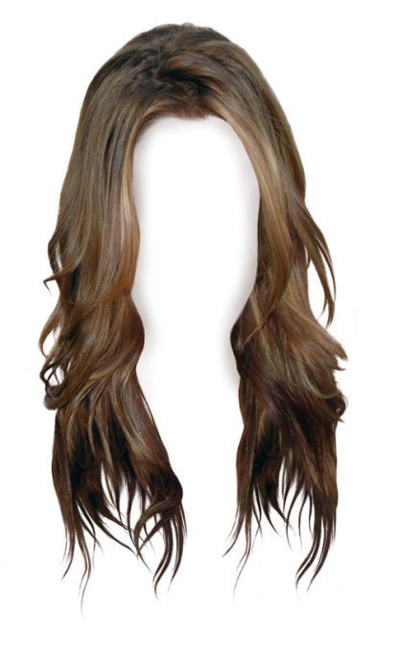
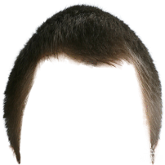
The Nature of Man
Part 1
https://www.youtube.com/watch?v=p5U5bM1jatw
Notes:
Notes created by Victoria Thomas based from Elder Parminder’s presentation on the nature of man (Sept. 2017).

Slide 2
Finishing Touch of Immortality
The purpose of the reform line is to redeem God’s people back to Himself.
That work begins first with the church and then the world.
When you are all ready, having overcome your sins, having put away all your iniquity from you, you are in a condition to receive the finishing touch of immortality. Many are waiting and expecting that a more favorable opportunity than the present time will come when they can put away sin more easily than now; and when it will not require so great humility and sacrifice on their part, and they will not have to make the effort they are required to make at the present time to perfect holiness in the fear of God. I fear that while they are thus waiting for the better time, their probation may close and they be found in their sins. For the sentence is to go forth: "He that is unjust let him be unjust still; and he which is filthy let him be filthy still; and he that is righteous let him be righteous still; and he that is holy let him be holy still." This may be spoken in Heaven in your case, and the work for you will have been done, and you lost, eternally lost. {RH, April 12, 1870 par. 5}
The opening statement is a repeat and enlarge three times. The definition of being ready is having overcome your sins. The definition of having overcome your sin means having put away all your iniquities from you.

Slide 3
Finishing Touch of Immortality Cont’
The finishing touch of mortality is the third step in the gospel:
Justification
Sanctification
Glorification
Final few moments before leaving this earth is when we see this new body-glorified body. This is not the only finishing touch of immortality.
What experience do we have to go through before we get a new body?
GC—Jacobs Time of Trouble deals with the step of immortality.
Does this relate just to our physical body? No.
There is still some internal nonphysical spiritual development that goes on. The removal of earthly things.
It has to do with issues of the mind as well as the physical body.

Slide 4
Nature of Man is 3-Fold
No work ever undertaken by man requires greater care and skill than the proper training and education of youth and children. There are no influences so potent as those which surround us in our early years. Says the wise man, "Train up a child in the way he should go, and when he is old, he will not depart from it." The nature of man is three-fold, and the training enjoined by Solomon comprehends the right development of the physical, intellectual, and moral powers. To perform this work aright, parents and teachers must themselves understand "the way the child should go." This embraces more than a knowledge of books or the learning of the schools. It comprehends the practice of temperance, brotherly-kindness, and godliness; the discharge of our duty to ourselves, to our neighbors and to God. {RH, January 10, 1882 par. 1}
Physical
Intellectual
Nature of Man
Moral
The nature of man is 3-fold. It is dealing with the: physical, intellectual, and moral powers.

Slide 5
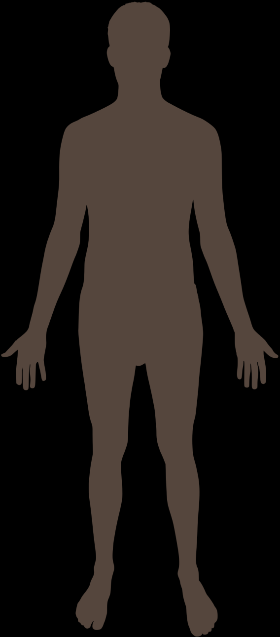
Nature of Man is 3-Fold Cont’
This is NOT us, but our HOUSE
The nature of man is dealing with the:
Physical,
Intellectual, and
Moral powers.
NOT Us
Us:
Somewhere inside
The house in which we live is our physical body. Our physical body is not us. We are somewhere inside the body.
Often we say the brain is us. That is not quite correct. The brain is not us. The brain and the body are all connected together.
We are spiritual beings. The brain and body is all one thing. They are connected together. We need to understand that there is interaction between the physical and the spiritual being. When you start playing around with the physical it affects the spiritual. But the physical is not the spiritual. When we die and go to heaven we don’t take any of these chemicals with us.

Slide 6
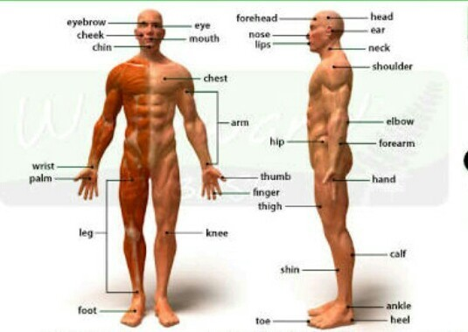
The Human
What are you?
Character—your thoughts and feeling
A spiritual being.
What is the human body?
The human body is the structure of a human being. It is composed of many different types of cells that together create tissues and subsequently organ systems. They ensure homeostasis and the viability of the human body.
It comprises a head, neck, trunk (which includes the thorax and abdomen), arms and hands, legs and feet.
The human body is composed of elements including hydrogen, oxygen, carbon, calcium and phosphorus.^{[1]} These elements reside in trillions of cells and non-cellular components of the body.

Slide 7
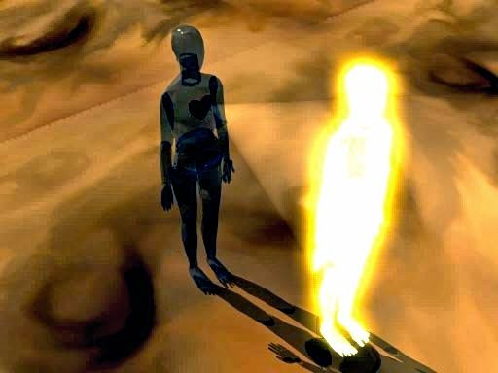
The Human Cont’
The atoms in which we think compose us are not us. They are just the house in which we live.
The only thing we will take to heaven is our character. This phrase is not the best way of expressing it because technically we cannot take our character to heaven. This is because our character is us. It is not part of us. So we are here on earth and we are going to heaven. We don’t take something with us to heaven. We just go.
Our physical bodies are separate and distinct from who we are. The body is just the machinery to keep us moving. For instance, if someone were to chop another person’s arm off. And that arm went a distance away from that person. That arm is not the person.
The physical body, including the brain is not us. The physical body is not the nature of man—physical, intellectual, and moral. When EGW refers to the physical in the passage, she is not primarily referring to the body though at first it appears that way.

Slide 8
The Higher and Lower Powers
3 fold nature of the human being is composed of:
Higher powers
Lower powers/passions
Our Bodies a Purchased Possession.--The lower passions have their seat in the body and work through it. The words "flesh" or "fleshly" or "carnal lusts" embrace the lower, corrupt nature; the flesh of itself cannot act contrary to the will of God. We are commanded to crucify the flesh, with the affections and lusts. How shall we do it? Shall we inflict pain on the body? No; but put to death the temptation to sin. The corrupt thought is to be expelled. Every thought is to be brought into captivity to Jesus Christ. All animal propensities are to be subjected to the higher powers of the soul. The love of God must reign supreme; Christ must occupy an undivided throne. Our bodies are to be regarded as His purchased possession. The members of the body are to become the instruments of righteousness. {AH 127.2} 127.2

Slide 9
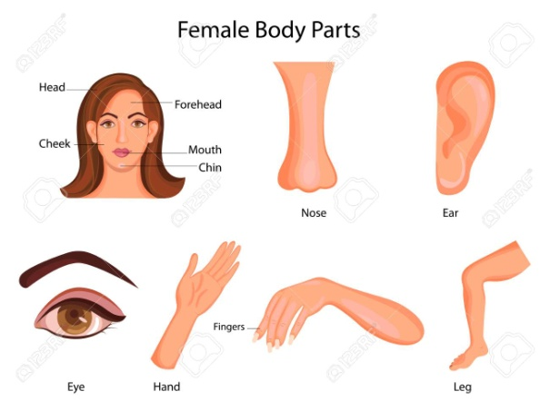
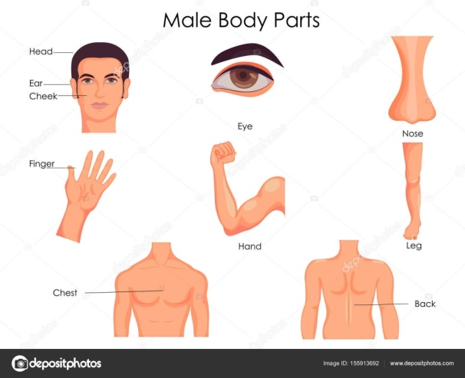
The Higher and Lower Powers Cont’
What are the members of the body?
Members of the Body
Eyes, ears, nose, etc… The members are supposed to be used as instruments and the instruments are tools for doing good. So our fingers, eyes, etc are to be used for acts of righteousness.
Remember we’ve been told that the nature of man is 3 fold: 1Mental 2 Moral 3 Physical
The lower powers are part of the 3 fold nature. Which part? The physical.
“The lower passions have their seat in the body and work through it.“
The lower passions work through the physical body. We have these senses that come and they produce our emotions and feelings; or what we would call in this context the lower passions. So what we see, smell, taste, hear, and touch affects our emotions—the way we feel. The lower passions have their seat, or they operate through, or are intermittently connected with the body. This is why EGW uses the term physical.

Slide 10
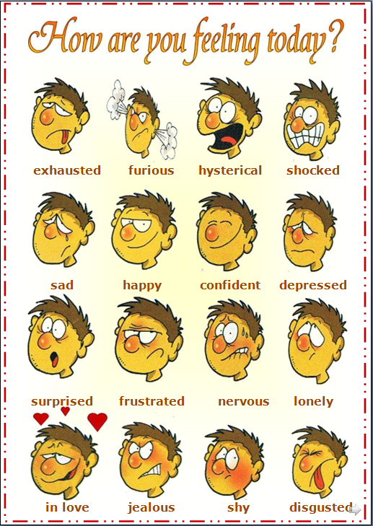
Emotions Have Their Place
All the emotions we have are good
Examples of emotions (or the lower passions):
Lust, appetite, anger, jealousy.
Where do our emotions come from?
GOD.
Anger—righteous indignation—We get our anger from God.
Lust—Adam was attracted to his wife; etc, etc.
All of these are characteristics of God. This is why we have them.
Who created sin? Where did sin come from? Sin is the absence of God. Sin is a mysterious thing. Our emotions are not sin. Lower passions have been manipulated as an effect of sin (temptation, Satan, and our own wickedness) so we often think of these emotions in a negative way. But, emotions are not bad. We get our emotions from God.

Slide 11
Emotions Have Their Place Cont’
The lower passions/power has its seat in the physical. There is a close connection between the two.
The lower passions cannot disobey God—All these emotions and feelings cannot disobey God.
What does this mean—when our emotions cannot disobey God?
Ex. I’m hungry. I got an appetite. So I eat something I shouldn’t eat and say, “I couldn’t help it. I just felt hungry.” So, I disobey God.
Was it those feelings and emotions that disobeyed God? No.
Animal propensity—leaning, Flesh, Carnal Lust. All part of the physical nature—so it is not wrong to be like an animal because animals work instinctively—God put those passions there. But animal passions are to be subject to the higher power of the soul.
I know I shouldn't eat this donut, but…
Subjection—to submit—to be a slave
Higher power is the intellectual and moral

Slide 12
An Undivided Throne
Christ will NOT share
Christ must occupy an undivided throne. Christ must reign supremely; so He must reign over our higher and lower powers. The problem is that Christ is ruling half of our nature. Which part?
7 Know ye not, brethren, (for I speak to them that know the law,) how that the law hath dominion over a man as long as he liveth?
² For the woman which hath an husband is bound by the law to her husband so long as he liveth; but if the husband be dead, she is loosed from the law of her husband.
³ So then if, while her husband liveth, she be married to another man, she shall be called an adulteress: but if her husband be dead, she is free from that law; so that she is no adulteress, though she be married to another man.
⁴ Wherefore, my brethren, ye also are become dead to the law by the body of Christ; that ye should be married to another, even to him who is raised from the dead, that we should bring forth fruit unto God.
The higher powers. Unfortunately, not the lower powers.
Christ will not share the throne with you, or the heart. He wants all of it or none of it. Why will He not share?
He is not allowed to. It’s against the law. It’s against the law for two people to share the throne. Theme of ROMS 7 is marriage. You cannot have two men marrying one woman.
The law controls everything. You have you, your husband, and Christ. The throne is the woman. The heart is corrupt—the current husband, Christ—the new husband. The law says you cannot do that. The only legal way is for the current husband to die. So when the heart dies, then you can have Christ reign on that throne.
Throne

Slide 13
Lower Passions Controlled
The History to Be Repeated.--Near the close of this earth's history Satan will work with all his powers in the same manner and with the same temptations wherewith he tempted ancient Israel just before their entering the Land of Promise. He will lay snares for those who claim to keep the commandments of God, and who are almost on the borders of the heavenly Canaan. He will use his powers to their utmost in order to entrap souls and to take God's professed people upon their weakest points. Those who have not brought the lower passions into subjection to the higher powers of their being, those who have allowed their minds to flow in a channel of carnal indulgence of the baser passions, Satan is determined to destroy with his temptations--to pollute their souls with licentiousness. He is not aiming especially at the lower and less important marks, but he makes use of his snares through those whom he can enlist as his agents to allure or attract men to take liberties which are condemned in the law of God. And men in responsible positions, teaching the claims of God's law, whose mouths are filled with arguments in vindication of His law, against which Satan has made such a raid--over such he sets his hellish powers and his agencies at work and overthrows them upon the weak points in their character, knowing that he who offends on one point is guilty of all, thus obtaining complete mastery over the entire man. Mind, soul, body, and conscience are involved in the ruin. If he be a messenger of righteousness and has had great light, or if the Lord has used him as His special worker in the cause of truth, then how great is the triumph of Satan! How he exults! How God is dishonored! {AH 327.1}

Slide 14
Lower Passions Controlled Cont’
There are two groups EGW is talking about: Those who have not brought their lower passions into subjection to the higher powers and those who have.
A false prophet is someone who does not have their lower passions in subjection to their higher powers. So they are controlled by their emotions and feelings, lower passions.
A true prophet is someone who is not controlled by their emotions. They have their lower passions in subjection to their higher powers.

Slide 15
You Are What You Eat
What About Flesh Foods?--We do not mark out any precise line to be followed in diet; but we do say that in countries where there are fruits, grains, and nuts in abundance, flesh food is not the right food for God's people. I have been instructed that flesh food has a tendency to animalize the nature, to rob men and women of that love and sympathy which they should feel for everyone, and to give the lower passions control over the higher powers of the being. If meat eating was ever healthful, it is not safe now. {CG 382.1}
When you start physically eating something that is not good for you, those chemicals begin to affect your lower powers and they can animalize you. Being animal like has its place as long as it is in subjection to the higher powers. So by eating unhealthy food it can distort and warp your emotions and damage them. So instead of emotions being positive, they end up being negative. So if you eat bad chemicals those chemicals affect the lower passions.
What you eat affects the lower powers—feelings and emotions.
So again, when you start playing around with the physical it affects the spiritual. But the physical is not the spiritual.

Slide 16
Summary
You have a house. The house represents your physical body. You live in the house. You is in reference to your character—thoughts and feelings. You are not the house. You are just an occupier of the house. You are a spiritual being. You are not physical. But when God created a human being, he joined the physical—the house with the spiritual, and you became a living soul.
Nature of man is 3 fold: physical, intellectual, and moral.
The three-fold nature of man can be divided into two sections: Higher: intellectual and moral and lower powers: physical.
The lower, which in one place EW refers to it as the physical only has its seat or kingdom in the physical, but it is not a physical thing. It is emotions and feelings—which are not physical things. It is flesh, carnal lust, and animal propensities, the lower passions. But, they have their seat in the physical which means they are closely connected to the physical.
The lower powers must be in subjection to the higher powers

