Slide 1
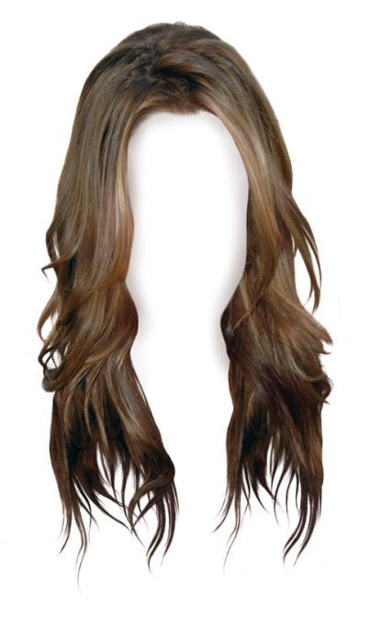
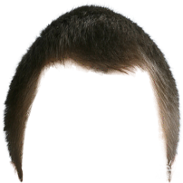
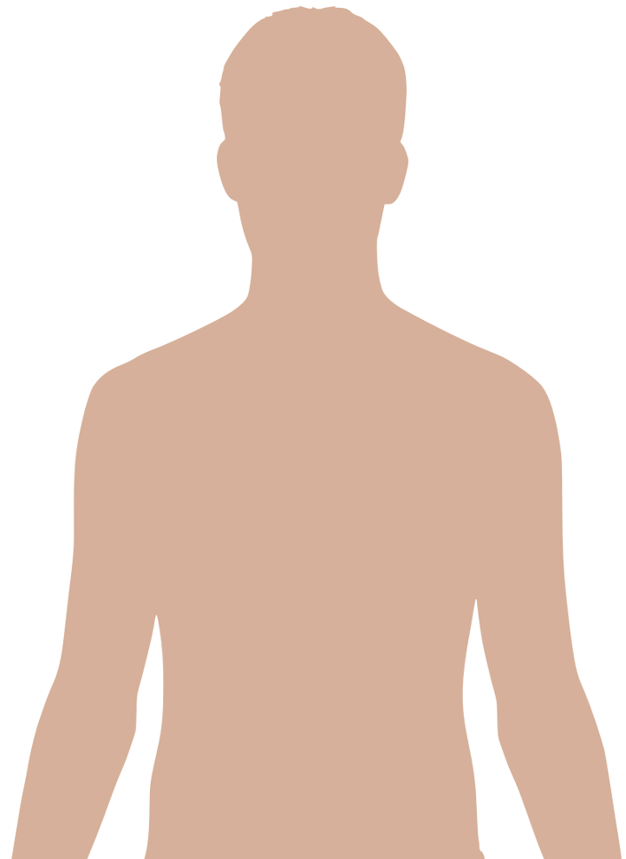
The Nature of Man
Part 2
https://www.youtube.com/watch?v=ZXVIMd_b71E&list=WL
Notes:
Notes created by Victoria Thomas based from Elder Parminder’s presentation on the nature of man (Sept. 2017).

Slide 2
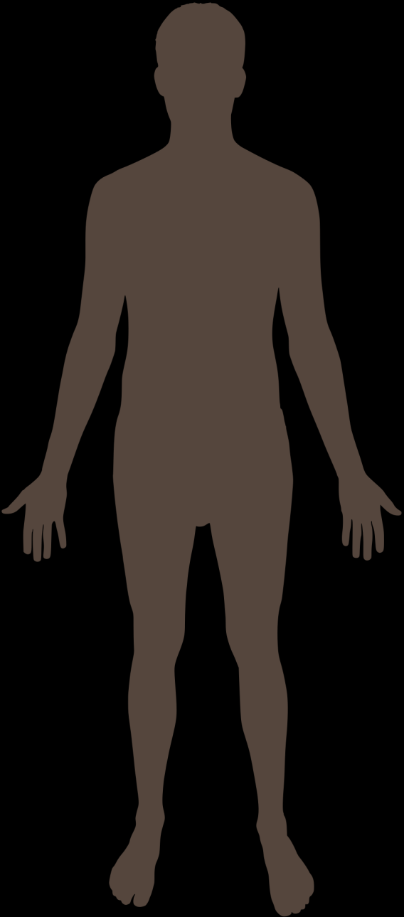
And You Are, Again?
This is NOT us, but our HOUSE
Humans are spiritual beings. They are not the physical body. The physical body is just the house the spiritual being lives in. The spiritual being is referred to our character (who we are) which is simply defined as our thoughts and feelings (mind and heart, which are the symbolic terms).
If you start manipulating or warping the human body by DNA mutation you begin to affect the spiritual. We know that this is not the only cause of damage to ourselves or the spiritual being. It’s not just some passive thing that can come upon us, but we can proactively do something that actually damages or harms us.
Us:
Somewhere inside
Ex. The deliberate refusal of truth will affect your spirituality. And this has nothing to do with what we do with our muscles or what we would eat, drink, or watch.

Slide 3
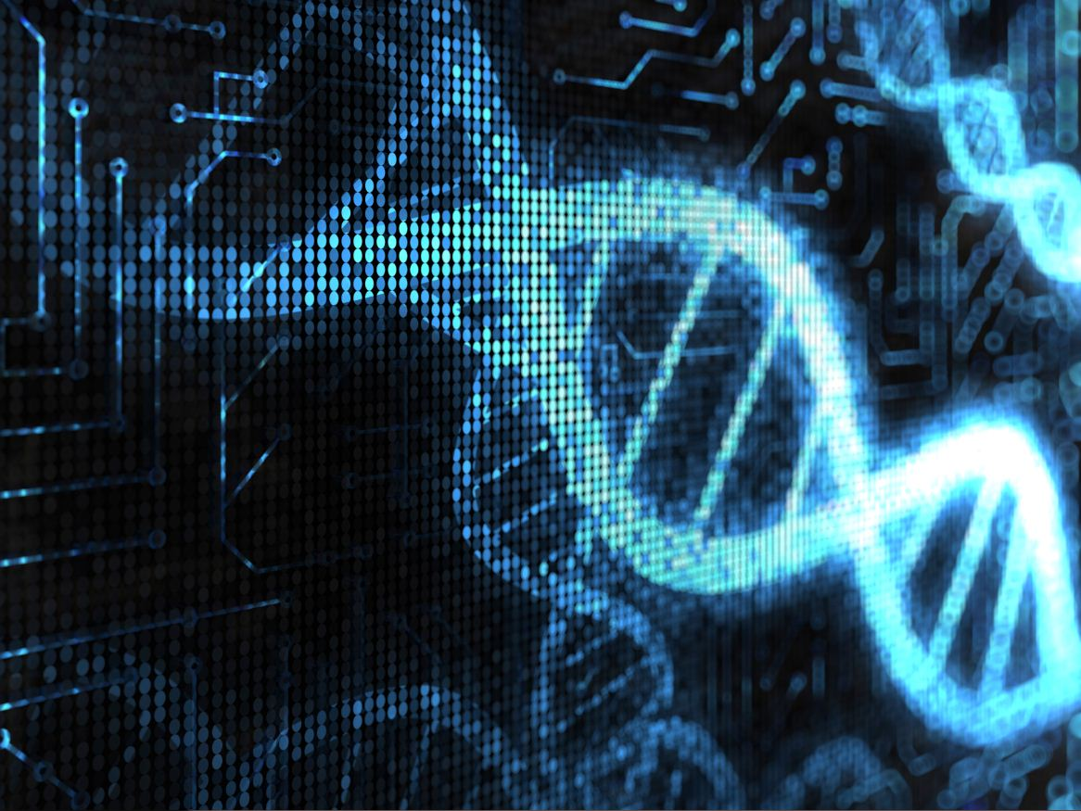
DNA Mutations
A person can have changes (or mutations) in a gene that can cause many issues for them. Sometimes changes cause little differences, like hair color. Other changes in genes can cause health problems. Mutations in a gene usually end up causing that particular gene copy to not do its job the way it normally should. Since we have two copies of every gene, typically there's still a "normal" working copy of the gene. In these cases, usually nothing out of the ordinary happens since the body can still do the jobs it needs to do. This is an example of an autosomal recessive trait. For someone to have a recessive disease or characteristic, the person must have a gene mutation in both copies of the gene pair, causing the body to not have working copies of that particular gene. Genes can be either dominant or recessive.
What is a mutation?
A mutation is a change that occurs in our DNA sequence, either due to mistakes when the DNA is copied or as the result of environmental factors such as UV light and cigarette smoke.
Dominant genes show their effect even if there is just one mutation in one copy of that gene pair; the one mutation "dominates" the normal back-up copy of the gene, and the characteristic shows itself. A person can be born with gene mutations, or they can happen over a lifetime. Mutations can occur when cells are aging or have been exposed to certain chemicals or radiation. Fortunately, cells usually recognize these types of mutations and repair them by themselves. Other times, however, they can cause illnesses, such as some types of cancer. If the gene mutation exists in egg or sperm cells, children can inherit the gene mutation from their parents. When the mutation is in every cell of the body (meaning a child was born with it), the body is not able to "repair" the gene change.
Notes:
https://kidshealth.org/en/teens/genes-genetic-disorders.html

Slide 4
Human Nature Is…
The nature of man is 3-fold, which is described as the physical, intellectual, and moral.
Physical
Intellectual
Nature of Human
Moral
The nature of man can also be divided into two parts: The lower powers and the higher powers.
Nature of Human
Higher Powers
Intellectual
Moral
Lower Powers
Physical
The nature of man is three-fold, and the training enjoined by Solomon comprehends the right development of the physical, intellectual, and moral powers. {RH, January 10, 1882 par. 1}
The term physical, EGW uses in describing the nature of man is NOT referring to the members of the body or the human body. The term physical mentioned is referring to the lower powers/passions--all those emotions that we feel—which have their seat in the physical body.
The lower passions have their seat in the body and work through it. AH 127.2}

Slide 5
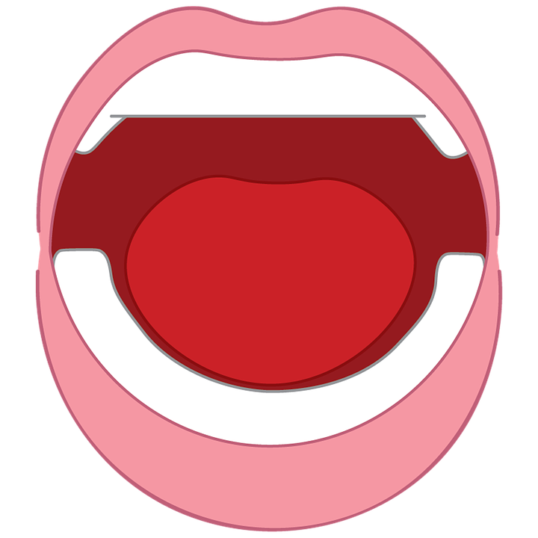
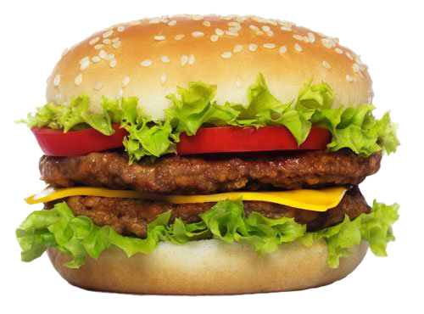
Lower Passions Must Submit
Lower passions are often represented as the heart where all our emotions and our feelings are seated.
I have been instructed that flesh food has a tendency to animalize the nature, to rob men and women of that love and sympathy which they should feel for everyone, and to give the lower passions control over the higher powers of the being. {CG 382.1}
All our lower passions—thoughts, feelings, appetite, etc. are good and have their place, but they need to be in subjection to the higher powers.
The lower powers must come into submission to the higher powers.
We saw that in eating meat, for example, a person can become animalized so much so that the lower powers are in control of the higher powers. However, we also read that the lower powers are required to be subjugated to the higher powers.
And this is not a vegan burger…

Slide 6
One Ruling the Throne
Christ will NOT share
The love of God must reign supreme; Christ must occupy an undivided throne. {AH 127.2}
7 Know ye not, brethren, (for I speak to them that know the law,) how that the law hath dominion over a man as long as he liveth?
² For the woman which hath an husband is bound by the law to her husband so long as he liveth; but if the husband be dead, she is loosed from the law of her husband.
³ So then if, while her husband liveth, she be married to another man, she shall be called an adulteress: but if her husband be dead, she is free from that law; so that she is no adulteress, though she be married to another man.
⁴ Wherefore, my brethren, ye also are become dead to the law by the body of Christ; that ye should be married to another, even to him who is raised from the dead, that we should bring forth fruit unto God.
Christ will not share His role with the heart.
This model of the heart and Christ is the very same model that is portrayed in Romans chapter 7. But in Romans chapter 7, it is the context of marriage.
The throne is the woman—us
The heart is the husband we are married to, or what we might call the old man sin.
Christ will not marry us while we are still married to this man--sins. Or while the lower powers are in control of the higher powers. They need to be subjugated to the higher powers.
Once that happens and the old man of sin dies, or the lower powers are now subjugated to the higher powers and the heart is taken off the throne, Christ can sit there and everything is good.
Throne

Slide 7
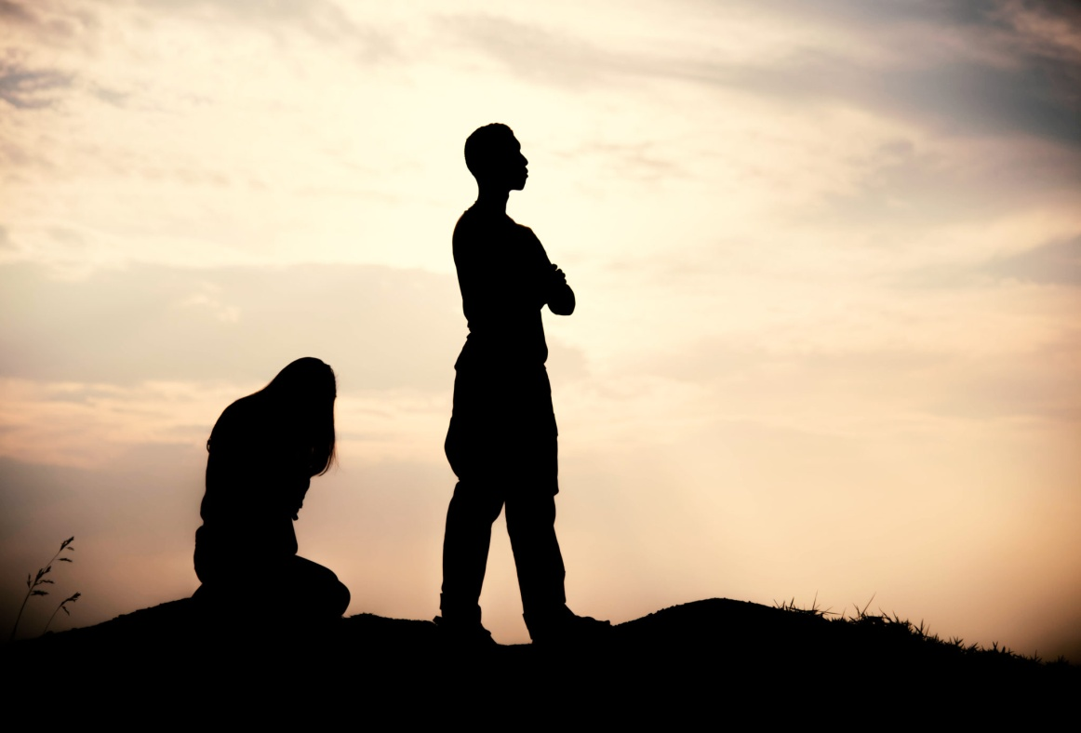
The Flesh Has No Power
The words "flesh" or "fleshly" or "carnal lusts" embrace the lower, corrupt nature; the flesh of itself cannot act contrary to the will of God. {AH 127.2}
The flesh doesn’t have the ability to act or do things contrary to the will of God.
If you distort the lower powers enough they can take control of the situation and have ascendancy over the higher powers and then Christ will no longer take residence in you but He'll back away and you will only have one person on the throne, which is the heart, your lower powers.
God wants to have the entire seat to Himself. He does not want to share it with the heart. He wants full control of the human being—to rule both the high and lower powers.

Slide 8
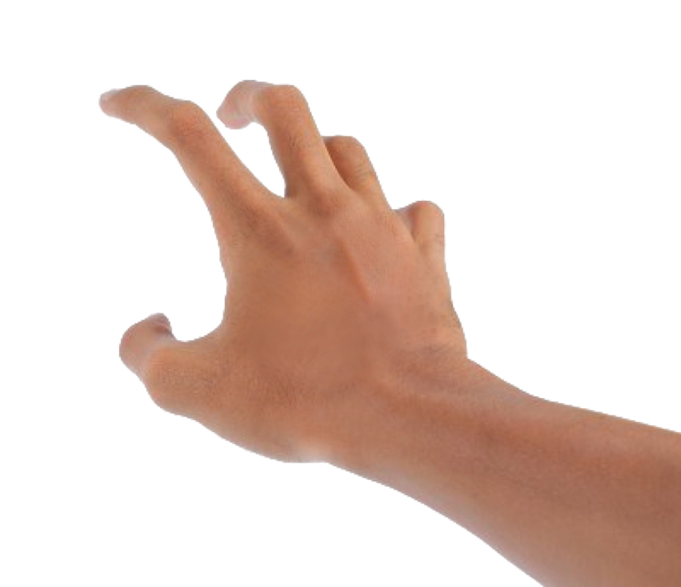
No Power Unless You Choose
So how Is it that the lower powers can take control of the higher powers and have its seat on the throne with Christ at one level, but on another level it can’t act contrary to the will of God—or do what it wants to do?
By your choice.
The lower passions cannot do anything that they want to do. They just sit there crying for you to do something, like to take your hand, reach out for the donut, and put it in your mouth; but, they have no ability to get your fingers to do the work.
They have no ability to act contrary to the will of God unless you choose not to do God’s will and allow your lower powers to have control…

Slide 9
The Will: The Deciding Power
Nature of Human
Higher Powers
Intellectual
Moral
Lower Powers
Physical
Governing Power in Nature of Man—The will is the governing power in the nature of man, bringing all the other faculties under its sway. The will is not the taste or the inclination, but it is the deciding power which works in the children of men unto obedience to God or unto disobedience. {2MCP 685.1}
Lower power cannot in and of itself take control of the situation of the human being. It cannot dictate the will of what you will or will not do.
God’s will is that the lower powers be in subjection to the higher powers. But if you don't control yourself, then the lower powers will take control. Yet, just because the lower powers are in control doesn't mean that they the ability to do anything. Hence, you have H1 (Intellectual) and H2 (Moral).
Higher powers are divided into 2: Mental and Moral

Slide 10
Double the Higher Power
The higher powers divided in to 2: (H1) and (H2)
H1
Intellectual
(Mental)
Understand Information
Knowledge
Memory
H2
Moral
(Spiritual)
Reason
Will
Conscience
Intellectual--ability to gather information, to understand information, to have knowledge, to retrieve information, or memory.
Moral and will can be used interchangeably.
The power to choose.

Slide 11
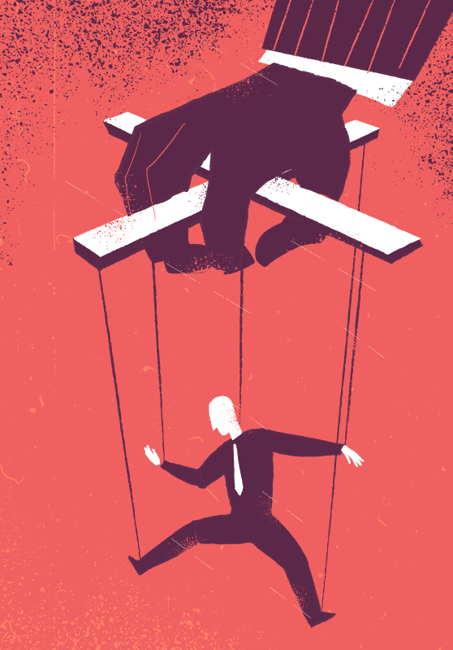
The Governing Power
“The will is the governing power in the nature of man.”
To govern means to:
The WILL
to rule over by right of authority:
to exercise a directing or restraining influence over; guide:
to hold in check; control:
to serve as or constitute a law for:
It means simply to rule—rule supremely
The will is the power that rules supremely.

Slide 12
The True Force of the Will
Every child should understand the true force of the will. He should be led to see how great is the responsibility involved in this gift. The will is the governing power in the nature of man, the power of decision, or choice. Every human being possessed of reason has power to choose the right. In every experience of life, God's word to us is, "Choose you this day whom ye will serve." Joshua 24:15. Everyone may place his will on the side of the will of God, may choose to obey Him, and by thus linking himself with divine agencies, he may stand where nothing can force him to do evil. In every youth, every child, lies the power, by the help of God, to form a character of integrity and to live a life of usefulness. {Ed 289.1}
Whatever situation, moment by moment of our day we are faced with thousands of decisions and at each one of those points/waymarks, we have to decide what we are going to do.
Everyone should understand what the will is.
You need to understand the true force of the will.
The will is the governing power of the nature of man-the power of decision or choice
Will=choice or decision
And who is going to make that decision? The will.
Is it the lower powers that is going to make that decision? No. They can't because they have no ability to go contrary to the will of Christ. It is the will, which is the governing power in a human being. That's what makes the decision. And it controls everything.

Slide 13
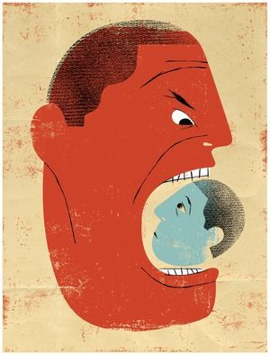
The Big Bully
L. Powers
But what have we been tricked into believing? Why do you swear or get angry and shout? One would say, “It just came out.” [Or some may say, “I just felt like it”]. This is just simply not the case.
We know that the lower power has its seat in the body.
So, in saying that the lower powers made my mouth speak (contrary to the will of God), we know that that cannot be. So what did the lower power, which has its seat in the body, have to do first before your mouth opened?
The Will

Slide 14
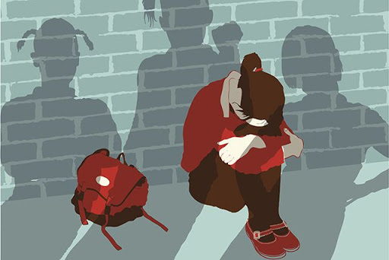
The Big Bully Cont’
It had to communicate to the Will. It demanded the Will to make the mouth open and force the mouth to say what the lower power wanted. The lower power wanted the mouth to say something rude. It wanted to be disrespectful because it wasn’t happy. The Will then replies back to the lower power and tells it, “You always bully me!” “I always feel pressured by you.” The lower powers respond, “So! And…?” And the Will, being so weak, gives in and says, “Okay, I’ll do it.”
And if you hadn’t eaten the meat you ate the other day, you wouldn’t be so animalized. And, the lower powers wouldn’t have so much power over you. The will wouldn’t be weakened. But if you keep on feeding the lower powers, you are going to get into trouble. Because it will take ascendancy and it will bully you. The lower powers cannot force you to do anything. You choose to do it because the Will cowards before the lower power.
An interesting fact is that bullies are actually weak. The lower powers have to go through the will. The will must stand up for it self and make the decision not to yield.
The will is to be the boss, to rule. It is the governing power.

Slide 15
The Correct Knowledge is Key
“Every human being possessed of reason has power to choose the right.” {Ed 289.1}
Paraphrasing, every human being has the power to choose the right.
If we do not have the truth, we cannot make a wise decision.
We were all brought into the world with little to none of the right information. Some of us had more access to the right information than others. Nevertheless, we were skewed in our knowledge base, not having all the correct information.
For example, some of us were informed that eating meat is okay. So with that information, what is one going to do? Keep eating meat. The point is, is that, without the correct information, one doesn’t have any hope of doing what’s right. That person is going to continue making the wrong choice. We have to have the right information to base everything off of in order to make the right decision.
We know that the sealing is a settling into the truth both intellectually and spiritually.

Slide 16
The Will is You
Is the will a gift given to you by God?
For instance, death is the result of sin. We know that the wages of sin is death. So, when a person dies, is her death a gift that she received from somebody? No, it’s her wages. She earned it. It was her right to receive that. She committed sin and her reward is death. So wages are not gifts. It is something you earn. You have to do something in order to get it.
No, the will is not a gift to you from God. It is you.
The lower and higher powers are you. When God created you, He put all the pieces together and said, “Wow, You are amazing! You are wonderfully and fearfully made!” “I made you to have a Will, your feelings, your thoughts, to think, to reason, to choose, —all as a part of you—and it was very good!”
This is why the will is not a gift because a gift is something that you don’t possess by nature. A gift is something that is not a part of you. It is something that someone gives to you as a favor. And I concur with the thought that when God created us as human beings, He didn’t do us any favor because we weren’t even in existence. We weren’t alive to receive a gift from Him. He created us (humans) with one of the pieces being the will to complete His ultimate masterpiece.
The will

Slide 17
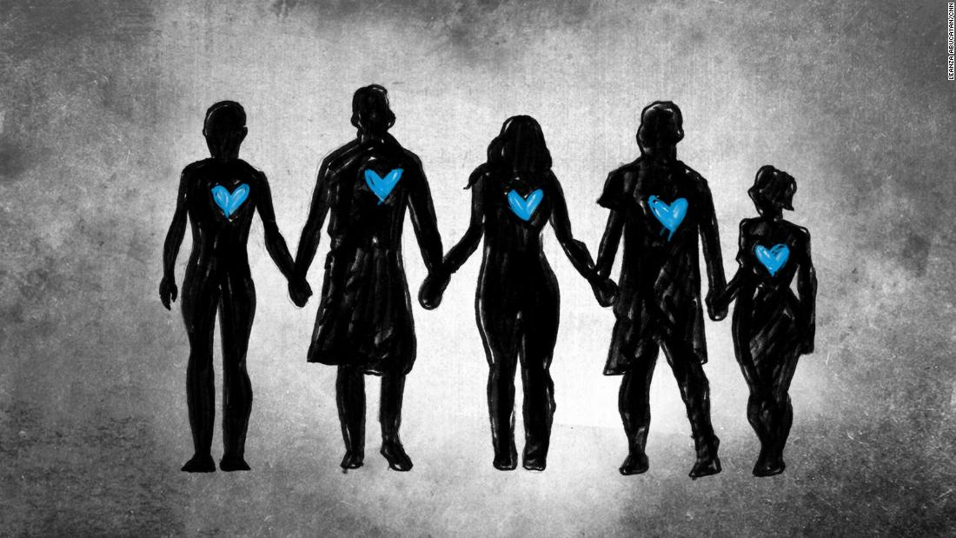
Created in God’s Image
So God has the awesome idea to create the human being. And when He creates anything, by definition, He has to create it in His own image. His image could be likened to a signature. And though everything that God creates must be created in His own image, not everything is created to the same degree.
It was Gods will that when He created human that “them” wouldn’t be created in a finish and completed state. Did God create the human perfect? Yes. Is the human fully mature? No. Has the human reached his or her ultimate purpose of existence? No.
The ultimate created thing by God, whether animate or inanimate, is human beings. Man is the ultimate creation in the image of God. Not only humans, but animals are really good as well because it is only on this earth that creation is able to reproduce itself. All things represent God in some way or form. Some things are a good representation and some are weaker representation. Yet, all creation was created in His image.
We know this is one of the issues between Lucifer and the Godhead. Lucifer was not allowed to be a part of creating human beings. And Lucifer was very upset about that. Lucifer was the top ranking being ever created at that point; and to not be included in the plan to create human beings, and furthermore assigned to be a teacher for mankind to teach them what they need to be in order to be God’s counterpart—the mature and completed human being, who would ultimately become the higher than the angels—so this was just disturbing and disappointing news to Lucifer.
Human beings were created a little lower than the angels. As this is the case, who is the ultimate being? Humans or Angels?
Humans. This is because humans still need to grow up.

Slide 18
The Problem Lies With the Heart
Do we have a will independent of God?
Yes, because God created us with a free will—the ability to choose as we will. And by definition, it has to be independent of God. We make our own choices. God does not choose for us.
We need to understand what the will is and how it operates and its true function. When we understand the true force of the will, then and only then can, the will do its job function properly, which is to make the right choices.
So what is the problem with our will? There isn’t one. There is nothing wrong with the will. We use our will countless times a day—making decisions all the time. It functions perfectly well. The problem with the human being is not the will, it is the heart. It is when the emotions bully the will to do what it wants.
The will is yours to do what you want with it. Hopefully we will choose to make the right decisions.

Slide 19
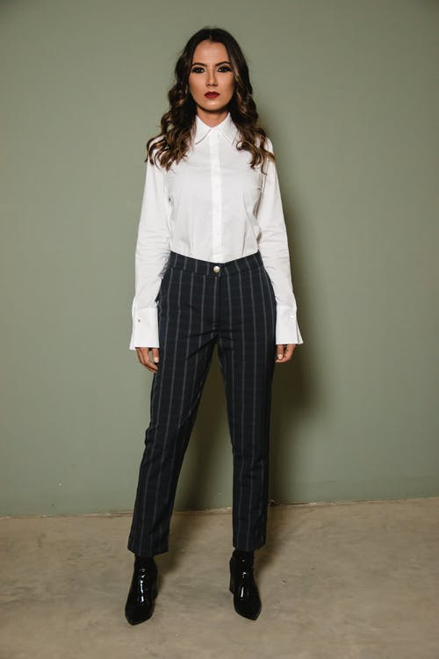
In Your Own Strength
Now this may be an assumption, but I know that we have all come out of doing something that we once did or use to do in the past. There is something we use to do that we no longer do. For instance, women in the movement now wear pants, whereas before most, if not all, of the women would only wear skirts or dresses.
So based on the truth and knowledge about equality and an understanding of what it means for us women to wear pants as members in the movement, we choose to wear pants. And just in case one has forgotten or is not aware of what it means when a woman, in the movement, makes the choice to step into a pair of pants, she is making a very clear statement. That woman is declaring that she is a Priest who accepts the third angel’s message and her role in this spiritual warfare alongside the men to fight and destroy the enemy. It is a declaration to all her brothers that she is to work on the same battleground doing the same job as they are in this battle. It is a symbol of equality.

Slide 20
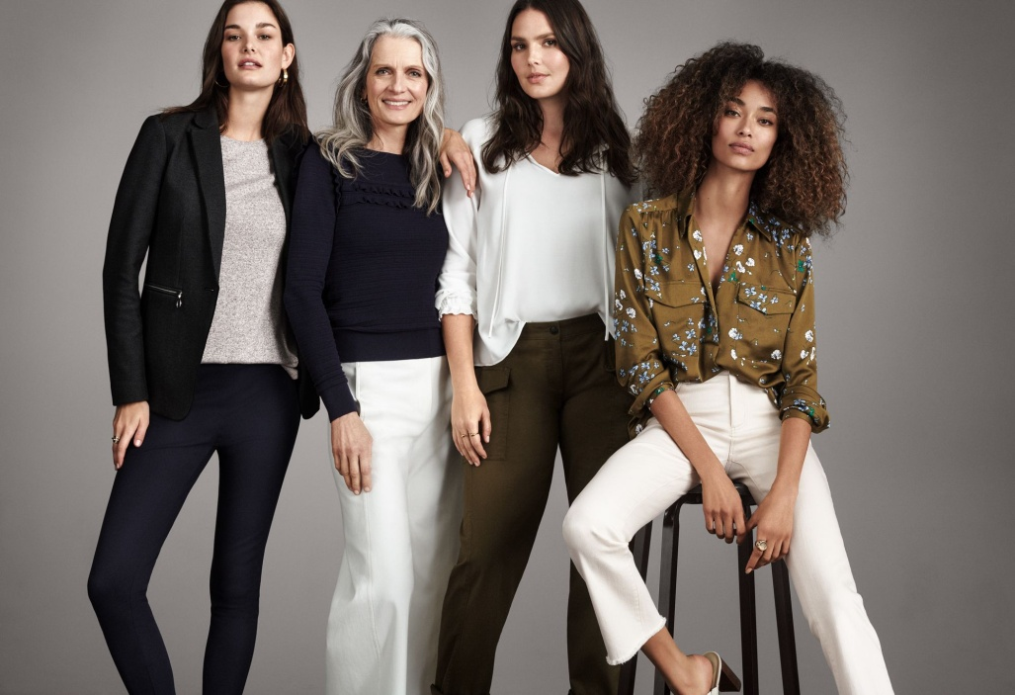
In Your Own Strength Cont’
Now the question is, for the women of course, did you stop wearing skirts and dresses in your own strength (in your own will) or in God's strength?
The answer most definitely is in your own strength.
You always had the power to choose to put on a pair of pants. However, you didn’t have the information before that you have now about equality and the wearing of pants as a symbol. We received this information as the light increased in our movement based on the reform lines and methodology. Aside from this, generally speaking, one can get information from wherever: the Bible, SOP, a teacher, etc. And you have a decision to make based upon the information or how you feel; but you also have the power to choose without the information. The correct information is what helps you make the right choice.
We can do all things in our own will.
So we need to understand what our part is and what God's part is.

Slide 21
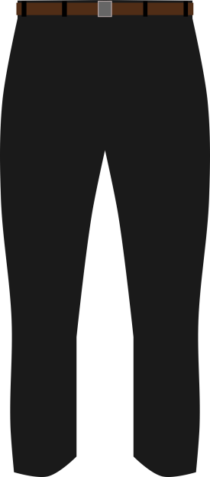
Habit is an Important Tool
So let’s keep with the pants example and say for some women, it was hard to wear pants at first. They weren’t use to wearing pants. It was may be a new experience and it didn’t feel comfortable. But after a few times of wearing pants, it no longer was an issue. It became habitual, like a normal thing to put on a pair of pants and walk out the house and wear them to church. There was no longer a struggle. Every time, you repeatedly made the choice to wear pants. It was in your own will and strength to stop wearing skirts and dresses all the time and to wear pants instead. So, you overcame what once was possibly a hurdle for you by making the decision to wear pants based upon correct knowledge on the subject of equality. Is it now a habit to wear pants ? Or, just a continual choice?
Habit is an important part of God's armory in helping human beings, but it is not the full and total solution. The reason you know that is because you can have a habit of never doing sin for 80 years, and then you sin. How do you explain a habitual life of perfection and then you sin right at the end?--talking about Moses--when he gets pushed hard enough and he has had enough, he lets loose his anger and strikes the rock and he doesn’t have a habit of doing that.
Habit is an important thing to grapple with and it is an important tool in our armory, but it is not the full solution to the gospel message. The reason it is not the full solution to the gospel message is because habit can be entered into, like someone can do something repeatedly such as go to sleep early over a time period, but also stop over time. Habit has connected with it time. But we know God is a God of creation. When He speaks, things happen.

Slide 22
The Correct Knowledge is Key
Everything Depends on Its Right Action—The tempted one needs to understand the true force of the will. This is the governing power in the nature of man—the power of decision, of choice. Everything depends on the right action of the will. Desires for goodness and purity are right, as far as they go; but if we stop here, they avail nothing. Many will go down to ruin while hoping and desiring to overcome their evil propensities. They do not yield the will to God. They do not choose to serve Him. {2MCP 685.2}
Yield the will to God means to choose to serve Him. This means that Instead of going to their emotions, they are going to go to their information--what God says they should or should not do. They are going to let the mind dictate or control what they should and should not do and not their emotions.
We can desire to put them out of our life, speaking of the evil propensities, and hope they go away, but if the will doesn’t stand up and do something, if we don’t choose, and yield our choice to God’s choice, then nothing will happen—we will not overcome.
The will is the governing power (H1) and it needs to go to the information that God as given--the right information (H2). You can’t do what God wants you to do without first knowing His instruction.
The will may very well want to make the right choice, and in order to make the right choice the will has to have the right information. But because the will is bullied by the lower power, the will chooses to follow the emotions rather than choose to follow God’s instruction and make the right decision.
“Evil propensities” are the lower powers

Slide 23
Your Will is like a Spring
The Spring of All Actions—Your will is the spring of all your actions. This will, that forms so important a factor in the character of man, was at the Fall given into the control of Satan; and he has ever since been working in man to will and to do of his own pleasure, but to the utter ruin and misery of man. {2MCP 685.3}
Spring means to:
Verb
1.
move or jump suddenly or rapidly upward or forward.
2. originate or arise from.
Every action you do begins in the will. We control the will because the will is us. The governing power.
Noun
1. the season after winter and before summer, in which vegetation begins to appear, in the northern hemisphere from March to May and in the southern hemisphere from September to November.
2. a resilient device, typically a helical metal coil, that can be pressed or pulled but returns to its former shape when released, used chiefly to exert constant tension or absorb movement
It's all about will power. So when you think about what you are capable of doing and what you are not I want you to see that it is all about will.

Slide 24
Habits are Centered in the Lower Powers
Many are inquiring, “How am I to make the surrender of myself to God?” You desire to give yourself to Him, but you are weak in moral power, in slavery to doubt, and controlled by the habits of your life of sin. Your promises and resolutions are like ropes of sand. You cannot control your thoughts, your impulses, your affections. The knowledge of your broken promises and forfeited pledges weakens your confidence in your own sincerity, and causes you to feel that God cannot accept you; but you need not despair. What you need to understand is the true force of the will. This is the governing power in the nature of man, the power of decision, or of choice. Everything depends on the right action of the will. The power of choice God has given to men; it is theirs to exercise. You cannot change your heart, you cannot of yourself give to God its affections; but you can choose to serve Him. You can give Him your will; He will then work in you to will and to do according to His good pleasure. Thus your whole nature will be brought under the control of the Spirit of Christ; your affections will be centered upon Him, your thoughts will be in harmony with Him. {SC 47.1}
Your habits are centered in the lower passions.
Your lower power cannot go contrary to the will of God.
The lower power can trump your mental powers, but it cannot control your will. Your will is the governing force in the human being.
So you cannot be controlled by the habits of your life of sin, but your lower power is a bully and has deceived you into being a slave.

Slide 25
A Slave to Doubt
You desire to give yourself to Him, but you are weak in moral power, in slavery to doubt, and controlled by the habits of your life of sin. Your promises and resolutions are like ropes of sand. You cannot control your thoughts, your impulses, your affections. The knowledge of your broken promises and forfeited pledges weakens your confidence in your own sincerity, and causes you to feel that God cannot accept you; but you need not despair. {SC 47.1}
The slave master is doubt. What is doubt? It is unbelief. It is our unbelief that keeps us from making a full surrender to God. In order for us to make a full surrender to God all we have to do is choose to follow the right information from God. In other words, H2 (the will) follows H2 (the Intellect) which has got all the correct information.
So we make promises and resolutions, such as I'm going to stop shouting, I'm going to stop eating that thing, I’m going to start getting up early and start studying, I'm going to make effort, but they are like ropes of sand. Why? Is it because the will does not have the ability to do that? No. It is because you have been deceived by your slave master doubt. The lower power keeps on telling the will that “You can’t.” And the will feeds upon that lie and ends up following the heart.
However, most of us are in ignorance at the fault of someone else—a parent, pastor, teacher, etc. simply because we were told the wrong information. But once we do have the right information, we are required to follow it.

Slide 26
Just Can’t Control It?
“You cannot control your thoughts, your impulses, your affections.” {SC 47.1}
Which power do your thoughts, impulses, and affections fall under?
The lower power.
Can you control your thoughts, impulses, and affections? No way, you can’t! They come thick and fast. You cannot control your thoughts, impulses, and affections. You cannot control if your belly starts rumbling and you start feeling hungry. You can’t control that. For example, If you are young woman and you see a handsome man over there and you're looking to get married, you cannot control those emotions that well up inside you. You might not act upon them. You might not do anything, you might turn around and scream or something, but at that moment, you can’t, they just spring up. I’m not saying you should do anything with them because we are not required to. But it is part of the lower powers. It is built into us. You can’t control them.

Slide 27
The Power of Choice
“What you need to understand is the true force of the will. This is the governing power in the nature of man, the power of decision, or of choice.” {SC 47.1}
The will is the governing power in the nature of man. The power of decision or choice. If you understand this your life can be transformed.
We can make the right choices, but that will not save us. Through making the decision to follow the right information our life can be transformed. We can get up on time; we can eat right; we can dress right; we stop shouting; stop swearing, etc. We can live a perfectly nice life if we just follow that counsel and we understand the true force of the will, but that is not salvation.

Slide 28
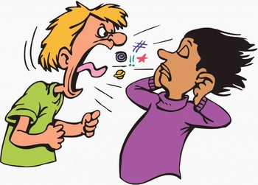
The Power of Choice Cont’
“What you need to understand is the true force of the will. This is the governing power in the nature of man, the power of decision, or of choice. Everything depends on the right action of the will. The power of choice God has given to men; it is theirs to exercise. You cannot change your heart, you cannot of yourself give to God its affections; but you can choose to serve Him. “{SC 47.1}
Many of us attend the camp meetings and prophecy schools and absorb in the information, but once we leave, we do not act upon the information given because we are in slavery to doubt. We don’t understand the true force of the will and we make unlawful excuses for our behavior when there isn’t one. We do wrong simply because we choose to do so.
We cannot change our heart—the lower powers, but we can sort out the will. The will can take its rightful place. And when the heart tells the will to do something you know isn’t right, such as “Look at that cute guy” based from the right information given to you by God, the will can say, “No. I will not.” Your will has the power to do that, but the will doesn’t have the power to say to the heart, “Stop this guy stuff—you can’t do that. But you can choose to serve Him.

Slide 29
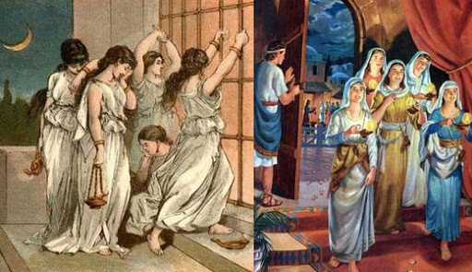
Obedience and Love
“You cannot change your heart, you cannot of yourself give to God its affections; but you can choose to serve Him. You can give Him your will; He will then work in you to will and to do according to His good pleasure.” {SC 47.1}
Most Adventist are not happy. Why? Because our hearts have not been changed. We choose to serve a God who we don't like. Why don't you like Him? Because we cannot change our hearts. We can choose to obey Him but we cannot choose to love God.
Old Covenant | New Covenant
Do good | Love to do good
The difference between the two groups is that one group does good and the other loves to do good.

Slide 30
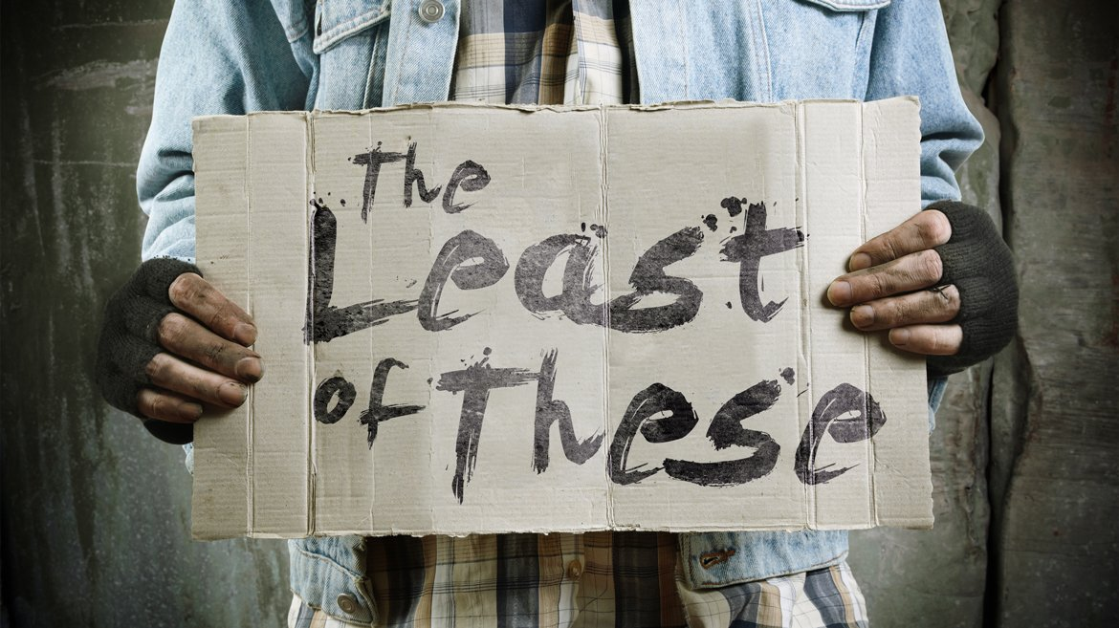
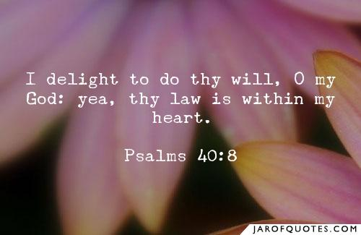
Summary
Nature of man is 3 fold. It is comprised of two parts: lower and higher powers.
Lower powers has one part (physical) and the higher powers has two: mental and moral
Symbolically, the physical is the heart and the mental is the mind. And then you have the will--governing power
The will is not a gift. It is yours by creation. There is some complexities in this thing because when Adam fell, his will went into the captivity of Satan. But God gave Adam and Eve their will back through the power of the gospel message. They were given the ability to choose once again.
We have the ability to make any decision we want to make, but we have been deceived because we are in slavery to doubt, so we think we cant. But what we need to understand is the true force of the will. We can choose to serve God, but we cannot give Him our affections, our love, our emotions because we cannot change the heart. What this model is teaching is that our part is to do right in our own strength. The problem is that you cannot love God.

