Slide 1
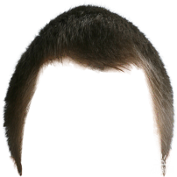
The Nature of Man
Part 3
https://www.youtube.com/watch?v=q_yLFjeyGTk
Notes:
Notes created by Victoria Thomas based from Elder Parminder’s presentation on the nature of man (Sept. 2017).

Slide 2
Human Nature Is…
Physical
Intellectual
Nature of Human
Moral
Nature of Human
Higher Powers
Intellectual
Moral
Lower Powers
Physical
The nature of man is 3-fold, which is described as the physical, intellectual, and moral.
The nature of man can also be divided into two parts: The lower powers and the higher powers.
Physical
Emotions
Appetite
Animal Propensities (Impulse) or (Instinct)
Thoughts
H1
Intellectual
(Mental)
Understand Information
Knowledge
Memory
The higher powers divided into 2: (H1) and (H2)
H2
Moral
(Spiritual)
Reason (Logic)
Will (Choice)
Conscience (Inner Voice)
Mind
Heart
Lower Powers

Slide 3
Working in Harmony Is the Goal
The will is the governing power in the nature of the human being. It has absolute control. Ultimately, we choose to do right or wrong based on the information we have.
The will is not a gift that was given to us. It is part of our nature.
We must keep the lower powers subjugated to the higher powers. If we are not careful, either through our environment or plainly because we allow it to because we become imbalanced, our lower powers (passions) can take control of our human actions or behavior and make us do things that we shouldn’t. And by make us, that means the lower power bullies or pressures the will into doing what it wants as opposed to what's right.
The Lord wants to bring the lower and higher powers back to a balanced position as they were in the original creation of humankind. The balance is basically the higher and lower powers working harmoniously together.
Unity

Slide 4
The Conscience is You
Is the conscience a gift of God?
No, your conscience is a part of your nature.
Conscience
What part of your nature does the faculty of the conscience fall under?
The higher power, specifically the moral power.
So when you were put together, you were given the heart, mind, and will. And plainly expressed as: the heart to feel; the mind to think; and the will to choose. And not only were you given them, they are parts of who you are.
So again, your conscience is not a gift. It is you.

Slide 5
Conscience VS Conscious
On the Merriam Webster site, it provides a great explanation on the difference between conscience and conscious.
Conscience and conscious derive from the same Latin roots—the prefix com- ("with," "together," "jointly") and the verb scire ("to know"), and the combination, conscire, means "to be aware of guilt"—and both relate to a state of awareness, the first of a moral awareness and the second of a physical or mental wakefulness in which a person is aware of their surroundings
The noun conscience refers to a state of awareness or a sense that one's actions or intentions are either morally right or wrong, along with a feeling of obligation to do the right thing. Cartoons often personify the conscience as a proverbial angel/devil pair who talk into the ear of an indecisive character, encouraging him or her to follow either a path of moral virtue or of moral corruption.
Notes:
https://www.merriam-webster.com/words-at-play/usage-of-conscience-vs-conscious

Slide 6
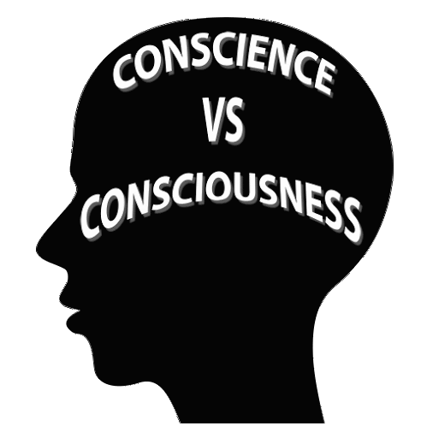
Conscience VS Conscious Cont’
Conscious, on the other hand, is an adjective that indicates that a person is awake and alert and able to understand what is happening around them … It can also imply that a person is aware of a particular fact or feeling … Another common meaning of conscious describes a person who cares about something specified … Additionally, conscious can modify an act or decision that is done deliberately (and one that might very well result in conscious guilt or a guilty conscience).
Your conscience is the part of your personality that helps you determine between right and wrong. ... Your conscious, on the other hand, is your awareness of yourself and the world around you.
Notes:
https://www.verywellmind.com/conscience-vs-conscious-whats-the-difference-2794961
Author Kendra Cherry

Slide 7
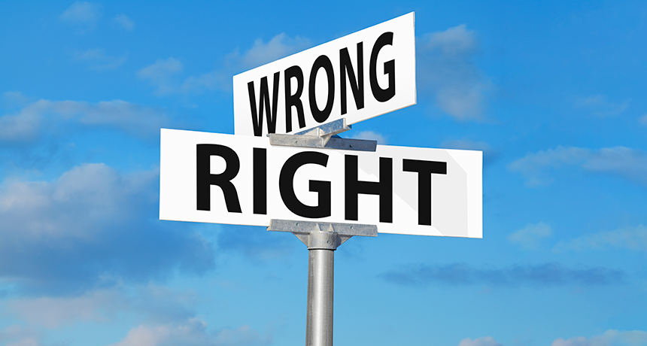
The Conscience Defined
Conscience means your inner sense of right and wrong. ~ Kendra Cherry
So, the conscience is an internal self-knowledge and judgment of right and wrong. So we naturally have a sense or what is right and wrong because it is already built into us to know, just through the power of the conscience alone.
The conscience is the faculty, power, or principle within us which decides either lawfulness or unlawfulness of something.
Our conscience is the part of your personality that helps you determine between right and wrong. It is what makes you feel guilty when you do something bad and good when you do something kind. ~Kendra Cherry~
Notes:
https://www.verywellmind.com/conscience-vs-conscious-whats-the-difference-2794961

Slide 8
The Purpose of the Conscience
Whenever, we do something, we have a conscience which knows automatically if that action we do is right or wrong. The conscience is built into us to know right and wrong and performs without the help of God.
So as we know, in order for the conscience to work properly, we have to have two things:
We have to know what’s right and wrong
We have to have the ability to feel bad about doing wrong (and good when doing right).
So, the answer is yes. We are able to know right and wrong in our own capability without help from Christ. And we have evidence of this truth from the lives of Nethinims, who though know not God, have a knowledge of right and wrong just simply because it is part of human nature.
Are we able to know what’s right and wrong without the help of God?
And that’s the purpose of the conscience – the power to help us sense or know when we are, someone or something is right or wrong. We don't need God to tell us. The conscience works as a convicting power.

Slide 9
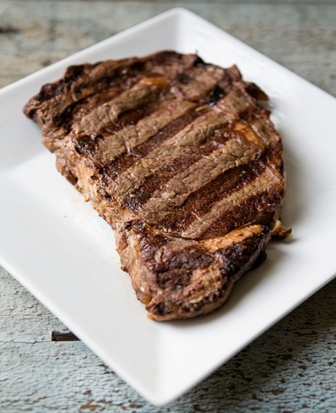
What’s Wrong With Our Conscience?
Revelation 14:7
⁷ Saying with a loud voice, Fear God, and give glory to him; for the hour of his judgment is come:
So why do we need the Holy Spirit to convict us of sin (which is the first step of the everlasting gospel) if we have the ability to do that work? Why do we need the help of external forces, outside our own, to know what is sin-wrong?
John 16:8-9
⁸ And when he is come, he will reprove the world of sin, and of righteousness, and of judgment:
In 1Tim 4:2, it mentions the problem--a seared conscience.
Sin
Righteousness
Judgment
The word seared means to burn. But it is not just a generic form of burning. It has this concept of having burn marks or a brand. This becomes a symbol of possession.
1 Timothy 4:2
² Speaking lies in hypocrisy; having their conscience seared with a hot iron;

Slide 10
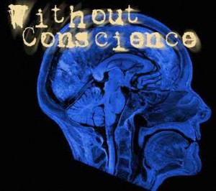
What’s Wrong With Our Conscience? Cont’
When your conscience is seared—in the possession of someone else—there is either one of three options that is happening:
You don’t know what is right and wrong
You know what’s right and wrong but you don’t feel guilty
You don’t know what is right and wrong so you would never feel guilty. Your conscience is totally dysfunctional.
We either don’t know what’s right and wrong or we have a problem about feeling bad.
So, we should understand that the conscience does not function properly as it should because it has been seared—burnt. Or a further way to explain it is that our conscience is so damaged that we either no longer know what is right and wrong, have a problem with an inability to feel guilty when committing sin, or simply don’t care. And therefore, we need external help. We need the aid of the Holy Spirit to do the work of the conscience.
Without heart,
simply don’t care.

Slide 11
The Aid of the Holy Spirit
Does God know what is right and what is wrong?
Of course He does.
How does He know what right and wrong is?
He knows because it is a part of His nature.
So God must have a conscience. And the simple reason why we have a conscience is because God has a one. The reason why you have a mind, heart, and will is because God has one. God created us in His image. And, when He crested us in His image, He had to create us with the same nature as His own. But the problem is that we have wrecked and destroyed our conscience. So now we have the Holy Spirit to assist us.

Slide 12
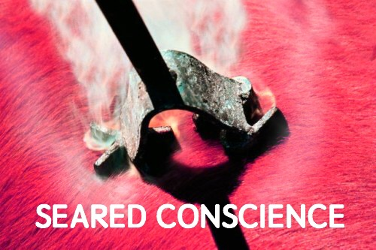
The Conscience Seared Cont’
When we talk about a gospel it is a prophetic gospel. The prophetic message is not about what you eat, dress, or any kind of reform issue. That is just a parable so you can understand how the prophetic gospel works because without the prophetic gospel, you have no idea of sorting out what is right or what is wrong. This issue of a burnt out conscience that you don’t know what right and wrong is. And this is not pertaining to moral sin. If you love the truth everything gets sorted out.
Just to clarify, our consciences have been seared so we no longer know what is right or wrong. Our consciences were not seared in a sense of moral purity. They were seared over prophetic truth and how that truth is to mature us and adjust our relationship with humankind and God. Our conscience has been so damaged, so warped through the progressive sins of our fathers that when you get to the fourth generation, the time of the end, we don't even have the ability anymore to discern what is right and wrong because our conscience have been destroyed.

Slide 13
The Heart Must be Open to Truth
“My teaching is not Mine,” said Jesus, “but His that sent Me. If any man willeth to do His will, he shall know of the teaching, whether it be of God, or whether I speak from Myself.” John 7:16, 17, R. V. The question of these cavilers Jesus met, not by answering the cavil, but by opening up truth vital to the salvation of the soul. The perception and appreciation of truth, He said, depends less upon the mind than upon the heart. Truth must be received into the soul; it claims the homage of the will. If truth could be submitted to the reason alone, pride would be no hindrance in the way of its reception. But it is to be received through the work of grace in the heart; and its reception depends upon the renunciation of every sin that the Spirit of God reveals. Man’s advantages for obtaining a knowledge of the truth, however great these may be, will prove of no benefit to him unless the heart is open to receive the truth, and there is a conscientious surrender of every habit and practice that is opposed to its principles. To those who thus yield themselves to God, having an honest desire to know and to do His will, the truth is revealed as the power of God for their salvation. These will be able to distinguish between him who speaks for God, and him who speaks merely from himself. The Pharisees had not put their will on the side of God’s will. They were not seeking to know the truth, but to find some excuse for evading it; Christ showed that this was why they did not understand His teaching. {DA 455.3}
Notes:
Note : Cavil: to make petty or unnecessary objections.--someone who deliberately twists another person's opinion or message to cover the truth

Slide 14
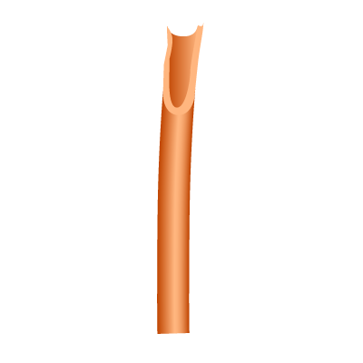
The Heart Must be Open to Truth Cont’
TRUTH
The sealing is a intellectual and spiritual settling into the truth.
So truth has to be first understood intellectually. Without having the correct information—God’s truth, you wouldn’t know what to love or what to hate.
Truth goes into the mind and down into your heart.
All of the faculties of the human being the spiritual being is housed in the brain and connected to the physical body.

