Slide 1
The Role of Islam
Etabo Esinyen

Slide 2
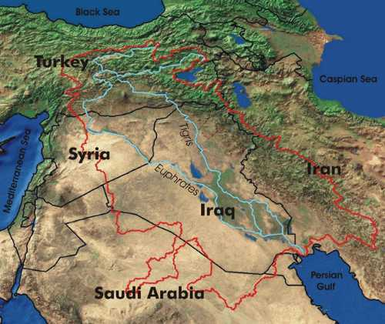
“The light that Daniel received from God was given especially for these last days. The visions he saw by the banks of the Ulai and the Hiddekel, the great rivers of Shinar, are now in process of fulfillment, and all the events foretold will soon come to pass…When the books of Daniel and Revelation are better understood, believers will have an entirely different religious experience.” TM 112,114
“Knowing the principle will help master the details; but a study of the details is necessary to prove the existence of the principle. Principles in Nature and Revelation are discovered after earnest, patient, tireless research. Constant contact brings to light the fact that things which at first seemed unrelated details are held or grouped together by governing principles.”
THE CERTAINTY OF THE THIRD ANGEL'S MESSAGE, Were.

Slide 3
The purpose of this prophetic discourse is to illustrate the nature of Islam at Panium, 2021 (Daniel 11: 13-15) to SL time period by looking into several lines of thoughts: Revelation 9, the first and fourth generation understanding of Daniel 11:40, Numbers 22 (Balaam) in relation to the Ship of Adramytium (Acts 27).
In this discourse, we are going to use triple application, an important and proved principle of prophetic interpretation that demands Bible students to look into the two preceding histories of any prophetic subject and combine them in order to understand the nature of the third.

Slide 4
3rd Diadochi war
Battle of
Gabiene
Peithon
Killed
Antigonus
Vs
3 allies
Battle of Gaza
Seleucus
Master of Asia
ultimatum
Seleucus
War
Antig KN
Eumenes KS
Antig
ê
Eumenes
Pheiton
Seleucus
Antigonus
dictator
3 allies
ê
Antigonus
Spheres of
influence
Dem defeated against adv. gen
Seleucus
Nabateans
On October 3rd to 13th of 2018, the Lion of the Tribe of Judah opened up the Midnight Cry message in repetition of the Millerites history. The message or the theme of the midnight cry message among other subjects, was embedded upon the king of the North and the king of the South (especially the victory of the king of the South connected to the model of equality). As the message continued to develop, the line of the 3rd Diadochi war was opened up: war that was sparked through tension between Antigonus and Eumenes at end of 2nd DW. After the death of Alexander the great (Dan 8:8) in 323BC, he left behind dozens of generals who plunged the kingdom into wars (Diadochi) as a vocation in order to succeed the empire because Alexander did not have able successor of the kingdom. At the end 2st DW, two most powerful generals were left behind: Antigonus and Eumenes. The last war, 4th DW, only left four generals after the Battle of Ipsus (301BC). In the line of the 3rd Diadochi war, we were confronted with the peace of dynasty (311bc) waymark which, by diligent application, parallels with Panium (2021). Antigonus while marching towards Egypt in response to the battle of Gaza where his son, Demetrius, was defeated by Ptolemy, was obstructed by Nabateans (they obstructed Antigonus armies) and Seleucus. Who were the Nabateans?

Slide 5
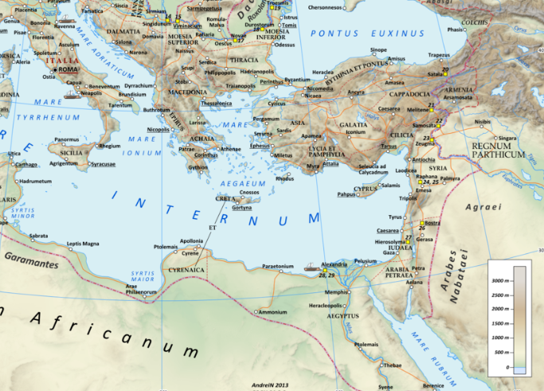
3rd Diadochi war
Battle of
Gabiene
Peithon
Killed
Antigonus
Vs
3 allies
Battle of Gaza
Seleucus
Master of Asia
ultimatum
Seleucus
War
Antig KN
Eumenes KS
Antig
ê
Eumenes
Pheiton
Seleucus
Antigonus
dictator
3 allies
ê
Antigonus
Spheres of
influence
Dem defeated against adv. gen
Seleucus
Nabateans
“First, Josephus the ancient Jewish historian identified the Nabataeans with Ishmael's eldest son (Genesis25:13). He claimed that the Nabataeans lived through the whole country extending from the Euphrates to the Red Sea. Here refers to this area as Nabatene, or the area that the Nabataeans ranged in. Josephus goes on to say that it was the Nabataeans who conferred their name son of the Arabian nations. (Jewish AntiquitiesI.22,1) By this statement, we can assume to mean that during his lifetime the word Arabs and Nabataeans had become synonymous. Josephus lived and wrote during the time that the Nabataeans were in existence, and supposedly, he obtained his information directly from the Nabataeans themselves. http://nabataea.net/who.html

Slide 6
3rd Diadochi war
Battle of
Gabiene
Peithon
Killed
Antigonus
Vs
3 allies
Battle of Gaza
Seleucus
Master of Asia
ultimatum
Seleucus
War
Antig KN
Eumenes KS
Antig
ê
Eumenes
Pheiton
Seleucus
Antigonus
dictator
3 allies
ê
Antigonus
Spheres of
influence
Dem defeated against adv. gen
Seleucus
Nabateans
The first definite appearance dates from 312/311 BCE, when they were attacked at Sela or perhaps at Petra without success by Antigonus I's officer Athenaeus in the course of the Third War of the Diadochi; at that time Hieronymus of Cardia, a Seleucid officer, mentioned the Nabataeans in a battle report.
Antigonus appointed one of his officers, Athenaeus, to attack the Nabataeans and take their herds as booty. Athenaeus marched with 4000 men and 600 horsemen into Petra, Nabataea's stronghold, during the night time while the Nabataean men were away trading.^{[1]} Coming from Judea and after 3 travel days across 160 km, Athenaeus captured the place easily as only women and children were present, and the troops loaded themselves with as much frankincense and myrrh as their animals allowed and stole around 13.7 tonnes of silver.^{[1]}
The Nabataean women and children found they were taken to be sold as slaves.^{[3]} Athenaeus and his troops regrouped as dawn broke and set off for where they came from, making camp around 36 km away, assuming they were safely away from the Nabataeans.^{[3]} Spotted by some nomads while they were leaving, an 8,000 Nabataean camel cavalry force, superior to horses in such a barren terrain, came in pursuit only hours later. A few prisoners escaped from the camp at night and managed to tip off the Nabataean force on the whereabouts of the camp. They engaged the Greeks with javelins while they were asleep, and freed the families.^{[3]} Based on Hieronymus, Diodorus described how "all the 4000 foot-soldiers were slain, but of the 600 horsemen about fifty escaped, and of these the larger part were wounded".^{[1]}
The Nabataeans sent a letter of complaint in Aramaic, the lingua franca of the ancient Middle East, to Antigonus. The letter argued that the Nabataeans did not want war but were forced to attack the Greeks in self-defence. Antigonus replied that Athenaeus had acted on his own and that Nabataeans were indeed excused.^{[3]}

Slide 7
They were connected to Ishmael, the root cause of Islam. This leads or helps us review our understanding of the role of Islam at the end of the world especially at Panium (2021).How will Islam obstruct USA in 2021 as it (USA) takes back the sphere of Influence and what does Islam look like? Revelation 9 (the woe trumpets) gives us a basic and impressive history of the role of Islam. We are not going to unlock every detail/symbols in Rev 9 (I recommend us to the Advent Pioneers (Uriah Smith Daniel and Revelation and Josiah’s Litch prophetic exposition volume 2) understanding of the trumpets.
If we were to look into the line of the 144K, we will have:

Slide 8
Between 911 and SL, we have 2019 and 2021. 2019 is an increase of knowledge while 2021 is a formalization. SL is a test. To understand the increase of knowledge and formalization, we need to look at 911 and SL. At 911, we have the subject of Islam arriving into history. What we’ll have is an increase of knowledge on the role of Islam and the nature of the Sunday Law. That is what we would like to figure out.

Slide 9
1989 is the fulfilment of the 40thverse of Daniel 11. Daniel 11:40 gives us two historical fulfilments based on the current prophetic events. Part A (1798) & B (1989) respectively. In 1798, Dan 8:14 was unsealed as the first angel’s message in relation to time. In 1989, Daniel 11:40-45 was unsealed, a message connected to time which was formalized in 1996 in the TIME OF THE END MAGAZINE that has been clarified recently i.e. the nature of Sunday Law just as Snow clarified the message given to Miller, 2300. 1989, 911, SL, COP and Second Coming are five key primary waymarks in the line of 144K. We have four dispensations with two waymarks in each dispensation. 2021 is MC where we expect the arrival of Islam just as it was on September 11, 2001 (911). Our burden is to figure out the nature of Islam in 2021. We’ll look at the origin of Islam before we look into other lines that can help us conceptualize 2021.
In this series, we are going to look into the basic understanding of the origin of Islam. Before we look into that, we need to identify the context in which Islam became a subject of prophecy and why it did happen.

Slide 10
THE PLACE OF ISLAM
Josiah Litch
DR. JOSIAH LITCH (1809-1886), an Adventist Pioneer, was and is an interesting figure in the early course of Advent history who joined Miller in the preaching of the 2nd advent of Christ in 1844. He took an extensive exposition of Revelation 9, Islam, (GC 334) in connection with Dan 11:40. God raised him from his weird understanding of 1260 to an investigation of Rev 9:
“He(Litch) was already well aware that the Protestant world generally believed that Antichrist, under the various prophetic symbols of Daniel, Paul, and John, was the Papacy. And he knew that Protestants generally believed that this power was to continue for 1260 year-days, and that quite a few of these learned writers began the period with the decree of Phocas in 606 ad, and consequently would not terminate until 1866. To Litch this evidence had seemed rather decisive.” PFF4 530.1

Slide 11
From nothing to something, Litch still realized that 606 ad remains an interesting date in regard to the rise of Islam after Miller convinced him that 1260 period began in 538 ad and not as he used to believe.
If we would turn our attention to the book of Daniel 2, 7, 8 and 11th chapters respectively, Daniel gives us 4 dispensations of the false King of the North. The fourth one is the kingdom of Rome. Rome came in two phases: Rome 1 (Republic) and Rome 2 (Dictator- the history of 1260). Revelation 9 finds its historical context in the second phase of Rome.

Slide 12
The role of Islam (Woe Trumpet) entered the field of prophecy when Rome changed from a Republic to a dictatorial form based on the testimony of Daniel. There are couple of reasons to show that Rome=USA at the end of the world. One of them being the Sunday edict of 321AD and the 1888 history. I would like us to focus on the US transitioning from Democratic (constitutional) Republic to Dictatorship: Lamb like (Republic) to a dragon (Dictatorial) voice and how Islam plays it
If we would compare and contrast US and ROME in regard to the subject under study, Islam arrives in the history of Dictatorship in both histories. In the study of the two ships from the book of Acts 27, we have the ship of Alexandria (good) representing both USA and SDA from 1798 (Dan 11:40a) respectively. Adramytium is a bad ship which represents USA from 1989 (Dan 11:40b) as it sails towards the SL when it will fully speak like a dragon:

Slide 13
“The lamblike horns and dragon voice of the symbol point to a striking contradiction between the professions and the practice of the nation thus represented. The "speaking" of the nation is the action of its legislative and judicial authorities. By such action it will give the lie to those liberal and peaceful principles which it has put forth as the foundation of its policy.” GC 442
We will try to overlay the history of Acts 27 and Numbers 22 from 1989 in the second last narrative of this discourse. What I want us to realize is that Islam enters into prophetic history as a scourge against a dictatorial administration of Rome and USA at the end of the world. This can be well demonstrated with the rise of radical Islam since 1989, which is a milestone year that illustrate the rise of USA as a dictator (Adramytium).

Slide 14
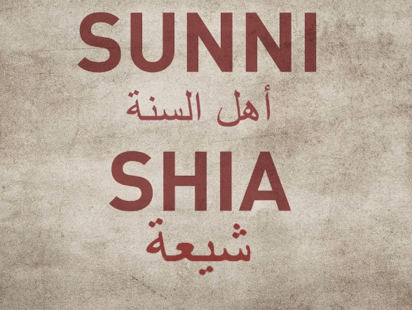
THE RISE OF THE SUNI AND THE SHIA
The two factions, Sunni and Shia, plays an integral part in the role of Islam at the end of the world. The two tribes have been in dire conflict after the death of Mahomet. Each faction believing that the successor of Mahomet came from each tribe. This is well demonstrated in the day and age conflict between Saudi Arabia and Iran among other Middle East countries like Iraq.

Slide 15
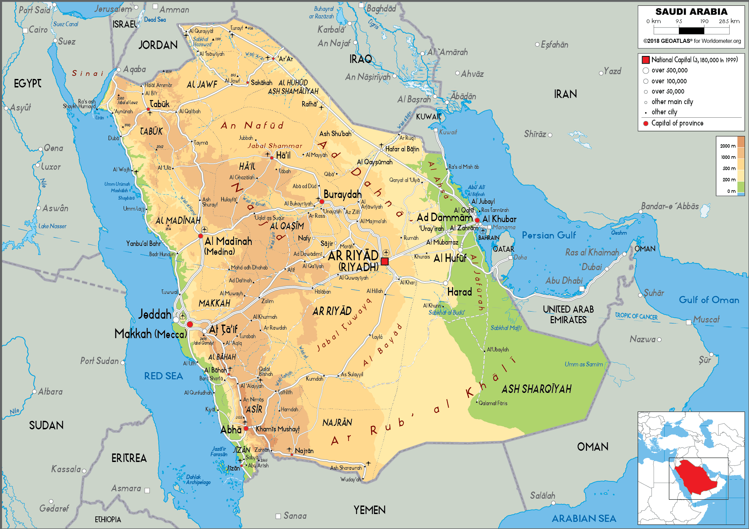
THE ORIGIN OF ISLAM
570 AD
“Near the close of the sixth century there was born in Mecca, of the princes of Arabia, a man who claimed direct descent from Ishmael, the son of Abraham. This man was Mohammed, the son of Abdallah, and the founder of a faith, which, to-day has many thousand adherents. "Arabia," says Gibbon, "was free; the adjacent kingdoms were shaken by the storms of conquest and tyranny, and persecuted sects fled to the happy land where they might profess what they believed, and practice what they professed." In Arabia were gathered, at this time, Christians, Jews, Persian fire-worshipers, and representatives of all sects and beliefs. {1905 SNH, SSP 162.2}
“Mohammed was acquainted with them all as he mingled in the thoroughfares of Mecca, and in his journeys to Damascus, and seaports of Syria.” {1905 SNH, SSP 163.1}
(Gen 16:12; 21: 20-21)

Slide 16
“Born approximately 570 CE (Year of the Elephant) in the Arabian city of Mecca, Muhammad was orphaned at the age of six.^{[6]} He was raised under the care of his paternal grandfather Abd al-Muttalib, and upon his death, by his uncle Abu Talib.^{[7]} In later years he would periodically seclude himself in a mountain cave named Hira for several nights of prayer. When he was 40, Muhammad reported being visited by Gabriel in the cave,^{[8][9]} and receiving his first revelation from God. Three years later, in 610,^{[10]} Muhammad started preaching these revelations publicly,^{[11]} proclaiming that "God is One", that complete "submission" (islām) to God^{[12]} is the right way of life (dīn),^{[13]} and that he was a prophet and messenger of God, similar to the other prophets in Islam.^{[14][15][16] “}https://en.wikipedia.org/wiki/Muhammad
“Muhammad, in full Abū al-QāsimMuḥammad ibn ʿAbdAllāh ibn ʿAbd al-Muṭṭalib ibn Hāshim, (born c. 570, Mecca, Arabia [now in Saudi Arabia]—died June 8, 632, Medina), the founder of Islam and the proclaimer of the Qurʾān. Muhammad is traditionally said to have been born in 570 in Mecca and to have died in 632 in Medina, where he had been forced to emigrate to with his adherents in 622.” https://www.britannica.com/biography/Muhammad

Slide 17
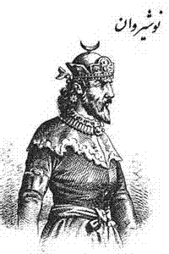
606 AD- Mahomet began to have series of visions
He claims to have been called by God to be a prophet.
"'While the Persian monarch contemplated the wonders of his art and power, he received an epistle from an obscure citizen of Mecca, inviting him to acknowledge Mahomet as the apostle of God. He rejected the invitation, and tore the epistle. "It is thus," exclaimed the Arabian prophet, "that God will tear the kingdom, and reject the supplication of Chosroes."Prophetic Expositions volume 2, 163.3
Chosroes I (500-579)

Slide 18
610AD – Praying in the cave of darkness- First Revelation
“Muhammad's revelation was an event described in Islam as taking place in 610 AD, during which the Islamic prophet, Muhammad was visited by the archangel Jibrīl, known as Gabriel in English, who revealed to him the beginnings of what would later become the Qur’an. The event took place in a cave called Hira, located on the mountain Jabal an-Nour, near Mecca. As for the exact date of this event, it has been calculated to be on Friday, the 17th of Ramadan at night, i.e. August 6, 610 C.E. - when Muhammad was 40 lunar years, 6 months and 12 days of age, i.e. 39 Gregorian calendar years, 3 hours and 22 days.^{[1]} ^{[2]}
https://en.wikipedia.org/wiki/Muhammad%27s_first_revelation
“Mohammed was of a serious mind, and it was his custom to retire one; month each year to a cave, a few miles from Mecca, where he gave himself to; fasting and prayer. On his return from one of these seasons of seclusion he announced his belief in one God, and that Mohammed was the prophet of God. This was the beginning of Islamism. The prophet first taught in his own family, and gradually gained a number of converts.” SSP 163.2

Slide 19
613AD- Speech on mount Safa
The Public Mission of the Prophet of Islam
To promulgate the holy religion of Islam to all Arab tribes and all over the world, God commanded the Holy Prophet to openly declare his prophetic mission and explain to the masses the truth of his faith.2 So he made his way to Mount Safa, stood on a high place, and exclaimed, `Yasabaha-hu'." His voice resounded on the mountain and attracted the attention of the people. Large crowds from various tribes hurried toward him to hear what he was going to say. The Holy Prophet turned to them and said, `O people! Will you believe me if I tell you that your enemies intend to ambush you at dawn or at night?' They all answered, `We have not heard a lie from you throughout your life'.https://www.al-islam.org/glance-life-holy-prophet-islam/chapter-9-public-mission-prophet-islam

Slide 20
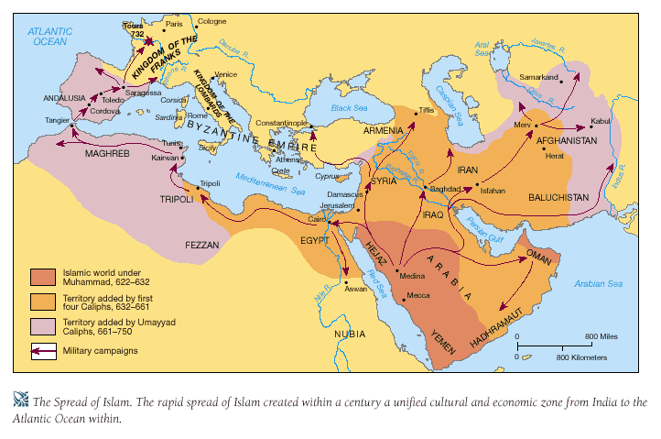

Slide 21
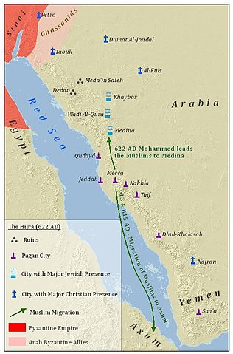
622AD- THE HEGIRA- FLEES FROM MECCA TO MEDINA
OPPOSITION
“His flight, from Mecca, called the Hegira, [a. d.622] is the era of his glory, and the date from which the Mohammedans compute their time. In opposition to the forms and ceremonies of the numerous worshipers who congregated at Mecca, and to the professed Christians who revered the images of saints and martyrs, the simple principles of the new religious leader called for prayer, fasting, and alms. Five times a day, his followers all over the world turn their eyes toward Mecca, and lift their hearts in prayer.” SSP 163.2
“When Mahomet entered Medina, (A. D. 622,) and was first received as its prince, 'a turban was unfurled before him to supply the deficiency of a standard.' The turbans of the Saracens, like unto a coronet, were their ornament and their boast The rich booty abundantly supplied and frequently renewed them. To assume the turban, is proverbially to turn Mussulman. And the Arabs were anciently distinguished by the mitres which they wore.” {1842 JoL, PREX2 175.4}

Slide 22
628AD TREATY
MECCANS AND MOSLEMS
“Pact of Al-Ḥudaybiyah, (628ad), compromise that was reached between Muḥammad and Meccan leaders, in which Mecca gave political and religious recognition to the growing community of Muslims in Medina. Muḥammad had been approaching Mecca with approximately 1,400 followers in order to perform the ʿumrah (pilgrimage) as directed in a dream. The Meccans, however, humiliated by their inability to besiege Medina (March 627), would not allow Muḥammad entry into their city. Instead, a Meccan delegation met the Muslims at their stopping place, Al-Ḥudaybiyah, situated about 9 miles (14.5 km) outside Mecca, to negotiate a treaty, thereby acknowledging the equality of the Muslims as bargaining partners. A 10-year truce was declared. Muḥammad then agreed to abandon his ʿumrah, on the condition that he be allowed to enter Mecca the following year, at which time the city would be emptied for three days to allow the Muslims to perform their rites. In addition, provision was made for the return of any Meccan who might flee to Medina without permission from his guardian (although a similar provision for Muslims going to Mecca was not stipulated). Finally, the various tribes could ally themselves with either the Meccans or the Muslims, as they wished.”
https://www.britannica.com/event/Pact-of-Al-Hudaybiyah

Slide 23
629 AD
Mahomet Attacks the Romans
Muslim conquests, 629–718
“According to Muslim biographies, Muhammed, having received intelligence that Byzantine forces were concentrating in northern Arabia with intentions of invading Arabia, led a Muslim army north to Tabouk in present-day northwestern Saudi Arabia, with the intention of pre-emptively engaging the Byzantine army; the news, however, proved to be false as the Byzantine army had retreated beforehand. Though it was not a battle in the typical sense, nevertheless the event represented the first Arab assault against the Byzantines. It did not, however, lead immediately to a military confrontation.^{[16]}
However, there is no contemporary Byzantine account of the Tabuk expedition, and many of the details come from much later Muslim sources. It has been argued that there is in one Byzantine source possibly referencing the Battle of Mu´tah traditionally dated 629, but this is not certain.^{[17]} The first engagements may have started as conflicts with the Arab client states of the Byzantine and Sassanid empires: the Ghassanids and the Lakhmids of Al-Hirah. In any case, Muslim Arabs after 634 certainly pursued a full-blown offensive against both empires, resulting in the conquest of the Levant, Egypt and Persia for Islam. The most successful Arab generals were Khalid ibn al-Walid and 'Amr ibn al-'As.” https://en.wikipedia.org/wiki/Arab%E2%80%93Byzantine_wars#Muslim_conquests,_629%E2%80%93718

Slide 24
630 AD
THE CONQUEST OF MECCA
632 AD
DEATH OF MOHAMMED
“After the death of Mahomet, he was succeeded in the command by Abubeker, A. D. 632; who, as soon as he had fairly established his authority and government, despatched a circular letter to the Arabian tribes, of which the following is an extract:-"This is to acquaint you that I intend to send the true believers into Syria to take it out of the hand of the infidels, and I would have you know that the fighting for religion is an act of obedience to God." {1842 JoL, PREX2 171.4}
NB: As noted before, the two prominent Arabian Tribes that are playing a significant role of Islam in our day and age, are Sunni and the Shia. They’ve been in conflict with each over the succession of Mahomet. I recommend that we watch some interesting PBS FRONTLINE FILMS in order to have a glimpse of the above conflict: The SECRET RISE OF ISIS, BITTER RIVALS par 1 & 2.
https://youtu.be/VHcgnRl2xPM

Slide 25
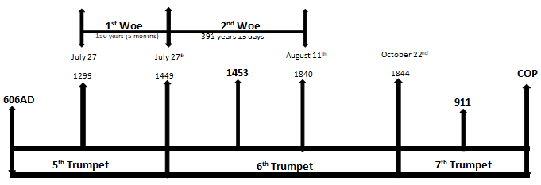
THE WOE TRUMPETS AND APPLICATIONS

Slide 26
If we were to draw the line of the priests from the 144K line, we will have:
We are going to use the principle of natural/ spiritual (Compare and contrast) from the history or the beginning of 1st Woe (Rev 9:12) and 2nd woe (Rev 11:14) respectively and see what the 3rd woe teaches us.

Slide 27
606 AD=1989
Rev 9:1-3
“A star fell from heaven unto the earth: and to him was given the key of the bottomless pit." "'While the Persian monarch contemplated the wonders of his art and power, he received an epistle from an obscure citizen of Mecca, inviting him to acknowledge Mahomet as the apostle of God. He rejected the invitation, and tore the epistle. "It is thus," exclaimed the Arabian prophet, "that God will tear the kingdom, and reject the supplication of Chosroes." Placed on the verge of these two empires of the east, Mahomet observed with secret joy the progress of mutual destruction; and in the midst of the Persian triumphs he ventured to foretell, that, before many years should elapse, victory should again return to the banners of the Romans.' 'At the time when this prediction is said to have been delivered no prophecy could be more distant from its accomplishment (!) since the first twelve years of Heraclius announced the approaching dissolution of the empire.'{1842 JoL, PREX2 163.1,2}
606 AD

Slide 28
"'Since the days of Scipio and Hannibal, no bolder enterprise has been attempted than that which Heraclius achieved for the deliverance of the empire. He permitted the Persians to oppress for a while the provinces, and to insult with impunity the capital of the east; while the Roman emperor explored his perilous way through the Black Sea and the mountains of Armenia, penetrated into the heart of Persia, and recalled the armies of the great king to the defense of their bleeding country. The revenge and ambition of Chosroes exhausted his kingdom. The whole city of Constantinople was invested,-and the inhabitants descried with terror the flaming signals of the European and Asiatic shores. In the battle of Nineveh, which was fiercely fought from daybreak to the eleventh hour, twenty-eight standards, besides those which might be broken or torn, were taken from the Persians; the greatest part of their army was cut in pieces, and the victors, concealing their own loss, passed the night on the field. The cities and palaces of Assyria were open for the first time to the Romans. {1842 JoL, PREX2 164.2}
606 AD

Slide 29
“And the fifth angel sounded, and I saw a star fall from heaven unto the earth: and to him was given the key of the bottomless pit. And he opened the bottomless pit. He fell unto the earth. When the strength of the Roman empire was exhausted, and the great king of the east lay dead in his tower of darkness, the pillage of an obscure town on the borders of Syria was 'the prelude of a mighty revolution.' 'The robbers were the apostles of Mahomet, and their fanatic valor emerged from the desert."{1842 JoL, PREX2 166.3}
606 AD

Slide 30
606AD as seen on the 1850 chart marks the rise of Mahomet. The Key (Rev 9:1) that unlocked the latter in 606ad-627ad is the battle of Nineveh (627ad)between two antagonists [Eastern Rome (Heraclius) and Persia (Chosroes)]. The two powers especially the Persians were a blockade to the rise of Mahomet and his teachings. At the battle of Nineveh, the two parties were exhausted and they became a key for the rise of Mahomet.
That brings us to the history of 1989 that marks the rise of radical Islam. Prior to 1989, we had constant proxy war between Russia and USA from 1979, the Soviet Afghan war.
Rome and Persia were the key that marked the rise of Mahomet into power which parallels USA and Russia in the rise of radical Islam from 1989, the Al-qaeda.
We also had the Iranian Revolution in 1979 and the rise of Saddam Hussein in Iraq.
606 AD

Slide 31
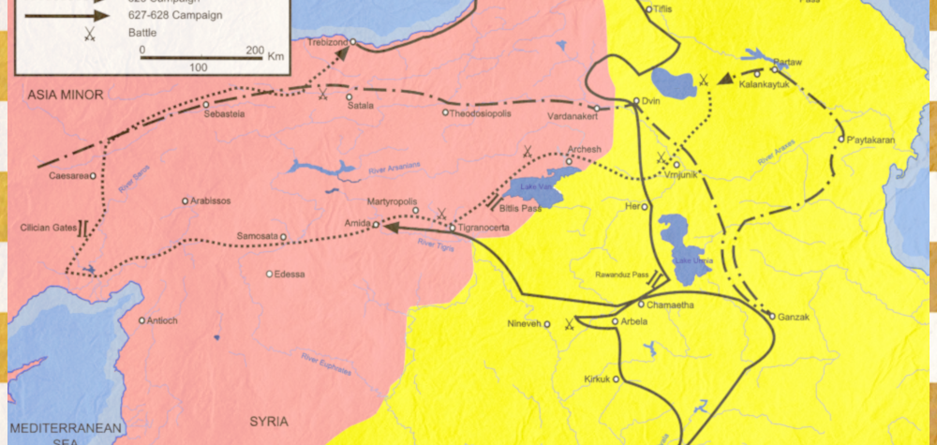

Slide 32
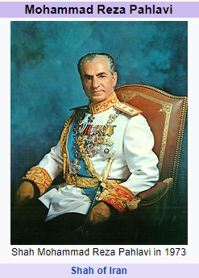
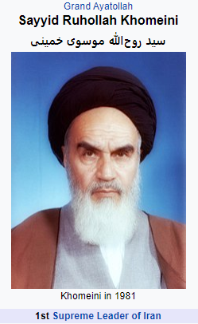
“The Iranian Revolution , also known as the Islamic Revolution or the 1979 Revolution,^{[6]} was a series of
events that involved the overthrow of the last monarch of Iran, Mohammad Reza Pahlavi,^{[7]} and the replacement of his government with an Islamic republic under the Grand Ayatollah Ruhollah Khomeini, who was supported by the United States^{[8][9][10]} and was a leader of one of the factions in the revolt.^{[11]} The movement against the United States-backed monarchy was supported by various leftist and Islamist organizations^{[12]} and student movements. Demonstrations against the Shah commenced in October 1977, developing into a campaign of civil resistance that included both secular and religious elements,^{[13][14][15]} and which intensified in January 1978.^{[16]} Between August and December 1978, strikes and demonstrations paralyzed the country. The Shah left Iran for exile on 16 January 1979, as the last Persian monarch, leaving his duties to a regency council and Shapour Bakhtiar who was an opposition-based prime minister. Ayatollah Khomeini was invited back to Iran by the government,^{[17][18]} and returned to Tehran to a greeting by several million Iranians.^{[19]} The royal reign collapsed shortly after on 11 February when guerrillas and rebel troops overwhelmed troops loyal to the Shah in armed street fighting, bringing Khomeini to official power.^{[20][21]} Iran voted by national referendum to become an Islamic republic on 1 April 1979^{[22]} and to formulate and approve a new theocratic-republican constitution^{[13][14][23][24]} whereby Khomeini became Supreme Leader of the country in December 1979.”https://en.wikipedia.org/wiki/Iranian_Revolution
Iranian Revolution
606 AD
1979

Slide 33
We also had the Iran-Iraq war in 1980 whose root is dated back in 1979 over tension in the Persian Gulf. In that war, Iraq was also supported by Kuwait.
“The Iran–Iraq War began on 22 September 1980, when Iraq invaded Iran, and it ended on 20 August 1988, when Iran accepted the UN-brokered ceasefire. Iraq wanted to replace Iran as the dominant Persian Gulf state, and was worried the 1979 Iranian Revolution would lead Iraq's Shi'ite majority to rebel against the Ba'athist government. The war also followed a long history of border disputes, and Iraq planned to annex the oil-rich Khuzestan Province and the east bank of the Arvand Rud (Shatt al-Arab). Although Iraq hoped to take advantage of Iran's post-revolutionary chaos, it made limited progress and was quickly repelled; Iran regained virtually all lost territory by June 1982. For the next six years, Iran was on the offensive^{[68]} until near the end of the war.^{[63]} There were a number of proxy forces—most notably the People's Mujahedin of Iran siding with Iraq and the Iraqi Kurdish militias of the KDP and PUK siding with Iran. The United States, Britain, the Soviet Union, France, and most Arab countries provided political and logistic support for Iraq, while Iran was largely isolated.” https://en.wikipedia.org/wiki/Iran%E2%80%93Iraq_War
Iranian Revolution
Iran-Iraq War
606 AD
1979
1980

Slide 34
During Iran-Iraq war, Kuwait had financed Iraq which Kuwait in 1989 was demanding to be paid but Iraq refused to pay because it felt that the financial support of war was a corporate subject and Kuwait should not demand it.
“In early 1990 Iraq was accusing Kuwait of stealing Iraqi petroleum through slant drilling, although some Iraqi sources indicated Saddam Hussein's decision to attack Kuwait was made a few months before the actual invasion.^{[17]} Some feel there were several reasons for the Iraqi move, including Iraq's inability to pay the more than US $14 billion that it had borrowed to finance the Iran–Iraq War, and Kuwaiti high petroleum production levels which kept revenues down for Iraq.” https://en.wikipedia.org/wiki/Invasion_of_Kuwait
Iranian Revolution
Iran-Iraq War
606 AD
1979
1980

Slide 35
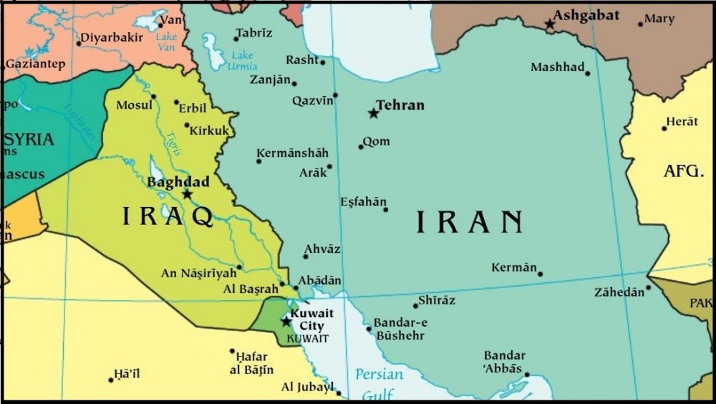

Slide 36
The relation between Russia and Iraq by this time was strong while Kuwait was an ally to USA. When Iraq invaded Kuwait in 1990, US responded by attacking Iraq in 1991.
This sparked the rise of a Terrorist group, the Al-Qaeda.
“Al-Qaeda began as a logistical network to support Muslims fighting against the Soviet Union during the Afghan War; members were recruited throughout the Islamic world. When the Soviets withdrew from Afghanistan in 1989, the organization dispersed but continued to oppose what its leaders considered corrupt Islamic regimes and foreign (i.e., U.S.) presence in Islamic lands. Based in Sudan for a period in the early 1990s, the group eventually reestablished its headquarters in Afghanistan (c. 1996) under the patronage of the Taliban militia.” Britannica
The end of the cold war between Russia and USA in 1989 and 1991 respectively with the collapse of the Soviet Union led to the rise of Radical Islam. From 1989, America began acting as Unilateral (Dictatorship) instead of Multilateral. That led to the rise of Al-qaeda that attacked the USA on 911.
Iranian Revolution
Iran-Iraq War
606 AD
1979
1980
Afghan War 1979-1989

Slide 37
JULY 27, 1299 = 911
Rev 9:4-11
“After the death of Mahomet, he was succeeded in the command by Abubeker, A. D. 632; who, as soon as he had fairly established his authority and government, despatched a circular letter to the Arabian tribes, of which the following is an extract:-"This is to acquaint you that I intend to send the true believers into Syria to take it out of the hand of the infidels, and I would have you know that the fighting for religion is an act of obedience to God." {1842 JoL, PREX2 171.4)
Iranian Revolution
Iran-Iraq War
606 AD
July 27, 1299
1979
1980
Afghan War 1979-1989

Slide 38
"It was on July 27 a. d., 1299," says Gibbon, "that Othman first invaded the territory of Nicomedia; and the singular accuracy of the date seems to disclose some foresight of the rapid and destructive growth of the monster." More than human foresight recorded this date with such definiteness. To the prophet on Patmos, it had been revealed that "their power was to hurt men five months." {1905 SNH, SSP 171.2}
Iranian Revolution
Iran-Iraq War
606 AD
July 27, 1299
1979
1980
Afghan War 1979-1989

Slide 39
"His messengers returned with the tidings of pious and martial ardor, which they had kindled in every province; the camp of Medina was successively filled with the intrepid bands of the Saracens, who panted for action, complained of the heat of the season and the scarcity of provisions, and accused, with impatient murmurs, the delays of the caliph. As soon as their numbers were complete, Abubeker ascended the hill, reviewed the men, the horses, and the arms, and poured forth a fervent prayer for the success of their undertaking. His instructions to the chiefs of the Syria were inspired by the warlike fanaticism which advances to seize, and affects to despise, the objects of earthly ambition. 'Remember,' said the successor of the prophet, 'that you are always in the presence of God, on the verge of death, in the assurance of judgment, and the hope of Paradise: avoid injustice and oppression; consult with your brethren, and study to preserve the love and confidence of your troops. When you fight the battles of the Lord, acquit yourselves like men, without turning your backs; but let not your victory be stained with the blood of women or children. Destroy no palm-trees, nor burn any fields of corn. Cut down no fruit trees, nor do any mischief to cattle, only such as you kill to eat. When you make any covenant or article, stand to it, and be as good as your word. As you go on, you will find some religious persons who live retired in monasteries, and propose to themselves to serve God that way; let them alone, and neither kill them nor destroy their monasteries; and you will find another sort of people that belong to the synagogue of Satan, who have shaven crowns; be sure you cleave their skulls, and give them no quarter till they either turn Mahometans or pay tribute.' {1842 JoL, PREX2 171.5}
Iranian Revolution
Iran-Iraq War
606 AD
July 27, 1299
1979
1980
Afghan War 1979-1989

Slide 40
The invasion of Nicomedia by Othman parallels the attack of American soil on September 11, 2001 marking the arrival of third woe prophetically. 911 was not a hot war. It was just a response or punishment towards the United States when it misbehaves. That’s the role of Islam- A scourge against Rome. It acts as a punishment against the apostasy of the King of the North. We are in the information age and we need to conceptualize the nature of this war. 911 was a sudden and unexpected attack like a scorpion.
After the invasion of Nicomedia, we are told that it marked “the rapid and destructive growth of the monster.“ From 911 to 2019, we have been witnessing the rise of Islamic “kingdom”, ISIS, whose root can be traced back in 2003 with the invasion of Iraq by United States.
We have the likes of Saddam Hussein, Osama Bin Laden, Abu-Musab Al-Zarqawi, and Abu Bakr al-Baghdadi who announced himself a caliph on July 2014 after capturing Mosul, the second largest city in Iraq.
Iranian Revolution
Iran-Iraq War
606 AD
July 27, 1299
1979
1980
Afghan War 1979-1989

Slide 41
“In 2013 the largely secular anti-Assad opposition represented by the Free Syrian Army increasingly saw itself being eclipsed by a variety of Islamist militant groups. In November 2013 seven Islamist regional militias merged to form the Islamic Front. The portion of the Islamist opposition with ties to al-Qaeda and its Iraqi affiliate also continued to evolve: in April 2013 Abu Bakr al-Baghdadi, the leader of al-Qaeda in Iraq, announced his intention to combine his forces in Iraq and Syria under the name Islamic State in Iraq and the Levant (ISIL; also known as the Islamic State in Iraq and Syria [ISIS]). The merger was rejected by the Nusrah Front; infighting between the Nusrah Front, aligned with the faction of al-Qaeda led by Ayman al-Zawahiri, and ISIL, the successor of al-Qaeda in Iraq, followed.
Iranian Revolution
Iran-Iraq War
606 AD
July 27, 1299
1979
1980
Afghan War 1979-1989

Slide 42
In spite of its alienation from the Nusrah Front, ISIL retained considerable strength in eastern Syria, establishing a zone of exclusive control in the Euphrates valley centred on the city of Al-Raqqah. In the areas ISIL controlled, it imposed a strict version of Islamic law. It also cultivated a reputation for brutality, staging public executions and killing or expelling non-Muslims. From eastern Syria, ISIL launched a series of successful operations in both Syria and Iraq; the western Iraqi cities of Al-Fallūjah and Al-Ramādī came under its control in early 2014, and a subsequent offensive captured Mosul, the second largest city in Iraq. In control of a wide swath of territory straddling the Iraq-Syria border, ISIL proclaimed the establishment of a caliphate, with al-Baghdadi as caliph, in June 2014.” Britannica
Iranian Revolution
Iran-Iraq War
606 AD
July 27, 1299
1979
1980
Afghan War 1979-1989

Slide 43
JULY 27, 1499: 9TH NOV 2019 (RAPHIA)
Greek Emperor (Constantine Deacozes) voluntarily surrenders to Islam Sultan (Amurath).
“In the year 1449, John Paleologus, the Greek emperor, died, but left no children to inherit his throne, and Constantine Deacozes succeeded to it. But he would not venture to ascend the throne without the consent of Amurath, the Turkish Sultan. He therefore sent ambassadors to ask his consent, and obtained it, before he presumed to call himself sovereign.” {1842 JoL, PREX2 182.2}
We’ve been marking Raphia as a win for the King for the South (Russia) against the King of the North (USA).
This marks the activity of Russia conquering USA over the issue of the spheres of influence among other subjects. For Donald Trump to take the presidential seat, he had to surrender his allegiance of US constitution to Russia which meddled in the 2016 US presidential election. This can be traced back from2013/2014,an alliance between Putin and Donald Trump: Trumps road to the White house.
July 27, 1449
Iranian Revolution
Iran-Iraq War
606 AD
July 27, 1299
1979
1980
Afghan War 1979-1989

Slide 44
2014 Parallels 303BC in the line Pyrrhus in Macedonia: An Alliance between Demetrius (KoN) and Pyrrhus, KS. Donald Trump allowed Russia to interfere in the US 2016 presidential election. He was not largely elected by the consent of his own people but through Russia, a foreign power just like a Turkish Sultan who allowed Deacozes to take the throne of Greece.
The war between Russia and USA has been through Spheres of Influence. We can look at it in the perspective of Ukraine, Venezuela, Syria, China, Africa and Libya that Culminate with the prediction of Nov 9, 2019. However, this can well be demonstrated in the election of Donald Trump in 2016. Raphia cannot be disconnected from other waymarks like 2014 which are stepping stones.
If we would strain our muscles to conceptualize our history and Millerites history especially Daniel 11:40, the Millerites (Josiah Litch) focused on Turkey (Islam). We have come to realize how Russia is an important entity in the prophetic field. We thought it was dead in 1991 after the dissolution of Soviet Union but through compare and contrast of 1798 and 1989, we saw a resurrection of the King of the South (Russia) in our history. The resurrection began in 1999 with the presidency of Putin. We will discuss more in our last presentation as we look into the understanding of Daniel 11:40 in our history, the fourth generation.
July 27, 1449
Iranian Revolution
Iran-Iraq War
606 AD
July 27, 1299
1979
1980
Afghan War 1979-1989

Slide 45
1451
Death of Amurath
“The death of Amurath in 1451, and the succession of Mohammed II., a wily man full of ambition and restless of restraint, did not retard the conquest. Mohammed's one design was to capture Constantinople. "Peace was on his lips but war was in his heart," and every energy was bent toward the accomplishment of this design. At midnight he once started from his bed, and demanded the immediate attendance of his prime vizier. The man came trembling, fearing the detection of some previous crime. He made his offering to the sultan, but was met with the words, "I ask a present far more valuable and important,-Constantinople." Mohammed II. tested the loyalty of his soldiers, warned his ministers against the bribery of the Romans, studied the art of war and the use of firearms. He engaged the services of a founder of cannon, who promised weapons that could batter down the walls of the city.”{1905 SNH, SSP 174.2}
July 27, 1449
Iranian Revolution
Iran-Iraq War
606 AD
July 27, 1299
1979
1980
Afghan War 1979-1989

Slide 46
The death of Amurath demands careful examination in our application before 2021. Mohammed II made thorough preparation before he besieged Constantinople in 1453. How does that look like before 2021 in our history? Does the responsible death of Abu Bakr al-Baghdadi in 2019(ISIS Caliph, by Trump Administration have any implication as we approach 2021?. 2019 marks a restrain of Islam which is to be loosed from 2021 as a destructive tool against USA as it changes from Constitution democracy to a dictatorial from .
July 27, 1449
Iranian Revolution
Iran-Iraq War
606 AD
July 27, 1299
1979
1980
Afghan War 1979-1989

Slide 47
Resume Aug. 1, 2020
1453AD =2021 (PANIUM)
Attack on the wall of Constantinople
“He (Mohammed II) accordingly made preparations for besieging and taking the city. The siege commenced on the 6th of April, 1453, and ended in the taking of the city, and death of the last of the Constantines, on the 16th day of May following. And the eastern city of the Cæsars became the seat of the Ottoman empire.” {1842 JoL, PREX2 183.2}
July 27, 1299
July 27, 1449
Iranian Revolution
Iran-Iraq War
606 AD
1453
1979
1980
Afghan War 1979-1989

Slide 48
“In April, 1453, the memorable siege was formed. At the sound of the war trumpet, the forces of Mohammed II were increased by swarms of fearless fanatics until, as Phranza has said, the besieging army numbered two hundred and fifty-eight thousand. Constantinople fell; the last vestige of Roman greatness was gone, and the Moslem conquerors trampled the religion of Rome in the dust. This memorable event affected all future history. The fall shocked Europe; and the convulsions had not passed, before the light of the Reformation broke the darkness which shrouded the Western Empire. While the smoke from the "bottomless pit" was settling over the East, streaks of light heralded a coming dawn in the nations of Europe.” {1905 SNH, SSP 174.2}
July 27, 1299
July 27, 1449
Iranian Revolution
Iran-Iraq War
606 AD
1453
1979
1980
Afghan War 1979-1989

Slide 49
We’ve been understanding that from Panium to Sunday Law, US will be rising as a dragon.
What we can notice from Elder Haskell is that when Constantinople fell, “the Moslem conquerors trampled the religion of Rome in the dust.” When Constantine took the seat of the empire from Rome to Constantinople in 330ad, it became the strength of Rome which was destroyed by Islam, Othman Empire. What makes America to be a lamb or to have strength is the nature of its government: THE SEPARATION OF CHURCH AND STATE. The nature or attack by Islam in 2021 will orchestrate the separation of church and state till SL when America will fully speak like a dragon hence bringing down the wall of separation. After 911 event, we had numerous attempts from White evangelicals coming together with the idea that God is punishing US because there is no Bible reading in public schools, that the Gays and transgender among other issues are the cause of 911 event. They pushed for “IN GOD WE TRUST” to be printed in public amenities. That strengthened the union of church and state.
July 27, 1299
July 27, 1449
Iranian Revolution
Iran-Iraq War
606 AD
1453
1979
1980
Afghan War 1979-1989

Slide 50
From this incident, it can be figured out how from Panium to SL , Apostate Protestantism or Religious Plurality in America will be crumbling as a result of Church and state coming together when Islam is arriving in 2021. Islam is going to mark the end of the proxy between Russia and US.
In the line of 3rd Diadochi war, we have a Babylonian WAR which parallels a war between the Papacy and US from Panium to SL. What will this attack by Islam look like?
The fall of Constantinople shocked Europe and the light of reformation went forward.
I consent that the arrival of Islam again in the prophetic field in 2021 in the American soil will give much impetus to this movement bearing in mind that from 2021 to Sunday Law waymark is the harvest of Levites and the falling of the latter rain for the Nethanims.
We need to take time and see the nature of 2021. I hope and pray that God will open and clarify 2021 as tension between Iraq, Iran, Russia and USA continues.
The attack of Constantinople in 1453 parallels 2021 (Panium).
July 27, 1299
July 27, 1449
Iranian Revolution
Iran-Iraq War
606 AD
1453
1979
1980
Afghan War 1979-1989

Slide 51
11th August 1840=SL
RESTRAIN
“Commencing when, the one hundred and fifty years ended, in 1449, the period would end August 11th, 1840. Judging from the manner of the commencement of the Ottoman supremacy, that it was by a voluntary acknowledgment on the part of the Greek emperor that he only reigned by permission of the Turkish sultan, we should naturally conclude that the fall or departure of the Ottoman independence would be brought about in the same way; that at the end of the specified period, the Sultan would voluntarily surrender his independence into the hands of the Christian powers, from whom he received it.” {1842 JoL, PREX2 189.1}
606 AD
July 27, 1299
July 27, 1449
1453 AD
Aug. 11, 1840
Iranian Revolution
Iran-Iraq War
1979
1980
SL
Afghan War 1979-1989

Slide 52
In the year 1840 another remarkable fulfillment of prophecy excited widespread interest. Two years before, Josiah Litch, one of the leading ministers preaching the second advent, published an exposition of Revelation 9, predicting the fall of the Ottoman Empire. According to his calculations, this power was to be overthrown "in A.D. 1840, sometime in the month of August;" and only a few days previous to its accomplishment he wrote: "Allowing the first period, 150 years, to have been exactly fulfilled before Deacozes ascended the throne by permission of the Turks, and that the 391 years, fifteen days, commenced at the close of the first period, it will end on the 11th of August, 1840, when the Ottoman power in Constantinople may be expected to be broken. And this, I believe, will be found to be the case."--Josiah Litch, in Signs of the Times, and Expositor of Prophecy, Aug. 1, 1840. {GC 334.4}
“At the very time specified, Turkey, through her ambassadors, accepted the protection of the allied powers of Europe, and thus placed herself under the control of Christian nations. The event exactly fulfilled the prediction.” GC 335.1
606 AD
July 27, 1299
July 27, 1449
1453 AD
Aug. 11, 1840
Iranian Revolution
Iran-Iraq War
1979
1980
SL
Afghan War 1979-1989

Slide 53
At the Sunday Law, Islam would be restrained just as Turkey (Othman Empire), an Islamic power in 1840.
Sunday Law marks the death of Russia as the king of the South while United States rises fully into dictatorship.
From 2021 (Panium) to SL, we should be looking into the activity of Islam. 1989-1991 equals 2021 to SL.
606 AD
July 27, 1299
July 27, 1449
1453 AD
Aug. 11, 1840
Iranian Revolution
Iran-Iraq War
1979
1980
SL
Afghan War 1979-1989

Slide 54
“Yesterday,” the 11th of August 1840, the Sultan applied, in his own capital, to the ambassadors of four Christian nations, to know the measures which were to be taken in reference to a circumstance vitally affecting his empire; and was only told that “provision had been made,” but he could not know what it was; and that he need give himself no alarm “about any contingency which might afterwards arise!!” From that time, then, they, and not he, would manage that. Where was the Sultan’s independence that day? GONE. Who had the supremacy of the Ottoman empire in their hands? The great powers. According to previous calculation, therefore, Ottoman Supremacy did depart on the eleventh of August into the hands of the great Christian powers of Europe.” Josiah Litch, PREX2 198.4,5,6
606 AD
July 27, 1299
July 27, 1449
1453 AD
Aug. 11, 1840
Iranian Revolution
Iran-Iraq War
1979
1980
SL
Afghan War 1979-1989

Slide 55
11th August 1840=SL. We need also to see the nature of this restraint at the SL. At the Sunday Law, Russia (KS) will be prophetically dead as the King of the South as its spheres of influence is taken by USA from 2021.
This leads us to the study of Numbers 22.
606 AD
July 27, 1299
July 27, 1449
1453 AD
Aug. 11, 1840
Iranian Revolution
Iran-Iraq War
1979
1980
SL
Afghan War 1979-1989

Slide 56
NUMBERS 22
BALAAM AND ACTS 27
THE SHIP OF ADRAMYTIUM
“Balaam was once a good man and a prophet of God; but he had apostatized, and had given himself up to covetousness; yet he still professed to be a servant of the Most High. He was not ignorant of God's work in behalf of Israel; and when the messengers announced their errand, he well knew that it was his duty to refuse the rewards of Balak and to dismiss the ambassadors. But he ventured to dally with temptation, and urged the messengers to tarry with him that night, declaring that he could give no decided answer till he had asked counsel of the Lord. Balaam knew that his curse could not harm Israel. God was on their side, and so long as they were true to Him no adverse power of earth or hell could prevail against them. But his pride was flattered by the words of the ambassadors, “He whom thou blessest is blessed, and he whom thou cursest is cursed.” The bribe of costly gifts and prospective exaltation excited his covetousness. He greedily accepted the offered treasures, and then, while professing strict obedience to the will of God, he tried to comply with the desires of Balak.” PP 439.2
606 AD
July 27, 1299
July 27, 1449
1453 AD
Aug. 11, 1840
Iranian Revolution
Iran-Iraq War
1979
1980
SL
Afghan War 1979-1989

Slide 57
BALAAM= UNITED STATES OF AMERICA (Revelation 13:11) in Apostasy
Lamb like- Good (The ship of Alexandria)
Dragon – Bad (The ship of Adramytium.)
When the prophetic structure of Acts 27 was opened in 2016-2018, it gave us two ships (Institutions): Alexandria and Adramytium. The ship of Alexandria represents a good ship: The SDA and USA from 1798 respectively.
The ship of Adramytium represents a bad ship since 1989 till Sunday Law. It gives a perfect picture of USA since 1989. It also represents the work of Balaam going forward to curse (Dragon voice) God’s people.

Slide 58
The ship of Adramytium (USA) is a bad ship right from 1989 till the Sunday Law just like Balaam (USA) was bad as a result of his intention to curse God’s people. We diligently combine the two concepts together as see what it teaches us. I want us to look into the story of Balaam. He has been connected to an ASS (Islam) from the inception of his journey to go and curse Gods people. Curse= Dragon voice of Rev 13:11= Ship of Adramytium.
The second Biblical Rule of Interpretation says that:
RULE II
“All scripture is necessary, and may be understood by a diligent application and study.” MWV1 20.5

Slide 59
Numbers 22 Application
Balaam began his journey in the morning by Saddling the Ass, a Symbol of Islam. Before morning, we must have darkness preceding it. The darkness before 1989 (Morning) is prophetically a symbol of the 126 years of Laodicea condition that began in 1863 with a rejection of the prophetic Message. In the morning, there is a light from the Sun. That light is Daniel 11:40-45 that was unsealed in 1989 as our first Angel’s message to shed light before Sunset (CoP, Dan 12:1-3).
God uses the known to teach us the unknown. Naturally, the Sun always dispenses light from morning to evening. Spiritually, God is a Sun (Psalm 84:11, Rev 9:2, Malachi 4:2). Daniel 11:40-45 that was unsealed for our generation is of vital importance as the general priesthood of Christ is about to close. Dan 8:14= Daniel 11:40-45. They are found in the book of Daniel, they are both unsealed at the time of the end: 1798 (Dan 11:40a) and 1989 (Dan 11:40b) respectively. They are also messages connected to time. However, 2300 prophetic years gives us an impressive work of the opening of Christ priesthood in 1844/10/22 while Daniel 11:40-45 explains the events leading to the close of human probation (Dan 12:1-3). There has been a huge development of Daniel 11:40-45 which we need to understand.
Balaam (USA) has been interacting with the ass (Islam) since morning (1989). From other lines, we have shown how Radical Islam (AL- Qaeda) began to rise up in 1989-1991 history when USA attacked Iraq in the Iraq-Kuwait Persian-gulf tensions. This symbolize the Saddling of the Ass by Balaam from the beginning.
126
COP
Sunset
Dan 12:1-3
1863

Slide 60
FIRST SMOTE
The first Smote of the Ass by Balaam was as a result of it turning away of the way. The turning from the way by the Ass is a symbol of Radical Islam attacking the American soil on 11th September, 2001 when the world Trade Centers were brought down into ashes.
Islam has been always the protector (Psalm 48:7) of Gods people (Rev 9:4), those that have the seal of God, and to act as a scourge against an apostate church (Rome) and a dictatorial administration.
The first smote symbolize the work of USA in invading Iraq in the name of countering the radical Islam: That led to the killing of Sadam Hussein and Osama Bin Laden. Islam was restrained just as Balaam struck the Ass.
126
COP
Sunset
Dan 12:1-3
1863

Slide 61
SECOND SMOTE
The second smote of the Ass finds or parallels the history of 1453 under the second woe. Under the symbol of the 2nd Woe that began on July 27th 1449, Islam was loosed to destroy or kill. In the first woe, Islam was commanded not to destroy but to hurt only. 2021 as seen in the structure represents the second attack of Radical Islam in the American Soil. May God help us recognize its nature as we approach it. We will look into the structure that shows us 2021.
The Ass crushed Balaam’s foot on the wall which was a devastating scene just as the attack of Constantinople in 1453. This begins telling us how devastating the nature of Islam is going to look like in 2021 that will escalate the speaking as a Dragon.
From Panium (2021), USA will begin acting dictatorial (just as the foot of Balaam was crushed on the wall) till it’s speaking like a Dragon at Sunday law waymark. Hope we understand the nature of the Sunday Law (Image of the Beast) in our history.
The second smote of the Ass by Balaam illustrates a restraint of Islam till the Sunday Law waymark, the third smote, when the Ass found it extremely hard to move forward.
126
COP
Sunset
Dan 12:1-3
1863

Slide 62
THIRD SMOTE
The third strike parallels 11th August, 1840 when Othman Empire fell in Constantinople. At the Sunday Law waymark, just as the Ass found it difficult to move forward BETWEEN THE NARROW PLACE, it will be vehemently restrained. The narrow place is a difficult place to pass through. This symbolize the dragon voice of (legislative and judicial actions) that will act strongly against radical Islam.
There are a couple of symbols illustrated in Numbers 22 like speaking of the Ass and the work of the angel connected to the Ass. I treated the speaking of the Ass as noise because it violates the simple laws of nature (Rule XI). The repentance of Balaam can also be treated as noise because if we parallel Balaam to USA in a dragon state, it can’t work in this prophetic model.
I want us to look into DANIEL 11:40
126
COP
Sunset
Dan 12:1-3
1863

