Slide 1
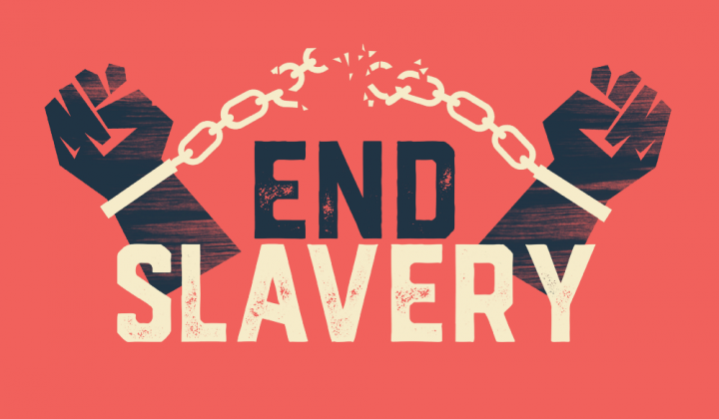
Freedom In America Part 4
The Tradition of Rights
Part 10: The End of Slavery and the Reconstruction Amendments
https://www.docsoffreedom.org/readings/the-end-of-slavery-and-the-reconstruction-amendments
Side Notes:
American Civil War
Description
The American Civil War was a civil war in the United States from 1861 to 1865, fought between the northern United States and the southern United States. The civil war began primarily as a result of the long-standing controversy over the enslavement of black people. Wikipedia
Dates: Apr 12, 1861 – Apr 9, 1865
Last battle: Battle of Palmito Ranch
First battle: Battle of Fort Sumter
President: Abraham Lincoln
Bloodiest day: Battle of Antietam
Confederate states president: Jefferson Davis
Biggest battle: Gettysburg was the bloodiest battle of the Civil War. infoplease.com

