Slide 1
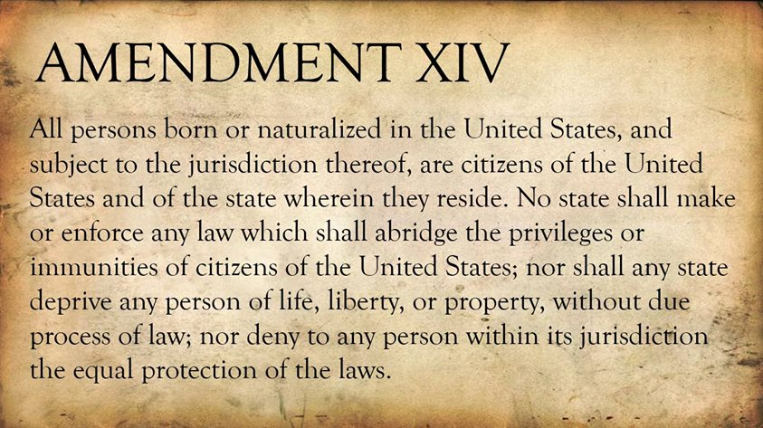
Freedom In America Part 4
The Tradition of Rights
Part 11: The fourteenth Amendment and Incorporation
https://www.docsoffreedom.org/readings/the-fourteenth-amendment-and-incorporation
Side Notes:

