Slide 1
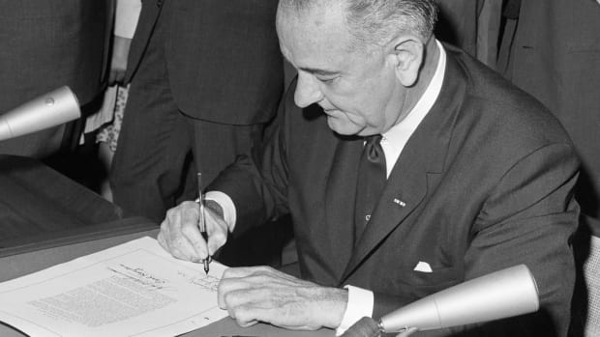
Freedom In America Part 4
The Tradition of Rights
Part 14: The Great Society
https://www.docsoffreedom.org/readings/the-great-society
Side Notes:

