Slide 1
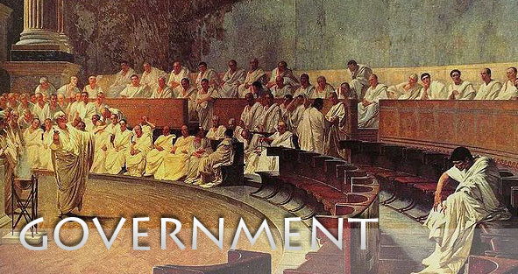
Freedom In America Part 4
The Tradition of Rights
Part 2: Ancient Republics and European Charters
https://www.docsoffreedom.org/readings/ancient-republics-and-european-charters
Side Notes:

