Slide 1
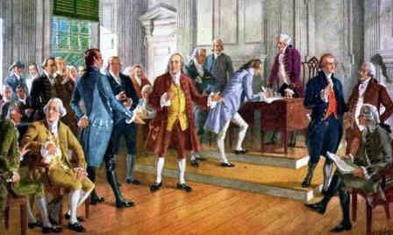
Freedom In America Part 4
The Tradition of Rights
Part 4: Rights and the Declaration of Independence
https://www.docsoffreedom.org/readings/rights-and-the-declaration-of-independence
Side Notes:
John Locke
For Locke, in the state of nature all men are free "to order their actions, and dispose of their possessions and persons, as they think fit, within the bounds of the law of nature." (2nd Tr., §4). "The state of Nature has a law of Nature to govern it", and that law is reason.

