Slide 1
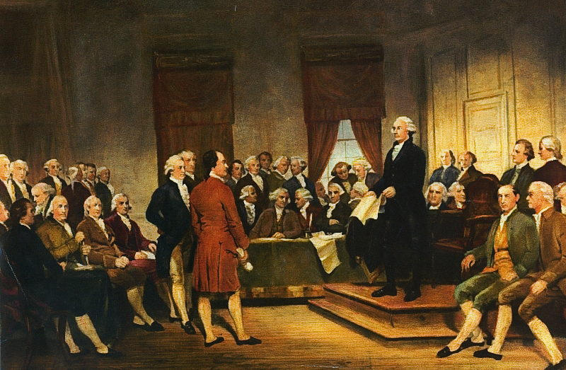
Freedom In America Part 4
The Tradition of Rights
Part 7: The Ratification Debate
https://www.docsoffreedom.org/readings/the-ratification-debate
Side Notes:
Federalist were people who were in favor of the U.S. Constitution and wanted it to be ratified .
Anti-Federalist were people who opposed the U.S. Constitution and did not want it to be ratified.

