Slide 1
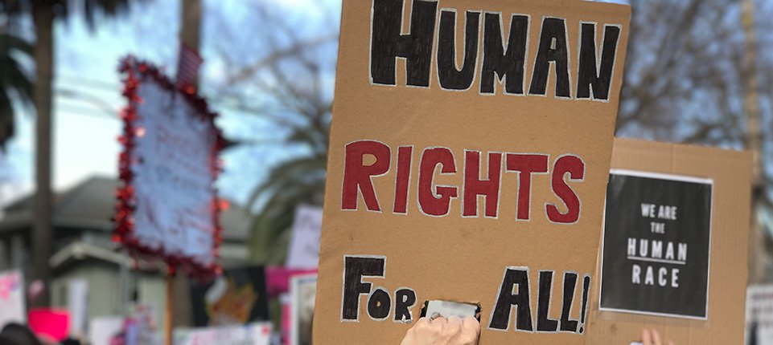
Freedom In America Part 4
The Tradition of Rights
Part 15: Modern Debates on Rights
https://www.docsoffreedom.org/readings/modern-debates-on-rights
Side Notes:

