Slide 1
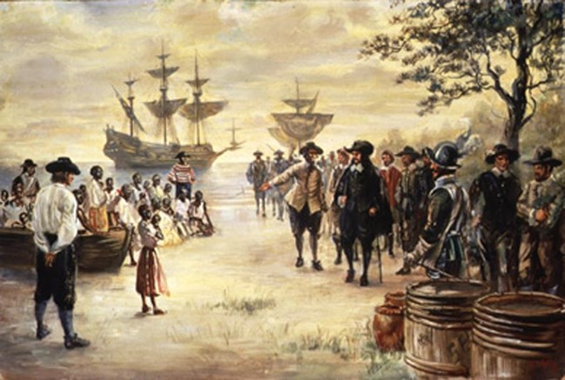
Freedom In America Part 4
The Tradition of Rights
Part 3: Colonial Experience with Government and Economics
https://www.docsoffreedom.org/readings/colonial-experience-with-government-and-economics
Side Notes:

