Slide 1
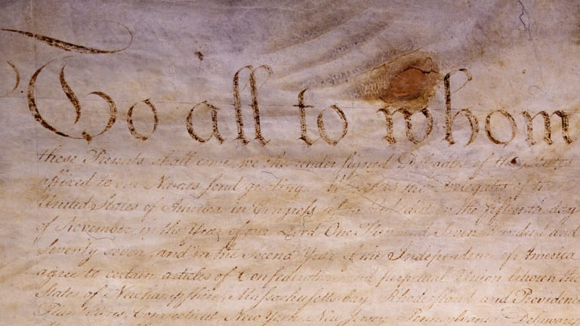
Freedom In America Part 4
The Tradition of Rights
Part 5: The Articles of Confederation
https://www.docsoffreedom.org/readings/the-articles-of-confederation
Side Notes:

