Slide 1
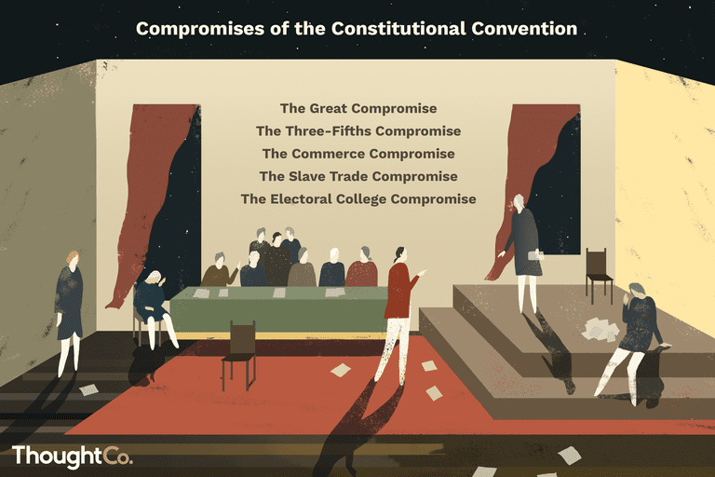
Freedom In America Part 4
The Tradition of Rights
Part 6: The Constitutional Convention
https://www.docsoffreedom.org/readings/the-constitutional-convention
Side Notes:

