Slide 1
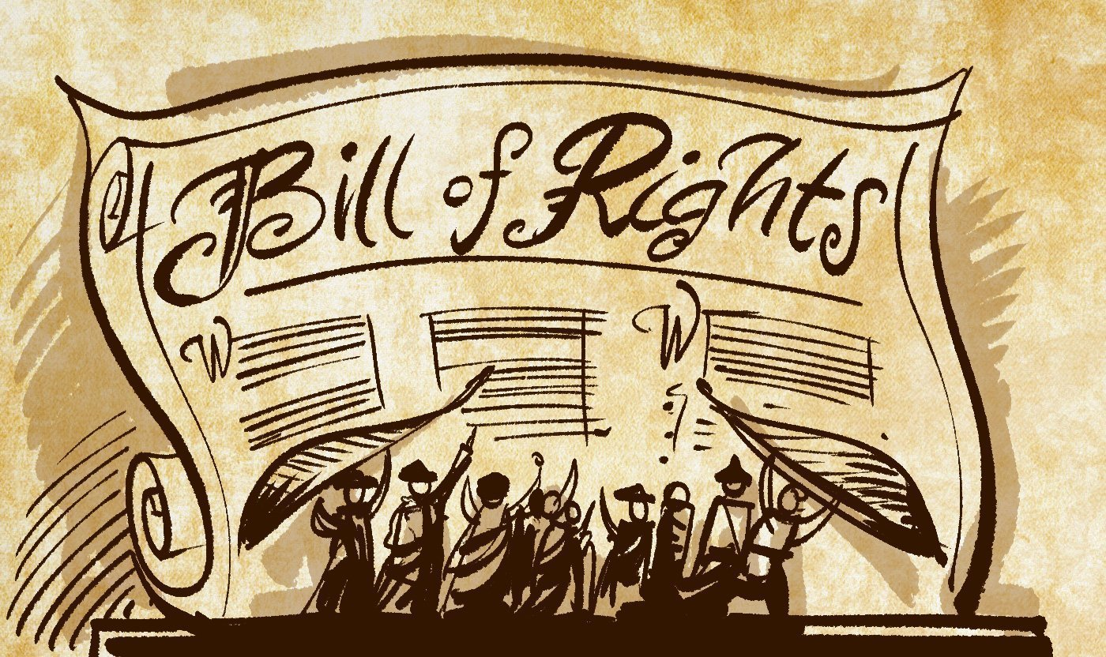
Freedom In America Part 4
The Tradition of Rights
Part 8: The Bill of Rights
https://www.docsoffreedom.org/readings/the-bill-of-rights
Side Notes:
“The House approved seventeen amendments. Of these seventeen, the Senate approved twelve. Those twelve were sent to the states for approval, as the Constitution directed. Of those twelve, ten were ratified and became the Bill of Rights (1791).”

