Slide 1
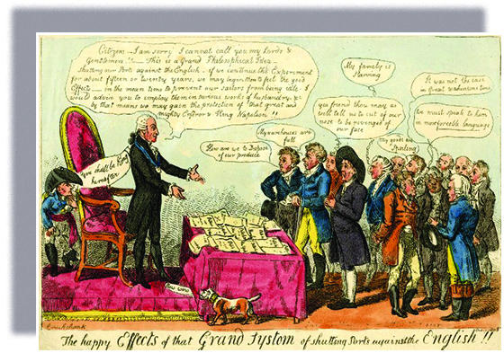
Freedom In America Part 4
The Tradition of Rights
Part 9: Early Challenges in the Constitutional Republic
https://www.docsoffreedom.org/readings/early-challenges-in-the-constitutional-republic
Side Notes:

