Slide 1
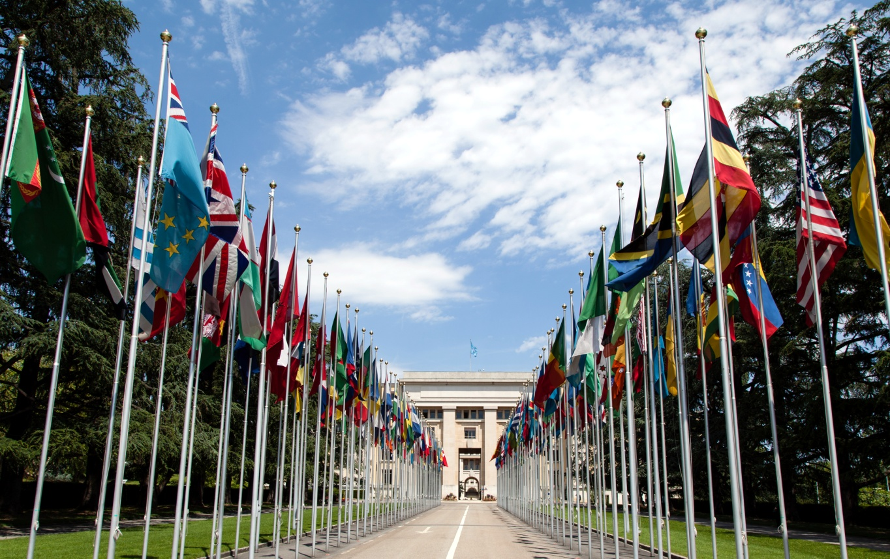
Freedom In America Part 9
The United States and the World
Part 1: International Relations and the Constitutional Separations of Power
https://www.docsoffreedom.org/readings/international-relations-and-the-constitutional-separation-of-powers
Side Notes:

