Slide 1
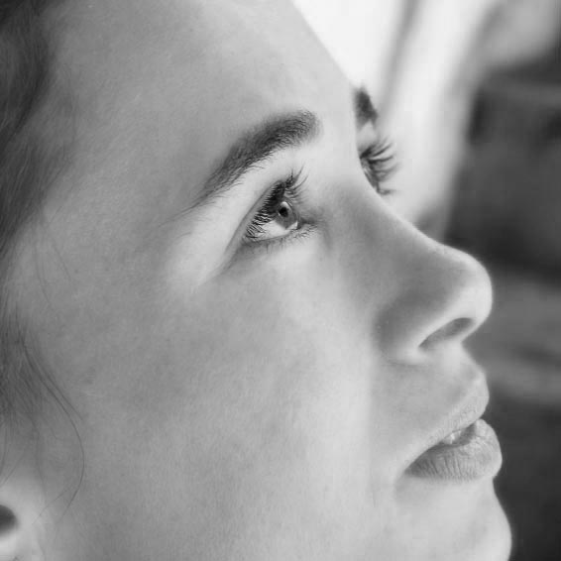
“Look A Little Higher” Camp Meeting
Brazil February 2021
Two Streams of Creation Tess Lambert 10.02.2021
O Livrinho

Slide 2
Look a Little Higher Two Streams of Creation Tess Lambert 10.02.2021
O Livrinho
Ancient
Modern
1500
2nd
Adv
Eden
Eden
Flood
Moses
1989
α
Ω
α
Ω
Jesus - Love
Sin
Yesterday we continued our discussion on gender. We reviewed what we had said the day before and we were wanting to discuss this issue we have with a prototypical model. It's a key issue outside the movement so as we face an ongoing civil war inside the movement, we should expect the same fundamental issue. The problem with the prototype, people have this mindset externally that a prototypical American is white, Christian, not from a recent immigrant background and patriarchal. This is been an ongoing issue externally from the formation of the United States.

Slide 3
Look a Little Higher Two Streams of Creation Tess Lambert 10.02.2021
O Livrinho
Ancient
Modern
1500
2nd
Adv
Eden
Eden
Flood
Moses
1989
α
Ω
α
Ω
Jesus - Love
Sin
We have a problem internally, our parallel civil war, information war as people either embrace or oppose the ‘Midnight Cry’ message. Not everyone leaves the movement when they are in opposition. They may be hostile or claim to be in agreement with us. But the problem is this message impacts our personal lives in such a direct way so it's impossible to claim agreement, secretly disagree, and not give physical external evidence of that. One of the reasons that there is this disagreement is because they have this wrong prototypical model.

Slide 4
Look a Little Higher Two Streams of Creation Tess Lambert 10.02.2021
O Livrinho
Ancient
Modern
1500
2nd
Adv
Eden
Eden
Flood
Moses
1989
α
Ω
α
Ω
Jesus - Love
Sin
External civil war, internal civil war; external disagreement over a prototypical model that tells them that power belongs in the hands of white Christian America and internal fight over a historical prototypical model that tells people that the power belongs in the hands of men. Internal issues: a fight over wrong prototypical model, which is why we have been making the point that God is not male. I hope you can see that simple compare and contrast.

Slide 5
Look a Little Higher Two Streams of Creation Tess Lambert 10.02.2021
O Livrinho
Ancient
Modern
1500
2nd
Adv
Eden
Eden
Flood
Moses
1989
α
Ω
α
Ω
Jesus - Love
Sin
Some of those concepts may seem just common sense but they have a strong impact on how we think even subconsciously. I tried to make that point at the end of our second last presentation when I said humanity has an obsession with gender. We hang so much of a person's individuality upon their gender. Sister Ana Paula tackled that subject directly in the discussion af ‘A Gendered Brain.’ When we start to see God and Heaven without the concept of gender, you should spend time to actually allow your thinking to change, to allow that to sink in, and actually undo some of the damage that wrong model has had on you.

Slide 6
Look a Little Higher Two Streams of Creation Tess Lambert 10.02.2021
O Livrinho
Ancient
Modern
1500
2nd
Adv
Eden
Eden
Flood
Moses
1989
α
Ω
α
Ω
Jesus - Love
Sin
The correct way to read this history of humanity is a Heaven without a gender came into disagreement, God created Adam and Eve in His image, sin entered humanity. What was equality became inequality and as God tries to redeem us back into the form of his character, there's a reason that is a 6,000 year process, because like a ladder it is step by step. God does not expect you to be on the second rung, now you may have to be on the 20th. So, your understanding is changing. We cannot go back to the time of Moses and behave as people then were permitted to behave. We cannot think as they were permitted to think. That is true for the time of Moses, for the time of Christ and it is just as true for the time of Ellen White. We are transforming.

Slide 7
Look a Little Higher Two Streams of Creation Tess Lambert 10.02.2021
O Livrinho
Ancient
Modern
1500
2nd
Adv
Eden
Eden
Flood
Moses
1989
α
Ω
α
Ω
Jesus - Love
Sin
The problem that people will have is that written inspiration ends here, so they're going to see us transforming outside of written inspiration. She had a similar problem, but we don't see it that way because we see them as having a prophet. But for us inspiration is here. And we are over here near the Second Advent saying that an abused wife can leave her husband. Ellen White emphatically clearly tells you that is not the case, no reason except adultery. People can then say we tear up her writings, conform to the world, do what is right in our own eyes. I would suggest we have a prophetic weight of evidence for every step that we make but it makes people uncomfortable when they see us in a history still of restoration, when they can't go halfway down the ladder to find a quote for that restoration. So that's all the summary I want to do on the subject of restoration.

Slide 8
Look a Little Higher Two Streams of Creation Tess Lambert 10.02.2021
O Livrinho
Ancient
Modern
1500
2nd
Adv
Eden
Eden
Flood
Moses
1989
α
Ω
α
Ω
Jesus - Love
Sin
I want to go to the next subject we tackled that may seem like a detour but it's another area where a wrong understanding, it really warps and damages our thinking. And that was when we drew up the subject of creation. Now when I asked what does God create, there was excitement, it was quite a joyful discussion as we saw the beauty and the variety, and we contemplated the fact that God enjoys something. And then we came to humanity and said what does God enjoy or what did God give humanity to create and everything that people said could summarize in just saying babies. But that is the creativity that God inplaced into Adam and Eve. I think we all came into unity that that's not the case. God loves creating both living and nonliving things. He creates the architecture and then the life to fill that architecture. He takes joy in the colors, in patterns, in structures. He takes joy in the chemical processes, in rocks and minerals. That is also where His creativity finds expression. And we're limit it when we take that characteristic of God and look at humanity. We limit it to procreation, and I would suggest we damage our thinking when we do that.

Slide 9
Look a Little Higher Two Streams of Creation Tess Lambert 10.02.2021
O Livrinho
Ancient
Modern
1500
2nd
Adv
Eden
Eden
Flood
Moses
1989
α
Ω
α
Ω
Jesus - Love
Sin
One example of that, when we see a woman study architecture and choose not to have children and we see her as failing to fulfill her God-given mandate. Selfishly failing to exhibit that love of creation that we say God planted in her, that that has to manifest itself through children. And conservativism uses that mindset, it has over thousands at least hundreds of years to hold back women in many other areas of creativity.
The second example of where it impacts us, without getting into the arguments of homosexuality, one thought or attack that is made against them is that God designed humanity to create. And some of the same gender cannot create. Two issues connected, they don't create, God intends us to create, connected second issue to replenish the Earth. And this idea of the necessity of creating children, it's a fairly standard attack that I would suggest is ridiculous.

Slide 10
Look a Little Higher Two Streams of Creation Tess Lambert 10.02.2021
O Livrinho
Ancient
Modern
1500
2nd
Adv
Eden
Eden
Flood
Moses
1989
α
Ω
α
Ω
Jesus - Love
Sin
Replenish the Earth, first of all God never set a time frame for that. And I think we can say it's quite replenished. But there's a more fundamental issue when we look at the role of creation and we should see it as something as varied and as beautiful as what God enjoys.

Slide 11
Look a Little Higher Two Streams of Creation Tess Lambert 10.02.2021
O Livrinho
Ancient
Modern
1500
2nd
Adv
Eden
Eden
Flood
Moses
1989
α
Ω
α
Ω
Jesus - Love
Sin
2 Streams
I want to address the subject of creation from a slightly different angle now. When the ‘Midnight Cry’ arrived in 2018 what was its fundamental underlying principle? Remember it started here that principal will take you all the way to the second Advent. Yes, two streams of information, this was the underlying platform of the ‘Midnight Cry’ message. We illustrated that the following way: there are two external streams, really, they're just symbols: CNN and FOX. Depending which river you flowed down, which water you drink from will depend your future choices at every step before during and after the Sunday law. For or against the truths of this movement. CNN can take you to life and FOX can take you to death and it was the first little part of that message that people fought and rejected and the attack began subtly.
CNN
FOX

Slide 12
Look a Little Higher Two Streams of Creation Tess Lambert 10.02.2021
O Livrinho
Ancient
Modern
1500
2nd
Adv
Eden
Eden
Flood
Moses
1989
α
Ω
α
Ω
Jesus - Love
Sin
2 Streams
The attack was the following: there's truth and error in both. I can take light from CNN and I can take light from Fox News. I can mix the two and use my own judgment to decide what I'll take and what I'll leave. So I'll listen to CNN and Fox and I'll use my logic and my experience, what I will take and what I will leave from CNN and what I will take or leave from Fox News.
The Midnight Cry was designed to put a wedge between these two and say you are not permitted to do that; you have to choose because whenever people said they would take and leave from both in practice even if they did not admit to it, it's because they still lean towards Fox, they preferred it. It was still their worldview.
Prefer
CNN
FOX

Slide 13
Look a Little Higher Two Streams of Creation Tess Lambert 10.02.2021
O Livrinho
Ancient
Modern
1500
2nd
Adv
Eden
Eden
Flood
Moses
1989
α
Ω
α
Ω
Jesus - Love
Sin
I'm not sure you've heard of this form of study: iridology. I'll explain what this is. There was a Hungarian physician, I won't try and pronounce his name, he first published his ideas in 1893. I say physician but it's a stretch of the word. He first published his ideas in 1893 so we're going back well over 100 years. When he was a boy, he found an injured owl, it had a broken leg. He took this bird and nursed it back to health. He made the following observation: when looking into the eye of this bird he saw that along the iris there was a black stripe. Once the bird had been nursed back to health, he noticed that this black stripe had disappeared. So, like the development of any good conspiracy theory, he decided that black stripe equaled the broken leg. From that one observation developed iridology. He engaged in no proper scientific research; it was more imagination based on what he thought he could observe.

Slide 14
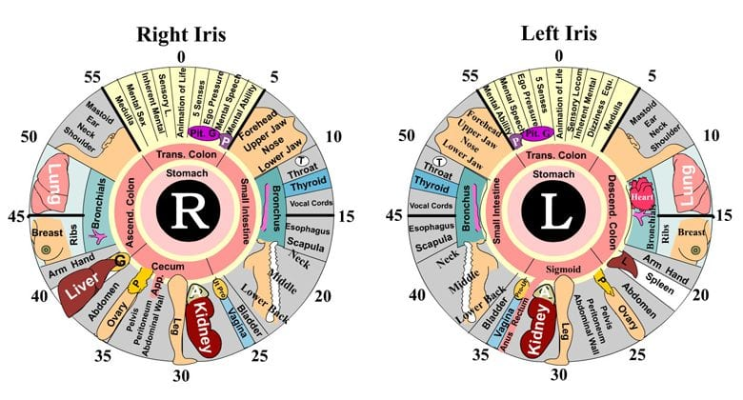
Look a Little Higher Two Streams of Creation Tess Lambert 10.02.2021
O Livrinho
This is iridology; you have the right Iris and the left Iris. This is what he came up with. So, this eye, if it has a black stripe down here that indicates there's a problem with the leg but then he goes ahead to map the whole human body. So, if a woman has a problem here, something on her eye, that is somehow directly connected to the health of her ovaries. You'll see he has mapped the senses. Now if you want to look at this portion you can judge a mental ability. Someone gets their nose broken it'll be visible here. Lung cancer, over here. Back pain, over here. Vocal cords, here.

Slide 15
Look a Little Higher Two Streams of Creation Tess Lambert 10.02.2021
O Livrinho
As you might imagine, any research that has been done on this since 1893, with scientific blind studies, show that there is absolutely no evidence, it never works. It's absolute creativity. He was a very creative man, but the creation was fanaticism. There is no evidence or truth in iridology. His method of studying this is equivalent to someone standing on a hill thinking that horizon looks flat, from my observation I conclude that the Earth is flat, I've been able to observe and give my own evidence for that. And then thousands of people are led to believe it despite the abundance of evidence against it.

Slide 16
Look a Little Higher Two Streams of Creation Tess Lambert 10.02.2021
O Livrinho
Ancient
Modern
1500
2nd
Adv
Eden
Eden
Flood
Moses
1989
α
Ω
α
Ω
Jesus - Love
Sin
This could have largely died out, but it has survived just like the flat Earth theory, risen in popularity particularly in the United States through a US chiropractor who wrote the book The Science and Practice of Iridology in 1952. His name is Bernard Jensen. Now people will get uncomfortable because you might not believe in iridology, but thousands believe in him because of how he studied and treated the colon and the health of the digestive system. I see people who claim to believe in our message share and spread his quotes on places like Facebook and it's so discouraging. They might not share what he says on iridology which he believed, taught and promoted but they believe what he taught on the colon.
Iridology
Bernard Jensen
Colon

Slide 17
Look a Little Higher Two Streams of Creation Tess Lambert 10.02.2021
O Livrinho
Ancient
Modern
1500
2nd
Adv
Eden
Eden
Flood
Moses
1989
α
Ω
α
Ω
Jesus - Love
Sin
And my problem is the following: what type of scientific methods does this man employ? He died in 2001, we're going back many years. If he looks at your iris and sees evidence that he can identify a problem with your toe, with your ovaries based on a line in your iris, how trustworthy is his methodology? What people do with CNN and Fox is the following: they'll say, what I'll do is I'll watch both, I'll watch both and I'll use my experience in judgment to see what is right and wrong in both. Because to be truthful, not everything that Tucker Carlson says is rubbish, not every word can be incorrect. So, I'll watch MSNBC and I'll watch Tucker Carlson and I'll judge between the two.
Iridology
Bernard Jensen
Colon

Slide 18
Look a Little Higher Two Streams of Creation Tess Lambert 10.02.2021
O Livrinho
Ancient
Modern
1500
2nd
Adv
Eden
Eden
Flood
Moses
1989
α
Ω
α
Ω
Jesus - Love
Sin
2 Streams
That was the very first step FFA took on their path to rejection. And they made that statement openly because even if they were not willing to admit it to themselves Fox News is what they preferred.
Science and medicine, this took us to vaccines, it's created, but it's created using rules and methodology that are concrete and sound. And just as a title you have the works of Bernard Jensen, his teachings and the methodology he uses to come to those conclusions.
Prefer
CNN
Science
Medicine
⬇
Vaccines
FOX
Tucker Carlson
⬇
Bernard Jensen

Slide 19
Look a Little Higher Two Streams of Creation Tess Lambert 10.02.2021
O Livrinho
Ancient
Modern
1500
2nd
Adv
Eden
Eden
Flood
Moses
1989
α
Ω
α
Ω
Jesus - Love
Sin
2 Streams
Now the Midnight Cry message would say the following: you no longer get to put a foot in both streams, can any man serve two masters? For a day? Or a month? But the problem is he loves one and hates the other. You cannot blend truth and error. If Tucker Carlson says one decent good thing in all of his error, you will find it on CNN. If Bernard Jensen has anything decent to say you will find it evidenced through science and medicine. So why do people who claim to believe the Midnight Cry message, look at the creativism the same creativism that created iridology and continue to quote and trust a false stream of information? If there is any good you will find it in CNN which means there is absolutely no reason to watch Tucker Carlson or listen to Bernard Jensen.
Prefer
CNN
Science
Medicine
⬇
Vaccines
good
FOX
Tucker Carlson
⬇
Bernard Jensen
good

Slide 20
Look a Little Higher Two Streams of Creation Tess Lambert 10.02.2021
O Livrinho
Ancient
Modern
1500
2nd
Adv
Eden
Eden
Flood
Moses
1989
α
Ω
α
Ω
Jesus - Love
Sin
I cannot express the danger except to point you back to a witness we've already been given of when elder Jeff did just that and because his disciples trusted him more than this movement, more than the Midnight Cry message, they followed him to his ruin. The Midnight Cry message was designed to put a severing wedge between good creation and bad Creation because not all that humanity creates is fit for purpose. This cannot be encouraged or supported by the movement. People cannot be teaching their own observations and beliefs, not when it comes to the body but especially when they start trying to teach people about their mind. We have qualified doctors who are members of this movement, qualified psychologists who are members of this movement, who have followed science and medicine without mixing it with a false stream.
2 Streams
Prefer
CNN
Science
Medicine
⬇
Vaccines
good
FOX
Tucker Carlson
⬇
Bernard Jensen
good

Slide 21
Look a Little Higher Two Streams of Creation Tess Lambert 10.02.2021
O Livrinho
Ancient
Modern
1500
2nd
Adv
Eden
Eden
Flood
Moses
1989
α
Ω
α
Ω
Jesus - Love
Sin
Any other teaching about the body and mind that is built upon or mixes this stream, we have to oppose and reject. Or we reject the Midnight Cry as much as Elder Jeff did in 2018 in a time when he said he would have never separated from this movement, we've seen what is inevitable. Because what we teach impacts our daily lives consistently, it impacts how we relate to our brothers and sisters constantly. We still see people following the false stream especially when it comes to medicine and I don't believe that the position of the Midnight Cry message could be made more clear. The treatment of the body is a serious issue, but it becomes so much more serious when it involves the treatment of the mind.
2 Streams
Prefer
CNN
Science
Medicine
⬇
Vaccines
good
FOX
Tucker Carlson
⬇
Bernard Jensen
good

Slide 22
Look a Little Higher Two Streams of Creation Tess Lambert 10.02.2021
O Livrinho
Ancient
Modern
1500
2nd
Adv
Eden
Eden
Flood
Moses
1989
α
Ω
α
Ω
Jesus - Love
Sin
2 Streams
Yesterday we spoke about creation, vaccines are creation, iridology is creation. A true stream of information can create ideas, for example, CNN will say Donald Trump is racist and then they're going to lay out line upon line of evidence. Fox News is creative, they'll say Obama is a Muslim. We need to be able to define between the two different methods that not all that is created is good. Whether it's a supplement for the body, a method for the mind or a concept like QAnon the conspiracy theory. What FFA would have said, we will trust our experience and our observation.
Prefer
CNN
Science
Medicine
⬇
Vaccines
good
FOX
Tucker Carlson
⬇
Bernard Jensen
good

Slide 23
Look a Little Higher Two Streams of Creation Tess Lambert 10.02.2021
O Livrinho
Ancient
Modern
1500
2nd
Adv
Eden
Eden
Flood
Moses
1989
α
Ω
α
Ω
Jesus - Love
Sin
2 Streams
And Elder Jeff had all his experiences and observations that he said we're abundant evidence that the Clintons imported drugs and killed people, just like the fellow who created iridology, or people who see a flat horizon. Our methods cannot be built upon that, we cannot keep a foot in both streams, and we have not been allowed to do that for two and a half years.
Going back to our subject, we have less than one and a half presentations left, and we haven’t gone to our document yet. It isn't my purpose to read all through that document but there are key observations I want us to absorb.
Prefer
CNN
Science
Medicine
⬇
Vaccines
good
FOX
Tucker Carlson
⬇
Bernard Jensen
good

Slide 24
Look a Little Higher Two Streams of Creation Tess Lambert 10.02.2021
O Livrinho
2nd Advent
1st GA
2nd GA
1863
1900s
40s
50s
1979
Now
2 Streams
Before we go back to the document again, so we're still not doing it yet. When does the document begin? What's the starting point of their discussion? I like 1861 but I'm going to say 1863. And I don't think it was a very fair question because he does mention times before 1863, like the First Great Awakening. But I wanted to mention that's when his first movement begins. We're talking about the document How the Constitution Became Christian. So there's three movements he wants to trace, the 1860s to the 1900s, the late 1940s to late 1950s, and then 1979 to now. So, these are the three movements he's tracing, and I want us to step backward and just look briefly at the first and the Second Great Awakening.
Prefer
CNN
Science
Medicine
⬇
Vaccines
good
FOX
Tucker Carlson
⬇
Bernard Jensen
good

Slide 25
Look a Little Higher Two Streams of Creation Tess Lambert 10.02.2021
O Livrinho
2nd Advent
1st GA
2nd GA
1863
1900s
40s
50s
1979
Now
I’m not going to read all these quotes for time, we could spend about 10 presentations just reading relevant material, but I don't think any of this material is anything people can easily question so I'm just going to summarize it.
This is taken from the book The Evangelicals that we have brought up numerous times before, from page 24. She said, “Before the First Great Awakening there had been other revivals, but the First Great Awakening was different. The other revivals called for people to become more connected through Covenant renewal or obedience to the God-given order of ministers and magistrates.” So calling people into obedience to the Protestant churches and their secular governments. But the First Great Awakening was different, it was an act of rebellion. They were understanding similar concepts that would lead to the American Revolution regarding that the Protestant churches were not the link between themselves and Christ. It was a rebellion against that strict Orthodox Calvinism.

Slide 26
Look a Little Higher Two Streams of Creation Tess Lambert 10.02.2021
O Livrinho
2nd Advent
1st GA
2nd GA
1863
1900s
40s
50s
1979
Now
Old side
Vs.
New side
Many of you may have heard of George Whitfield, he was probably one of the most prominent figures of the First Great Awakening. He arrived in the United States from England in 1739 and this really gave life to that revival. But many of the more Orthodox Calvinist ministers objected, and an anti-revivalist party was formed. So this was not a time period of unity. It was old side versus new side, revivalists versus anti-revivalists. And the attack the old school made against the new school was there use of unseemly emotions. So part of the fight was about theology and part of the fight was about emotionalism.

Slide 27
Look a Little Higher Two Streams of Creation Tess Lambert 10.02.2021
O Livrinho
2nd Advent
1st GA
2nd GA
1863
1900s
40s
50s
1979
Now
Old side
Vs.
New side
Now we come to the Second Great Awakening, the Second Great Awakening begins around the 1790s and ends in the 1840s. So if it's perfectly in the Millerite timeline of 1798 to 1844, that Millerite reform line was all the history of the Second Great Awakening. I'm quoting from a page that you can find online called the Second Great Awakening and Rise of Evangelicalism. This is an MA thesis in english from the University of Virginia August 1995 by Ian Frederick Vincent. He speaks about the success of the Second Great Awakening; it was largely through their methods of communication, how they would have these itinerant preachers who travel from town to town.

Slide 28
Look a Little Higher Two Streams of Creation Tess Lambert 10.02.2021
O Livrinho
2nd Advent
1st GA
2nd GA
1863
1900s
40s
50s
1979
Now
Old side
Vs.
New side
Now this quote doesn't say it, but other sources do, they would hold extensive camp meetings. The Millerites did not invent the concept of tent camp meetings. These camp meetings, these traveling ministers were the characteristics of the Second Great Awakening. Great numbers were converted through emotionally charged revivals.

Slide 29
Look a Little Higher Two Streams of Creation Tess Lambert 10.02.2021
O Livrinho
2nd Advent
1st GA
2nd GA
1863
1900s
40s
50s
1979
Now
Old side
Vs.
New side
Old side
Vs.
New side
The Second Great Awakening is old school versus new school. Now George Whitfield is probably the most key figure of the First Great Awakening. Charles Finney is probably the main or one of the main figures of the Second Great Awakening. The First Great Awakening was a fight, and the Second Great Awakening was a fight. There was a theological fight in both revivals, there was a fight in both revivals about church hierarchy and there was a fight in both revivals over what old school would call emotionalism. They were directly connected to the external American Revolution. You see people fighting for their freedom from English dictatorship so when your boring traditional Calvinist Minister stands and preaches and he preaches predestination which essentially says you don't have a say in whether you're saved or lost, that conflicted with the lessons they had just learned and implemented through the American Revolution, where we get to choose our destiny. So strong Calvinist beliefs like predestination were challenged in the Second Great Awakening.

Slide 30
Look a Little Higher Two Streams of Creation Tess Lambert 10.02.2021
O Livrinho
2nd Advent
1st GA
2nd GA
1863
1900s
40s
50s
1979
Now
Old side
Vs.
New side
Old side
Vs.
New side
And Calvinist theology did transform, particularly their teaching of predestination and innate depravity. So you know we’re tracing the threat, what takes us from millerite history all the way to the Sunday law. And I'm sure you all know by now that we're saying that the threat is through old side old school fundamentalism. But my last presentation before camp, we spoke about this dispensation being more complicated. It undoes in no way our message of two streams of information, that hasn't been undone in the slightest way. But we see that not everyone that watches CNN will be saved. If I can speak bluntly people that follow Fox just won't, they cannot have a worldview that's acceptable that doesn't conflict with our message if they do that.

Slide 31
Look a Little Higher Two Streams of Creation Tess Lambert 10.02.2021
O Livrinho
2nd Advent
1st GA
2nd GA
1863
1900s
40s
50s
1979
Now
Old side
Vs.
New side
Old side
Vs.
New side
But considering the complication that we have in this dispensation, I want to look at this new side, new school for a moment. I'm going to end with a quote by Charles Finney and we will come back to this point tomorrow. Beginning with Finney went further than anyone else, "Finney went further than anyone else had to date in setting out precise methods and objectives of revivalist evangelicalism." First, he stressed the importance of emotion, quoting him "men are so sluggish, there are so many things to lead their minds off of religion and to oppose the influence of the Gospel that it is necessary to raise an excitement among them till the tide rises so high as to sweep away the opposing obstacles." So, we're so sluggish, you have to raise the emotion to such a pitch, it breaks down that laziness and the distractions.

Slide 32
Look a Little Higher Two Streams of Creation Tess Lambert 10.02.2021
O Livrinho
2nd Advent
1st GA
2nd GA
1863
1900s
40s
50s
1979
Now
Old side
Vs.
New side
Old side
Vs.
New side
Now this is late 1700’s through to the early 1840’s. The new side new school is the good side we would say. So if you want to do your own reading go to Life Sketches 80 chapter 5 and read through that chapter of Ellen White's parentage and early life. And you read Ellen White's young impressions of the Second Great Awakening as she watched firsthand this tide of emotionalism. Many of us even without reading that, we should still read it, are aware of the battles she faced as a young person, her fear of not being saved, her fear of hell, her fear that she hadn't had a proper emotional experience, her really what was just a great discouragement and confusion. And the cause of that experience was that her parents were taking her to the meetings of the Second Great Awakening. Really, they're on the right side of the issues, rejecting the control of the Protestant churches and Calvinism but just like today they needed the Millerite message.

Slide 33
Look a Little Higher Two Streams of Creation Tess Lambert 10.02.2021
O Livrinho
2nd Advent
1st GA
2nd GA
1863
1900s
40s
50s
1979
Now
Old side
Vs.
New side
Old side
Vs.
New side
On our next study we'll do a revision of that and we’ll trace briefly her experiences growing up in the Second Great Awakening and as it's my closing presentation we may want to make some short and relevant points about these three movements.

Slide 34
Look a Little Higher Two Streams of Creation Tess Lambert 10.02.2021
O Livrinho
2nd Advent
1st GA
2nd GA
1863
1900s
40s
50s
1979
Now
Old side
Vs.
New side
Old side
Vs.
New side
So in summary, we need to spend time every day thinking about how our mindset has been wrong, about Heaven, God, gender, creation. And how that impacts how we view people, like couples who choose not to have children and find themselves judged. Like women in a man's world and other issues. We went back to the subject of creation, the fundamental underlying principle of the Midnight Cry, to put us in a position where we are forced to choose between two creative methodologies and agencies and the men that represent those ideologies. That has impacted our lives in such a way we have been prepared for a US election, we have had all of these external issues perfectly explained to us from the death of George Floyd to the pandemic. And yet, still there is this resistance to a message that has been both beautiful and clear.

Slide 35
Look a Little Higher Two Streams of Creation Tess Lambert 10.02.2021
O Livrinho
2nd Advent
1st GA
2nd GA
1863
1900s
40s
50s
1979
Now
Old side
Vs.
New side
Old side
Vs.
New side
Then we came back to our history, our document, we've gone through a very quick revision of the two awakenings that led to that first movement and we'll make some conclusions of those thoughts in our next study.

Slide 36
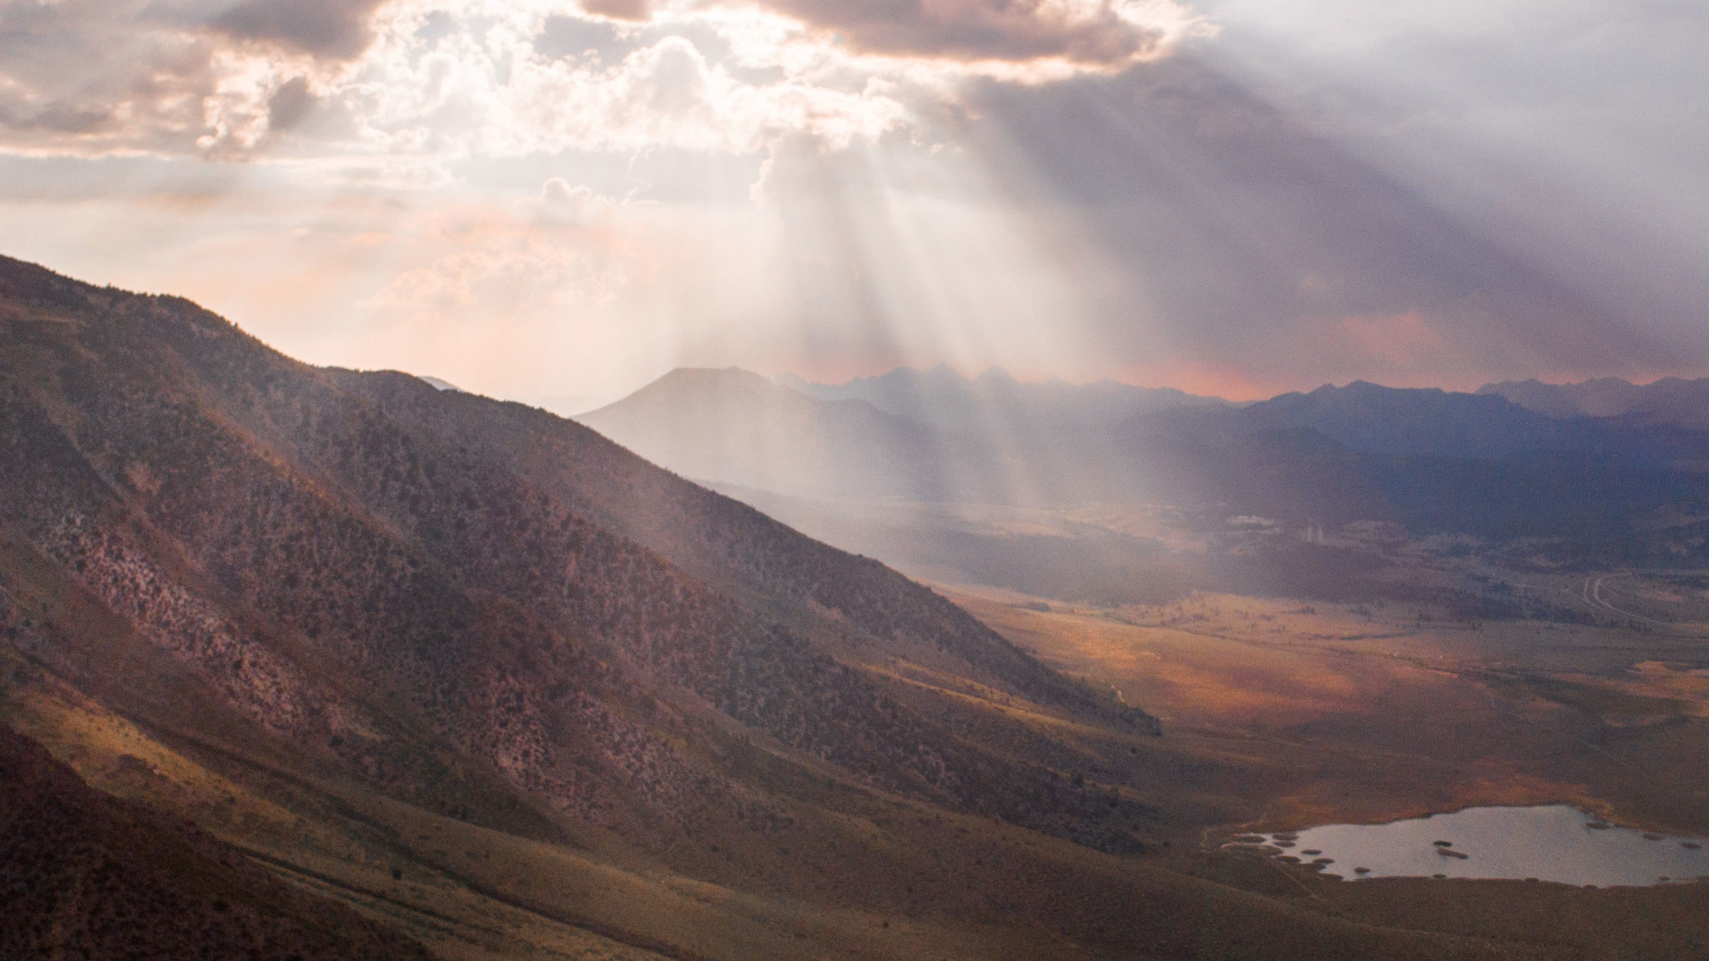
If you kneel with me, we’ll close in prayer,
Dear Lord,
We look back at a few painful years and yet we see the beauty in what you have done. Even as people are hurting their lives have been transformed, there is peace also in the midst of pain. I pray that we will dwell on this light, allow the restoration that is meant to occur at this time to do its work of healing us and preparing us for what is coming, both tests of the Sunday law and the Heaven and new earth that comes soon after. I pray for each member fighting their own battles, suffering their own pain, troubled by their own questions. I do pray they will cling to their confidence in the reform lines, holding on to the cords.
I pray in Jesus' name amen

