Slide 1
Two Upper Room Experiences
Compare & Contrast

Slide 2
The Opening Up of Reform Lines
Question: When did the study of reform lines open up?
The study of reform lines opened up to God’s people in 1989 and became the foundation for all light that has followed.
What is a reform line?
It is a line that shows how God brings reformation to His church. God’s people have failed. They are in captivity and are caught up in idolatry. They have a misunderstanding of God and the nature of His kingdom. And so there is a need for reformation. God begins the process of restoring His people to a correct understanding of Himself and His nature so that they can truly reflect His image and successfully carry out the work He has raised them up to do that will ultimately lead to a harvest of a people ready in the time of His 2nd Advent.
What is the significance of a reform line?
A reform line is important because it shows God’s people their past history and the condition they have come out of; where they are currently in present time and their current condition; and where they are headed and the condition they will be in; and what that means for them both internally and externally as God reveals it and opens up light on it. It is the method by which God uses to guide His people to Him.
Notes:
Question: When did the study of reform lines open up?
Answer: 1989
Internally—what is happening in the Movement
Externally—What is happening outside the Movement

Slide 3
The Key Reform Lines
Question: How many key reform lines are there?
There are four key reform lines that demonstrates how God deals with His people and brings about reformation. On these reform lines we can see how God dealt with literal Israel (Jewish nation) in ancient times and how God deals with spiritual Israel (Seventh Day Adventist) in modern times of which both have a beginning and an ending history. Using parable methodology, we can look to how God dealt with literal Israel to tell us how He will deal with spiritual Israel. So in regards to ancient Israel, there is an alpha and omega history. And similarly for modern Israel, there is an alpha and omega history; which can be broken down into four key reform lines.
Apis Bull… Form: (Calf) / Character: (Warrior King/Conquer, Courage, Strength, and Fertility)….Idolatry
Egypt
Failure
Babylon
Failure
Rome
Success
TOE – Completion of time prophesy
Darkness
Captivity
Idolatry
Lost of Sabbath
Sabbath reinstituted
Given a prophet—Moses
Cured from making images
Not cured from character of idol
Beginning of Ancient Israel
End of Ancient Israel
Lit. Form & Spirit
Lit. Form & Spirit
Lit. Character
Two Leaders: Moses | Joshua
Two Leaders: J.Bapt. | Christ — Parable Teaching
1260 (Apostate Protestantism)
1888
1989
(Laodicean Condition)
126
Papal persecution
Darkness
Captivity
Idolatry
Lost of Sabbath
Sabbath reinstituted
Given a prophet—EW
Beginning of Modern Israel
End of Modern Israel
Sp. Form & Spirit
Sp. Form & Spirit
Sp. Character
Two Leaders: Elders J. | P. — Parable Teaching
Two Leaders: Miller | Snow
Notes:
Question: How many key reform lines are there?
Answer: 4
As a general overview, God’s people are in darkness. They are practicing idolatry and have lost sight of the Sabbath for a period of time. At the completion of the time prophesy prophesied God raises up leaders, notably two, to play a role in doing a work to lead God’s people out of bondage and then begin the work of reformation that will train and prepare them to know God and the nature of His kingdom so they can rightly represent Him to the world around them that will hasten His advent.
In ancient times, the alpha history of Israel, God’s people fail. They reject the true God and choose to hang onto their idolatry in both the form and the spirit, identified as the Apis bull (from Egypt)—the image and idea of a warrior king that is courageous, strong, and fertile as their god of worship. Though they are given a prophet and the Sabbath is reinstituted during the time they are to unlearn and increase in their knowledge of God, they continue to practice idolatry. So they go into captivity again, but under Babylon for another period of time. And by the completion of that time prophesy, God’s people are no longer practicing idolatry in the form, but continue to worship the god formed in their own image in spirit. So they fail again and fall captive under Rome which brings us to the omega history of ancient Israel. At the completion of this time prophesy, God raises up two leaders again. However, in this history there is a difference. God’s people are still stooped in the spirit of idolatry, hanging onto the mindset of the Apis bull—the idea of a warrior king, and thereby did not recognize Christ at His 1st Advent.
So God raises up leaders again, notably two, to bring about reformation in His people. And this time God’s people succeed. Through the 2nd leader correcting the mistakes of the 1st leader using parable methodology, a select group of people are restored from their idolatrous mindset and have a correct understanding of God and the nature of His kingdom to do a work in spreading the gospel to the church and then to the world completing their job function. Christ does not come back in the omega history of ancient Israel, but He completes His mission.
In modern times, history repeats with spiritual Israel. Under papal persecution, the early Christians have lost sight of the Sabbath, becoming Sunday keepers and have succumbed to idolatry, which is noted as the form and spirit of conservatism and the conservative mindset—conspiracy theories, nationalism, racism, sexism, homophobia. They have a wrong understanding of God and His nature and have formed a god in their own image under apostate Protestantism. So at the beginning of modern Israel, God raises up leaders, notably two, to bring His people out of apostate Protestantism and restore His people and prepare them for a work to do. However, His people fail and do not complete their job function. They are also given a prophet in their day and the Sabbath is reinstituted, signified in their name as Seventh-Day-Adventist, but they continue to hold onto idolatry and end up falling into the Laodicean condition, a form of captivity. So at the completion of the time prophesy, again God raises up leaders in our current history, notably two, to bring about reformation. And similar to the end of ancient Israel, God’s people will succeed in completing their job function. Through the 2nd leader correcting the mistakes of the 1st using parable methodology, a select group are being restored from their idolatrous mindset and will have a correct understanding of God and the nature of His kingdom to do a work in spreading the MC message to the church and then the world that is preparing a people for Christ 2nd Advent.
https://youtu.be/_XyIX5I5y9A (Apis Bull by Elder Tess)
https://youtu.be/xmvgeM_O3J4 (Idolatry of Adventism by Elder Tess)
Gn 15:13 And he said unto Abram, Know of a surety that thy seed shall be a stranger in a land that is not theirs, and shall serve them; and they shall afflict them four hundred years; 14: And also that nation, whom they shall serve, will I judge [plauges]: and afterward shall they come out with great substance
Idolatry—their own image of God.

Slide 4
The Structure of the Reform Lines
Question: Which structure is the alpha history and which structure is the omega history?
Failure
Success
Alpha History Reform Line Structure
Omega History Reform Line Structure
Beginning of Ancient Israel
Beginning of Modern Israel
End of Ancient Israel
End of Modern Israel
3 H
If the alpha history succeeded, there wouldn’t be a need for an omega history.
4 H
One call to the church; one call to the world
Fail to complete their job function
Christ does not come in their history
Two calls to the church; One to the world
Complete their job function
Christ comes in their history
Notes:
Question: Which structure is the alpha history and which structure is the omega history?
Answer:
-- Structure on the left is the alpha history
-- Structure on the right is the omega history
The alpha history reform structure is the same for both the beginning of ancient Israel and the beginning of modern Israel. It could be either one of those histories. Similarly, the omega history reform structure is the same for both the end of ancient Israel and the end of modern Israel.
The alpha history is a history of failure
The omega history is a history of success
At the end of ancient Israel, Christ came the 1st time (Christ 1st Advent). At the end of modern Israel, Christ will come the 2nd time (Christ 2nd Advent).

Slide 5
The Structure of the Reform Lines Cont’
- 4BC
27AD
34AD
70AD
100AD
Pent..
- 4BC
27AD
1TC
Pent..
2
-- Disciples
1
-- 1 Group
27AD
1TC
Pent..
34AD
-- Jews
1
Pent..
34AD
70AD
1
1TC
-- Gentiles
Beginning of Ancient Israel
End of Ancient Israel
1798
1840
1850
1861
1863
1989
2001
SL
COP
2ND ADV
7/21
1844
10/22
1844
2019
2021
Ez.7|9
1798
1840
7/21
1844
10/22
1844
1850
1989
2001
2014
2019
2021
2
1
-- Priest
-- 1 Group
2001
2014
2019
2021
SL
-- Levites
1840
7/21
1844
10/22
1844
1850
1861
1
2014
2019
2021
SL
COP
1
Beginning of Modern Israel
End of Modern Israel
-- Nethinims
Notes:
The message is watertight… These histories line up impeccably.
There have been studies done on the reform line of the beginning of ancient Israel, but because it has yet to be finalized, I chose to leave it blank. I want us to focus on the calls….

Slide 6
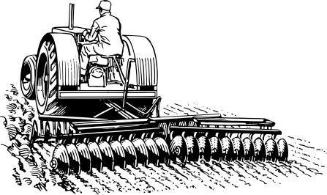
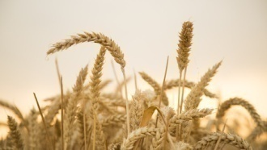
The Agricultural Model
In every reform line there are 5 primary waymarks with 4 dispensations in between. These 5 major waymarks divide up the four stages of the agriculture process: P, ER, LR, H i.e. The reform line of the 144K is composed of 5 major waymarks. We construct 1989 & 9/11. EW gives us SL, COP, and 2nd ADV. The 4 spaces in between denote the 4 stages of agriculture.
144K
Ploughing
Early Rain
Latter Rain
Harvest
1989
9/11
SL
COP
2nd Adv
SL
9/11
COP
Early Rain
Latter Rain
1989
2001
SL
COP
2ND ADV
2019
2021
Harvest
2nd Adv
P
ER
LR
H
Ploughing
1989
1989
2001
2014
2019
2021
The theme of agriculture can be recognized in in every structure of a reform line: ploughing, early rain, latter rain, and harvest.
We could use our hand as a tool to help us remember the 5 major waymarks and 4 stages.
P
ER
LR
H
2001
2014
2019
2021
SL
P
ER
LR
H
2014
2019
2021
SL
COP
P
ER
LR
H
A Handy Reminder

Slide 7
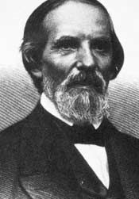
A Repeating Pattern
On a reform line we can identify a repeating pattern.
Unsealing
Unsealing
Unsealing
Unsealing
Unsealing
TEST
TEST
TEST
TEST
TEST
A message is unsealed; there is an increase of knowledge; that message is formalized; There is a test —answers are finalized.
IOK
Form
IOK
Form
IOK
Form
IOK
Form
B
C
E
B
C
E
B
C
E
B
C
E
B
B = Boston – Unsealing of a message
C = Concord – Unity—in one accord
E = Exeter – Time element
In the time of the Millerites, Samuel Snow spoke at 3 camp meetings. The first held in Boston on July 21, 1844; Again in Concord on Aug 1, 1844; and in Exeter on Aug 15, 1844. The MC message, 1st given publicly by Snow at the Boston camp meeting, had swelled to a LC at the Exeter Camp meeting, at which his message that Jesus would return Oct 22, 1844, was accepted. On Oct 22, 1844, their faith was tested when Christ did not come that date, which was a great disappointment for them.
U/T
U/T
U/T
U/T
U/T
1989
2001
I
F
SL
COP
2ND ADV
I
F
2019
2021
I
F
I
F
J.T.T.
(C) – DD
(E ) – D&H
B
C
E
B
C
E
B
C
E
B
C
E
B
U/T
U/T
U/T
U/T
U/T
i.e.,
In every dispensation of the structure of a reform line you see this pattern repeat: B, C, E, Test/: Message unsealed, IOK, Form, Test.
1989
2001
2014
2019
2021
I
F
I
F
I
F
I
F
B
C
E
B
C
E
B
C
E
B
C
E
B
U/T
U/T
U/T
U/T
U/T
So the takeaway, a messenger is brought up and given a message; shares it and the light of the message increases; then is formalized; and is tested.
2001
I
F
2014
I
F
2019
I
F
2021
I
F
SL
B
C
E
B
C
E
B
C
E
B
C
E
B
U/T
U/T
U/T
U/T
U/T
2014
I
F
2019
I
F
2021
I
F
SL
I
F
COP
B
C
E
B
C
E
B
C
E
B
C
E
B
Notes:
https://youtu.be/2h6kDOo_Muk
Things to note for thought:
The repeating pattern is just one of many models used to understand our reform line. With this in mind, it does not mean that a new messenger will be raised up at every dispensation or that there will be a new message at the start of every dispensation. We have to factor in what the other models tell us about our reform line. For instance, in the agriculture model, there is no new message at the time of harvest. However, in light of the repeating pattern model, the message originally given is repeated with more emphasis and detail, which makes the message more clear, sharp, and simple though not a new message, if that makes sense. We are to understand the principles of each model and apply them appropriately.
There can’t be a message without a messenger and vice versa. So, though the message has arrived, it takes time for the message to be understood and developed and then shared and tested—either rejected or accepted, which causes a shaking—a split between two classes of people.
The messenger is not born knowing their mission, they are taught; providence; revelation… it is revealed.
Point— Miller was originally a deist who believed that the Bible was a bunch fables and contradictions before he became a serious Bible student and ultimately the leader of the Millerite movement; as a side note, God truly has a sense of humor; because it was Miller He used to create the 14 rules of Bible interpretation, but anyhow the point is that though the messenger is present and the message has arrived, it takes time for it to be understood (even by the messenger himself or herself); it is developed, shared, and tested. The same goes for every reform line at every point of a transition of leadership.
Christ arrived as a baby… He had to learn His mission as He grew and matured. Once understood, He taught with power; and the message He gave was shared and tested.
The TEST waymark
The B waymark is both an unsealing of a message and a test. The pattern repeats and the B waymark is not moved over one. It stands stationary at the beginning waymark of every dispensation. Knowledge is being built upon previous light and is increasing. At the time the message arrives and is presented, we are given time to accept or reject it. We are tested at the formalization of the message. The point of the test, or the test waymark is not the moment we are tested, but the day our papers are turned in--the sealing or finalizing of our answer to the test, if that makes sense. The test starts the moment the message is formalized, but we are given a probationary time to either accept or reject the message. The test could be viewed as a close of probation or shut door. However, intercession still continues for God’s people. People still have opportunity to repent and have things they had wrong corrected; all until the COP on the big line when Michael the arch angel literally stands up as recorded in Dan 12:1, which is the hard shut door where choices are permanently set. We know that there are smaller tests that occur before the great test begins at the SL waymark.
Interesting to note that a test begins at the COP waymark. So even at the COP we will be increasing in knowledge, we have not yet arrived, so to speak; knowing everything and having all figured out. It appears that this repeating pattern continues even after Christ’s second advent. I suggest that we will ever be increasing in knowledge, especially of the character of God.
Note: Death Decree (C)
Time—Day and the hour given (E)
Time of the End magazine, 2520, Nov 9, we know the (E) waymark for our dispensation now will have a time element to it.

Slide 8
Understanding Fractals
Question: How are these fractals similar to the big scale?
144K Line
Early Rain
Ploughing
Latter Rain
Harvest
In every reform line there is a big scale (the main line) that can be reduced to similar smaller scales. We call the smaller scale(s) fractals. A fractal is basically a smaller copy of a larger scale/template.
U/T
U/T
U/T
U/T
U/T
1989
2001
IOK
Form
SL
COP
2ND Adv
IOK
Form
2019
2021
IOK
Form
IOK
Form
Big Scale
‘91
‘96
B
C
E
B
C
E
B
Ploughing
Early Rain
Latter Rain
Harvest
U/T
U/T
U/T
U/T
U/T
The study of fractals and the naming of this branch of geometry took place in 1975 and escalated over the years as the innovation of computers were developed.
1989
2001
2014
2019
2021
Ex. The structure of the 144K reform line itself is fractalized into quasi-similar smaller lines.
IOK
Form
IOK
Form
IOK
Form
IOK
Form
‘91
‘96
‘09
‘12
‘16
‘18
‘20
-- Priest
B
C
E
B
P
ER
LR
H
U/T
U/T
U/T
U/T
U/T
There are three types of fractals, but two particularly are what we need to be familiar with and understand the difference of. The two are exact self-similar fractals and quasi self-similar fractals. Simply defined, exact self-similar fractals are ones in which the parts are exactly similar or identical to each other and the whole; whereas, quasi self-similar fractals are ones in which the parts are almost similar or alike in principle to each other and the whole.
2001
2014
2019
2021
SL
Form
Fractals
(Smaller Scales)
IOK
Form
IOK
Form
IOK
Form
IOK
Form
‘09
‘12
‘16
‘18
‘20
-- Levites
B
C
E
B
P
ER
LR
H
U/T
U/T
U/T
U/T
U/T
2014
2019
2021
SL
COP
IOK
Form
IOK
Form
IOK
Form
IOK
Form
‘16
‘18
‘20
-- Nethinims
B
C
E
B
C
E
B
C
E
B
C
E
B
Notes:
https://youtu.be/18x-1JPHG_o
Question: How are these fractals similar to the big scale?
Answer: They are NOT exactly similar, but are partially similar. They are similar in their principle points, but there is not an exactness.
These fractals are quasi similar. They all have a ploughing, early rain, latter rain, harvest, but there experience different. It is not exactly alike. The 144K COP is not exactly the same for the priest. The harvest for the priest is not exactly the same for the Levites and Nethinims; and so forth. However, they are similar in their principle points, if that makes sense.

Slide 9
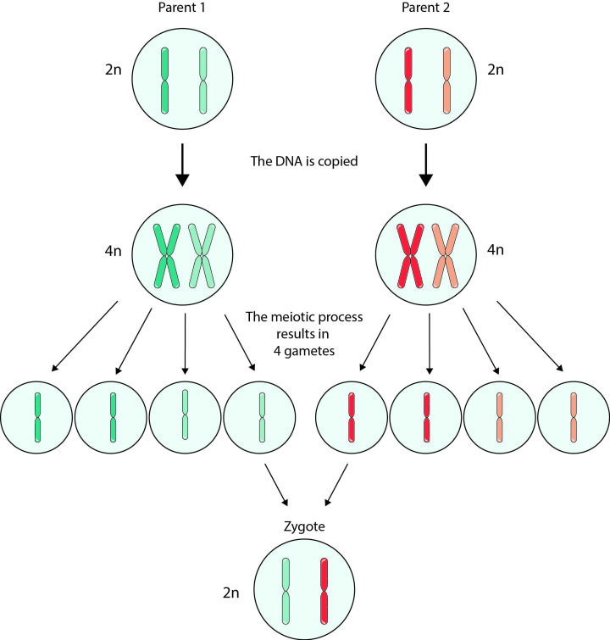
A Quasi Fractal Example
All through nature we can see fractals, specifically quasi fractals. And one example is in species that reproduce—the parent/offspring model, particularly focusing on humans of parent/child relation.
So, usually when two individuals have intercourse, they can reproduce another individual, a child. That child develops in the mother’s womb until the mother gives birth and the child is delivered and then continues to develop outside the womb. The child, as an individual human, exhibits similarities to the parents in form and feature (anatomy and built), but is different in character and personality. In other words, that child is its own individual though having a similar copy of the parent form, which is the break down of the self—the human—into another/multiple human(s) that have similar components if that makes sense. So another way of looking at quasi fractals is through the parent/offspring model to explain the fractalization of a reform line.
“Figure 1: Classical gamete formation. Parent 1 (blue cells) and Parent 2 (red cells) both start with a complete pair of chromosomes (2n), duplicate their chromosomes (4n), and eventually end up with four gametes that contain half the normal number of chromosomes (1n). When two 1n gametes from two different individuals combine together, a zygote (2n) is formed. For simplicity’s sake, only one set of chromosomes is depicted, but this normally takes place across all 23 pairs of chromosomes simultaneously.”

Slide 10
The End of Ancient Israel, A General Overview
Before the start of the end of ancient Israel, God’s people are in darkness. They were under Roman oppression and were expecting a warrior king to take down the roman empire and establish a temporal earthly kingdom as taught by the Pharisees. At the completion of the time prophesy/TOE, in -4BC, the birth of John the Baptist and Christ occurred. The two leaders raised up to do an appointed work to bring about reformation to God’s church. John the Baptist eventually begins his ministry: preaching, baptizing, and training up disciples. Jesus is baptized by John in 27AD and then is led into the wilderness for 40 days where He fasted and is tempted by Satan. At the end of the 40 days, Christ is ministered unto by the angels and is given bread to eat. Christ is invited to a wedding in Cana where He performs His first miracle. It is at the 1st temple cleansing that Christ begins His ministry and the transition of leadership from John to Christ transpires. Meanwhile, John the Baptist is sent to prison and after some time beheaded. Christ begins to correct the errors taught by John the Baptist to the disciples in order for them to have a correct understanding of Him and the nature of His kingdom to complete the work they are to do using parable methodology. The disciples, who continue to quarrel over who is the greatest and are still holding onto the belief of Christ as a king who will overthrow Rome and establish an earthly kingdom, hopes only amplified at Christ's triumphal entry. However, when Christ wept a bitter cry, their hearts sank. And In the upper room to celebrate the Passover, all 11 hearts were humbled by the preparatory service, which were then ready to participate in the communal service. Though taking part in the services, Judas’s heart was not humbled and rejected Christ as the messiah. Judas left and betrayed Christ. Christ was then taken, beaten, and hung on the cross to die at Calvary. Christ resurrects and spends 40 days reviewing the prophesies with the remaining disciples. Christ ascends to heaven and the angels minister to the disciples after Christ departs. In the upper room, another disciple is anointed to replace Judas, the disciples pray and receive the Holy Spirit promised them at Pentecost and begin their work starting with the Jews and then in 34AD with the Gentiles. In 70AD, the disciple John is put into hot oil to die, but is not harmed. He is then sent to the Island of Patmos where he witnesses the 2nd advent of Christ in 100AD.
- 4BC
27AD
34AD
70AD
100AD
Pent..
- 4BC
27AD
1TC
Pent..
-- Disciples
27AD
1TC
Pent..
34AD
-- Jews
1TC
Pent..
34AD
70AD
-- Gentiles
Notes:
https://youtu.be/18x-1JPHG_o

Slide 11
Focusing on the First Group, Disciples/Priest
Harvest
J
P
1st Test
1.Church
1989
9/11
2014
11/9
2019
2021
5/25
2020
‘91
‘96
27AD
‘09
‘12
‘16
‘18
Pent.
“Work”
- 4BC
(Baptized)
1TC
Age 12
2A
Bread
Cana
Asc.
Pent.
BO Christ
BO Jn. Bapt.
Christ Ministry begins
40
40
10
Wilderness
John is put in prison
Judas
leaves
Matthias anointed
1. Disciples
J
C
Lining up the omega history of ancient Israel with the omega history of modern Israel we can compare and contrast the two histories to see what it is telling us about our own history.
Upper Room Experience
Upper Room Experience
Mark 1: 14
EW 154.1
1.) Comply w/organization of the Movement
2.) Lay aside differences w/brothers and sisters
3.) Come into unity on the message and the methodology
Notes:
I have no intentions to make applications in this study. The goal of this study is review the history of the two major upper room experiences and compare and contrast them in their historical context.
At the formalization, God’s character is revealed.

Slide 12
The Upper Room Experiences
Now we have arrived to the heart of my study…
Are there any questions or comments?

Slide 13
Two Upper Room Experiences Identified
A first upper room experience can be identified in the dispensation of the latter rain of the first group called—the disciples; which is after the 1TC and before the cross.
A second upper room experience can be identified in the dispensation of the harvest of the first group called—the disciples; which is after the cross and before the work they do on the day of Pentecost.
Notes:
So we can identify to upper oom experiences

Slide 14
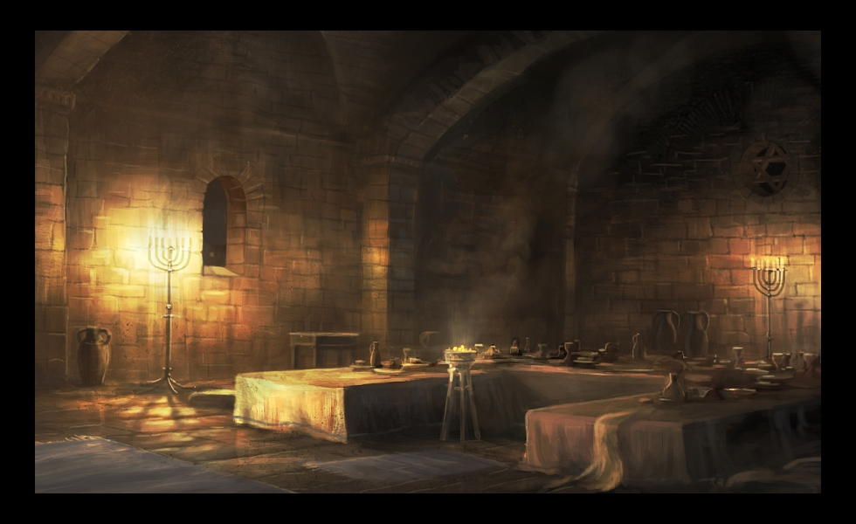
1ST Upper Room Experience
1TC
Christ Ministry begins
John is put in prison
Judas
leaves
Upper Room Experience
J
C
2 part service:
Preparatory—foot washing
Communal—eating of the bread and drinking of the unfermented wine
12 disciples and one leaves– start with 12 end with eleven
Christ is with the disciples in person
Disciples held onto wrong belief—earthly king—misunderstanding of Christ and the nature of His kingdom
God’s character is revealed. Christ reveals himself to them and the nature of His kingdom. He demonstrates to His disciples His mission
Disciples are not humble
Strife among the disciples, which should be accounted the greatest
Exaltation of self—thinking one is better than the other.

Slide 15
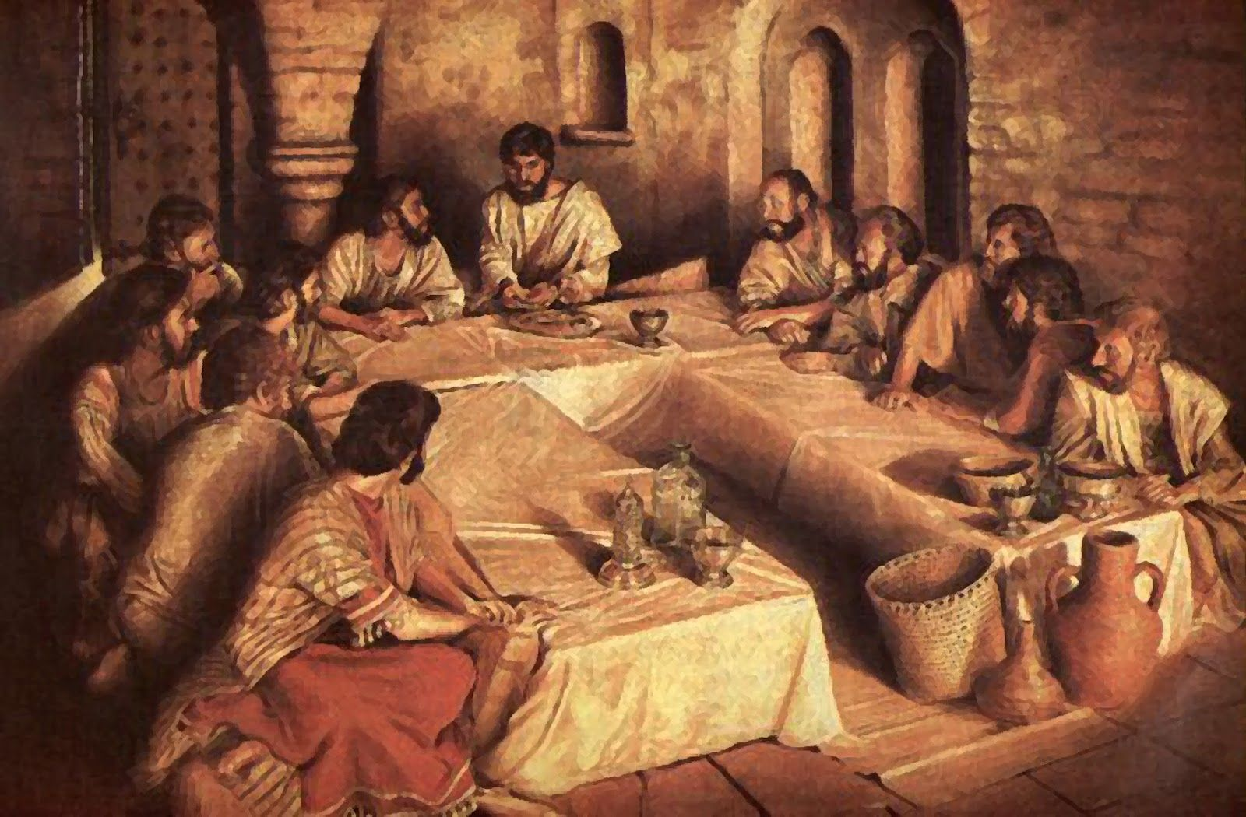
1ST Upper Room Experience Cont’
In the upper chamber of a dwelling at Jerusalem, Christ was sitting at table with His disciples. They had gathered to celebrate the Passover. The Saviour desired to keep this feast alone with the twelve. He knew that His hour was come; He Himself was the true paschal lamb, and on the day the Passover was eaten He was to be sacrificed. {DA 642.1}
The whole life of Christ had been a life of unselfish service. “Not to be ministered unto, but to minister,” (Matthew 20:28), had been the lesson of His every act. But not yet had the disciples learned the lesson. At this last Passover supper, Jesus repeated His teaching by an illustration that impressed it forever on their minds and hearts. {DA 642.2}

Slide 16
1ST Upper Room Experience Cont’
On this last evening with His disciples, Jesus had much to tell them. If they had been prepared to receive what He longed to impart, they would have been saved from heartbreaking anguish, from disappointment and unbelief. But Jesus saw that they could not bear what He had to say. As He looked into their faces, the words of warning and comfort were stayed upon His lips. Moments passed in silence. Jesus appeared to be waiting. The disciples were ill at ease. The sympathy and tenderness awakened by Christ’s grief seemed to have passed away. His sorrowful words, pointing to His own suffering, had made little impression. The glances they cast upon each other told of jealousy and contention. {DA 643.3}
There was “a strife among them, which of them should be accounted the greatest.” This contention, carried on in the presence of Christ, grieved and wounded Him. The disciples clung to their favorite idea that Christ would assert His power, and take His position on the throne of David. And in heart each still longed for the highest place in the kingdom. They had placed their own estimate upon themselves and upon one another, and, instead of regarding their brethren as more worthy, they had placed themselves first. The request of James and John to sit on the right and left of Christ’s throne had excited the indignation of the others. That the two brothers should presume to ask for the highest position so stirred the ten that alienation threatened. They felt that they were misjudged, that their fidelity and talents were not appreciated. Judas was the most severe upon James and John. {DA 643.4}
When the disciples entered the supper room, their hearts were full of resentful feelings. {DA 644.1}

Slide 18
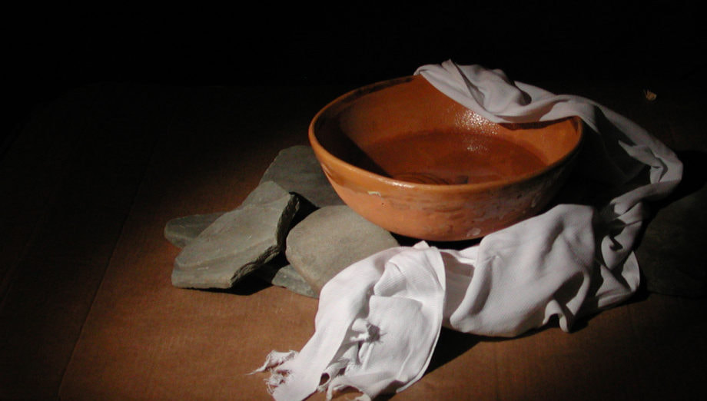
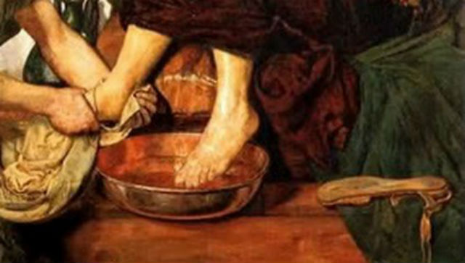
1ST Upper Room Experience Cont’
Another cause of dissension had arisen. At a feast it was customary for a servant to wash the feet of the guests, and on this occasion preparation had been made for the service. The pitcher, the basin, and the towel were there, in readiness for the feet washing; but no servant was present, and it was the disciples’ part to perform it. But each of the disciples, yielding to wounded pride, determined not to act the part of a servant. All manifested a stoical unconcern, seeming unconscious that there was anything for them to do. By their silence they refused to humble themselves. {DA 644.2}
The disciples made no move toward serving one another. Jesus waited for a time to see what they would do. Then He, the divine Teacher, rose from the table. Laying aside the outer garment that would have impeded His movements, He took a towel, and girded Himself. With surprised interest the disciples looked on, and in silence waited to see what was to follow. “After that He poureth water into a basin, and began to wash the disciples’ feet, and to wipe them with the towel wherewith He was girded.” This action opened the eyes of the disciples. Bitter shame and humiliation filled their hearts. They understood the unspoken rebuke, and saw themselves in altogether a new light. {DA 644.4}

Slide 19
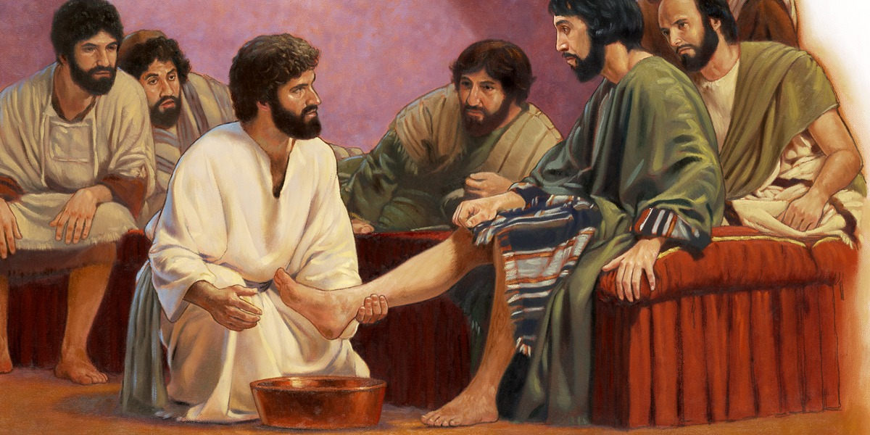
1ST Upper Room Experience Cont
Before the Passover Judas had met a second time with the priests and scribes, and had closed the contract to deliver Jesus into their hands. Yet he afterward mingled with the disciples as though innocent of any wrong, and interested in the work of preparing for the feast. The disciples knew nothing of the purpose of Judas. Jesus alone could read his secret. Yet He did not expose him. Jesus hungered for his soul. He felt for him such a burden as for Jerusalem when He wept over the doomed city. His heart was crying, How can I give thee up? The constraining power of that love was felt by Judas. When the Saviour’s hands were bathing those soiled feet, and wiping them with the towel, the heart of Judas thrilled through and through with the impulse then and there to confess his sin. But he would not humble himself. He hardened his heart against repentance; and the old impulses, for the moment put aside, again controlled him. Judas was now offended at Christ’s act in washing the feet of His disciples. If Jesus could so humble Himself, he thought, He could not be Israel’s king. All hope of worldly honor in a temporal kingdom was destroyed. Judas was satisfied that there was nothing to be gained by following Christ. After seeing Him degrade Himself, as he thought, he was confirmed in his purpose to disown Him, and confess himself deceived. He was possessed by a demon, and he resolved to complete the work he had agreed to do in betraying his Lord. {DA 645.1}

Slide 20
1ST Upper Room Experience Cont
When Jesus girded Himself with a towel to wash the dust from their feet, He desired by that very act to wash the alienation, jealousy, and pride from their hearts. This was of far more consequence than the washing of their dusty feet. With the spirit they then had, not one of them was prepared for communion with Christ. Until brought into a state of humility and love, they were not prepared to partake of the paschal supper, or to share in the memorial service which Christ was about to institute. Their hearts must be cleansed. Pride and self-seeking create dissension and hatred, but all this Jesus washed away in washing their feet. A change of feeling was brought about. Looking upon them, Jesus could say, “Ye are clean.” Now there was union of heart, love for one another. They had become humble and teachable. Except Judas, each was ready to concede to another the highest place. Now with subdued and grateful hearts they could receive Christ’s words. {DA 646.3}
Jesus said to the disciples, “Ye are clean, but not all.” He had washed the feet of Judas, but the heart had not been yielded to Him. It was not purified. Judas had not submitted himself to Christ. {DA 649.1}
After Christ had washed the disciples’ feet, and had taken His garments and sat down again, He said to them, “Know ye what I have done to you? Ye call Me Master and Lord: and ye say well; for so I am. If I then, your Lord and Master, have washed your feet; ye also ought to wash one another’s feet. For I have given you an example, that ye should do as I have done to you. Verily, verily, I say unto you, The servant is not greater than his lord; neither he that is sent greater than he that sent him.” {DA 649.2}

Slide 21
1ST Upper Room Experience Cont
Again and again Jesus had tried to establish this principle among His disciples. When James and John made their request for pre-eminence, He had said, “Whosoever will be great among you, let him be your minister.” Matthew 20:26. In My kingdom the principle of preference and supremacy has no place. The only greatness is the greatness of humility. The only distinction is found in devotion to the service of others. {DA 650.1}
Now, having washed the disciples’ feet, He said, “I have given you an example, that ye should do as I have done to you.” {DA 650.2}
This ordinance is Christ’s appointed preparation for the sacramental service. {DA 650.3}
Judas the betrayer was present at the sacramental service. He received from Jesus the emblems of His broken body and His spilled blood. He heard the words, “This do in remembrance of Me.” And sitting there in the very presence of the Lamb of God, the betrayer brooded upon his own dark purposes, and cherished his sullen, revengeful thoughts. {DA 653.4}
At the feet washing, Christ had given convincing proof that He understood the character of Judas. “Ye are not all clean” (John 13:11), He said. These words convinced the false disciple that Christ read his secret purpose. Now Christ spoke out more plainly. As they were seated at the table He said, looking upon His disciples, “I speak not of you all: I know whom I have chosen: but that the scripture may be fulfilled, He that eateth bread with Me hath lifted up his heel against Me.” {DA 653.5} Even now the disciples did not suspect Judas. But they saw that Christ appeared greatly troubled. A cloud settled over them all, a premonition of some dreadful calamity, the nature of which they did not understand. As they ate in silence, Jesus said, “Verily I say unto you, that one of you shall betray Me.” {DA 654.1}

Slide 23
1ST Upper Room Experience Cont
As they realized the import of His words, and remembered how true His sayings were, fear and self-distrust seized them. They began to search their own hearts to see if one thought against their Master were harbored there. With the most painful emotion, one after another inquired, “Lord, is it I?” But Judas sat silent… The disciples had searched one another’s faces closely as they asked, “Lord, is it I?” And now the silence of Judas drew all eyes to him. Amid the confusion of questions and expressions of astonishment, Judas had not heard the words of Jesus in answer to John’s question. But now, to escape the scrutiny of the disciples, he asked as they had done, “Master, is it I?” Jesus solemnly replied, “Thou hast said.” {DA 654.2}
In surprise and confusion at the exposure of his purpose, Judas rose hastily to leave the room. “Then said Jesus unto him, That thou doest, do quickly.... He then having received the sop went immediately out: and it was night.” {DA 654.3}
Until this step was taken, Judas had not passed beyond the possibility of repentance. But when he left the presence of his Lord and his fellow disciples, the final decision had been made. He had passed the boundary line. {DA 654.4}

Slide 24
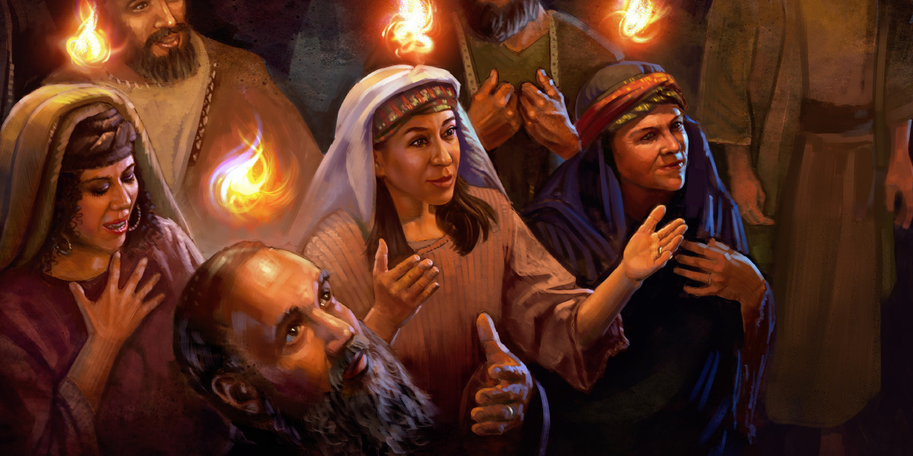
2ND Upper Room Experience
Harvest
Pent.
“Work”
Asc.
Pent.
40
10
Matthias anointed
1. Disciples
Upper Room Experience
Christ revealed Himself in power to His church
In mind and character they have become like Christ
Disciples in one accord
Disciples humbled their hearts in true repentance
11 disciples and one is added—start with 11 end with 12
Truths that they could not understand is now understood
The disciples pray for and receive the Holy Spirit
Deep heart searching
Setting aside differences
Anointing of Matthias -- organization

Slide 25
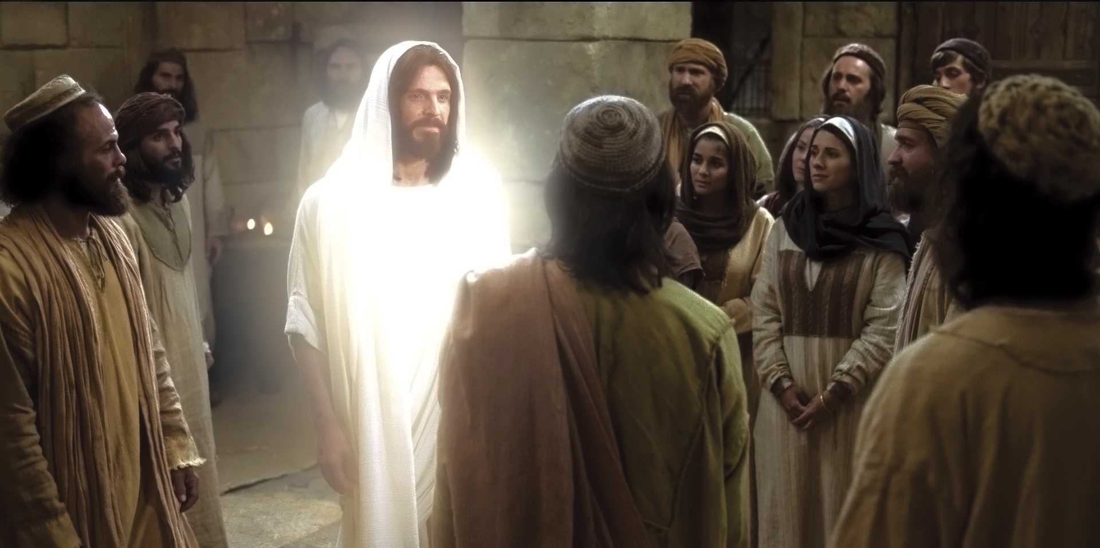
The Days Before Pentecost
After the death of Christ the disciples were well-nigh overcome by discouragement. Their Master had been rejected, condemned, and crucified. {AA 25.1}
Jesus had several times attempted to open the future to His disciples, but they had not cared to think about what He said. Because of this His death had come to them as a surprise; and afterward, as they reviewed the past and saw the result of their unbelief, they were filled with sorrow. When Christ was crucified, they did not believe that He would rise. He had stated plainly that He was to rise on the third day, but they were perplexed to know what He meant. This lack of comprehension left them at the time of His death in utter hopelessness. They were bitterly disappointed. Their faith did not penetrate beyond the shadow that Satan had cast athwart their horizon. All seemed vague and mysterious to them. If they had believed the Saviour’s words, how much sorrow they might have been spared! {AA 25.2}
Crushed by despondency, grief, and despair, the disciples met together in the upper chamber, and closed and fastened the doors, fearing that the fate of their beloved Teacher might be theirs. It was here that the Saviour, after His resurrection, appeared to them. {AA 26.1}

Slide 26
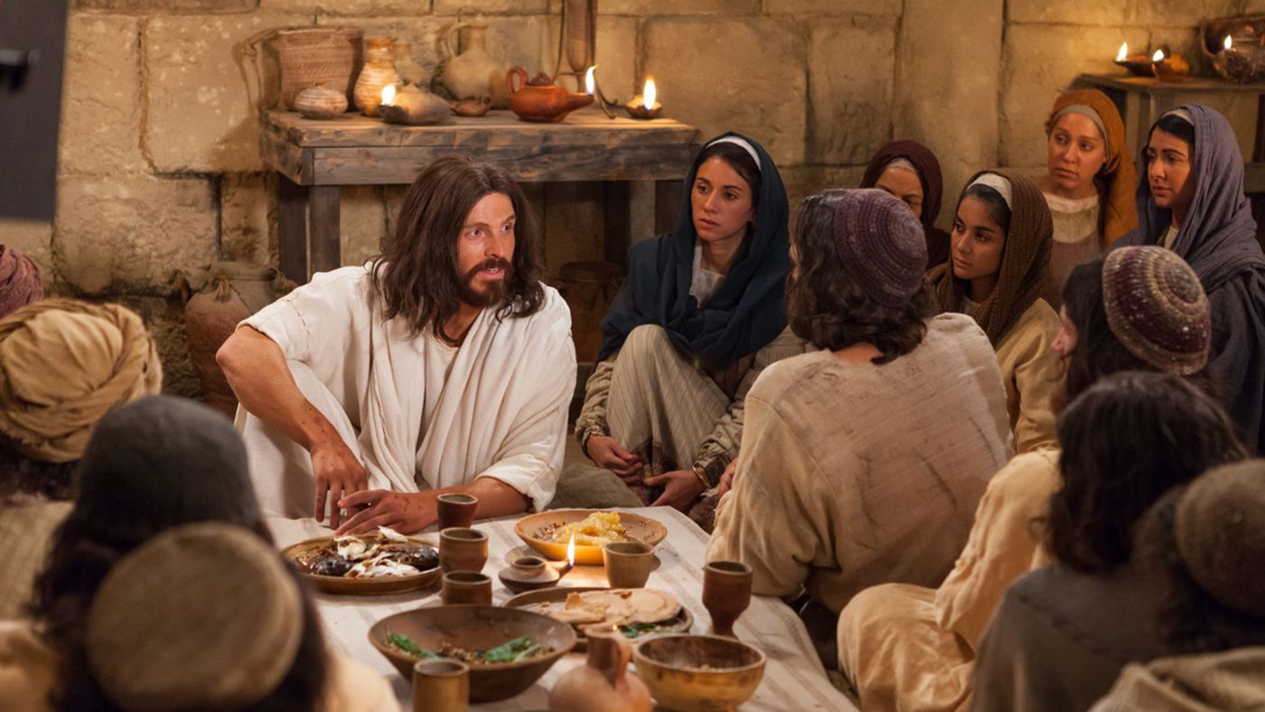
The Days Before Pentecost
For forty days Christ remained on the earth, preparing the disciples for the work before them and explaining that which heretofore they had been unable to comprehend. He spoke of the prophecies concerning His advent, His rejection by the Jews, and His death, showing that every specification of these prophecies had been fulfilled. He told them that they were to regard this fulfillment of prophecy as an assurance of the power that would attend them in their future labors. “Then opened He their understanding {AA 26.2}
Just before leaving His disciples, Christ once more plainly stated the nature of His kingdom. He recalled to their remembrance things He had previously told them regarding it. He declared that it was not His purpose to establish in this world a temporal kingdom. He was not appointed to reign as an earthly monarch on David’s throne. {AA 30.1}
During these days that Christ spent with His disciples, they gained a new experience. As they heard their beloved Master explaining the Scriptures in the light of all that had happened, their faith in Him was fully established. {AA 27.1}

Slide 27
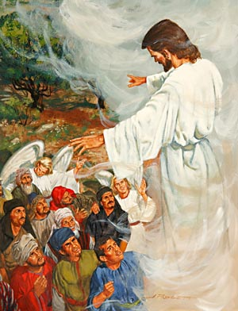
2ND Upper Room Experience Cont’
ACTS 1:
⁹ And when he had spoken these things, while they beheld, he was taken up; and a cloud received him out of their sight.
¹⁰ And while they looked stedfastly toward heaven as he went up, behold, two men stood by them in white apparel;
¹¹ Which also said, Ye men of Galilee, why stand ye gazing up into heaven? this same Jesus, which is taken up from you into heaven, shall so come in like manner as ye have seen him go into heaven.
¹³ And when they were come in, they went up into an upper room, where abode both Peter, and James, and John, and Andrew, Philip, and Thomas, Bartholomew [Nathanael] , and Matthew, James the son of Alphaeus, and Simon Zelotes, and Judas the brother of James.
¹⁴ These all continued with one accord in prayer and supplication, with the women, and Mary the mother of Jesus, and with his brethren.
¹⁵ And in those days Peter stood up in the midst of the disciples, and said, (the number of names together were about an hundred and twenty,)
¹⁶ Men and brethren, this scripture must needs have been fulfilled, which the Holy Ghost by the mouth of David spake before concerning Judas, which was guide to them that took Jesus.
¹⁷ For he was numbered with us, and had obtained part of this ministry.

Slide 28
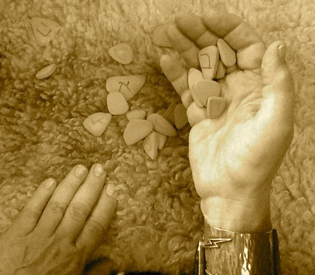
2ND Upper Room Experience Cont’
Side Note the ordination of Matthias in reference to organization.
ACTS 1:
²¹ Wherefore of these men which have companied with us all the time that the Lord Jesus went in and out among us,
²² Beginning from the baptism of John, unto that same day that he was taken up from us, must one be ordained to be a witness with us of his resurrection.
²³ And they appointed two, Joseph called Barsabas, who was surnamed Justus, and Matthias.
²⁴ And they prayed, and said, Thou, Lord, which knowest the hearts of all men, shew whether of these two thou hast chosen,
²⁵ That he may take part of this ministry and apostleship, from which Judas by transgression fell, that he might go to his own place.
²⁶ And they gave forth their lots; and the lot fell upon Matthias; and he was numbered with the eleven apostles.
Christ originally ordained 12 as the 1st step to organization of the church.
… And He ordained twelve, that they should be with Him, and that He might send them forth to preach.” {DA 290.1}
The first step was now to be taken in the organization of the church that after Christ’s departure was to be His representative on earth. {DA 291.2}
While Jesus was preparing the disciples for their ordination, one who had not been summoned urged his presence among them. It was Judas Iscariot, a man who professed to be a follower of Christ. He now came forward, soliciting a place in this inner circle of disciples. {DA 293.2}

Slide 29
2ND Upper Room Experience Cont’
In obedience to Christ’s command, they waited in Jerusalem for the promise of the Father—the outpouring of the Spirit. They did not wait in idleness. The record says that they were “continually in the temple, praising and blessing God.” Luke 24:53. They also met together to present their requests to the Father in the name of Jesus. {AA 35.2}
As the disciples waited for the fulfillment of the promise, they humbled their hearts in true repentance and confessed their unbelief. As they called to remembrance the words that Christ had spoken to them before His death they understood more fully their meaning. Truths which had passed from their memory were again brought to their minds, and these they repeated to one another. They reproached themselves for their misapprehension of the Saviour. Like a procession, scene after scene of His wonderful life passed before them. As they meditated upon His pure, holy life they felt that no toil would be too hard, no sacrifice too great, if only they could bear witness in their lives to the loveliness of Christ’s character. Oh, if they could but have the past three years to live over, they thought, how differently they would act! If they could only see the Master again, how earnestly they would strive to show Him how deeply they loved Him, and how sincerely they sorrowed for having ever grieved Him by a word or an act of unbelief! But they were comforted by the thought that they were forgiven. And they determined that, so far as possible, they would atone for their unbelief by bravely confessing Him before the world. {AA 36.1}

Slide 30
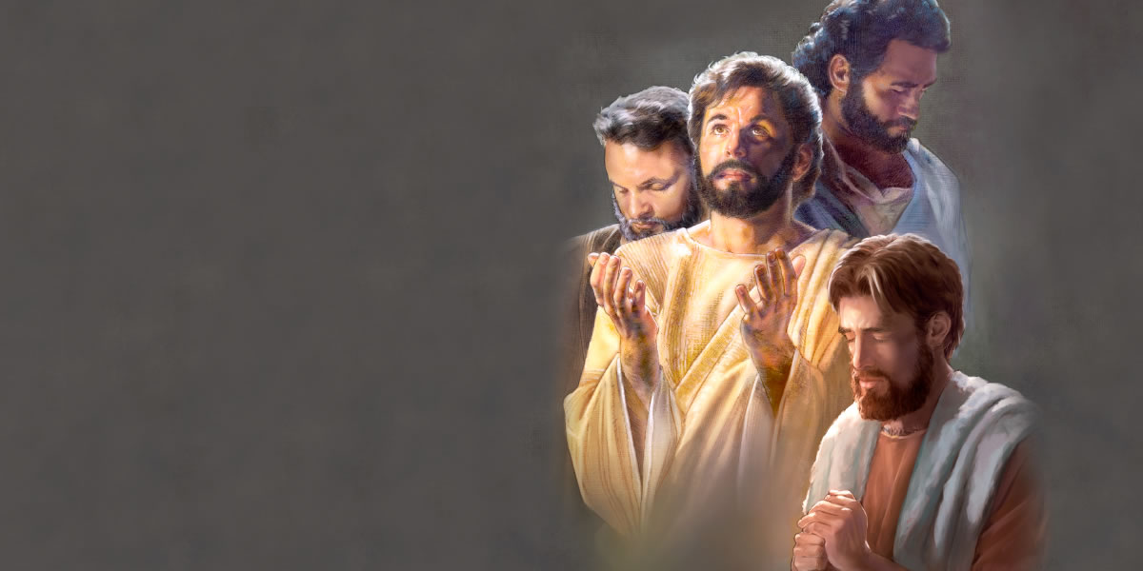
2ND Upper Room Experience Cont’
The disciples prayed with intense earnestness for a fitness to meet men and in their daily intercourse to speak words that would lead sinners to Christ. Putting away all differences, all desire for the supremacy, they came close together in Christian fellowship. They drew nearer and nearer to God, and as they did this they realized what a privilege had been theirs in being permitted to associate so closely with Christ. {AA 37.1}
These days of preparation were days of deep heart searching. The disciples felt their spiritual need and cried to the Lord for the holy unction that was to fit them for the work of soul saving. They did not ask for a blessing for themselves merely. They were weighted with the burden of the salvation of souls. They realized that the gospel was to be carried to the world, and they claimed the power that Christ had promised. {AA 37.2}
“And when the Day of Pentecost was fully come, they were all with one accord in one place. And suddenly there came a sound from heaven as of a rushing mighty wind, and it filled all the house where they were sitting.” {AA 37.4}
The Spirit came upon the waiting, praying disciples with a fullness that reached every heart. The Infinite One revealed Himself in power to His church. It was as if for ages this influence had been held in restraint, and now Heaven rejoiced in being able to pour out upon the church the riches of the Spirit’s grace. And under the influence of the Spirit, words of penitence and confession mingled with songs of praise for sins forgiven. Words of thanksgiving and of prophecy were heard. {AA 38.1}

Slide 31
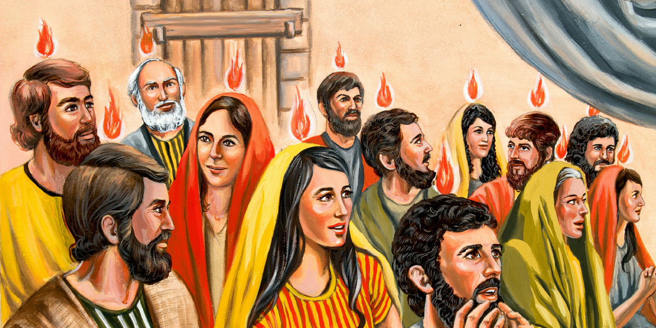
2ND Upper Room Experience Cont’
The Holy Spirit, assuming the form of tongues of fire, rested upon those assembled. This was an emblem of the gift then bestowed on the disciples, which enabled them to speak with fluency languages with which they had heretofore been unacquainted. {AA 39.1}
ACTS 2:1
And when the day of Pentecost was fully come, they were all with one accord in one place. fully (G4845) From:G4862 and G4137, to implenish completely that is (of space) to swamp (a boat) or (of time) to accomplish (passively be complete): - (fully) come fill up. KJV Usage: be fully come (Strongs Concordance)
Under the influence of this heavenly illumination the scriptures that Christ had explained to the disciples stood out before them with the luster of perfect truth. The veil that had prevented them from seeing to the end of that which had been abolished, was now removed, and they comprehended with perfect clearness the object of Christ’s mission and the nature of His kingdom. {AA 44.1}

Slide 32
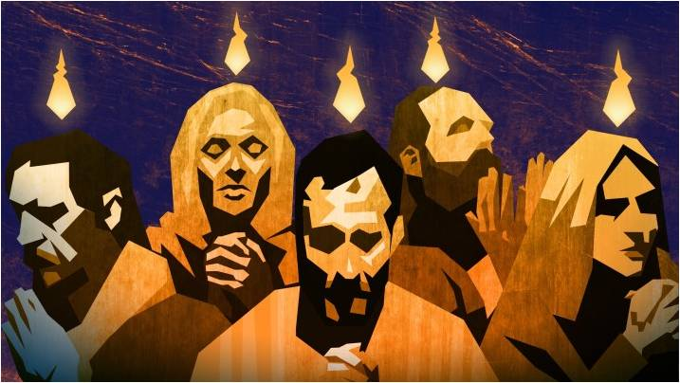
2ND Upper Room Experience Cont’
Under the training of Christ the disciples had been led to feel their need of the Spirit. Under the Spirit’s teaching they received the final qualification, and went forth to their lifework. No longer were they ignorant and uncultured. No longer were they a collection of independent units or discordant, conflicting elements. No longer were their hopes set on worldly greatness. They were of “one accord,” “of one heart and of one soul.” Acts 2:46; 4:32. Christ filled their thoughts; the advancement of His kingdom was their aim. In mind and character they had become like their Master, and men “took knowledge of them, that they had been with Jesus.” Acts 4:13. {AA 45.2}
Pentecost brought them the heavenly illumination. The truths they could not understand while Christ was with them were now unfolded. With a faith and assurance that they had never before known, they accepted the teachings of the Sacred Word. {AA 45.3}
They realized the greatness of their debt to heaven and the responsibility of their work. Strengthened by the endowment of the Holy Spirit, they went forth filled with zeal to extend the triumphs of the cross. {AA 46.1}

Slide 33
A Compare and Contrast
#1 Upper Room Experience
#2 Upper Room Experience
12 disciples and one leaves—Start with 12 and end with 11
God’s character is revealed. Christ reveals Himself to them and the nature of His kingdom. He is demonstrating to His disciples His mission through the services
2 part service: Preparatory—foot washing &
Communal—eating of the bread and drinking of the unfermented wine
Disciples are not humble
Strife among the disciples—which should be accounted the greatest.
Exaltation of self—thinking one is better than the other
Disciples’ hearts were full of resentful feelings
Disciples held onto wrong belief—earthly king—misunderstanding of Christ and the nature of His kingdom.
11 disciples and one is added—Start with 11 and end with 12
Anointing of Matthias—organization
The disciples pray for and receive the Holy Spirit
Christ revealed Himself in power to His church
Disciples are in one accord
Disciples set aside differences
Deep heart searching
Disciples humbled their hearts in true repentance
In mind and character they have become like Christ
Truths that they could not understand are now understood

Slide 34
Summary
The study of reform lines opened up in 1989. Reform lines are the guide God has given us that places us in history/time and reveals to us our past, present, and future condition (on a corporate level and an individual level) as light is opened up on events occurring both internally and externally of the Movement.
There are four key reform lines God uses to bring about reformation to His church identified as: the beginning of ancient Israel, the end of ancient Israel, the beginning of modern Israel, and the end of modern Israel.
In the alpha history, there is one call to the church and one call to the world. It is a history of failure. God’s people do not complete their job function and Christ’s Advent is delayed. In the omega history, there are two calls to the church and one call to the world. It is a history of success. God’s people complete their job function and Christ comes in their history.
In every reform line there are 5 primary waymarks and 4 dispensations in between that divide the agricultural process: ploughing, early rain, latter rain, and harvest.
In every dispensation of a reform line we can identify a repeating pattern: B, C, E, Test/: A message unsealed, IOK, Formalization, Test.
In every reform line there is a big scale that can be reduced to similar smaller scales called fractals. These fractals are quasi-similar, not identical, but alike in their principle parts to each other and the whole.
We can line up reform lines with each other and compare and contrast them to see what it is telling us about our own history.
In this study we looked at the omega history of ancient Israel; though not making any application, we focused particularly on the fractal of the first group, the disciples, and identified two upper room experiences and compared and contrasted the two in their historical context using the Bible and the Spirit of Prophesy.

