Slide 1
Tyler Sena APS 2019 #6

Slide 2
The Constitution governs national acts.
Principles found in the constitution are perfect and have errors from its conception.
Constitution represents the beginning of the work but that work needs to be accomplished by the 2nd and the 3rd angel. How? – Amendment system that allows for clarification and more light to be added to the constitution. But in principle all amendments should be in unison.
In many other important events in US history the constitution has always been on the right side of the issue.
There are about five major events or time periods that we are going to mark and I am going to try to show you that the constitution has always been on the right side and that the individuals have always been on the wrong side.
1260
AL+ Fred Douglas “no property in man
1766 1776 1789 1798 1808 1836 1850 1852 1860 1861 1862
Declaratory Act:
The Declaratory Act was a measure issued by British Parliament asserting its authority to make laws binding the colonists “in all cases whatsoever” including the right to tax
Declaration of Independence
U.S. Constitution starts operating
Death of Madison
C. Sumner
Civil war

Slide 3
Five major cases that illustrate that Constitution was on the right side (righteous)

Slide 4
Slavery
US Constitution was perfect since its inception but needed clarifications or additions. This is achieved by Amendments.
The constitution did not allow slavery, but for those who fought it, fought it under the First Amendment, claimimng that it was their religious right to own a slave and citing benefits for the slaves themselves, that it was good for them to be slaves.
By 1865 the slavery has been dealt with ratification of the 13th amendment that bans slavery. In this controversy, both sides are using the constitution to sustain their position and both sides are using religion to sustain their position.
1260
AL+ Fred Douglas “no property in man
1865 1776 1789 1798 1808 1836 1850 1852 1860 1861 1862
Declaration of Independence
U.S. Constitution starts operating
Death of Madison
C. Sumner
Civil war

Slide 5
Women’s Right to Vote Timeline
The federal woman suffrage amendment, originally written by Susan B. Anthony and introduced to Congress in 1878, is passed by the House of Representatives and the Senate.
The first women’s rights convention is held in Seneca, NY. Later known as the Seneca Convention.
1848 1913 1919 1920
The silence of the constitution explicitly mentioning “women” is the greatest defense in favor of women’s right for equal treatment.
On Aug. 26th the 19th Amendment to the Constitution is passed allowing women the right to vote.
The National Women’s Party is formed to work towards the federal passage of an amendment allowing women to vote.
Figure 1. “Women’s Right to Vote Timeline.”

Slide 6
1950s: Religion Finds Place in the Government
President D. Eisenhower was known to be a devoutly religious person. He opens door to mixing of church and state. Examples:
“In God We Trust”
Changes in Pledge of Allegiance to allow “Under God”
They change a lot of different things to insert religious principle or the idea of a Christian nation into society. This is a religious problem of the 1950’s. Again Bible and constitution were used to sustain their religious beliefs.

Slide 7
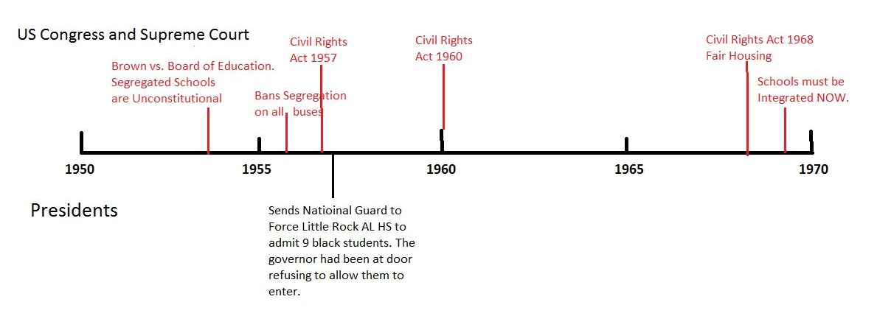
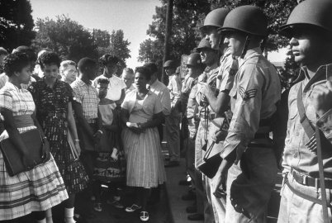
Civil Rights movement of 1960s
Now we are in the 1960’s. Slavery has not been an issue for a while, but we have the problem of discrimination and inequality of the races.
In 1964 you have the Civil Rights Act and this is sort of a rehashing of the slavery problem to some degree. Those sentiments are coming back, in some degree they never left. The problem with discrimination is finally going to get dealt with in the 1960’s.
Again similar arguments are going to be used for racism and discrimination. Similar biblical arguments as well as constitutional arguments get made there.
The equality is expressly given in the constitution. There is no basis in the constitution to discriminate for any reason. I don't know why it wasn't obvious back then. Maybe it was and maybe people just had prejudice and they just wouldn't let that stand.

Slide 8
Gay Rights Act 2015
States cannot keep same-sex couples from marrying and must recognize their unions, the Supreme Court says in a ruling that for months has been the focus of speculation. The decision was 5-4.
Justice Anthony Kennedy, seen as a pivotal swing vote in the case, wrote the majority opinion. All four justices who voted against the ruling wrote their own dissenting opinions: Chief Justice John Roberts and Justices Antonin Scalia, Clarence Thomas and Samuel Alito.
"They ask for equal dignity in the eyes of the law," Kennedy wrote of same-sex couples in the case. "The Constitution grants them that right."

Slide 9
In all these 5 cases the U.S. Constitution is on the right side of the issue
My question to you is why did any of these things become a problem? Why was slavery a problem or suffrage or the religious issue or gay rights? Individual biases. Why did they become a problem legally? Misinterpretation is closer to where I want to go with this. If you bring something up into the court how does that work? If I bring something up and it goes all the way to the court how does that work? What has already happened? There has already been an injustice. And if it's that kind of injustice where it is going to make its way to the court like that, what was the injustice? There was probably some sort of law that was in place. Who made the law? The state made a law. All these are state problems. Slavery was a state problem. Suffrage was a state problem. Religion was a state problem, but it also became a federal problem. This one was a little bit of both in that congress is going to start making those laws as well, so this one was bad on both sides. Civil rights was state problem. Gay rights is a state problem but also you can add DOMA (Defense of Marriage Act). So you would have a federal ruling as well. But my point is all of these began as a state issue and if they ever became a federal problem it was because the states pushed that idea. The states pushed an agenda and it became a federal issue. So in a few of these you see federal participation. But what I want to identify is the state problem. Most of these are a state issue. Slavery is a state issue.

Slide 10
To solve this problem a message comes. This message that comes brings these principles that come in 1776 and are then going to go through an increase of knowledge type situation where they become enshrined in the constitution. And what is the constitution do? What does it do? It formalizes that message and it creates the US. 1789 the constitution forms the nation. That is what the constitution is. It forms the nation. Once that becomes ratified and adopted from that point forward you have coming to life the USA. So what comes out of this? A nation. Now what is this Nation made up of? If you just had a Nation under the constitution and you just had a federal government what is the problem with that? What is the federal government? It is an administration of a group of states. The Federal government though is more of an idea than anything else. What do you need? You need states, you need a population to fill that government. You need states is what I am trying to get at. So these states come together and say this is what we are going to establish as our government and we are all going to play by the same rules set forth by the constitution under this nation. So it's like a club and the states are the members.
1766 1776 1789 1798 1860 1861 1862
Declaratory Act:
The Declaratory Act was a measure issued by British Parliament asserting its authority to make laws binding the colonists “in all cases whatsoever” including the right to tax
Declaration of Independence
U.S. Constitution starts operating
Nation is born
Good States and Bad States fight over slavery
Civil war

Slide 11
Now from 1798 - 1861 there is a progressive continual battle over slavery.
We saw that in 1808 the Atlantic Slave trade gets abolished. There are plenty of waymarks we can put on this line to show the battle that is going on and we can see that it is always between the two states. The good states and the bad states. It is always between the two states and how they are going to view the constitution. So one group of states is going to use the constitution to say slavery is good and the other group is going to use it to say that it's wrong. They are going to be using the same constitution to come to different or opposite conclusions. This battle is going to rage until a certain time. What did Abraham Lincoln say? He said you are threatening to break up the union because you think your constitutional right is being attacked, but you are not even making a good case for why you have that constitutional right. He is saying you are making a bad argument and because of your bad argument you are willing to divide the union. So Abraham Lincoln says that in 1860. He is identifying the fact that the union is going to be broken up. Was it broken up? Yes, the next year. The Next year Abraham Lincoln is correct about the union breaking up and the Civil War begins in 1861.
So these two types of states that have been part of the same body of this same nation, and they come to a point where the separation is eminent. Abraham Lincoln is identifying that accurately and the next year you have the split. You then have the Confederacy and you have the Union. The Union is the North and anti-slavery and the Confederacy is the South which is pro-slavery. The US has now been divided into two pieces at this point. Now when does the war end? 1865. In this year the war ends. So the Civil War begins over slavery and what happens in 1863? The emancipation proclamation. It goes out right dead in the middle of the Civil war. Abraham Lincoln is going to make his proclamation on Jan 1, 1863 and he is going to say using his own authority that he is freeing all the slaves in the South. He is not going to say he is freeing the slaves in the North because there are no slaves there.
Proclamation
1766 1776 1789 1798 1860 1861 1863 1865
Declaratory Act:
The Declaratory Act was a measure issued by British Parliament asserting its authority to make laws binding the colonists “in all cases whatsoever” including the right to tax
Declaration of Independence
U.S. Constitution starts operating
Nation is born
Good States and Bad States fight over slavery
Separation
Civil war War Ends AL killed
13th Amendment freeing all slaves

Slide 12
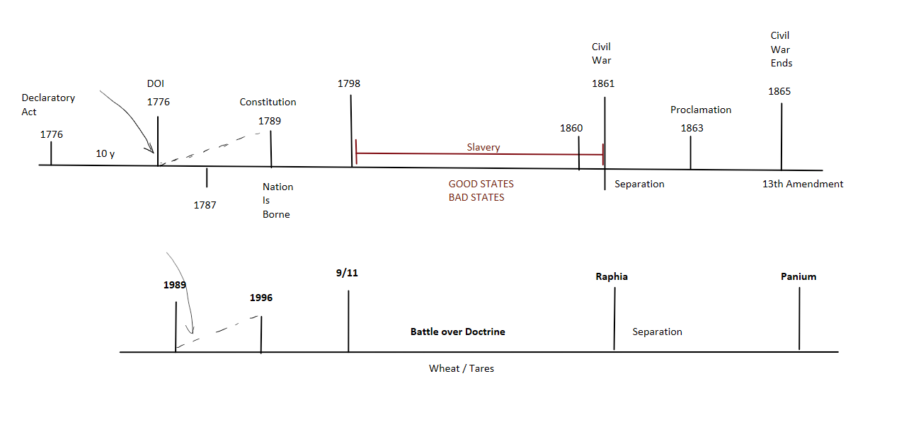
It is debated in history if he actually had the constitutional authority to do that but it is enough for the slaves to hear that and they then immediately go to the other side. So he is going to make this proclamation here where he is talking to the slaves and all the slaves are going to start coming out of the south. Most of the slaves actually start joining the Union army. They actually bolster the army for the North. So in the beginning you have the war starting over slavery and right in the middle you have Abraham Lincoln making this declaration here freeing all the slaves. Then finally in 1865 the Civil War comes to an end. And what also happens in 1865? Lincoln gets killed. What else? The 13th amendment comes into play. So the Civil War is going to end on May 2, 1865 and the 13th amendment completely freeing all slaves in the US comes on Dec 6, 1856. So the war ends and you also have the 13th amendment. So you have a separation and then you have this war and the war ends and then you have the 13th amendment and you see this continued theme of slavery through this war.

Slide 13
Now I want to put our line underneath this. So what happens in 1989? It is the time of the end internally. We are just going to talk internally. What's taking place? Internally what arrives? The first Angel arrives and it is a message. A message arrives in 1989, the first angels message and what is going to happen from that point forward? There is an increase of knowledge until you get to a point of formalization. So we're going to have a formalization. What year? 1996 you have the formalization of the message. What is borne in this formalization? What is born in this moment? A movement is born. A movement comes out of this formalization. A formalized movement. There was obviously a movement back here from 1989 just like in 1776 there was a movement of people trying to do something, but that idea becomes concrete and formalized once you come to 1996 at least in our movement, just like it was in 1798. A movement it born.

Slide 14
That movement is made up of what? People. What is the movement? It’s an idea, it's principles, it's a message. A message is nothing without people. You need people for it. So this movement that has been established based upon these principles and based upon this message, are going to now go forward now that they are established. Now there is going to be a battle that takes place. So what is the battle in the movement that takes place? What is the battle always over? It's over prophecy, doctrine. It's over ideas. They are battling over ideas but what are they specifically battling over? They are battling over doctrine generically or prophecy, or ideas. Some examples are Joel or public evangelism. So a doctrine like public evangelism comes in as a point of focus and there is a battle over it. What's going to happen with that battle? There is going to be two sides and what is going to happen now? A division is going to take place. Before division takes place what does the battle consist of? Methodology. The idea is methodology. What is another word for methodology? Interpretation. So you have an interpretive problem. Part of the problem of interpretation, and you've seen this a lot with someone with later ministries like Mark Bruce or others during that time, you have a battle not just over interpretation, but it's a battle over their understanding of the foundation of the movement.

Slide 15
Actually all of the problems that take place in the movement and all the doctrinal issue are always about a problem with the formalization of that message. They always have a problem with it whether it's explicitly said or not. They may give perfect and full accent to the fact that they believe in the time of the end magazine and whatever constitutes the formalization of the message, but the problem is the ideas they espouse go against the principles that are set forth in this time 1996. You see it over and over again with every single shaking there has been and it's always also a problem with interpretation. They are always going to read the same thing and come to a different conclusion. If we read a Spirit of Prophecy quote or the Time of the End magazine we are going to come to different conclusions from each other. We are reading the same thing but getting different understanding. Just like what was happening here with the constitution, both sides read the same document but came to opposite conclusions. The same thing takes place here. We are going to read the same things and we are going to come to the fact that the locust are Islam or the locust is the King of the North. So we are going to come to different conclusions about that reading the same thing.

Slide 16
So there is again a problem of interpretation and going forward you come to a point of separation. There is always a point where there is a divide that takes place. We know this divide takes place at Raphia which is a separation. So if you overlay the agricultural model on to this history. It's easy because we know about 9/11. At 9/11 what happens with the agricultural model? The seed is sown and the early rain comes. What does it produce? What happens? It will grow and then it will produce fruit and then that fruit will be harvested. We are missing something by what I just told you so what are we missing? When I say the seed is planted then the plant grows and then it is harvested. What are we missing from this model? Let me say it this way… You have the early rain and the seed and the latter rain and then the harvest so what am I missing? How many plants do we have? One plant. Technically there are two plants. We need Tares. Wheat and tares. Both of them start at the same point and they are going to grow together for a period of time and they are actually not only going to be together but will be vying for the same nutritional benefits and that’s what we see in the parable. Christ says don't remove them because they are too entwined with one another, there is too much going on right there. They are too connected. So you have wheat and tares and they grow together. This is just like the good and the bad states and you have the wheat and the tares. They are going to be together for an amount of time until they reach a point of separation they are now separated and one is going to go to victory and one is going to be like with the confederacy…burned. One is completely destroyed at that time so you can see the parallel. You can see that the history of the Civil War and Slavery from 1776 - 1865 is the history of our movement.

Slide 17
You see this time of separation and you see this battle that takes place and what you get from that is the fact that the constitution represents a message that is given. That message is going to formalize a government. The message that is given in 1989 is going to come and it's going to formalize a movement. It is going to establish a movement just like the constitution establishes a movement. So the movement here that is established is paralleling the USA as an institution. It creates an institution. A message arrives up here, a message arrives down here. An institution is created up here, an institution is created down here. Then you have the people who make up that institution. Who are they? So here you have the people of the movement, the good and the bad people, but up here you have states. You have the states that represent the people. So the constitution represents the message, the movement represents the nation, and the states represent the people. There are good people and bad people and there are good states and bad states. They are going to be fighting each other in this battle that begins to take place. What do you have within states? Are states homogeneous groups of people? No they are not. In every one of these states that we talk about with the good states and the bad states, there is a battle taking place. In the states there is a person who is pro-slavery and there are people who are anti-slavery.

Slide 18
Those are the people who are vying for the competition in the state. So there are two ideas battling within the state and only one of those ideas are going to come into prominence because at the end of the day after a certain amount of time the states are going to make their mind up one way or another by 1861. You are either pro-slavery state or you are anti-slavery states. But every one of those states have a battle taking place within it and what did we say the state represents? The people. So the people have a battle that they are going through from the beginning of their time from 9/11 to Raphia. They are dealing with a struggle internally dealing with two ideas. Two competing ideas. You are either a pro-slavery person or anti-slavery person. At the end of the day by the time you come to the Civil War only one of those sides is going to win when it comes to the legislation of the state because you are going to enact a pro-slavery law or an anti-slavery law.

Slide 19
So the system of the federal government and the structure of the government of the USA is a perfect parallel to that of the movement. From the top to the bottom you have the message which is the constitution or the principles of constitution which get formalized, and they both establish the movement or a nation and that nation is made up of states or people, and within each one of those states or people there is a battle taking place for supremacy. That battle comes to a head to where everyone has to make a decision to whether they are going to be one this side of the issue or on that side of the issue.
There is always a period of time that the Lord allows for decision making. From 9/11 - Raphia and from 1798 - 1861 this is your time. This is the only amount of time you get to make the decision whether your state is going to be pro or anti-slavery.

Slide 20
What I am trying to identify with pro or anti-slavery is that you have two sources of information taking place. You have the pro or the anti and it's either all bad or it's all right. Both of those forces are both playing on you as an individual. You can see that here if the model I am setting forth as the states representing a person is correct then you can see that every single person is having the struggle of whether they are going to be on the one side or the other. Everyone must make a decision about which stream they are going to drink from or fall into. It's dangerous to be playing in the other stream because as we saw in this period and talked about briefly there's the propaganda of the South. The South is pushing this message that the North is out to get and that slavery is actually this good thing and that they have this constitutional right and if they messed around with that and you let the people in the state go too far into imbibing that propaganda, then your state was going to make pro-slavery law and then you would have had to have gone with the confederacy. So you can see that the same dynamics of the two streams are taking place.

Slide 21
I just want to read two quotations from sister white about the war with Satan because it illustrates the same idea. The war in heaven.
7BC 973
The influence of mind on mind, so strong a power for good when sanctified, is equally strong for evil in the hands of those opposed to God. This power Satan used in his work of instilling evil into the minds of the angels, and he made it appear that he was seeking the good of the universe. As the anointed cherub, Lucifer had been highly exalted; he was greatly loved by the heavenly beings, and his influence over them was strong. Many of them listened to his suggestions and believed his words. "And there was war in heaven: Michael and his angels fought against the dragon; and the dragon fought and his angels and prevailed not; neither was their place found any more in heaven." {7BC 973.4}
So in heaven, if we overlay the history of heaven, there is a period of time where Satan is going to begin his rebellion secretly and he begins disseminating his information. It's the mind on mind. It's a war over ideas and they are going to be fighting over these ideas and you either have the message of Satan, the influence of Satan, or you have the influence of God and Christ. As the angels who are making up the people who are going to have to decide either you are going to listen to that, or you are going to reject that. What I want us to see is that it's the influence of mind on mind and it's also the fact that this rebellion of Satan is going to last for a long time. The Lord is going to allow it so that everyone can make their decision. I am going to jump down.

Slide 22
I just want to read two quotations from sister white about the war with Satan because it illustrates the same idea. The war in heaven.
7BC 973
The influence of mind on mind, so strong a power for good when sanctified, is equally strong for evil in the hands of those opposed to God. This power Satan used in his work of instilling evil into the minds of the angels, and he made it appear that he was seeking the good of the universe. As the anointed cherub, Lucifer had been highly exalted; he was greatly loved by the heavenly beings, and his influence over them was strong. Many of them listened to his suggestions and believed his words. "And there was war in heaven: Michael and his angels fought against the dragon; and the dragon fought and his angels and prevailed not; neither was their place found any more in heaven." {7BC 973.4}
So in heaven, if we overlay the history of heaven, there is a period of time where Satan is going to begin his rebellion secretly and he begins disseminating his information. It's the mind on mind. It's a war over ideas and they are going to be fighting over these ideas and you either have the message of Satan, the influence of Satan, or you have the influence of God and Christ. As the angels who are making up the people who are going to have to decide either you are going to listen to that, or you are going to reject that. What I want us to see is that it's the influence of mind on mind and it's also the fact that this rebellion of Satan is going to last for a long time. The Lord is going to allow it so that everyone can make their decision.
The Father decides the case of Satan and declares that he must be turned out of heaven for his daring rebellion, and that all those who united with him in his rebellion should be turned out with him. Then there was war in heaven. Christ and His angels fought against Satan and his angels, for they were determined to remain in heaven with all their rebellion. But they prevailed not. Christ and loyal angels triumphed and drove Satan and his rebel sympathizers from heaven. (3SG 38). {7BC 973.7}
So there is going to be a point in time where Christ says ok, we have made the decision and you have to leave. Then Satan and his angels are going to say no I want to stay. They are going to try to force the stay, but they are unable to do that it says. for they were determined to remain in heaven with all their rebellion. But they prevailed not. Christ and loyal angels triumphed and drove Satan and his rebel sympathizers from heaven. So they pushed them out of heaven in whatever way that looked at the point of separation. So what I want to mark on this is that there is a mind on mind battle that is taking place for a long period of time where everyone has to make their decision and then it comes to a point of separation where there is actually rebellion of Satan and his angels…there is a war that is going to take place there and they actually start fighting in whatever way that looks and they get driven out of heaven. They are then permanently lost from heaven from that point, so it illustrates that same point that they are identifying there.

Slide 23
What I want us to see is that the message represents the constitution in its principles. Those things get formalized in the constitution and the constitution (the message) is going to establish a nation or a movement. Then you have the states which represent the people who make up that movement or nation and each individual state has a battle within itself just like each individual has a battle within themselves and it comes to a point of separation.
So I want to talk about some fundamental thoughts for a little bit.
When we look at the idea of two streams in the time of the time of the end magazine.
What are these two rivers? The Ulai and the Hiddekel. One leads to life and one leads to death. So one leads to the sea of glass and one leads to the lake of fire. Two rivers both leading to a body of water. One is death and one is life. So you have life as one stream and you have death on the other stream. One is the Hiddekel and on is the Ulai. Then using our knowledge what else can we mark these two streams as when we look externally? Fox News and CNN was the symbol of the idea of the controversy between the news. Which one is good, and which one is bad? Fox is bad and CNN is good. You have these two streams, two rivers, two news sources depending on how you want to frame the rivers. What is the political disposition of Fox News? It's conservative so this is conservatism. What is CNN? Liberalism. So you have a battle between liberalism and conservatism
I want to define what both of those mean. We will start with conservatism. What is conservatism? To conserve and not change. What else? Exclusive. What else? Control. You are going into political, but I don't want to go there just yet. I want the mindset of conservatism. I want to think about if you are a conservative person not talking about your politics but talking about the way you view life. We are saying it’s a person that doesn't like change, they are exclusive and they like control. What else can that person be? Legalistic. What is legalism? Ok letter of the law verses spirit of the law. What is another really nice way of saying that? Ok Let's take the nonflexible idea. So if you have something that is none flexible what is that? It's rigid it's nonflexible. What kinds of things would we say are nonflexible in terms of like an institution what would we say? It's policy and principle. What is the difference between policy and principle. What is the difference between a mindset of policy and a minds set of principle? One is rigid so we can add that. What does that mean? What is a policy? It's the letter of the law. Policy tells you what you do and they principle tells you why you do it. Is it policy when God tells Abraham to go kill his son or is there a principle? Is that bad? Are God's laws policies or principles? They are principles. So if God's laws are laws… so if you have a law it's either going to be defined as a principle or a policy. What is the difference between that law if we are going to define it as either a principle or a policy.
Life Death
CNN FOX
Liberalism Conservatism

Slide 24
So principles are flexible. Maybe that is the best way of defining it is that this law has flexibility in it for situational problems. I think that’s a decent way of saying that. It's flexible and it allows for a variety of outcome depending on the situation or circumstance. It accounts for circumstance and allows for changing with circumstance. Policy is rigid. It just says oh you weren't here on time well there goes your paycheck you are not going to get payed today. But you say something happened. Let's change it to Sabbath that’s a better one. So God would be a policy person if He were looking at His servants from heaven and said oh that one went to go save his ox on Sabbath because it got stuck in a ditch. I'm a policy God and my law says you can't break Sabbath and he just broke my Sabbath so ok that person is judged. But principle God would say the principle is not that he is breaking my law because he loves my law, but the situation dictates that it's not actually breaking Sabbath. So one is flexible and one in un-flexible.
So we come back to this. Conservative is a not changing thing and likes control and exclusivity and likes policy. Anything else that we want to add in our list? Traditional that's a good one. I traditional bad? What does tradition mean? It's the way we have always done it. Is that always a bad thing? It's not always a bad thing. When does it become a bad thing? When it's rigid what else? Wouldn’t it be when tradition becomes policy and not principle. That is when tradition becomes a bad thing.
So let me ask one more thing. A conservative person has their focus on what? What is the word conservative mean? It means to conserve. So the person who is conservative is trying to conserve something. Where is their focus? Let me say it this way. So this conservative person who is concerned about something where is the focus on not what is the focus on? Themselves. Conservatism is self-focused. When you are worried about conserving something you are focused on something you have. If I am standing here and I have my little customs and traditions I am trying to hang on to them. Someone might be trying to pull the away and I am trying to hold on to what I have so a conservative person is someone who is self-focused. What is another way of saying that? Selfish. It sounds dirty but it's the facts of the matter. I think in my mind selfishness is the primary description of conservatism. It's selfish. Now I'm sure there's a 150 million people in the US that disagree with that. Half the population disagree probably but I think it's sustainable.
Law
Principle Policy
Flexible Rigid
Control

Slide 25
Conclusion
Life Death
CNN FOX
Liberalism Conservatism
Flexible Rigid
Control
Traditional
Self-focused
Unselfish Selfish

