Slide 1
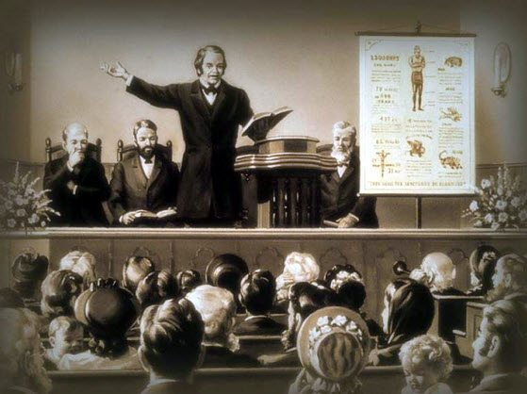
William Miller’s Rules of Interpretation
[Part 1]
https://www.youtube.com/watch?v=UqZ_5zzwi3U&list=WL&index=29
Notes:
Notes created by Victoria Thomas based from Elder Parminder’s presentation on WM rules.

Slide 2
The Meaning of Wisdom
What is wisdom?
Wisdom is not knowledge in itself, but it is the application of knowledge
To have wisdom you need to have knowledge first, and then you need to know how to apply that knowledge.
Understanding is very similar to wisdom.
The reason why we want to concentrate on the word wisdom is because wisdom comes from the word wise. We know in Daniel Chapter 12 it talks about wise people. Those people are not people who know a lot of information. They are people who understand.
Daniel 12
³ And they that be wise shall shine as the brightness of the firmament; and they that turn many to righteousness as the stars for ever and ever. ¹⁰ Many shall be purified, and made white, and tried; but the wicked shall do wickedly: and none of the wicked shall understand; but the wise shall understand.

Slide 3
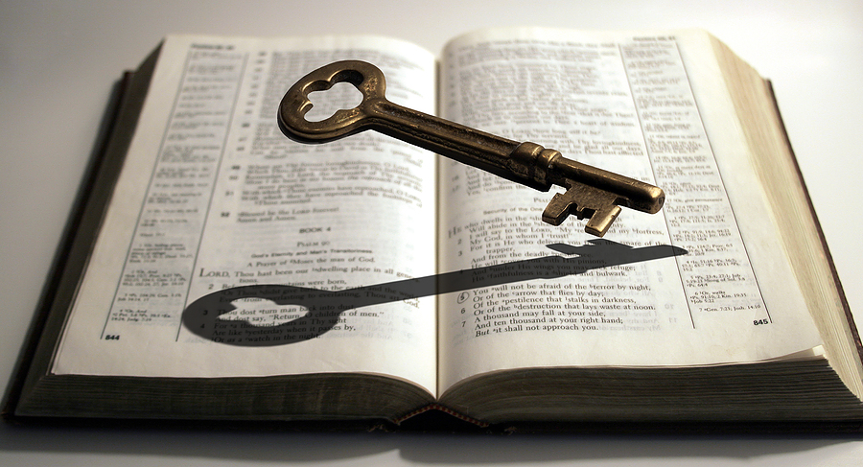
Miller’s rules—A Key Tool to Understanding the Bible
Previously, we noted that understanding is similar to wisdom.
William Miller’s rules is an important key tool to understanding the Bible. In that, the rules helps us to interpret the Bible correctly in order to see how to apply the word of God as present truth for us today. Thereby one becomes wise.
When reading any passage of the Bible, we are supposed to be looking for these techniques—rules that are embedded in the verses. Once you see them, it helps to know what those verses mean and then you can add more to your knowledge. Once you begin to see structure in the verses, it helps to explain what symbols are.

Slide 4
The Meaning of Wisdom Cont’
VERSE | STRUCTURE
Daniel 12 ³ And they that be wise shall shine as the brightness of the firmament; and they that turn many to righteousness as the stars for ever and ever.
Daniel 12 ¹⁰ Many shall be purified, and made white, and tried; but the wicked shall do wickedly: and none of the wicked shall understand; but the wise shall understand.
A : A
Wise
Wise
A B : B A
P,W,T
Wicked
Not understand
Understand
These three steps: purified, white, tried are made by understanding.

Slide 5
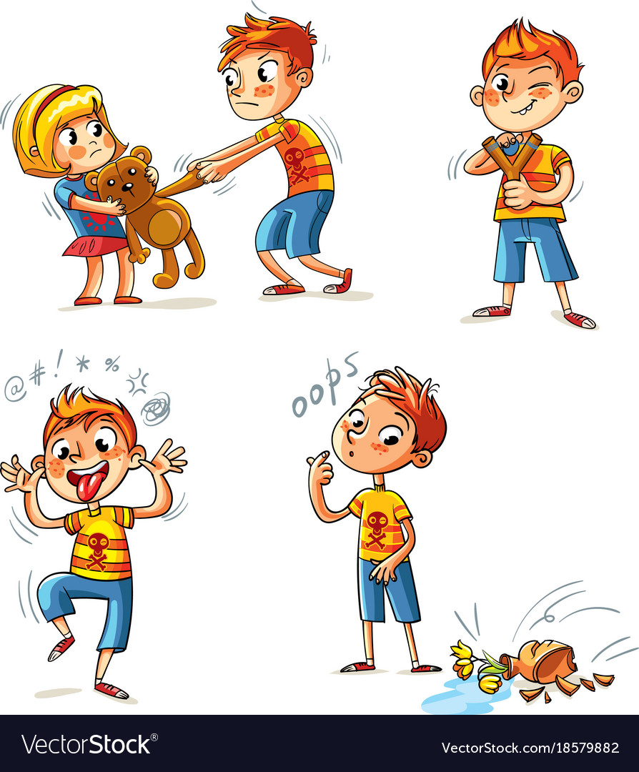
Wise Vs Wicked
What is the difference between a wicked person and a wise person according to the verse (Dan 12:10)?
The wicked do NOT understand. The wise understand.
The definition of being wicked is not bad behavior (or moral sin), but that you don’t understand. The concept of wickedness that is brought to view in verse 10 is different than what we normally think wicked is.

Slide 6
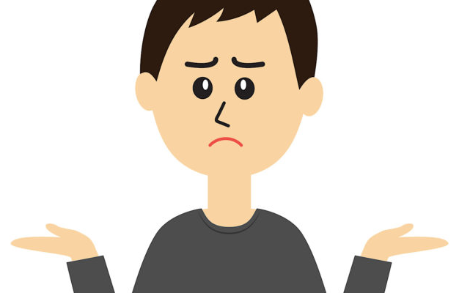
Wise Vs Wicked Cont’
Each one of us can read the Bible just like the Ethiopian, for example. We have a knowledge of the words—many of us can read the words—but how many of us understand what we are reading?
What we tend to do is say we know what wise means because we read the word wise in a verse somewhere else and bring that knowledge into this verse or we think we know what the word already means. But if we were to think carefully of what the word says in this verse, we can begin to have a much deeper understanding of what these concepts mean. And the very exercise of doing that helps you to see great depths in the Bible.
1989
2001
2014
2019
2021
There is a lot in a verse when you can see a structure and when you let the verse define itself. The difference between the wise and the wicked according to the verse is that the wicked can know the dates on a line for example, but they don’t have much understanding or wisdom about it. And when you take that definition, then you begin to think I might be wicked because there is a lot of things I don’t understand. This of course is not the only definition.

Slide 7
The Wise are Prophets
What is a prophet?
H5030: Inspired man (a prophet)
H5031: Inspired woman (a prophetess)
A person regarded as an inspired teacher or proclaimer of the will of God
So, the definition of a prophet is someone who speaks God’s word. Note: in order to speak God’s word, one has to have the mind of Christ.
Is this definition a good enough definition?
Are We Talking about:
Worldly-wise: If you describe someone as worldly-wise, you mean they are experienced and know about the practical or social aspects of life and are not easily shocked or impressed. Synonyms: experienced, knowing, worldly
https://www.collinsdictionary.com/us/dictionary/english/worldly-wise
Godly-wise: Wise in divine or religious things.
https://www.lexico.com/en/definition/godly-wise
Prophet is also known as a Seer
What is a Seer?
H7200: To see literally or figuratively (in numerous applications)
A person who is supposed to be able, through supernatural insight, to see what the future holds.
Simply put, a seer is someone with the ability to see with understanding/comprehension/perception

Slide 8
The Wise are Prophets Cont’
Matthew 8:
¹⁸ Having eyes, see ye not? and having ears, hear ye not? and do ye not remember?
What do you think it means to have eyes but not able to see?
It means that you can see, but not understand what you can see.
We should all be able to say today that we are prophets. The simple definition of a prophet is when you look at something, you understand what you are looking at. William Miller is a prophet because he could read these verses and understand what they mean.
The seer is the person who reads Dan 12:10—looks at those words and actually understands what those words mean. When he understands what those words mean, then he has eyes and he can see. He becomes a seer.
When you begin to live your whole life like this, then there is power in this message to change yourself.

Slide 9
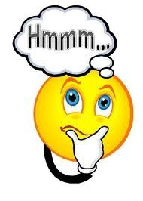
Telling Sign of Wisdom
Wise or not wise. How can one know?
Remaining quiet and not sharing the information absorbed is a telltale sign.
The reason we are self-deceived (thinking we are wise when we are not) is because either someone, like Elder Parminder, for example doesn’t come to you and expose you, or because you don’t look at your life carefully and expose yourself. It’s very difficult to look at yourself and come up with an accurate answer. But, as soon as you open your mouth and start speaking, and that speaking is with understanding, then you expose yourself. The deception happens because we are content with eating and not speaking.

Slide 10
In Summary
God wants us to have wisdom. The goal is to become wise—to be among the wise. How is this accomplished? It is by having a knowledge of the word of God and knowing how to apply that knowledge correctly.
William Miller was a prophet who knew how to study the Bible and apply his knowledge of the Bible correctly. The 14 rules he followed are the same rules we are to follow as a guide in interpreting the Bible.
Prophets do not just simply read the Bible, they do not just see what is written on a page and have a knowledge of it, most anyone can do that, but they not only read what the Bible says, they understand what they are reading and have a correct interpretation of it and are able to make application as present truth for us today.
In Dan 12:10, God defines the wicked as those who do not understand. One demonstrates their wisdom through speaking. It is easy to become self-deceived in thinking we are wise when indeed the fact is that we aren’t because we are solely absorbing information. When one is able to share knowledge with understanding based from information absorbed, it exposes that person as wise, or how much wisdom a person has acquired.

