Slide 1
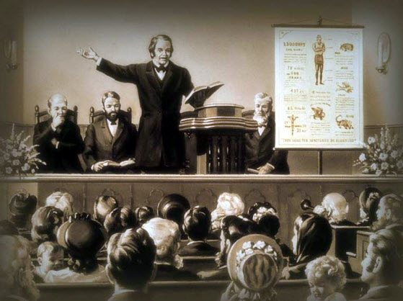
William Miller’s Rules of Interpretation
[Part 2]
https://www.youtube.com/watch?v=UqZ_5zzwi3U&list=WL&index=29
Notes:
Notes created by Victoria Thomas based from Elder Parminder’s presentation on WM rules (Nov. 2019).

Slide 2
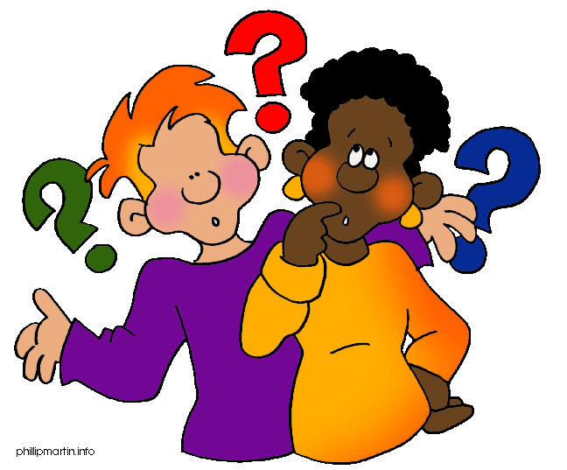
The Connecting Point in Review
In part one of this series, we saw that In Dan 12:10, God defines the wicked as those who do not understand. One demonstrates their wisdom through speaking. It is easy to become self-deceived in thinking we are wise when indeed the fact is that we aren’t because we are solely absorbing information. When one is able to share knowledge with understanding based from information absorbed, it exposes that person as wise, or how much wisdom a person has acquired.
Ezek 3
Rev 10
If all you do is absorb this message (Ezek 3 and Rev 10), you can become self-deceived, thinking that you are wise, when in fact, you may not be. It’s only when you share this message with others that you begin to realize whether or not you understand what you are reading because you begin to be confronted with questions. Often they are honest questions and sometimes not. Regardless, it brings out your understanding or lack of understanding. It’s by realizing how much or how little you understand that you begin to have an understanding of where you are.

Slide 3
The Connecting Point in Review Cont
We should look at the subject as it is presented to us ... The verse being the subject.
VERSE SUBJECT | STRUCTURE
Daniel 12 ¹⁰ Many shall be purified, and made white, and tried; but the wicked shall do wickedly: and none of the wicked shall understand; but the wise shall understand.
A B : B A
Wicked
Not understand
P,W,T
=
Understand
So when we looked at Dan 12:10, without explaining we defined the PWT as understanding based from the structure.
When people look at PWT, they bring in other concepts that they are familiar with. It’s not that we shouldn’t do that. But, before we bring pre-knowledge or pre-understanding to something, we should just look at the verse itself to see what the verse will teach us. When we have exhausted all of what the verse is teaching us then we can bring in some outside information. This can either be from life experiences or from the world, but preferably from the Bible. We call this line upon line study or proof texting. William Miller has 14 rules. If all we were to do was line upon line study or proof texting, we wouldn’t need 14 rules. William Miller covers a lot of ways of addressing the Bible.

Slide 4
The Connecting Point in Review Cont’
VERSE | STRUCTURE
Daniel 12 ¹⁰ Many shall be purified, and made white, and tried; but the wicked shall do wickedly: and none of the wicked shall understand; but the wise shall understand.
A B : B A
P,W,T
Wicked
Not understand
Understand
We should look at one verse and try to exclude everything else and see what that verse is teaching. Then, come to a conclusion on that verse. Try to develop your theory based upon one verse. If we did that, we would all see, in the example of Dan 12:10 that PWT means understanding.
From the structure of Dan 12:10, understanding is defined. The word understanding has now changed from a regular definition of what we normally think it means.
If we keep bringing our preconceived knowledge of what we think this word -- “understanding” means, we’re not allowing the verse to teach us something. I’m not trying to explain what or how we get this understanding. Other verses will teach that. But this verse teaches that whatever this experience is these three things (PWT) are the definition of understanding. The definition of a wicked person is someone who doesn’t have this.

Slide 5
Quick Look into Rule #4
In Rule # 4, William Miller mentions the word theory. We will look into Rule #4 in more depth in a future study, but for now we just want to touch on the word theory. Half-way into the rule, it says,
“If you can form your theory without a contradiction you cannot be in an error.”
¹⁰ Many shall be purified, and made white, and tried; but the wicked shall do wickedly: and none of the wicked shall understand; but the wise shall understand.
It says, you form a theory– “YOUR THEORY” So it’s not truth.
In Part 1 of this series of presentations, we concluded that William Miller was a prophet and we defined what we meant by that. When we look at his rules, we not only just read those words, but we check every word carefully.
Often when we approach this message, we state it as fact when we shouldn’t. William Miller says, paraphrasing rule #4, “Read the verse [verse 10, for example]. Having read the verse, you develop a theory.”

Slide 6
A Theory
What is a theory?
A supposition or a system of ideas intended to explain something, especially one based on general principles independent of the thing to be explained
A set of principles on which the practice of an activity is based.
An idea used to account for a situation or justify a course of action.
https://www.lexico.com/en/definition/theory
Simply put, a theory is not fact. A theory is a model or idea that you have. So you can read something or you can hear something and you can state what you think it means based from what you read or heard. When you say, “I think”, you are stating that it is not a fact.
Let’s go to Luke 10:26…

Slide 7
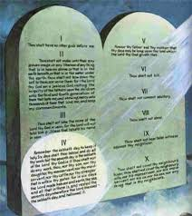
How Readest Thou?
Luke 10
²⁶ He said unto him, What is written in the law? how readest thou?
BACKGROUND:
Jesus and a lawyer. A lawyer is expert on the law and doctrine. They are in a discussion and the lawyer asks Jesus a question. He asks, “What must I do to be saved?” In Verse 26 Jesus answers him with a question back. Jesus asks, “What is written in the law? Rewording, “What does the law say?”
If you were to read in the Bible of the law, does the law say something? It does. It has words there. We can all read those words. Will they be the same words as in every Bible. Let’s say the law He was referring to is the ten commandments, the law written in Ex. Chapter 20. Will everyone give the same answer? Yes, because all the words read the same. We would read it off as is.

Slide 8
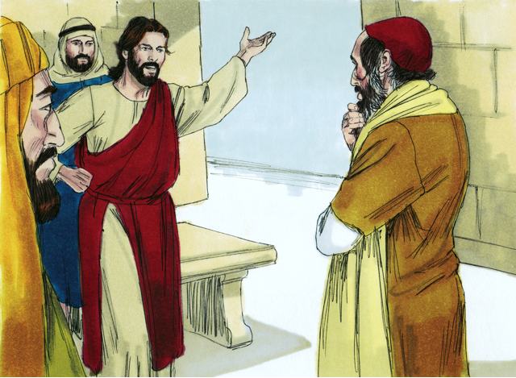
How Readest Thou? Cont’
Jesus asks him another question: “How readest thou?”
What does Jesus mean in asking him this question?
He is asking the lawyer to tell him what he thinks—what he thinks those words mean.
They both read the same words. But now Jesus asks the second question: What do you think that means? My brother would say I think it means this. And my sister would say I think it means something different. So we have to be honest when we approach the scripture. We each read the words. Everyone is reading the same words, but we are all coming to different conclusions. We all come to our own theory. We have to be clear about that when we say that scripture is not fact.
When we get to rule #4, William Miller is going to explain how you overcome this problem. Before going to rule #4, we still have to get through rule #1.

Slide 9
Staying in the Verse
What I am saying is when you are at rule #1, look at the verse you are dealing with and develop your theory from that verse because that is what you have to do.
You read a sentence, a verse and then you have to decide what that means. But what we tend to do is before we understand what the verse means, we start jumping to other places trying to prove what the verse means. And, we haven’t even understood the verse.

Slide 10
Developing Your Theory
We are suppose to develop a theory first.
When you have a theory, the next thing you are supposed to do is test it. That is what you do in an experiment in Science. You say when I mix these two chemicals, I think something is going to happen. And then, you test it to see if it is right or to see if it is wrong.
And if you just read and don’t share your thoughts with other people it will never get tested. And you will never know if you are wise or foolish
So when we look at a particular verse, we are to put all of our weight upon that verse. All of our focus and energy. People may say, “That’s not the truth or you’re wrong.” Then respond by asking them, “Where am I wrong?” People may say, “You haven’t considered this.” The point then should be made that, “You shouldn’t be considering those other things.” We should only be considering the one thing, understand it as best we can, and then test if it is correct. It is because we don’t follow that methodology that we sometimes confuse people and sometimes confuse ourselves. Without understanding one piece of information properly we go to many other places to say we are correct without completely understanding what the verse is teaching. William Miller’s rules claims that we should not be doing that.

Slide 11
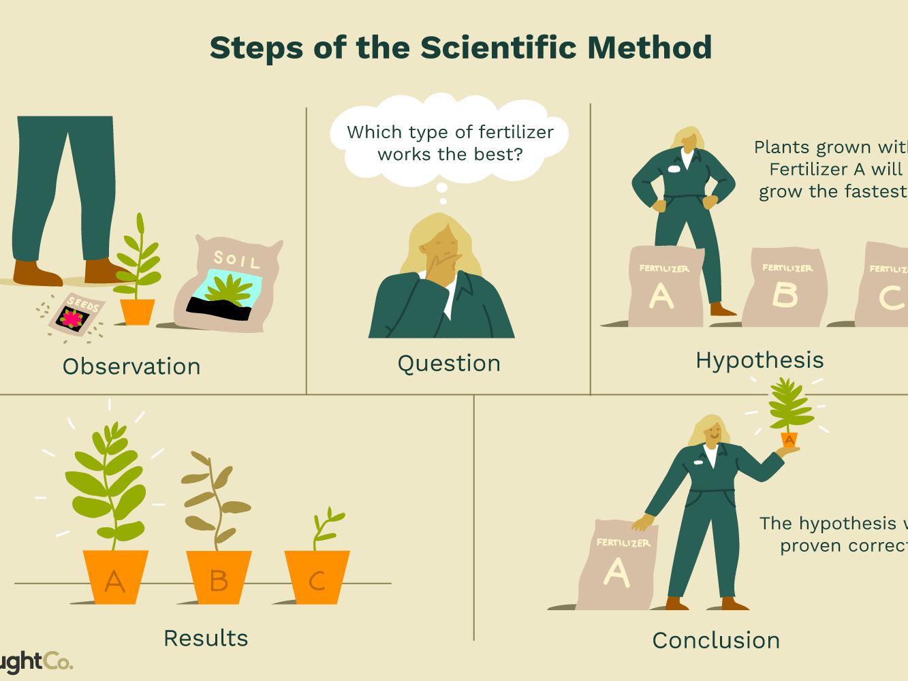
The Scientific Method
In focusing in on the point that we are suppose to develop a theory first; then test it, it would be good to look into the scientific method because it has interesting similarities to the process by which we are to study scripture.
The scientific method is a process for gathering data and processing information. It provides well-defined steps to standardize how scientific knowledge is gathered through a logical, rational, and problem-solving method.

Slide 12
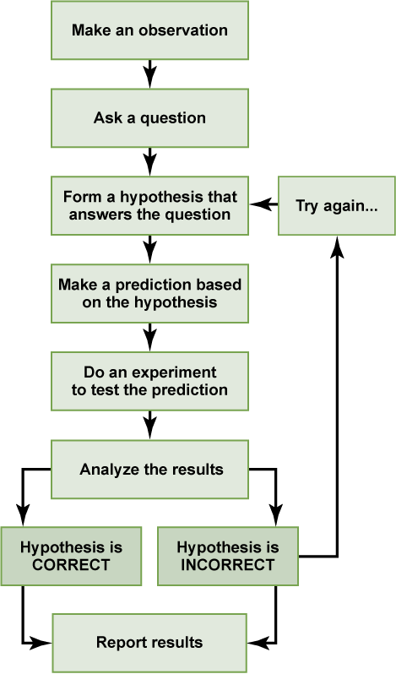
The Scientific Method Cont’
So, In a typical application of the scientific method, a researcher develops a hypothesis, tests it through various means, and then modifies the hypothesis on the basis of the outcome of the tests and experiments. The modified hypothesis is then retested, further modified, and tested again, until it becomes consistent with observed phenomena and testing outcomes. In this way, hypotheses serve as tools by which scientists gather data. From that data and the many different scientific investigations undertaken to explore hypotheses, scientists are able to develop broad general explanations, or scientific theories.
The Steps of the Scientific Method:
Make an observation
Ask a question
Form a hypothesis that answers the question
Make a prediction based on the hypothesis
Do an experiment to test the prediction
Analyze the results to see if hypothesis is correct or is incorrect
If the hypothesis is correct, report results (share). If the hypothesis is incorrect, try again.

Slide 13
Miller’s Rule #1
Rule #1: Every word must have its proper beating on the subject presented in the Bible.
We claim that we believe that, but time and again, we don’t practice what we preach. We skip over the words and we don’t let them have their proper bearing.
2+2=4
What does it mean “to have its proper bearing?” What is your theory of this?
As a side note:
It may be scary to share our thoughts of what we think these words mean. But we shouldn’t be afraid to share with someone our thoughts about scripture or subjects. We shouldn’t be afraid of appearing to look silly in public. Our job function is to be teachers. A good teacher is not afraid to speak one’s mind. That teacher will not be afraid to tell their students what he or she thinks these words mean.
Pretty much all of us has some experience of attending school. When attending school, there were good teachers and bad teachers. We all had that one favorite teacher. What makes a teacher better than another? Every teacher knows that 2+2=4. That is a fact. But what makes a good teacher is how one explains it. That teacher develops a theory about a subject and the explanation of the theory makes that teacher a good or bad one.

Slide 14
Miller’s Rule #1 Cont’
So, back to rule #1.
What does the word bearing mean in the context of the rule?
It means that when you come to a sentence or verse, you should be looking at every single word and you need to decide what are the important words. The important words should have more bearing, more weight on your theory.
In a verse, you have 10 words. You (and I) have to decide how important word #1 is; how important is word #3; and etcetera—weighing each word’s importance—and explain how you know it to be so. However, what we tend to do is look at a verse and say, “I think this is the most important word,” and ignore the other ones. But from this rule, it is instructing us to check every word, think about it, and make a decision of which word is more important than the others. That would be our theory; and then we would have to test it.

Slide 15
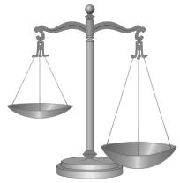
Miller’s Rule #1 Cont’
When it says proper bearing, my theory is that not every word has the same bearing. Some words have more bearing than others. They have their proper bearing.
For instance, in reference to the rule itself, the word “every” is more important than the word “it.” This is because we can take out the word “it” and we can still understand what it’s saying. But if we took out the word “every” then we wouldn’t know how many words. It would take away from the meaning of the sentence.
It’s not to be understood that not every word in the Bible is profitable to doctrine. Nevertheless, Rule #1 is teaching that some words are more important than other words. The problem occurs when we don’t look carefully to see what is the important word(s) and what is the unimportant word(s).
We need to be honest about that and not pretend that it’s a fact. It is a subjective reading of these words to decide what is important and what isn’t.

Slide 16
Miller’s Rule #1 Cont’
We are basing all of our message on these 14 rules. Ellen G. White says that those who will be teaching the third angel’s message will be doing so following the principles of William Miller’s rules.
The first rule is the most important. William Miller has them in a specific order. And since William Miller is a prophet, I think he knew what he was doing in ordering them and that the Lord would direct him.
THOSE WHO ARE ENGAGED IN PROCLAIMING THE THIRD ANGEL’S MESSAGE ARE SEARCHING THE SCRIPTURES UPON THE SAME PLAN THAT FATHER MILLER ADOPTED. {RH, 11-25-1884}
Side note: Before you proof text, look at the verse itself. Develop an understanding of what the verse teaches and then you have a theory. Then, bring other verses to bear their weight.
Rule #1 does not mention anything about going anywhere else. It says wherever you are reading those words that you are reading, those are the words to be considering. What I’m hoping we realize is that the problem lies when we consider what the words are saying that one verse, we go somewhere else first. The rule says that every word on the subject that you are dealing with should have its proper bearing.

Slide 17
Miller’s Rule #1 & Proof Text
When it says subject, how do you know what the subject is? For example, what is the subject in Dan 12:10?
Proof text for rule #1 is:
Subject
I’m suggesting, the entire verse is the subject. So every word in this verse we are to be dealing with. We should not go another verse before dealing with every word and bring those other verses to bear.
Matt 5
¹⁸ For verily I say unto you, Till heaven and earth pass, one jot or one tittle shall in no wise pass from the law, till all be fulfilled.
Daniel 12
¹⁰ Many shall be purified, and made white, and tried; but the wicked shall do wickedly: and none of the wicked shall understand; but the wise shall understand.
Does the proof text agree with the rule?
I think yes. It is a good proof text. He is saying that when we read a sentence or some words, we should not assume that the little things are not important. This is because when we approach a verse, we don’t know which words hold more proper bearing than another.

Slide 18
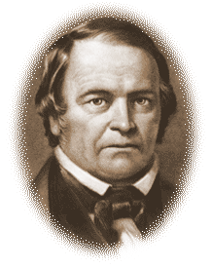
A Practical Example of Rule #1
William Miller followed his own rules of Bible interpretation. We can look at his personal experience and see how he used rule #1 in his personal studies as an example for how we are to apply the rule.
In the Second Advent Manual by A. Hales, we read William Miller stating:
“And [I] could find no other case in which it was found, but in Daniel. I then took those words which stood in connection with, ‘take away.’ He shall take away the daily, ‘from the time the daily shall be taken away’, etc. I read on, and thought I should find no light on the text; finally I came to 2 Thessalonians 2:7,8. ‘’For the mystery of iniquity doth already work, only he who now letteth, will let, until he be taken out of the way, and then shall that wicked be revealed,’‘ etc. And when I had come to that text, O, how clear and glorious the truth appeared! There it is! That is ‘’the daily!’‘ Well, now, what does Paul mean by ‘’he who now letteth,’‘ or hindereth? By ‘‘the man of sin,’‘ and ‘‘the wicked,’‘ Popery is meant. Well, what is it which hinders Popery from being revealed? Why, it is Paganism; well, then, ‘‘the daily’‘ must mean Paganism.” TSAM 66.1 – TSAM 66.2
So as we can see William Miller is studying the Book of Daniel and comes across the word “daily”. He says I couldn’t find this word anywhere in the Bible, except in the Book of Daniel.

Slide 19
A Practical Example of Rule #1 Con’t
The Hebrew word for daily is tamiyd (taw-meed) and it comes up 104 times in the Bible. In the book of Daniel the same word comes up 5 times and 99 times everywhere else.
So when William Miller reads the book of Daniel, (paraphrasing) he says, “When I am in the Book of Daniel, I can’t find the word anywhere else.” So why would he say that? We know the word comes up many places in the Bible. He says it’s nowhere to be found. So what does he mean? I’m suggesting that when he reads the verse in Daniel, he sees the word “daily” and he’s following his own rule. He is seeing how every word has its proper bearing. and what he is saying is the bearing that the word “daily” has in the book of Daniel can be found nowhere else. He has read the word “daily” before in another verse and he had understood the bearing that it had in that particular verse. But, he reads Dan 8:11. He checks all the words to see their bearing. He looks at the word “daily” and doesn’t see the bearing that is used in this verse anywhere else in the Bible. He knows it is different.

Slide 20
A Practical Example of Rule #1 Con’t
In using rule #1, he has checked all the bearings of the word and he knows it’s different but he doesn’t know what it means. It is then he goes to other parts of the Bible and brings those other bearings upon this verse. So he is following his own rule in the sequence he has given them. This is a real life example of him doing what he is asking us to do.
So to reiterate, when approaching a verse, we have to read the verse and decide how each of those words has their proper bearing. What are the important words in the verse? What are the non-important words in the verse?
We need to get comfortable with spending more time in the verse and see what the verse can teach us. It is only by spending time in the verses that we come to learn about Christ in a way that we have never understood before. It is in spending a little more time on a verse when we find pleasure and joy in studying the word of God. It can be hard at first because we are so use to not wanting to do that. We want to jump from verse to verse. But with practice of staying in the verse and allowing each word to have its proper bearing, we will come away with a richer understanding of the verse by allowing it to explain itself without bearings from another verse.

Slide 21
Miller’s Rule #2
Rule #2: All scripture is necessary, and may be understood by diligent application and study.
So we have to do some hard work and I understand this application is how we approach the Bible, not how we live what we read. I think it is the effort and the attention that we pay when we study the Bible.
And the study means what?...
It means to dig or to learn something. It says all scripture is necessary and all scripture can be understood if you put a lot of effort into it. So if we don’t put effort, if we don’t put hard work into our Bible study, we won’t understand. On the contrary, if we do put the hard work into our Bible study, we will understand what the Bible teaches.
HARD WORK = UNDERSTAND

Slide 22
Miller’s Rule #2 Cont’
It is interesting to point out that rule #2 doesn’t mention anything about God. It’s talking about one’s effort—one’s hard work. I think this rule is a basic rule of life. But, we want to imprint God into this rule when all this rule is saying is “if you work hard, you will be rewarded.” It’s a rule of life.
In every aspect of our life, we have to work. When it comes to religion, we want it all free. That’s the main reason why people complain about this message. When they say, “It’s too much information;” or, “It’s hard work.” What they are saying is that they don’t want to diligently apply themselves.
So to put it simply, this rule is just saying if you work hard, you will be rewarded. When it says ALL scripture, what do you understand by that? Can we understand a scripture without the Holy Spirit?
When we take a statement/verse, we should read the verse just as it is written. And then we can add layers to that. But when we come to a rule like this, some shake their heads in disagreement with the rule because they argue that scripture cannot be understood without the Holy Spirit.

Slide 23
Miller’s Rule #2 Cont’
What some want to do is ignore rule #1 and combine all the rules together, such as #2, #4, and #14 to create one rule as a guide to follow. The sum of the rules would sound something similar to, “You have to do everything God tells you to do.” And you can condense them to that, but that rule would be useless. Let me explain. It would be like summing up the 10 commandments to just say, “Love God.” But what does it look like to love God? You have discrete rules that show you one by one what that looks like. And this is what William Miller tried to do. And every time he tried to guide us step after step through each rule, we want to get through another way. If we let him guide us the way he wants to, we will be benefited by it. But we are scared to say that if we study hard, then we can understand scripture. So to combat our fears, we say that if we study hard and the Holy Spirit helps us, then we can understand it. I think William Miller is going to use the Holy Spirit in a different rule.
Do we have the faith in William Miller’s rules or not?
If we do, we wouldn’t be afraid of exploring them.

Slide 24
All, Means What?
So back to my question, what does ALL mean?
We know that before 1798, there are some things God has not shown us. So you can put as much effort as you want, but you will never understand what those words mean because they are sealed. This brings up an important point because it will help define what all means.
We should not expect that we will understand everything in the Bible, even at the end of the world. The only thing that we can understand is what is necessary for us to understand. And that does not mean everything.
ALL= what God makes available
SEALED
UNDERSTAND
BIBLE

Slide 25
All, Means What? Cont’
(4) So to me, one of the most important words in this rule is how do we understand all because initially our first reaction to all means everything.
(3) William Miller is saying that you can understand all of the unsealed if you make effort, but we know that with however much effort we want to, there are some verses we are just not going to understand because they are sealed. It depends what time period you are living in.
{2) And because we don’t understand this bit, we make excuses for not understanding the unsealed
(1) Our problem is we are supposed to understand all of this.
ALL= what God makes available
SEALED
UNDERSTAND
BIBLE

Slide 26
Miller’s Rule #2 & Proof Text
So lets read the proof text:
So in the example that we have here, it is necessary for you to understand of this. You cannot contend yourself with a little bit. So at the end of the world, we know that the Book of Daniel is unsealed. So the line moves over as truth is unsealed.
2 Tim 3
¹⁵ And that from a child thou hast known the holy scriptures, which are able to make thee wise unto salvation through faith which is in Christ Jesus.
¹⁶ All scripture is given by inspiration of God, and is profitable for doctrine, for reproof, for correction, for instruction in righteousness:
¹⁷ That the man of God may be perfect, thoroughly furnished unto all good works.
ALL= what God makes available
SEALED
UNDERSTAND
BIBLE

Slide 27
As Truth is Unsealed
In Millerite history was the truth all unsealed?
NO. The seven thunders-Rev 10:4—they haven’t been completely opened up.
So as we come to the end of the world, we know that our work is bigger than it has been for other people in the past because our “all” keeps growing.
Now there are still some Bible passages that aren’t salvational necessity for us in this dispensation. There are some Bible verses that are not necessary at the end of the world. We have a very focused attention with respect to what verses we are supposed to be dealing with and also how we are supposed to understand those verses.

Slide 28
As Truth is Unsealed Cont’
Now, in the past we thought that many of the Bible stories were sealed or didn’t make any sense. We now begin to see that they have great truths in them. So our “all” is growing day by day.
The “all” that we got today I’m certain will not be the same “all” that we’ll have next year.
The point that we would only be deceiving ourselves we continued to think that we’ll be okay of we don’t apply effort in understanding the “all”.

Slide 29
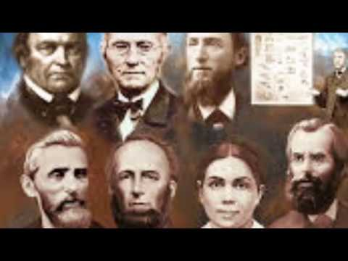
As Truth is Unsealed
If you go to all the reformers that have ever lived, you’ll see one characteristic that is the same for every single one. Some were angry; some were happy; some were quiet; some were loud. They were all different. But, they all had one thing in common. All of them studied the Bible diligently. So the thing that we should characterize us as, is our diligent study of the Bible.
And if you look at this concept of diligence and application, it has time attached to it. We need to be spending time studying. And if we don’t spend time, we won’t understand what we need ton understand. So many of us got busy lives or we’re distracted by the cares of this life, and get involved into those things which will only hinder us from diligent application.
We have to put a great amount of effort and spend a lot of time studying. If we don’t do that, we will not fulfill rule #2.

