Slide 1
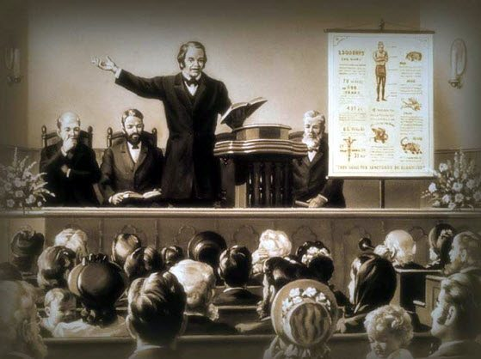
William Miller’s Rules of Interpretation
[Part 3]
https://www.youtube.com/watch?v=HlPiuzU1UtQ&list=WL&index=39
Notes:
Notes created by Victoria Thomas based from Elder Parminder’s presentation on WM rules (Nov. 2019).

Slide 2
Quick Review
Just as a recap, William Miller was a prophet who studied the Bible diligently. He was led by God to create fourteen rules that covers various techniques for careful Bible study. His method of study is the foundation of our message for how we approach scripture (and SOP). We are called to be among the wise and that means that we not only have a knowledge of the Bible, but we also understand it and are able to make application of that knowledge as present truth for us today . It is in following William Miller’s rules for Bible interpretation, that we obtain wisdom to understand the Bible accurately and make it practical for us presently. So far we have gone over rule # 1 and rule #2.
In rule #1 we understood that when reading a verse in scripture (or a sentence in SOP) we are to decide which word is the most important word. What word(s) bears the most weight on that subject—verse or sentence; and to let it teach us something without first jumping to another verse to add additional weight to the verse before allowing every word on that subject—the verse—to have its proper bearing.
In rule #2 we understood that we can understand all scripture. All in reference to information that is revealed to us, or in other words, information that is unsealed from past dispensations as well as our current dispensation that is necessary for us to know through diligent application and study on our part. Through the time, effort, and hard work we put into application and study of the Bible (and SOP) we are able to understand all information that is necessary for us to know.

Slide 3
Miller’s Rule #3
Rule #3: Nothing revealed in the Scripture can or will be hid from those who ask in faith, not wavering.
This rule tells us that just because something is revealed from scripture, it doesn’t men that everybody is going to know what’s there. Only a certain class of people can understand.
So there is a distinction between revelation and hiding. They are both occurring at the same time. And that is the nature of parables.

Slide 4
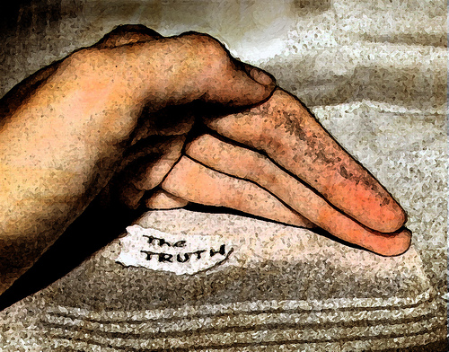
The Nature of Parables
Matt 13
¹³ Therefore speak I to them in parables: because they seeing see not; and hearing they hear not, neither do they understand.
According to this verse, why does Christ speak in parables?
The purpose of it is to make sure that they don’t understand what He is talking about.
It’s purposeful to hide information because before Matthew 13, everything that He speaks is not in parables. It’s all plain and then after that He speaks in parables. The reason He’s doing that is because it’s revealing truth, but it is hidden. In fact it is hidden from everybody. The disciples, scribes and Pharisees included. The information was presented to everyone. But all who wanted to understand made the effort to ask Jesus what the parable meant. It was to them that Jesus further explained and revealed the hidden truth within the parable.

Slide 5
The Nature of Parables Cont’
The fact that Christ is actually using parables to reveal information and hide it at the same time is interesting. Christ takes a simple spiritual truth and shield it with a parable. It’s a totally different way of seeing parables because most of the time we are under the misconception that parables are to make complicated things easy to understand.
According to rule #3, Christ does this because He is revealing information He is hiding.
Why?
Usually the thought behind the nature of parables is that in order to understand complicated scriptures of truth, you give it a parable. But in actuality, parables are the opposite. You have a simple spiritual truth and Christ is going to make it complicated with a parable. He does that for a very specific reason.
He wants us to make the effort to ask Him and seek (dig or search) for the hidden information. This shows interest. This marks the difference between those who truly want to understand and those who don’t. And those who truly want to understand will be wise enough to ask, seek, and knock.
What do you think is the reason He does that?

Slide 6
Revelation Through Scripture
How does light come to God’s people? How does He give that revelation?
It is only through scripture
So, for example, if someone had a dream today, and shared, “This is what’s going to happen…” Who would believe it? No one. The reason being is that we would want proof from the Bible that what is shared is truth. So we need to see that rule #3 clearly states that revelation has to be through Scripture only. When we talk about scripture, we are talking about both the Bible and SOP. So you can’t trust any other source of information.

Slide 7
Can vs Possible
Rule #3 states, “Nothing revealed in the Scripture can or will be hid..”
Why does he say “can” or “will”? What is the difference between can and will?
“Can” is certain and “will” is possible.
So we have “Can.” Since the word “cannot “ is the opposite of “can”, I am going to say that “can” and “cannot” are the same thing. I know they are the opposite, but whatever principle you apply to one, you can apply to the other. The word “can” changes only if you put “not” next to it. But, the principles that define what it is has to be the same because it is the same root word.
So in Numbers 23:19 we read…
¹⁹ God is not a man, that he should lie; neither the son of man, that he should repent: hath he said, and shall he not do it? or hath he spoken, and shall he not make it good?

Slide 8
Can vs Possible Cont’
If I say “I cannot cook”, for example, is there a possibility that I could cook?
NO
Now if I say “I will help you”. Is there a possibility that I could help you?
YES
So hopefully you can see that can is certain and will is possible.
So bringing it back to rule #3, this is saying that God is not only willing to do something which implies he doesn’t have to, but He also doesn’t have a choice—He has to.
What does He have to do that He has no choice about?
He has to reveal.

Slide 9
Can vs Possible Cont’
So when it reads, “God is not man that He should lie” what is this part of the verse telling us?
It is telling us the men lie and that God doesn’t lie.
Numbers 23:19 we read…
¹⁹ God is not a man, that he should lie; neither the son of man, that he should repent: hath he said, and shall he not do it? or hath he spoken, and shall he not make it good?
So if God does not lie is there a possibility that He could lie?
Obviously, yes. He doesn’t lie, but He could.
Titus 1:2 Affirms this
² In hope of eternal life, which God, that cannot lie, promised before the world began;

Slide 10
Faith or Effort?
Rule #2 said that if you want something revealed to you—to understand it, you have to work hard, but now in Rule #3, he is saying that all you have to do is have faith. And if you have faith, God doesn’t have a choice anymore, but to reveal it. He has to give you what you are asking for.
These totally different rules highly compliment one another. One is talking about human effort and the other is talking about 100% of God’s aid with no work on your part—You wouldn’t have to do anything , but say “I have faith” and expect God to tell you what the scripture means. And He would be totally committed to doing so.

Slide 11
What is Faith?
What is the definition of faith?
Hebrews 11:1 says,
11 Now faith is the substance of things hoped for, the evidence of things not seen.
VERSE | STRUCTURE
Hebrews 11: ¹¹ Now faith is the substance of things hoped for, the evidence of things not seen. What is the pattern in this verse? | |
Repeat and enlarge is the pattern
A : A
As a side note: We shouldn’t pay too much attention to the comma or the full stop. It’s helpful, but not necessary
Substance of things hoped for
Evidence of things not seen
S H : E NS
Substance = Evidence
Faith =
Hope = Not seen
Note: The words define themselves
Faith is: SUBSTANCE, HOPE, EVIDENCE, NOT SEEN

Slide 12
Allow the Word to Define Itself
When we read verses, we pick up those words whether they are English or any other language and we think we know what they mean. Yet we say that we are suppose to let the Bible interpret itself. So we agree with that principle and the way we use that principle is we say lets take the word “substance”, for instance, and go everywhere in the Bible where you can find the word “substance”.
But before you go and do that, the verse itself will tell you what it means. When you see that you have information and it is being repeated then it’s just reiterating what has already been said in a different way. In other words, information that is repeated in a different way only defines what has been previously stated.
We let the Bible interpret itself and we’re not imprinting our definition on what we think those words mean. I am not saying that this is all we are supposed to do, But I am saying that this is the first thing we should do. And for many of us this isn’t the last thing, we just never do it
And you limit your ability to understand scripture. You don’t understand the depth of what God is trying to teach us, That is why we follow William Miller’s rules. So that when you come to scripture, you can understand it easier at a deeper level.

Slide 13
Notice the Pattern
When you open the Bible to any verse, you should have some tools:
A dictionary, concordance, etc.
An eye for patterns and repetition, such as Chiasm (sentences/words mirroring each other) or Repeat and Enlarges (something stated again, but in a different way)
For instance, go to ( a verse); read the verse; look at the words; and see is there a repeat and enlarge there? Is there a chiasm—is there a mirror? Spend some time looking at it. And if you can see it, then you can open up the scripture in a really good way. If you can’t then you can’t. There may not be one there.
It is in noticing the patterns that you are able to conclude what a word or verse means based on how it defines itself by it’s structure.

Slide 14
What is Faith? Cont’
There are two parts in defining faith:
Believing in the future—what you cannot see.
Believing based upon past experiences—So if you don’t have any experience, you can’t have any faith.
You can see that demonstrated in nature and in children.
For instance, if you have a child and you put them on a high wall and you got a father In front of them and he puts his hands out towards the child, what would the child do? It will jump. Why would the child jump? It has confidence. If the father left and a stranger stood there instead and told the child to jump. What would the child do? Not jump because the child doesn’t have faith that if he jumped the stranger would catch him. The faith the child had with his father is based on the hundreds of times he jumped before and his father caught him.
Now if the father told the child to jump, but missed the child and the child fell on the floor and got hurt; and the father told the child, “not to worry, lets try again.” What would the child do? It would hesitate. The child wouldn’t jump because his faith is shattered by his fall. He no longer has the confidence that the father would catch him as he did before. So depending on the child’s experience settles his faith to jump. The child believes the father will catch him if he jumps based upon a previous experience of being caught. That is faith.
Because God did it in the past, we know that He will do it again. We have evidence based upon past experiences. Amen.

Slide 15
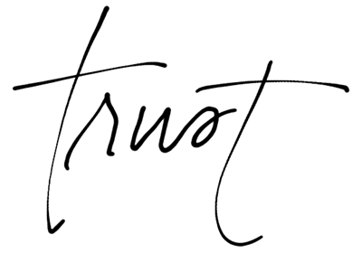
Think upon this…
There two things we should ponder in the example given about the experience of the child.
Our past experiences
The experiences of people in the Bible
There are only two experiences that you can trust.
There are three people in the world: you, someone else, and the people in the Bible. The three groups that I think we could put everyone into. So when you talk about faith and you talk about an experience about the past, out of those three groups, which one can you NOT trust? Someone else. I don’t think anyone would trust their future in someone else’s past. But we certainly can trust in our past and the past in the Bible. So we use this principle extensively in this message. But we don’t think about ourselves, we think about the Bible characters.

Slide 16
Making the Bible Personal
Ellen White says never leave one Bible verse until you have exhausted and studied all you can. Then, she says, when you read the Bible, make it personal.
How do we make the Bible personal?
It is by observing ourselves or particular situation in the life of a particular Bible character or event based from a similar character trait and/or experience to our own. And based from that observation, we apply that information to ourselves and our own experience. This in turns deepens our understanding of the Bible on an experiential level.
So when looking at a particular Bible character, such as Judas Iscariot, how would one know if he was him or not? He would have to look at Judas Iscariot, and when he sees how Judas Iscariot behaves, then he would compare him with his self. And based on those similarities, one would know.
Faith is believing that something has already happened so you can have evidence of what is about to happen. How do we know there will be a Sunday Law? Whose got the evidence for that. Prophecy is the evidence. That past history is the only evidence that you have. You can say that Ellen White says it’s going to happen. How do you know that is correct? You just cross your fingers and hope so? The proper definition of faith is not because Ellen White told you, but because you seen two Sunday Laws in the past. That’s the anchor that you have. Everything else is nice. But without that anchor, you can’t be 100% sure. That’s what faith is. Faith is line upon line.

Slide 17
Summary of Rule #3
Rule #3: Nothing revealed in the Scripture can or will be hid from those who ask in faith, not wavering.
All that you need to understand has already been revealed, but it is hidden from everybody.
Some of us will have faith—the faith that gives us the ability to see what’s being revealed and it is not hidden from us.
The definition of faith is believing something in the future is going to happen based upon something in the past that has already happened.

