Slide 1
Thabo Mtetwa. Germany #2
1st 2 or 3 presentations will be dealing with the parable teaching methodology
We will look at the structure of our line and identify various points on the line of the priests from the broader structure.
We will look at 2 midnight cry messages: that of Samuel Snow and MC today with the purpose of comparing and contrasting the two MC messages in order to make various points

Slide 2
Methodology
Let us lay out the context using this concept:
We know that A illustrates the Ω
Moses
Ω
Christ
Miller
Ω
144K
$$Α$$
$$Α$$
Methodology/Parables
Methodology/Parables

Slide 3
Methodology
We are at the history of Moses. History of Moses is Alpha of Ancient Israel – the beginning of the AI.
History of Christ is Omega of the Ancient Israel.
In the modern Israel we see the same thing as in the history of AI: there is alpha and omega.
The Alpha of the modern Israel (MI) is Millerites. Omega of the Modern Israel is our line, the line of the 144K.
We understand that God declares the end from the beginning.
In accordance with this principle we could look at the history of Moses as illustrating the history of Christ.
Moses
Ω
Christ
Miller
Ω
144K
$$Α$$
$$Α$$
Methodology/Parables
Methodology/Parables

Slide 4
We will look at history of the Millerites as illustration of the history of the 144K.
As we look at the History of Christ, we see that the history of Christ is the omega history and history of 144K is also omega history.
Eventhough the alpha can be used to illustrate omega (Moses →Christ, Millerites→144K), there ways in which the history of Christ more clearly represents the history of the 144K by virtue of their being omega histories.
Moses
Ω
Christ
Miller
Ω
144K
$$Α$$
$$Α$$
Methodology/Parables
Methodology/Parables

Slide 5
When we look at the history of Christ there are many points that we can identify to draw parallels with our history.
We see that that generation was tested by the prophetic message as we see in all the reform lines. But the central issue of the history of Christ that is identified at length by the Inspiration is that of methodology.
Christ’s message was communicated through a specific methodology, which is Parables.
Moses
Ω
Christ
Miller
Ω
144K
$$Α$$
$$Α$$
Methodology/Parables
Methodology/Parables

Slide 6
As we observe this history, we see that those who failed to come to grips with the methodology, failed to understand the testing message for their generation.
They were left in darkness regarding the change of dispensation in their line, and they died at the hands of Romans in A.D. 70
When we look at other omega history which is our line (144K) it is, therefore, no coincidence then that we see the methodology being a central issue. And just as in the history of Christ, parables – are the methodology.
All that this methodology meant in the history of Christ is all that it means in our time.
Moses
Ω
Christ
Miller
Ω
144K
$$Α$$
$$Α$$
Methodology/Parables
Methodology/Parables

Slide 7
Change in the dispensation is happening in our line.
And in order to understand this developments in the divine economy, we need to understand the messages and their methodology.
This is the context identifying the importance of the methodology in our line by virtue of us being in omega history.
When we look at parables, the approach I want to take is to look at them from the perspective of the Dan 11:40-41. we want to illustrate how the parameters of the methodology work. My hope is that as we do that, in your personal studies you will have a clearer picture of what you should be looking for and what the application of the methodology looks like.

Slide 8
But I am choosing to look at the Dan 11:40-45 specifically because these are verses that we should be all familiar with at this point.
By applying the methodology to the verses that we are already familiar with, this will allow us to see the strength of this methodology.
The strength of this methodology is to generate information that cannot be obtasisned through a surface reading of the text.

Slide 9
We are going to look at the verse 40 as a parable
Verse 41 as a parable
Verse 42-43 as a parable.
Then we are going to compare and contrast 40 and 41
And then compare and contrast 41 with 42
Then we are going to look at this entire history as a parable (40-43)
We are also going to look at Dan 12:3,10 and identify parables in there.
40
41
42-43

Slide 10
We are not necessarily are goin to go in chronological order, but I will lay them out in order that makes the most sense to me.
Before we delve into that I just want to make a few points about the definition of parable we derive from Strong’s concordance and Thayer’s.
Specifically from Thayer’s:

Slide 11
If we illustrate the definition pictorially, it tells us that a parable is the placing of one thing by the side of another.
So you have two objects placed side by side. This is done for the purpose of comparing and contrasting
As we C/C this two objects, this process of comparing/contrasting: comparing = identifying the similarities, contrasting = identifying the differences between the two objects, the conduction of this process generates information or “generates light”
1
C&C
2

Slide 12
But when we go back to Thayer’s definition of the “parable” it speaks to the type of the information that is generated through this process.
It describes “parable” as narrative by which either the duties of men or the things of God are illustrated, particularly, the nature and history of God’s kingdom are illustrated.
So when we are comparing and contrasting these two objects, it generates information/light.
But the information generated deals specifically with the nature and the history of God’s kingdom.

Slide 13
Nature = characteristics
Through this methodology, running scriptural symbols and narratives by comparing and contrasting we obtain information on characteristics of God’s kingdom in our history as well as the information on the history of our line.

Slide 14
Dan 11:41 “He shall enter also into the glorious land, and many countries shall be overthrown: but these shall escape out of his hand, even Edom, and Moab, and the chief of the children of Ammon.”
In verse 41 there two contrasting experiences that are brought into view.
As we examine the text, and just in our reading of it we see two objects brought in close proximity.
Two different experiences being connected with those two objects, and parables being C/Cing of the two objects, just the very reading of it shows that it is a parable.
So the question is what are the two objects that are Ced/Ced?
Many | EMA

Slide 15
So let us lay out a table:
There is “many” and “Edom Moab and Ammon” (EMA)
So these are the two objects that are brought into view in the verse.
When we look at the EMA, examine their characteristics while relying on background information – what we already know about the verse, what do we understand about who they (EMA) are?
They are God’s people. They are close relatives of God’s people. What does this tell us about the “many”?
By comparison, even if it’s not explicitly stated in the verse, if EMA represent the God’s people with an experience, we can deduce that “many” is a group of God’s people with their own experience
Many | EMA
God’s people | God’s people

Slide 16
There are other clues that flesh out this picture (that put flesh on this picture)
Let us look at their two experiences:
What is spoken of in connection with EMA?
It says that they escape.
By contrast, what is the experience of the “many” – it says that they are “overthrown”
We have two contrasting experiences: “escape” and “overthrown”
We need to figure what “escape” and “overthrown” means
Many | EMA
God’s people | God’s people
Overthrown | Escape

Slide 17
When we understand what it means to “escape”, I want to suggest that we don’t have to go to anywhere else in God’s word to understand what it means to be “overthrown”
The meaning of what it means to be “overthrown” can be understood simply by contrasting of “overthrown” with “escape”. Which is also the strength of this methodology – a lot of information can be gleaned by remaining in the verse that you are seeking to understand. By remaining in that verse and running that verse through he parameters of the methodology you can learn a lot without having to proof text here and there as we used to do
Many | EMA
God’s people | God’s people
Overthrown | Escape

Slide 18
What does it mean to “escape” and to be “overthrown”
In Strong’s concordance H4422 means to release or to let go.
The imagery that is painted by escape is the idea of releasing something. Because there are different ways you can escape
This concept of escape paints the picture of something that was once held and subsequently let go. If you are going to release something or let it go, by the very nature of that expression it means you once held that thing.
I will use an illustratiuon that has been shared before
Many | EMA
God’s people | God’s people
Overthrown | Escape (H4422)

Slide 19
In the concept of prison, when you are in prison, what state are you in?
You are in captivity. You are being held.
E.M.A are people who are being held in the state of captivity, and then subsequently released.
By contrast we compare the experiences between the two groups, this we will use to understand what it means to be “overthrown”
If escaping means formally being in captivity and subsequently being let go.
By contrast, the “many” are the people who were not in prison, but then subsequently taken into captivity.
Many | EMA
God’s people | God’s people
Overthrown | Escape (H4422)

Slide 20
We know that EMA are in captivity to Babylon=world, they subsequently escape
What does it look like to be in captivity of Babylon? When we understand what that means, it will help to understand what it means for “many” to go into captivity.
How does Babylon hold people in bondage?
We could input the information from different places to flesh this out
We could look at Revelation 18:
Dan 11:41 ~ Rev 18:4
Many | EMA
God’s people | God’s people
Overthrown | Escape (H4422)

Slide 21
In order to understand what the captivity looks like we need to understand the Omega history of Christ, because captivity in Omega history is better suited for understanding of the captivity in 144K history.
From Rev 18 we know that people who were kept captive in Babylon, they were held captive in error and false doctrines
When you look at the time of Christ, He came to His people, and they were in a state of bondage and captivity, they were in darkness.
We could characterize this darkness as being errors and false doctrines. But from this history (Omega – Christ) we derive the issue that Christ rebuked them for and lamented.
Moses
Ω
Christ
Miller
Ω
144K
$$Α$$
$$Α$$
Methodology/Parables
Methodology/Parables

Slide 22
The issue was that they did not know the time of their visitation
Captivity = Darkness = not understanding the concept of time.
Thus, we understood how the “many” will be “overthrown” and what that means by simply remaining in the verse.
We gleaned the information about the identity of the two groups as well their corresponding experiences and. We can draw the information on the related lines to further flesh out this picture
Many | EMA
God’s people | God’s people
Overthrown | Escape (H4422)

Slide 23
Being in captivity = being in bondage of the error and false doctrines.
By contrast, where does this group escape to?
When you escape the captivity of error what is opposite, or contrast of the error? – Truth.
Let’s return to the “many who are a group of God’s people, but who were free and now go into captivity, we can understand that they were once in the truth, and then they go into the captivity of the darkness and error.
Many | EMA
God’s people | God’s people
Overthrown | Escape (H4422)

Slide 24
From the Omega history of Christ we derive the definition of darkness. Darkness = not understanding the concept of time.
Using this method helps us to understand that many are the Seventh Day Adventists.
What is the basic understanding of the Dan 11:40?
The many who are overthrown are the Seventh Day Adventists, and that the EMA are the gentiles – the 11th hour’s workers.
However, we can conclude by this study that it’s not just the Seventh Day Adventists who are being overthrown in verse 41.
Many | EMA
God’s people | God’s people
Overthrown | Escape (H4422)

Slide 25
One more layer to this parable:
We know that Dan 11:41 ~ Rev 18:4
(it is a call to come out of the Babylon: “And I heard another voice from heaven, saying, Come out of her, my people, that ye be not partakers of her sins, and that ye receive not of her plagues.”)
This call out of Babylon which draws EMA to escape from Babylon, the message is speaking of Babylon, but says come out of her My people. We see this imagery being painted of God having a people IN Babylon.
Babylon = World, God’s people is his church. As we seek to understand verse 41, we can [plug in Rev 18:4 which paints this picture that EMA are HIS people IN Babylon.→ the message of Rev 18:4 is for the God’s church in the world. This what the experience of the EMA looks like, and this is what it looks like that they escape.
Many | EMA
God’s people | God’s people
Overthrown | Escape (H4422)
SDA
Babylon
My people
My people
EMA

Slide 26
The information are not plainly stated in the text. That is why this methodology is powerful, as it is able to generate information, which we, otherwise, wouldn’t get from the reading of the text. These things we need to understand in order to correctly navigate through our history. If this is what escaping of the EMA looks like, then by comparison, we must see the corresponding development for the many.
Many = Adventists, and within Adventism there is a group that are represented as My people, this is derived from the Rev 18:4 and brought it into our understanding of the Dan 11:41

Slide 27
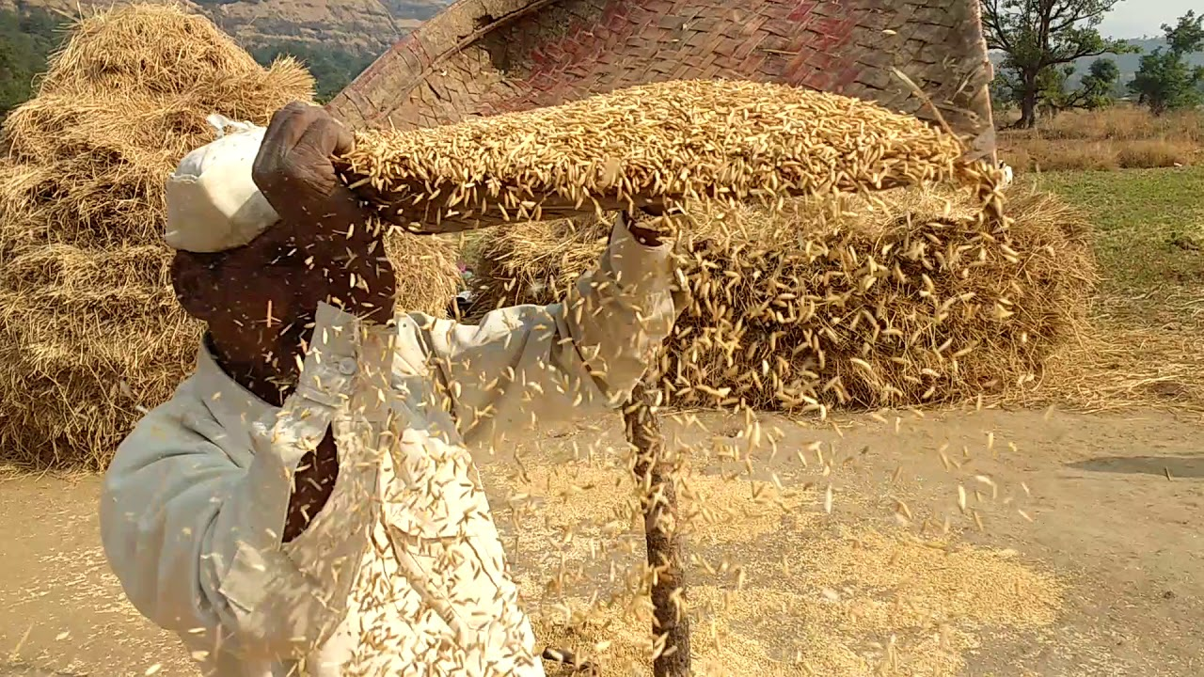
Before understanding the experience of the many, I want to show other places where this model is brought into view.
In Dan 2 we see a mountain, and an image. These two objects are brought into close proximity by the text. This means we are dealing with the parable and we are required to C&C these two objects.
At the basic level Mountain = God’s kingdom, image = Satan’s kingdom.
When we look at the mountain, we 2 groups. We see mountain and the stone that has been cut out of the mountain →within God’s kingdom there are 2 groups: mountain = world, and stone cut out of the mountain – church.
W
C

Slide 28
Satan’s kingdom by comparison we should see the similar 2 groups.
In Dan 2 the image is destroyed by the stone and the remnants of the image are blown away as the chaff. But with parables we understand that the natural things illustrate the spiritual.
If we bring in this concept that the natural is illustrated by the spitirual, even if it’s not stated in the text of Dan 2, the very fact that there is chaff that is being blown, tells us that there must be wheat. Because in order to obtain chaff, you have to thresh wheat. So by contrast, if there is chaff, there is also wheat.
W
C

Slide 29
So we see in Satan's kingdom there are also 2 groups: the wheat = “church”, chaff = world.
In the basic understanding of the Dan 11:41 it brings to view 2 groups of God’s people with contrasting experiences.
We can add layers to this parable, by bringing in the concepts from the corresponding lines of truth, such as Rev 18:4, Dan 2. Other places where you see this scenario being painted. But for our purposes as we see that the call to come out of Babylon is for the EMA – God’s people in Babylon. We know that by comparison the experience of the many, we also see the church and the world, and there is a group of people represented as God’s people who have already gone throught the experience similar to that of EMA
C
W

Slide 30
So, we find that there are God’s people in the church and God’s people in the world. In case of EMA the message to come out of Babylon is directed to the church. The world is in the captivity of Babylon, but the EMA are made free. The Adventist church is in the captivity, but God’s people in the Adventist church were in the captivity but are made free.
So what does it mean to be overthrown? – To have been free but then to go into captivity of darkness.
When we looked at Babylon, Babylon was never free. Babylon IS captivity.
Many | EMA
God’s people | God’s people
Overthrown | Escape (H4422)
C
W
SDA
Babylon
My people
My people
EMA

Slide 31
EMA were IN captivity but become free.
The Adventist church by comparison is in captivity, and there is a group of people who escape that captivity.
In order to be overthrown, based on the model that we have laid out, those who are overthrown cannot be the Adventist church, because they are already in captivity, the same way the Babylon is already in captivity. In order to be overthrown, you have to be free.
The many who are overthrown is the people who were once in the truth. They escaped captivity, they escaped Laodicea, they escaped the darkness of Laodicea = Adventists do not understand time. So they escaped the Laodicea but now going into darkness.
Many who are overthrown, at a basic level are Adventists. But as we interrogate this verse through compare and contrast and add layers to this model such as Rev 18:4, and Dan 2, we understand that many are not simply Adventists but the ones who were in the message and free in the truth, but they come to Sunday law and switch camps. This you will not obtain by surface reading of the text.
Many | EMA
God’s people | God’s people
Overthrown | Escape (H4422)
SDA
Babylon
My people
My people
EMA

